Slide 1
Learning righteous
IV&V methods
Tim@menzies.com
SE research chair, wvu
nasa iv&v facility
17-Feb-02

Slide 2
Status of this document
Analysis of a simulation model that is less than 10 days old
  Designed by Eickelmann/Harrison
  Implemented by me
    very quickly
    using software economics ideas I’ve barely heard of before
    While making ad hoc modifications as I went
Doubt is appropriate
Anyway, on with the show…

Slide 3
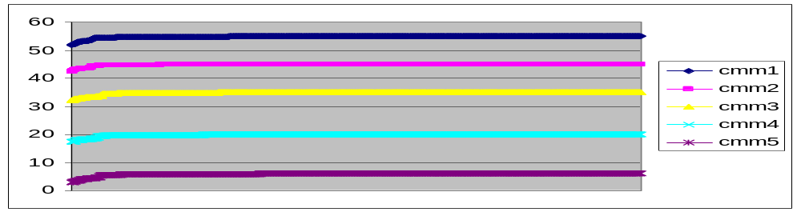
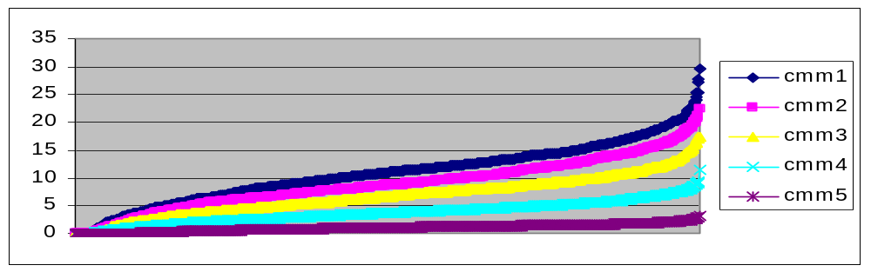
Sorted outputs from E/H model
(1000 runs per CMM level)
If rework =
All of max rework
If rework =
X%of max rework
(X mean=20%
X stdev=10%)
Non- righteous projects
(least IV&V benefit)
Righteous projects
(most IV&V benefit)
This talk: what takes us to righteous IV&V?

Slide 4
Model
:- [shell].
%----------------------------
phase(1,requirements).
phase(2,design).
phase(3,programming).
phase(4,integration).
phase(5,deployment).
%-----------------------------
ivv(fullPhase, [1,2,3,4,5]).
ivv(development, [1,2,3]).
ivv(early, [1,2]).
%ivv(requirements,[1]).
ivv(design, [2]).
ivv(programming, [3]).
ivv(integration, [4]).
ivv(deployment, [5]).
%----------------------------
reworkByPhase(coyle99,10, 100,1000).
reworkByPhase(remus83 ,1, 20, 82).
reworkByPhase(kan89, 1, 13, 92).
%----------------------------
% per KSLOC
defectDensity(akiyama72, 20 ).
defectDensity(rbey75, 4 ).
defectDensity(endres75, 5 ).
defectDensity(thayer78, 26 ).
%defectDensity(belford79, 57 ).
defectDensity(hatton94, 6 ).
defectDensity(sunazuka83, 16 ).
defectDensity(capersjonesAda,17 ).
defectDensity(capersjonesC, 13.7).

Slide 5
Model (2)
%----------------------------------
%cmm(1).
cmm(2).
%cmm(3).
%cmm(4).
%cmm(5).
%----------------------------------
ksloc(10).
budget(100000).
%----------------------------------
leakages(
%requirements
% %design
% % %programming
[[ 49, 681, 0 ] % design
,[ 39, 113, 2004 ] % programming
,[ 26, 49, 418 ] % integration
,[ 8, 16, 56 ] % deployment
]).
%--------------------------
doubts(0.1).
%-----------------------
cmmRework(1,0.55).
cmmRework(2,0.45).
cmmRework(3,0.35).
cmmRework(4,0.20).
cmmRework(5,0.06).
%-----------------------
reworkSaved(X,X) :- X is max(0,normal(0.2,0.1)).
%reworkSaved(ken, 0.15).
%reworkSaved(warren, 1 ).
%reworkSaved(pessimist, 0.05).
%reworkSaved(optimist, 0.3 ).
%------------------------
costToFix(_,1).

Slide 6
Model (3)
(sum the saved rework scaled by the increased
cost of fixing later, rather than sooner)
rework(J,K,I,Out) :-
(J=1 -> X= (-); X= (+)),
rework1(X,J,K,I,Out).
rework1(-,_,_,_,0).
rework1(+,J0,K0, I,L*C*F+Rest) :-
J is J0 - 1,
X is I - J,
K is K0 + 1,
Y is I - K,
leakage(X,I,L),
costToFix(I,C),
reworkByPhase(Y,F),
rework(J,K,I,Rest).

Slide 7
LURCH (not SPIN)
lurch(X,W0,W) :-
once(lurch0(X,Y,W0,W1)), %←---------------------------- [0]
lurch1(Y,W1,W).
lurch0(true, stop) --> [].
lurch0((X,Y), (X,Y)) --> [].
lurch0((X;Y), L) --> {c2l((X;Y),L)}. %←-- [1]
lurch0(X, call(X=Y)) --> {choices(X,Y)},old(Y). %←-- [2]
lurch0(X, new(X)) --> {choices(X,_)}. %←-- [3]
lurch0(X, call(X)) --> {knownBuiltIn(X)}. %←-- [4]
lurch0(X, sub(X)) --> {clause(X,_)}. %←-- [5]
lurch1(stop) --> [].
lurch1(call(X)) --> {X}.
lurch1((X,Y)) --> lurch(X), lurch(Y).
lurch1([H|T]) --> {rone([H|T],Y,_)}, %←--------------- [6]
lurch(Y).
lurch1(sub(X)) --> {clause(X,Y)},
lurch(Y).
lurch1(new(X), W0,[X|W]) :-
bagof(X/Y,clause(X,Y), L), %←------------------------ [7]
rone(L,X/Y,_), %←------------------------ [8]
lurch(Y,W0,W).

Slide 8
(a little detail)
:- arithmetic_function(normal/2).
normal(M,S,N) :- box_muller(M,S,N).
% classical fast method for computing
% normal functions using polar co-ords
% (no- i dont understand it either)
box_muller(M,S,N) :-
w(W0,X),
W is sqrt((-2.0 * log(W0))/W0),
Y1 is X * W,
N is M + Y1*S.
w(W,X) :-
X1 is 2.0 * ranf - 1,
X2 is 2.0 * ranf - 1,
W0 is X1*X1 + X2*X2,
(W0 >= 1.0 -> w(W,X) ; W0=W, X = X1).
:- arithmetic_function(ranf/0).
ranf(X) :-
N = 65536,
% X is random(N) returns a random number from 0 .. N-1
X is random(N)/N.

Slide 9
How to understand all this output?
If rework =
X%of max rework
(X mean=20%
X stdev=10%)
Use a treatment learner
  100,000 runs of CMM2 E/H
  10-way xval
  Seek factors that drive you
    into righteousness (make things better)
    away from righteousness (make things worse)

Slide 10
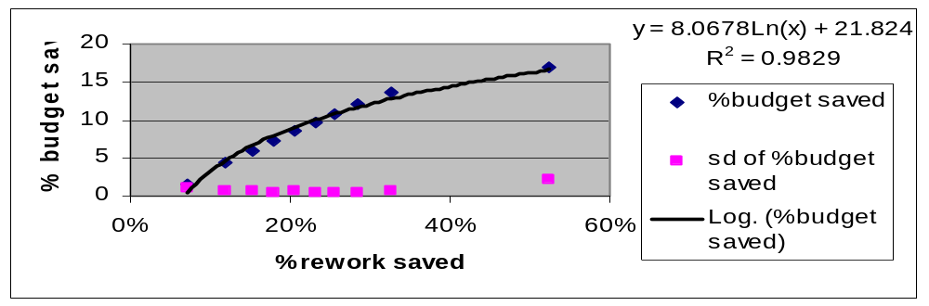
BTW: % rework saved is not the whole story
Data from 1000 runs of CMM2. Different shape to:

Slide 11
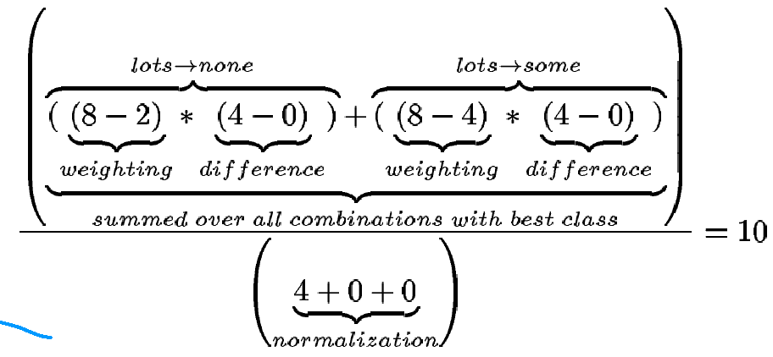
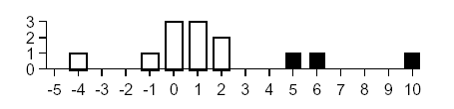
Treatment learning?
hours on
course
outlook
temp
humidity
wind
sunny, 85, 86, false, none (2¹=$2)
sunny, 80, 90, true, none
sunny, 72, 95, false, none
rain, 65, 70, true, none
rain, 71, 96, true, none
rain, 70, 96, false, some (2²=$4)
rain, 68, 80, false, some
rain, 75, 80, false, some
sunny, 69, 70, false, lots (2³=$8)
sunny, 75, 70, true, lots
overcast, 83, 88, false, lots
overcast, 64, 65, true, lots
overcast, 72, 90, true, lots
overcast, 81, 75, false, lots
More frequent in “good” than “bad”
Weighted by difference
“good” to “bad”.
Normalized by total counts
Summed for all classes.
Notes:
histogram bottom left shows all the “promising” counts for all ranges in the table top left (numeric values sorted, chopped into 3 percentile bands). Note that the score of “10” for outlook=overcast is outstandingly large.

Slide 12
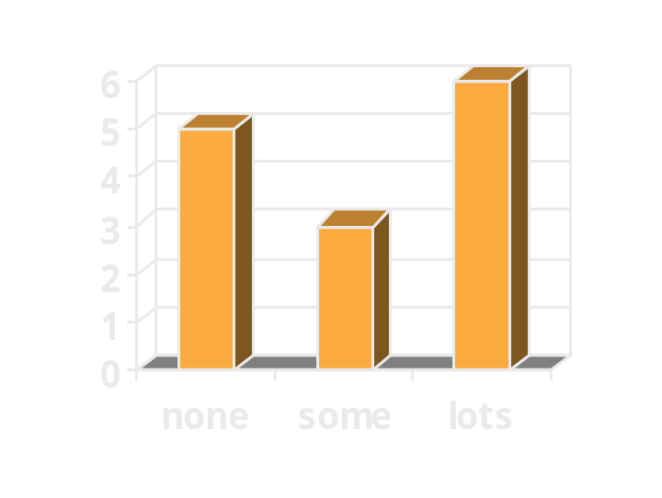
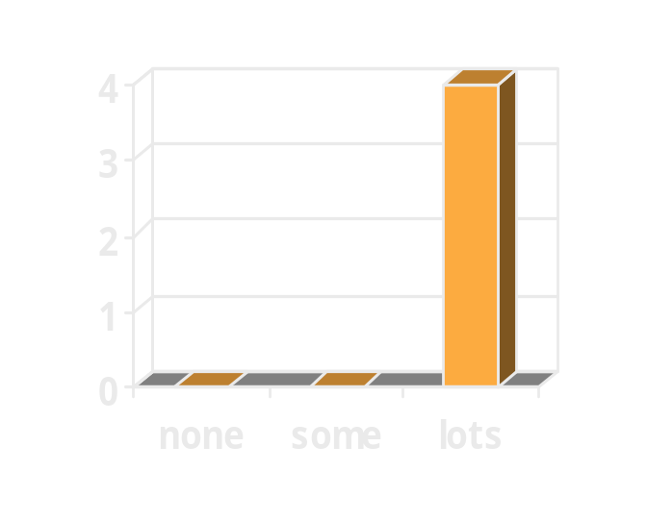
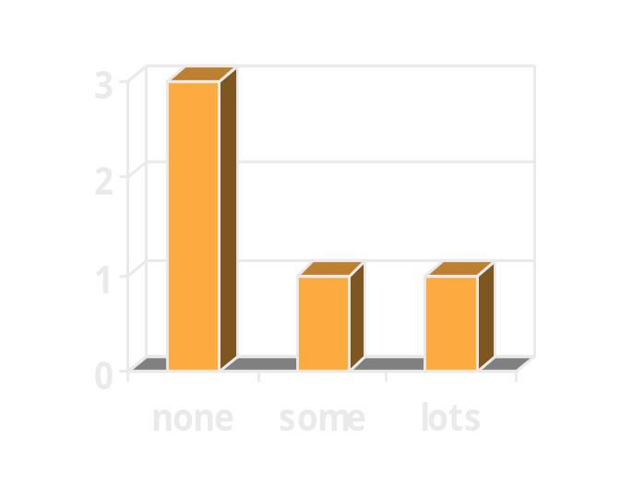
Treatments= combinations of promising ranges
If no change,
Then lots of golf 6/(6+3+5)= 43%
If outlook=overcast,
Then lots of golf 4/(4)= 100%
If humidity=90..97
Then lots of golf 1/(4)= 25%
Righteous change:
bribe DJs to lie about the weather
Non-righteous change:
watch the humidity- alert if rising over 90%

Slide 13
Digression
Treatment learner=
  K.I.S.S. association rule learning
    Confidence pruning, no support pruning
    Assumes data fits in RAM
      (not a data miner)
  Some class score knowledge
    Returns minimal contrast sets between good and bad scoring classes

Slide 14
10-way cross validation (xval)?
Don’t test on the training set
For a dataset with class frequency distribution F
  Divide into (e.g.) 10 buckets, preserving F
  For I = 1 to 10,
    Remove bucket I
    Train on all other nine buckets
    Test on bucket I
Final worth = average of xval worth

Slide 15
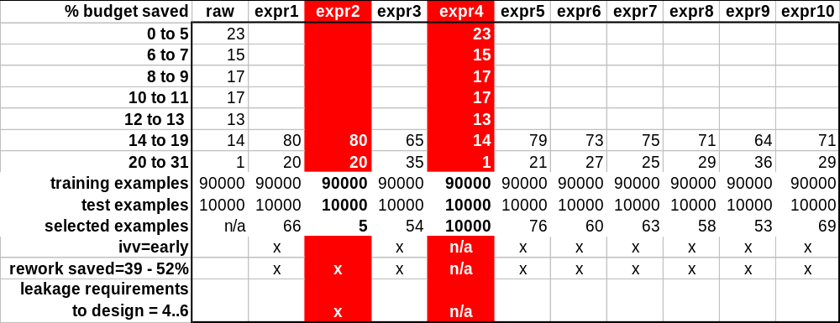
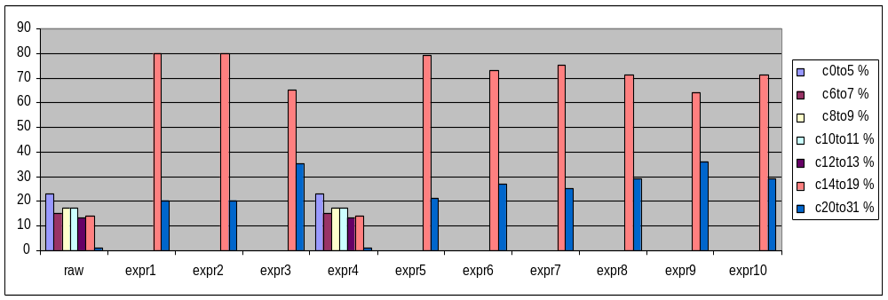
righteous CMM2 projects: granularity=5; #changes=2

Slide 16
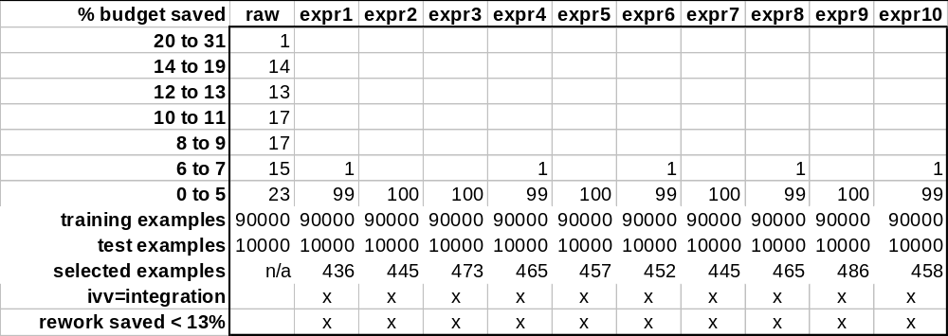
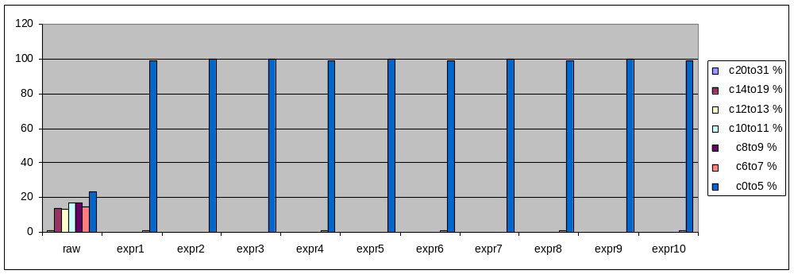
non-righteous CMM2 projects : granularity=5; #changes=2

Slide 17
Conclusions (1)
Amazingly:
  Despite all the unknowns of the E/H model,
  Some definite conclusions can still be reached
4 key E/H attribute ranges found (within ≈ 80)
  % rework saved by IV&V:
    < 13% = very bad;
    > 39% = very good
  At what phase is IV&V used
    early = very good;
    during integration = very bad
    surprise: can stop iv&v very early (after design)

Slide 18
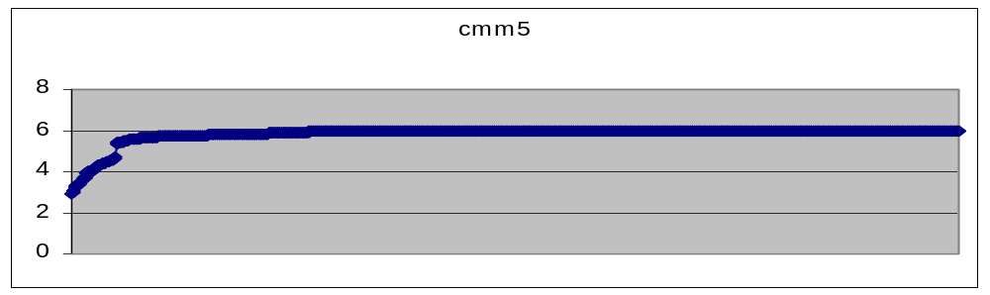
Conclusions (2)
Bad news:
  CMM3:
    same methodology, no stable results
    Most puzzling
  CMM5- probably no benefit:

Slide 19
Future work:
Data collection:
  % rework saved
  when is IV&V applied?
Apply to CMM1,CMM4
Need to re-check the “no result” for CMM3

