Slide 1
Technical Debt Reduction Using Search-Based Automated Refactoring
Michael Mohan¹,
Des Greer and Paul McMullan
Queen’s University Belfast, Northern Ireland, UK
¹mmohan03@qub.ac.uk
Notes:
Sunday, September 10th from 16.00-17.30.
Talk is 20 minutes including questions.
Smile when starting.
“Hi everyone. My name is Michael Mohan and I am a PhD student currently studying at Queen’s University in Belfast in Northern Ireland. I am a co author for this paper which was published last year that looks at technical debt reduction using search-based automated refactoring.”
Start with the thesis (short summary).

Slide 2
Technical Debt
As the development of a software project progresses, it will build up technical debt.
This makes it more difficult to add new functionality due to the code becoming less extendable, more complex etc.
If this debt isn’t paid off early on, the project can eventually fall into disrepair and the cost of resolving the debt in order to add new functionality may become too great.

Slide 3
Paper Outline
Technical debt is a difficult property to measure in a program.
We propose a metric function to measure the level of technical debt in a Java program.
We compare the function with measures of 3 other software properties to determine its usefulness.
To compare, we use a refactoring tool to modify different open source programs to improve each measure.

Slide 4
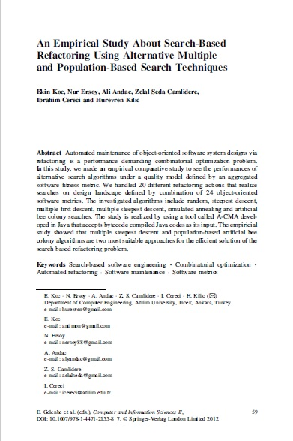
Refactoring Tool Used
The A-CMA tool¹ was adapted and used for the experimentation.
The tool contain 20 refactorings and 24 software metrics.
There are 5 different search techniques available to use in the tool.
¹ Koc, E., Ersoy, N., Andac, A., Camlidere, Z.S., Cereci, I., Kilic, H., 2012. An empirical study about search-based refactoring using alternative multiple and population- based search techniques. In: Gelenbe, E., Lent, R., Sakellari, G. (Eds.), Computer and Information Sciences II. Springer London, London, pp. 59–66. doi: 10.1007/ 978- 1- 4471- 2155- 8 .

Slide 5
Refactorings Used
Field Level | Method Level | Class Level
Increase Field Security | Increase Method Security | Introduce Factory
Decrease Field Security | Decrease Method Security | Make Class Abstract
Move Down Field | Move Down Method | Make Class Final
Move Up Field | Move Up Method | Make Class Non-Final
Remove Field | Move Method | Remove Class
 | Instantiate Method | Remove Interface
 | Freeze Method
 | Remove Method
 | Inline Method

Slide 6
Metrics Used
numField | avrgFieldVisibility | eC_Attr
numOps | nesting | iC_Par
numCls | NOC | eC_Par
numInterf | numDesc | Dep_In
iFImpl | numAnc | Dep_Out
abstractness | iC_attr

Slide 7
Search Techniques Used
Search Technique | Iterations/ Amount Of Restarts | Temperature/Depth
Random Search | 5,000 Iterations
Steepest Ascent Hill Climbing | 30 Restarts | Depth Of 5 Neighbours
Simulated Annealing | 5,000 Iterations | Temperature Value Of 1.5

Slide 8
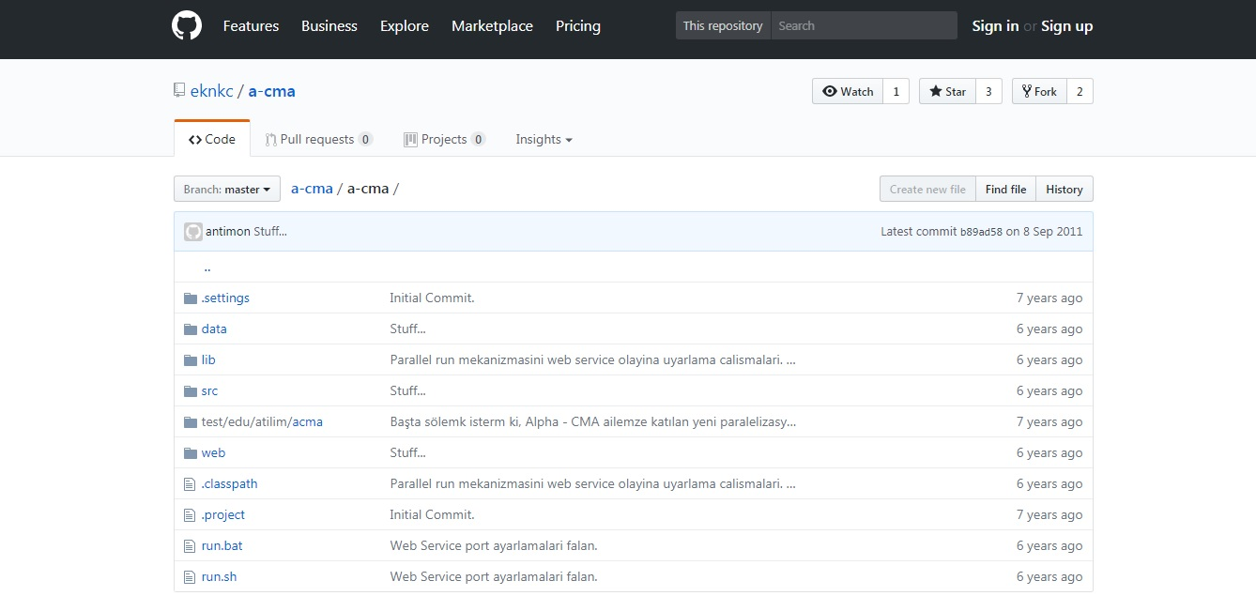
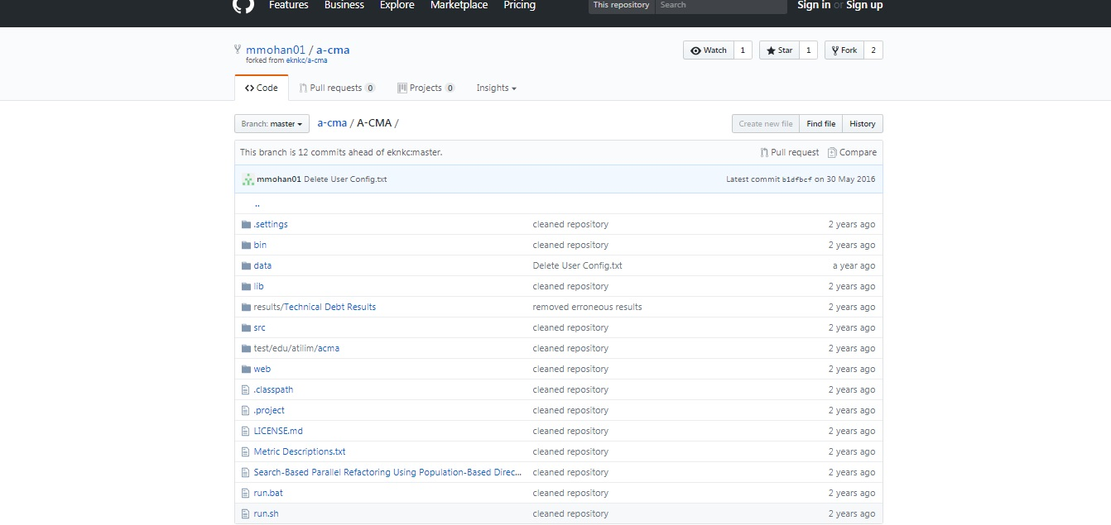
Tool Location
The original tool can be found at https://github.com/eknkc/a-cma
The tool was modified in order to give more configuration for the experimentation in this paper.
The modified version of the tool can be found at https://github.com/mmohan01/a-cma
This repository also contains the programs used for experimentation and the results generated.

Slide 9
Experimental Setup
For each of the 4 software measures, a fitness function is constructed using weighted combinations of metrics.
The SOLID principles of object oriented design and the QMOOD metrics suite were used to aid in constructing the functions.
A search-based refactoring setup was run for each of the 4 fitness functions.

Slide 10
Experimental Setup
Software Factor | Metric Components And Weights
Technical Debt | −0.1 ∗numFields − 0.1 ∗avrgFieldVisibility − 0.1 ∗numOps − 0.06 ∗nesting + 0.1 ∗abstractness + 0.1 ∗numCls + 0.1 ∗numInterf + 0.1 ∗iFImpl + 0.06 ∗NOC + 0.06 ∗numDesc − 0.06 ∗Dep_In − 0.06 ∗Dep_Out
Coupling | −0 .125 ∗iC_Attr − 0.125 ∗eC_Attr − 0.125 ∗iC_Par − 0.125 ∗eC_Par − 0.25 ∗Dep_In − 0.25 ∗Dep_Out
Inheritance | 0.25 ∗iFImpl + 0.25 ∗NOC + 0.25 ∗numDesc + 0.25 ∗numAnc
Abstraction | 0.33 ∗abstractness + 0.33 ∗numInterf + 0.33 ∗iFImpl

Slide 11
Experimental Setup
Each fitness function was run separately with 6 different open source Java programs, and repeated for each of the 3 search techniques.
Each task was run 10 times.

Slide 12
Experimental Setup
4 Fitness Functions
3 Search Techniques
6 Open Source Inputs
10 Runs Of Each Task
For a total of 720 runs.

Slide 13
Input Programs Used
Name | Classes | Lines Of Code
JSON 1.1 | 12 | 167
JFlex 1.4.1 | 56 | 1,094
Apache-XmlRpc 3.1.1 | 100 | 712
Mango | 78 | 598
Beaver 0.9.8 | 81 | 801
JHotDraw 5.3 | 241 | 3,297

Slide 14
Execution Times
Input Program | Overall Time Taken
JSON 1.1 | 0h 3m 13s
JFlex 1.4.1 | 2h 6m 38s
Apache-XmlRpc 3.1.1 | 1h 23m 43s
Mango | 1h 1m 29s
Beaver 0.9.8 | 1h 25m 4s
JHotDraw 5.3 | 49h 28m 4s
Total | 55h 28m 11s

Slide 15
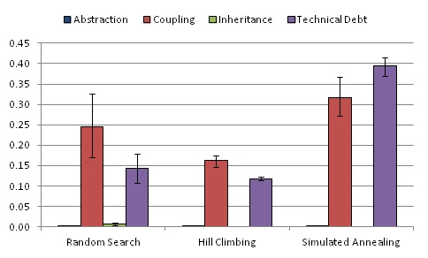
Comparison Of Searches
The Wilcoxon Rank-Sum/Mann–Whitney U statistical test was used to compare the results across the different searches.
Simulated annealing was found to be statistically different to the other searches.
The random results were also found to be significantly different to hill climbing.
This could possibly be due to the input parameters not being optimal for the hill climbing search.

Slide 16
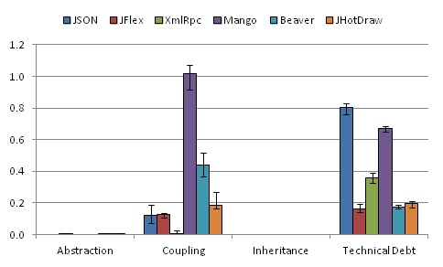
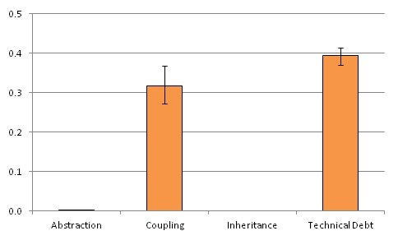
Comparison Of Functions
Across Each Input Program
Average
Wilcoxon Signed-Rank statistical test compared initial and final technical debt results and found that they were significantly better.

Slide 17
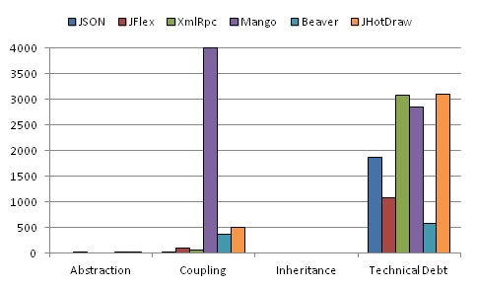
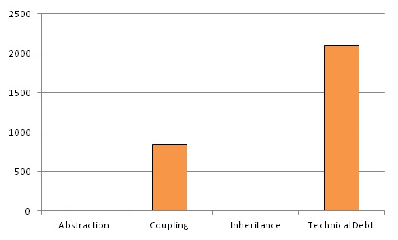
Refactoring Actions Applied
Across Each Input Program
Average
The similarity implies that there is a lack of available refactoring actions related to the metrics that make up the inheritance and abstraction functions.

Slide 18
Conclusion
A practical method was developed using the A-CMA refactoring tool to reduce technical debt in Java programs.
3 search techniques were compared and simulated annealing was shown to be more successful than hill climbing and a random search.

Slide 19
Conclusion
The technical debt function was compared against 3 other properties and was found to be more successful on average at improving the software.
The coupling function gave better improvements for 2 of the inputs, possibly due to coupling being higher for these inputs and allowing for more of an improvement.

Slide 20
Opportunities For Future Work
There is a possibility of using A-CMA’s parallel functionality to reduce the execution times of the search tasks.
Further experimentation with individual metrics could provide insight into their effect on refactoring ability.
The technical debt measure could be compared against other factors such as cohesion or complexity.

Slide 21

Email at: mmohan03@qub.ac.uk
Notes:
“Any questions?
If not, my email is mmohan03@qub.ac.uk or you can come talk to me at any time.
I hope this presentation has been at least mildly interesting and thank you all for coming and thanks for listening. Bye.”

