Slide 1
Storyboard
Cooking Calendar: Tim Magargee

Slide 2
Trendy Tina: Assign new recipe to specific day
Create account
Learn how to use site
Add recipe
Assign to specific day

Slide 3
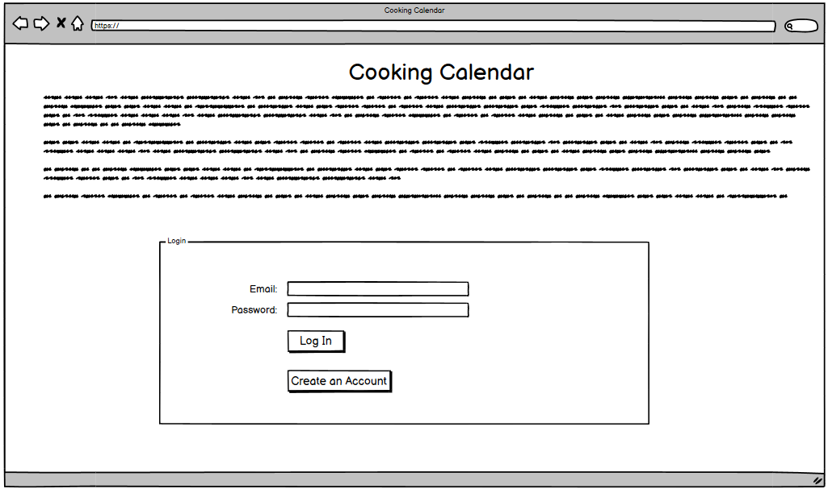
Navigate to site
Click Create an Account

Slide 4
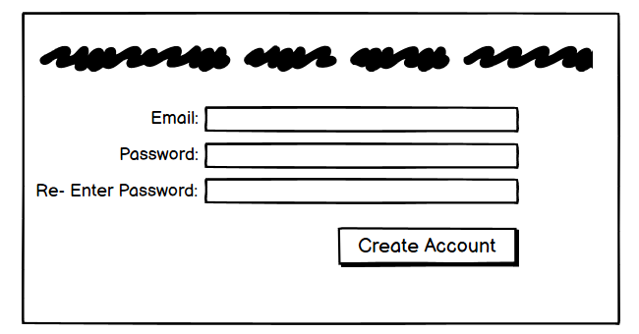
Fill out fields
Click Create Account

Slide 5
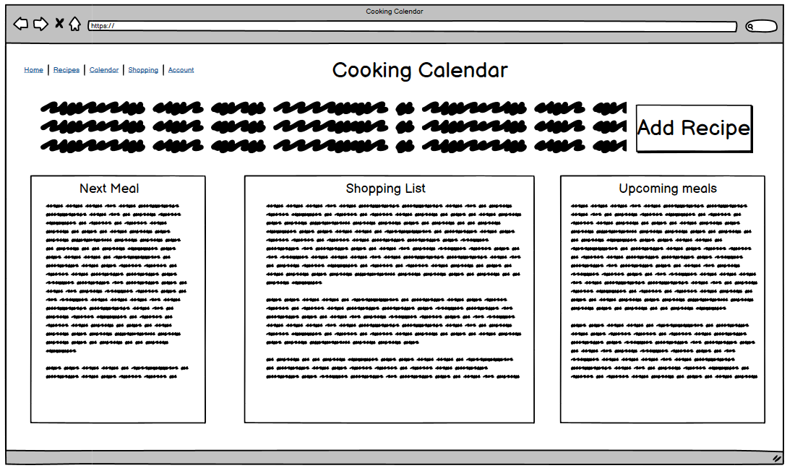
New account screen
Add Recipe

Slide 6
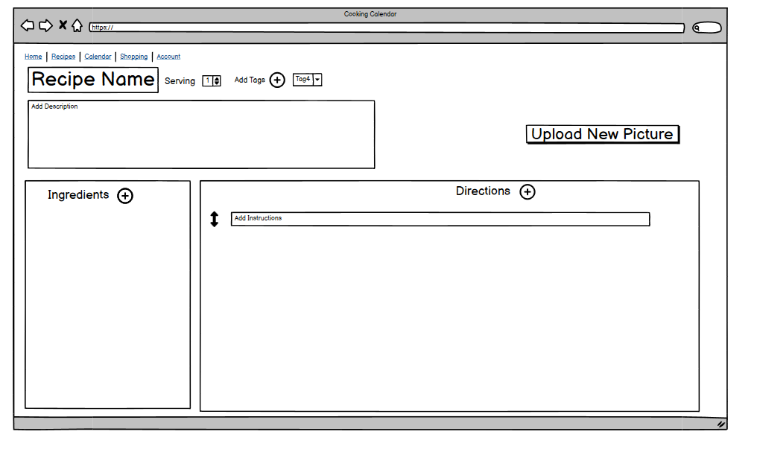
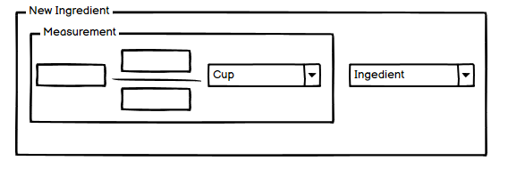
New recipe: Make Changes
Click circle plus icons, type in text boxes, click buttons.

Slide 7
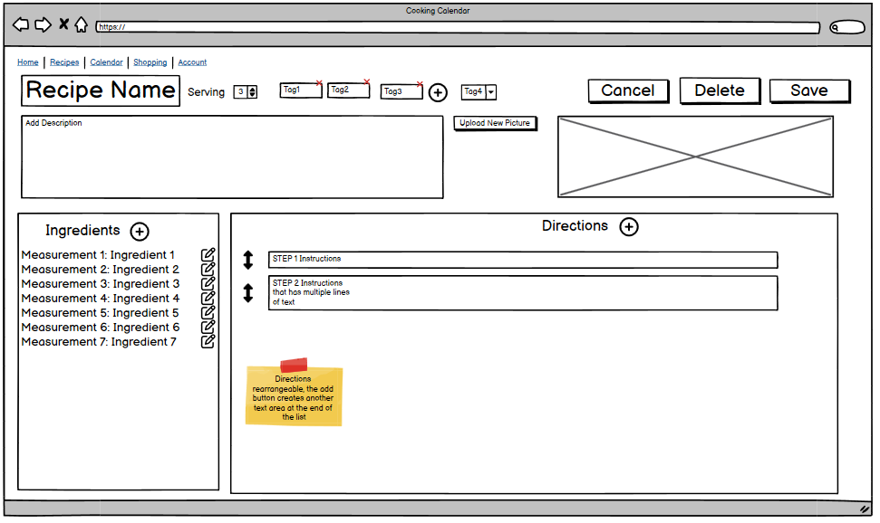
After changes
Click Save

Slide 8
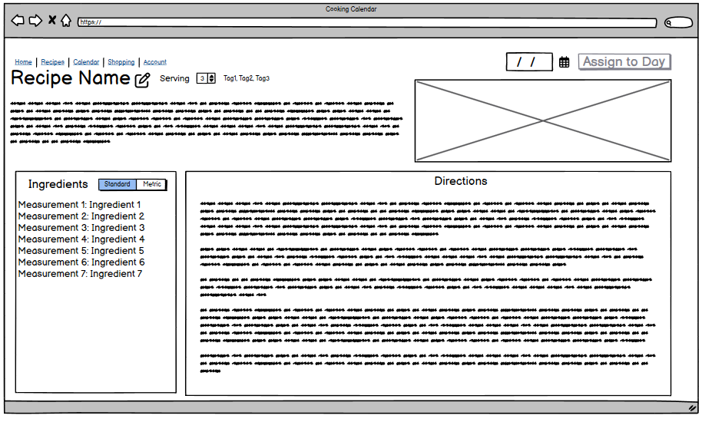
Assign day
Pick date and click assign to day button

Slide 9
Positive Peter: Build routine
Assume he has already input recipes
Choose categories for days
Generate plan
Look at shopping list for upcoming week
Add shopping items so that everything he needs is in one place

Slide 10
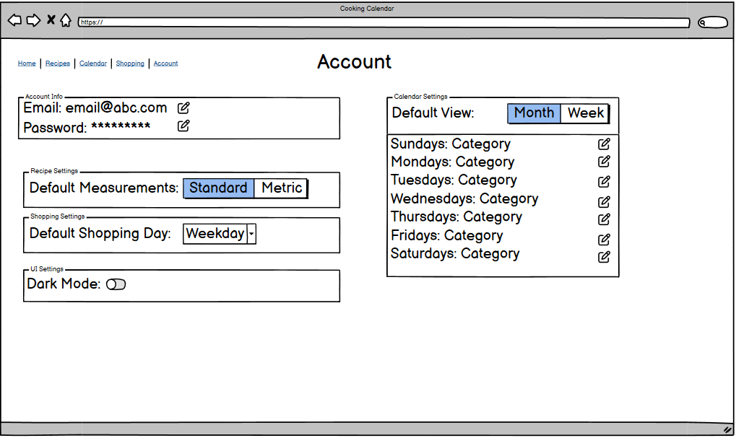
Choose categories for days: Account Page Path
Click edit buttons to change categories for each day

Slide 11
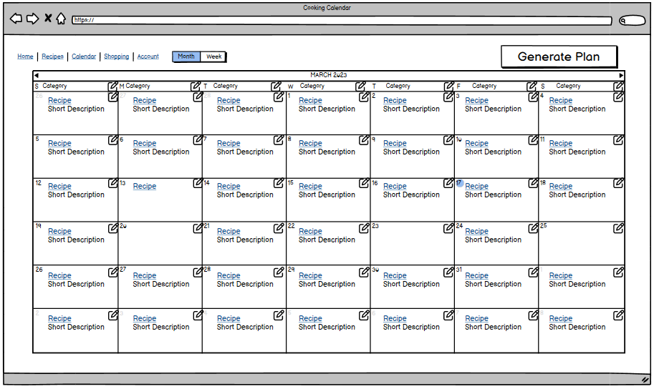
Choose categories for days: Calendar Page Path
Click top edit buttons to change categories for each day

Slide 12
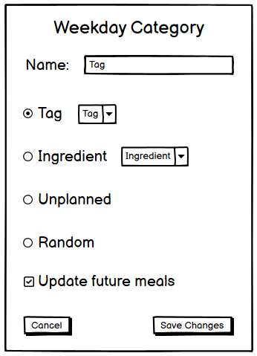
Change Category Dialog
Peter makes changes for each day and hits “Save Changes

Slide 13
Generate Plan
Click generate Plan
Then Click “Shopping
2
1

Slide 14
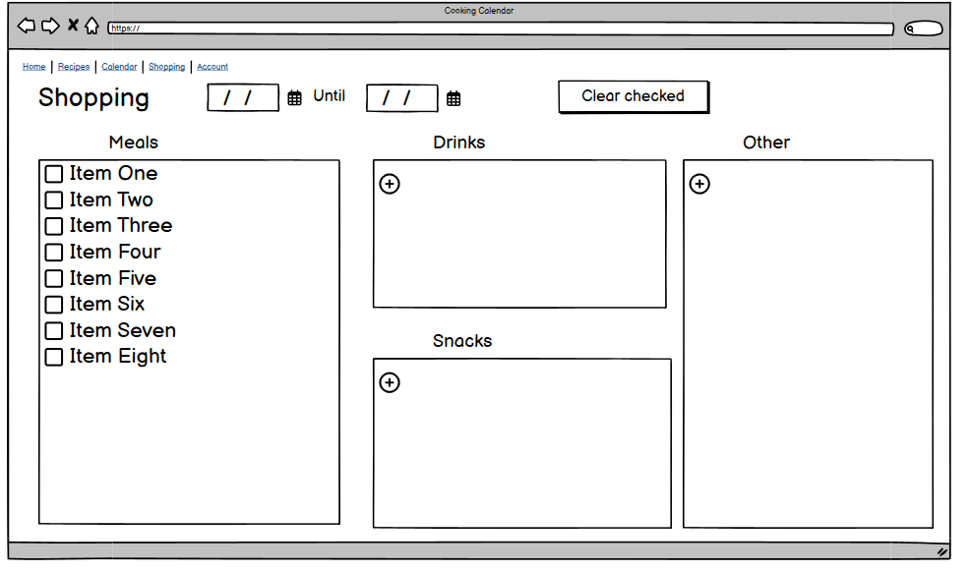
View shopping list
Check items off
Use add buttons

Slide 15
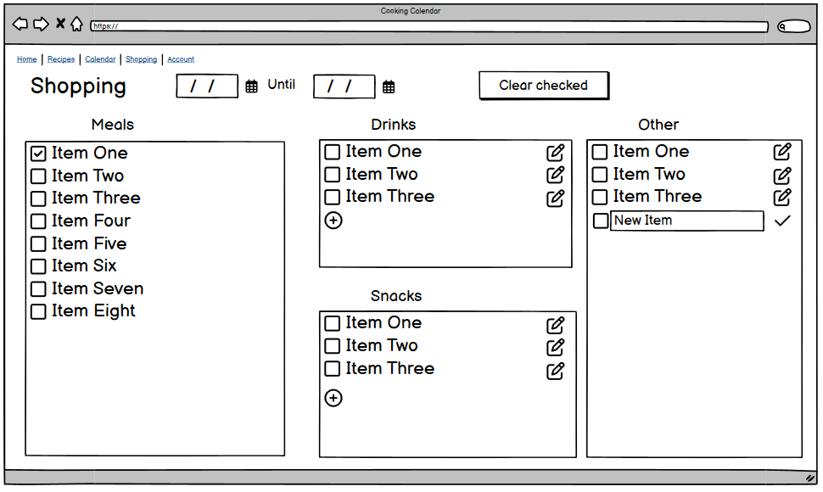
View shopping list (While editing)

