Slide 1


Web Scrapping and Data Analysis on Cars24 used cars DataBase

Slide 2
Business problem and objective of the project
Everybody views cars from a different angle. Some choose luxury. Some choose retro styles. Depending on their financial situation,
The goal of this experiment was to investigate the factors that influence car prices in the used car market all over India
In this project, I want to demonstrate to you how to create a database containing every listing that is obtained by scraping all of the search results from one of the most popular car-selling websites in India, where I currently reside. The website that was scraped is called Cars24.

Slide 3
Modules used
Requests
Beautiful soup
Numpy
Pandas
Sklearn
Matplotlit
seaborn

Slide 4
Web Scarping
Modules Used – Request and Beautiful Soup
In the cars24 portal after applying filters called brand and city it was able to generate a unique URL for each brand and city selected. So we chose 10 cities and 9 brands in this way we were able to generate 9X10 = 90 URLs
From each url we were able to scrape info about 100 -140 used cars. Thus we were able to make a dataset of size 1507 rows and 9 columns

Slide 5
Data Summary
Vehicle Information Summary: Column Type:
Numerical – kilometer driven, price, emi
Categorical - year, brand, model, Fuel Type, Transmission and City
Model Year Between 2010 to 2023
Kilometer Ranging between 100 km to 100000 km
Price ranging between – 1.5 lakhs to 26 lakhs

Slide 6
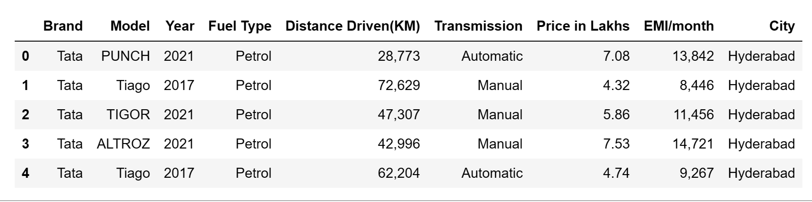
Data Cleaning Steps
Most of the data cleaning was done during the scrapping of the data as we were able to use proper regular expression patterns to extract exactly the data that we wanted. Almost 80% of the data cleaning is done through regular expression.
The remaining columns that were to clean was Distance Driven which was initially stored as string type and had commas between the digits so we removed them using the replace method and converted them into float type. Similarly with Emi column also

Slide 7
Data Manipulation steps
The missing values in the categorical columns Transmission and Fuel Type were imputed by using most frequent values of that column
The Mission values in the Numerical Column Distance Driven were filled using the mean value of that column

Slide 8
UNIVARIATE ANALYSIS

Slide 9
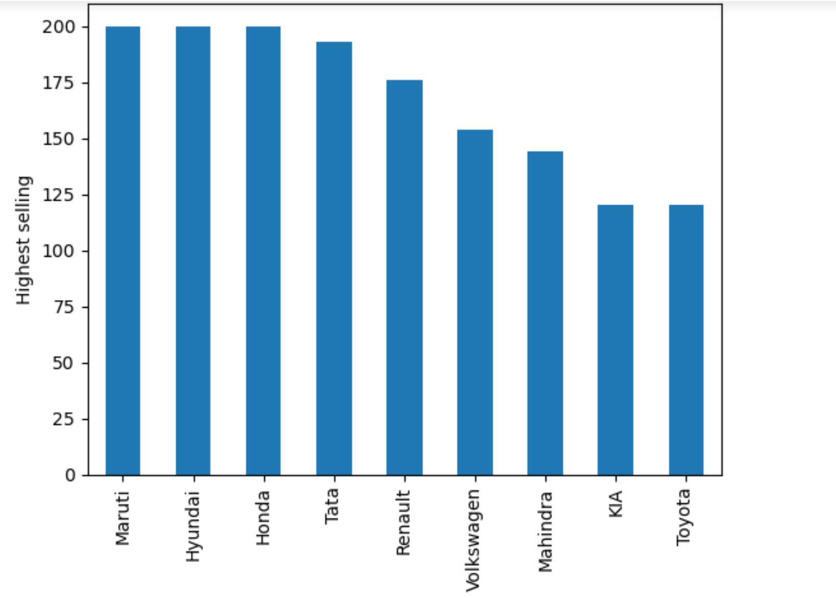
Most sellng brand:
OBSERVATIONS
The most selling brand is Maruti
The least selling brand is Toyota
Among all the nine brands the market share of Maruti, Hyundai, Honda is 40%

Slide 10
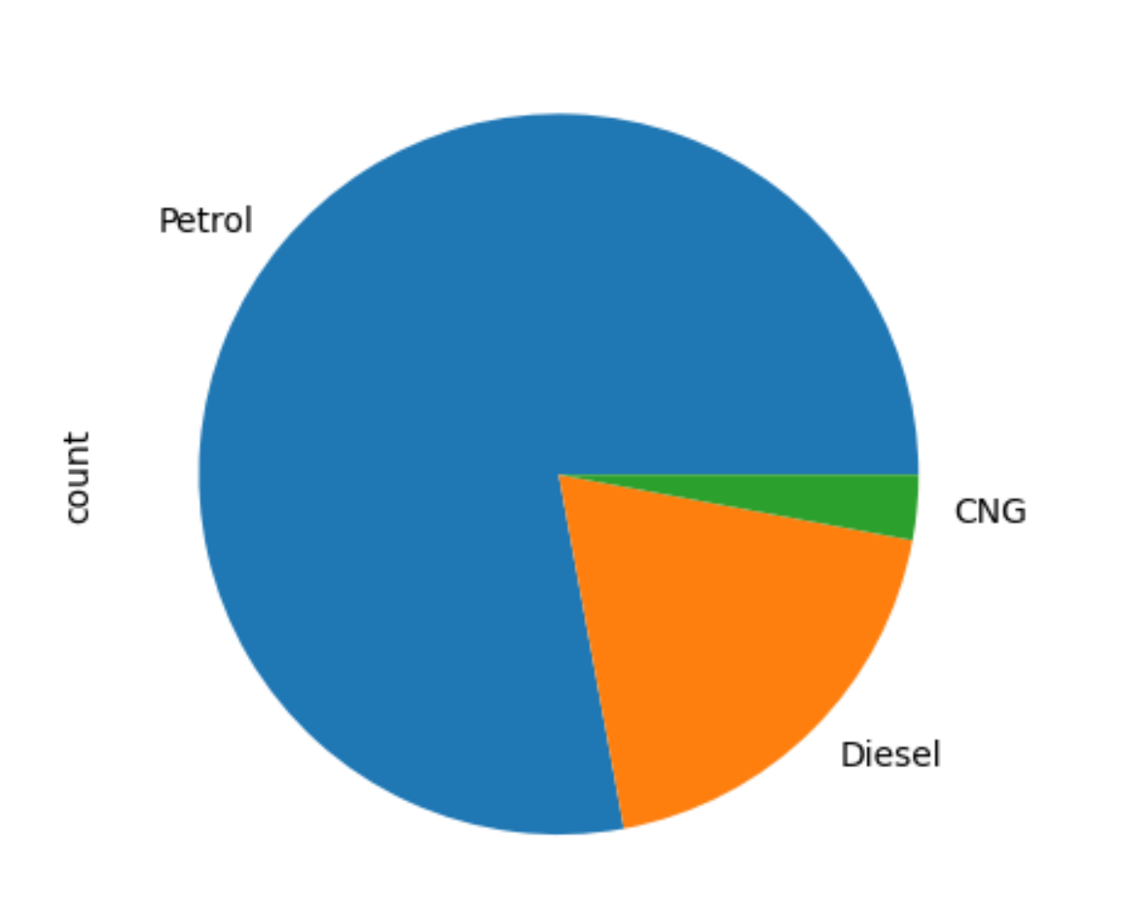
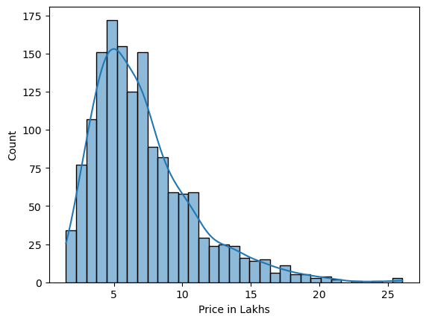
Price distribution:
Which types of cars are most used Fuel-Type :
OBSERVATIONS
The most selling cars are of petrol which is about 77% of used cars
The least selling cars are of CNG is only 3%
OBSERVATIONS
The Average price of cars is 7 lakhs and median price is about 6 lakhs
The Distribution is shows right skewness that means outliers are at higher price range that is very common in used cars

Slide 11
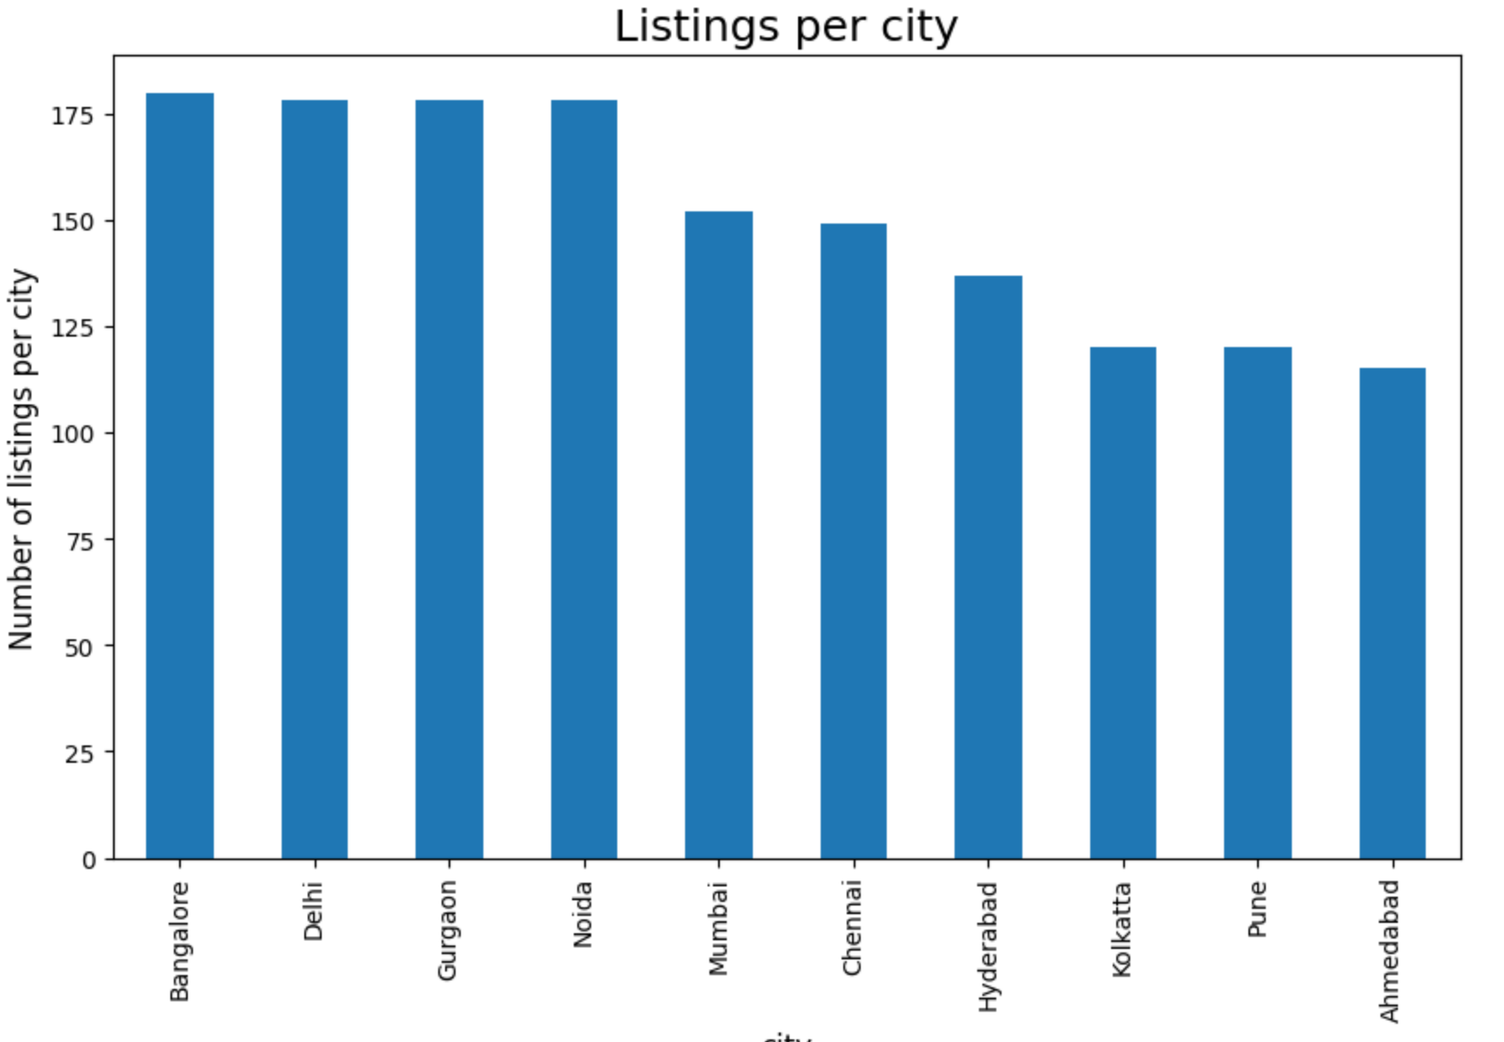
Vehicle listing in each city:
OBSERVATIONS
Delhi, Bangalore and Gurgaon are the cars with most no of used cars
The total no of Used cars in this 3 cities are 35% among all the other major cities
Among all the nine brands the market share of Maruti, Hyundai, Honda is 40%

Slide 12
BIVARIATE ANALYSIS

Slide 13
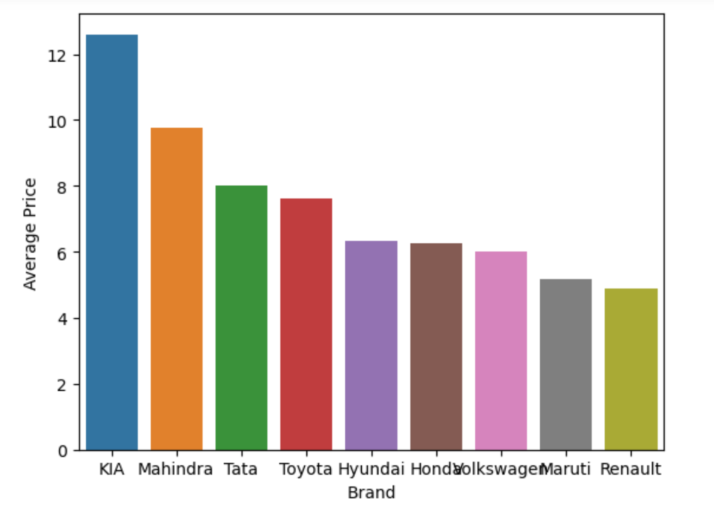
Average car Price for each brand:
OBSERVATIONS
Out of all the 9 brands Kia, Mahindra, and Tata are the costlier segment cars
The average price of Kia cars is about 12 lakhs which is the highest followed by Mahindra and Tata whose average is 9 lakhs and 8 lakhs respectively

Slide 14
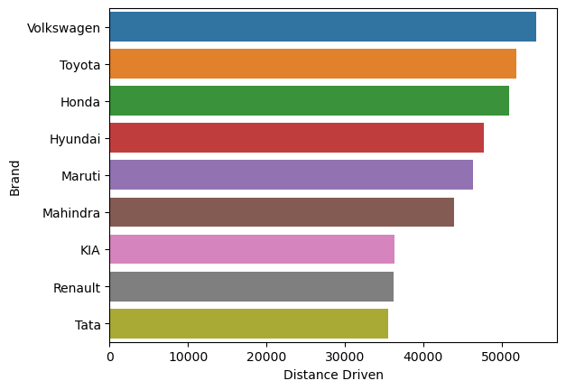
Average Distance Driven for each brand:
OBSERVATIONS
Volkswagen is the most driven or most used cars whose average distance driven is around 55000km
The least Driven or least used cars are of Tata whose average distance driven is 35000km

Slide 15
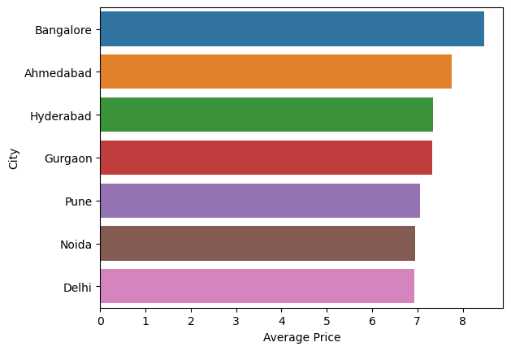
Average price of cars City wise :
OBSERVATIONS
In Bangalore the used car prices are highest which is about 8 lakhs
Used cars are available at cheaper prices in Delhi which is 6 lakhs

Slide 16
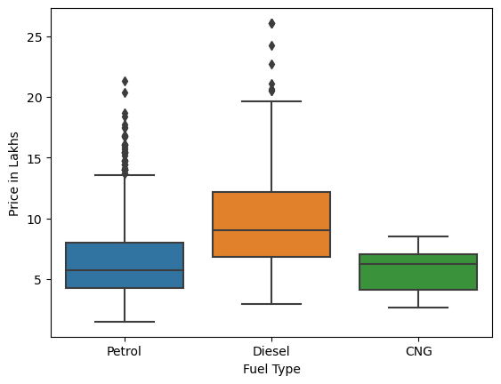
Does Fuel-Type impact Car Price:
OBSERVATIONS
is clear that the average price of diesel cars is much more higher that petrol and CNG

Slide 17
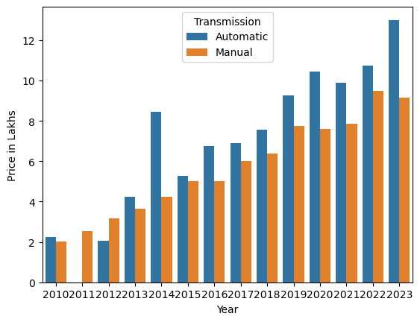
Which type of cars Autmatic or Manual have high price in each year :
OBSERVATIONS
In all the years from 2010 to 2023 the automatic car types are costlier than the manual transmission

Slide 18
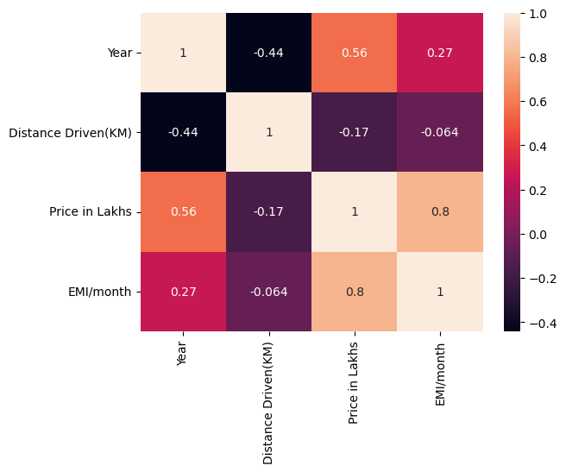
Heat map :
OBSERVATIONS
There is a strong relationship between price and emi
Year and price had positive relation

Slide 19
conclusions
Bangalore, Delhi, and Gurgaon are the top 3 used car markets.
Out of all the car brands the most driven cars are Volkswagen and the least driven cars are tata
In most years the automatic type of cars is higher than the manual type.
Maruti, Honda, and Hyundai are the most-selling car brands across India with a market share of 40 %.
The price of the car is correlated with the distance driven
The price is also correlated with the year of manufacture, Fuel_type.
The most important features that influence the use Distance Driven.

Slide 20

THANK YOU

