Slide 1
CS 6513: Big Data
Project
The Effect of COVID-19 Government Policies on Social Distancing and Infection Numbers
Group: OneTeammateRanAway
Members: Haifeng Zhan (hz2149)
TianyiZhao (tz1330)

Slide 2
Introduction
Social distancing: A major mechanism to reduce risk of infection.
Governments release policies: School closure, restaurant limits, banning large gatherings, working at home...
Safety Policies → Mobility → Infection Risk

Slide 3
Questions
How community mobility changes in response to the governments' stay-at-home orders.
How effective is social distancing in reducing spread of COVID-19.
Safety Policies → Mobility → Infection Risk

Slide 4
Data
1. Johns Hopkins dashboard data (5)
https://github.com/ CSSEGISandData/COVID-19/tree/master/csse_covid_19_data
Daily reports for new cases by Johns Hopkins CSSE.
2. COVID-19 Community Mobility Reports (88)
https://www.gstatic.com/covid19/mobility/Global_Mobility_Report.csv
Mobility data collected by Google. Based on mobile apps.
3. Government imposed safety measures (34)
https://data.humdata.org/dataset/acaps-covid19-government-measures-dataset
Official public safety measures collected by ACAPS.

Slide 5
Data Cleaning
1. Johns Hopkins dashboard data (5)
Use time_series_covid19_confirmed_US.csv.
Dates are column attributes. Need to switch rows and columns.
2. COVID-19 Community Mobility Reports (88)
Very well organized, including mobility percentage change in each county as well as the total change in each state. Only need to extract useful items.

Slide 6
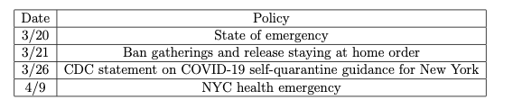
Data Cleaning
3. Government imposed safety measures (34)
Contents are safety measures and news reports. Extract data by keywords and manually check data.

Slide 7
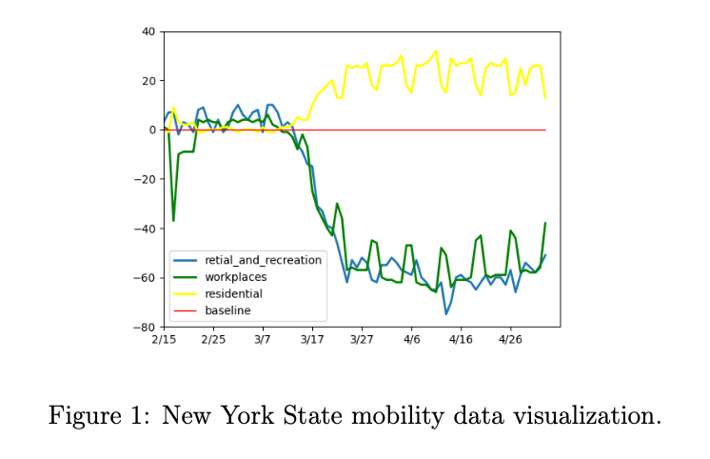
Visualization

Slide 8
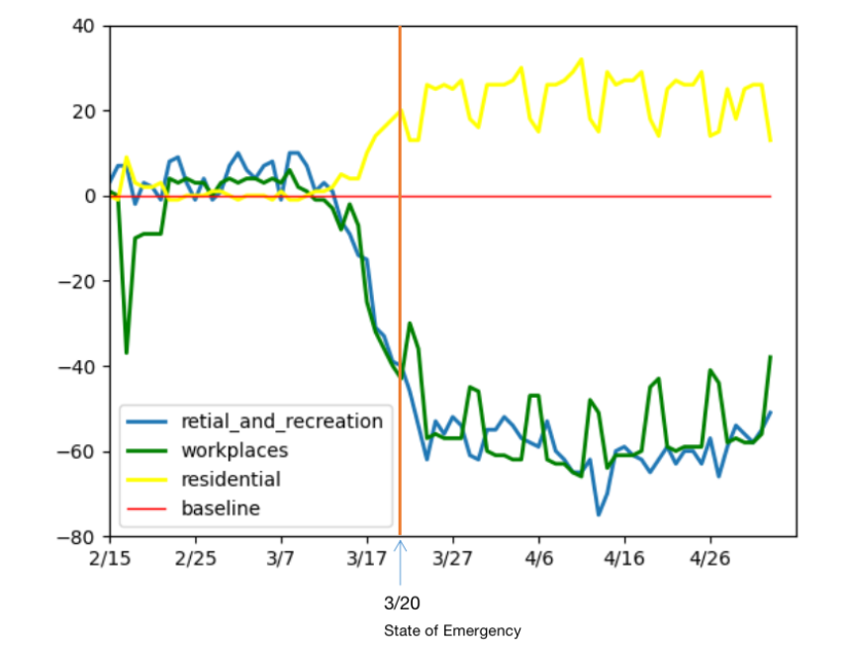
Visualization

Slide 9
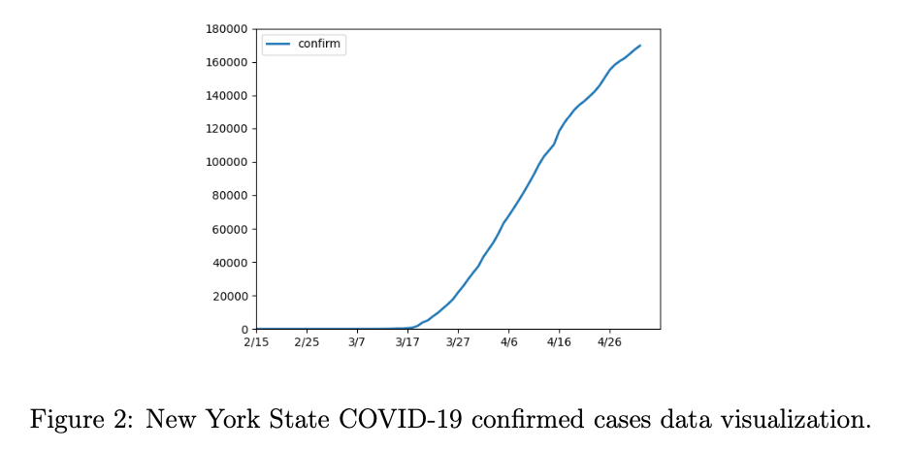
Visualization

Slide 10
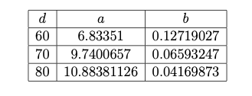
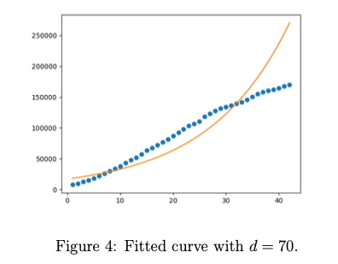
Model Fitting
y = exp(a) * exp(b*x)
Starts from Feb.15

Slide 11
Conclusion
State emergency reduced community mobility.
Many people took actions before governments releasing safety measures.
Spread rate of COVID-19 was limited, but its relation to community mobility and is still questionable.

Slide 12
References
Abouk, R., Heydari, B. The Immediate Effect of COVID-19 Policies on Social Dis- tancing Behavior in the United States. SSRN: https://ssrn.com/abstract=3571421 or http://dx.doi.org/10.2139/ssrn.3571421.
Adolph, C., Amano, K., Bang-Jensen, B., Fullman, N. & Wilkerson, J. Pandemic politics: Timing state-level social distancing responses to covid-19. medRxiv (2020).

Slide 13
Thank you!

