Slide 1
Netflix Exploratory Data Analysis
-Timothy Betancourt

Slide 2

contents:
Background of the Company
Research Question
The Analysis
Conclusion
Possible Future Work

Slide 3
Netflix, Inc.
Netflix was first launched on August 29,1997, it is an American subscription streaming service and production company.
Netflix was originally a DVD rental service that was revolutionary for its mail order rentals, Netflix has since pivoted to a platform only subscription streaming service.
As of December 31, 2021, Netflix had over 221.8 million subscribers worldwide, including 75.2 million in the United States and Canada, 74.0 million in Europe, the Middle East and Africa, 39.9 million in Latin America and 32.7 million in Asia-Pacific.

Slide 4
Research Question
What trends and demands amongst Netflix’s constantly changing media library has allowed it to increase the number of subscribers it enlists year by year.

Slide 5

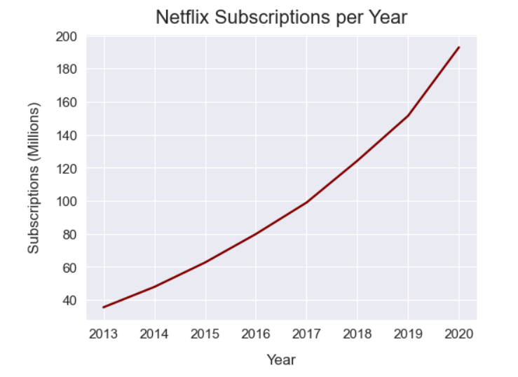
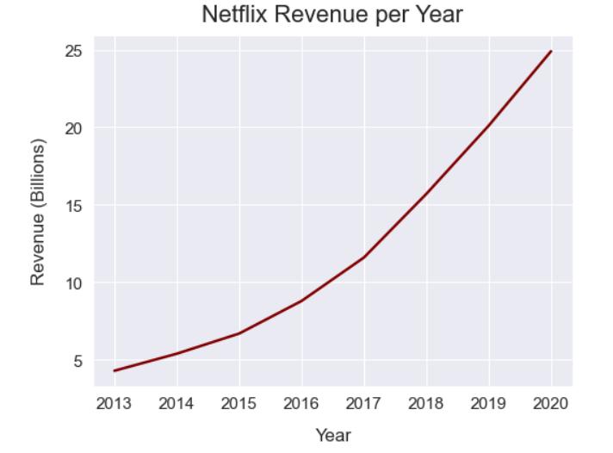
Analysis
In the last 5 years Netflix’s average yearly revenue growth has been paced at 27.45% whereas comparatively the rest of the industry has only seen a 7.33% average growth rate.

Slide 6
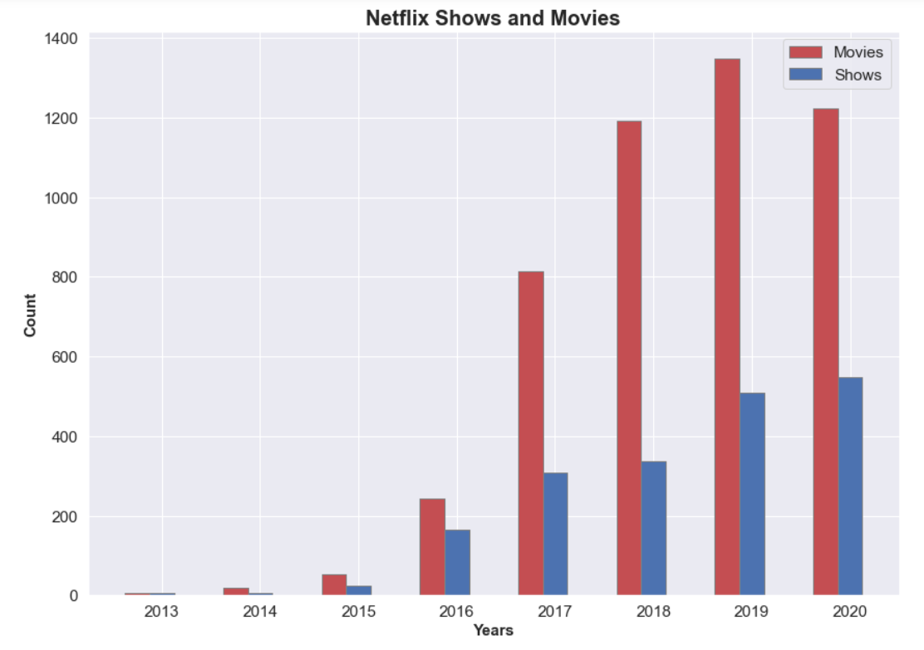
Netflix has shown consistent growth of their library year by year in both types of media, but we can see that in the latter year Netflix decreased it's Movie count while still steadily increasing its TV Shows.

Slide 7
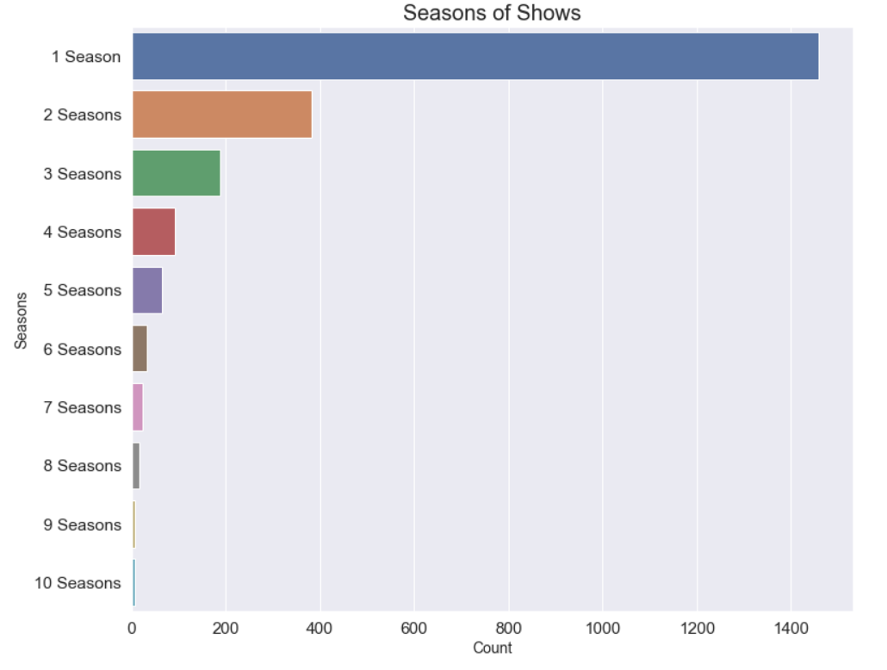
The amount of shows that end up getting subsequent seasons after their first season is very low in comparison with the total shows.

Slide 8
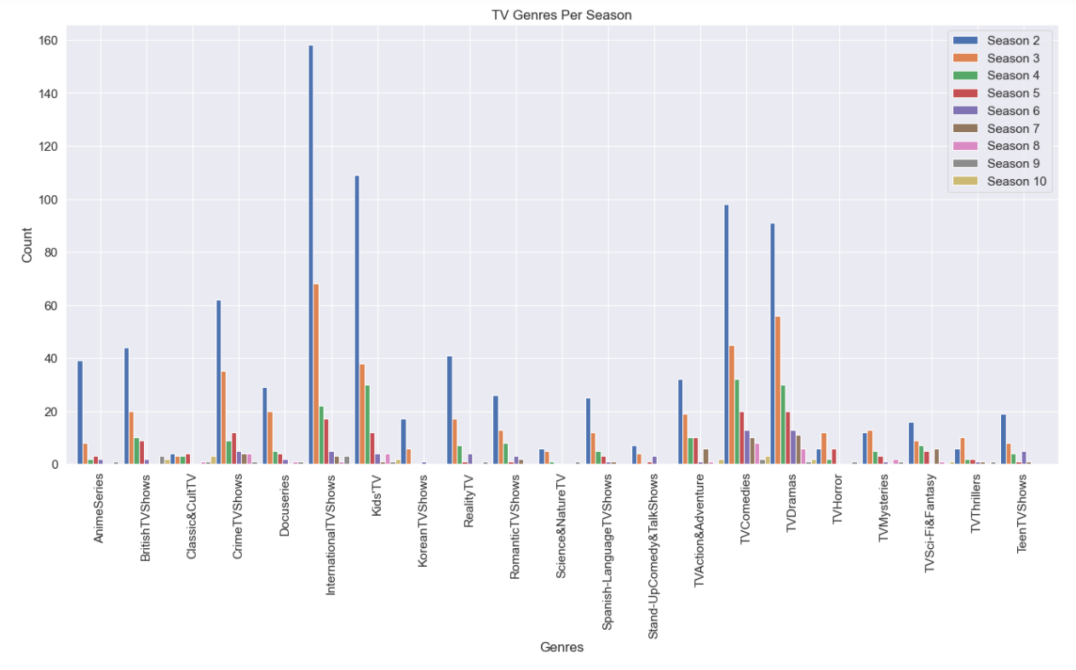

Slide 9
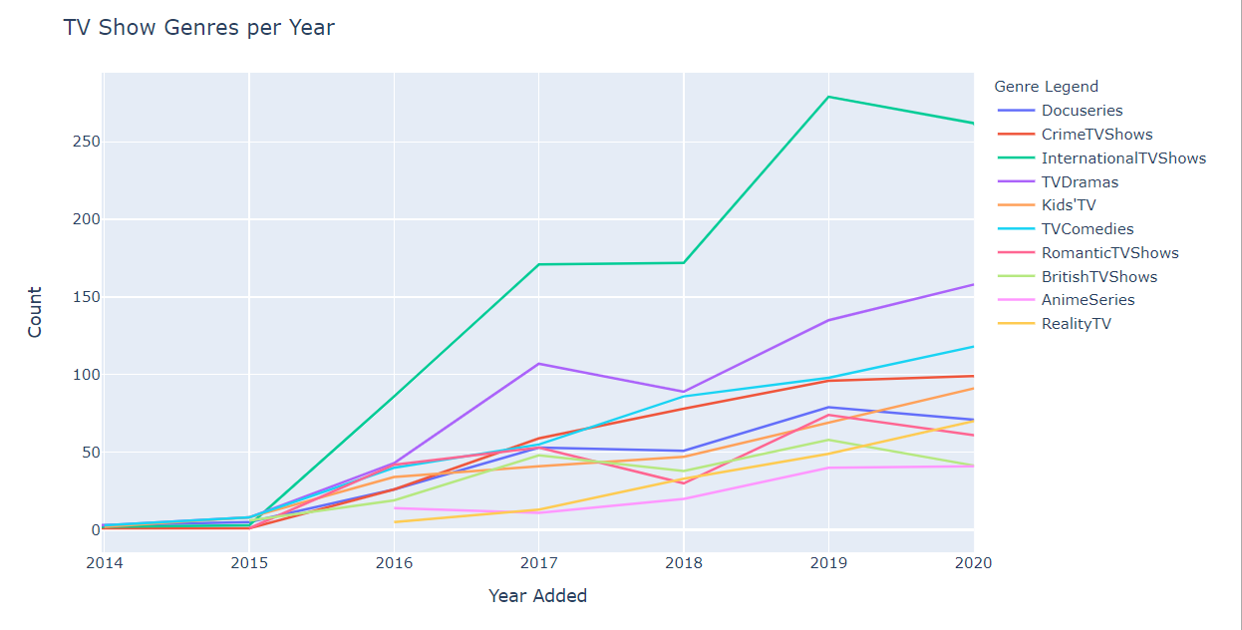
The plot shows that these trends with the TV genre are similar to the TV genres that get renewed the most.

Slide 10
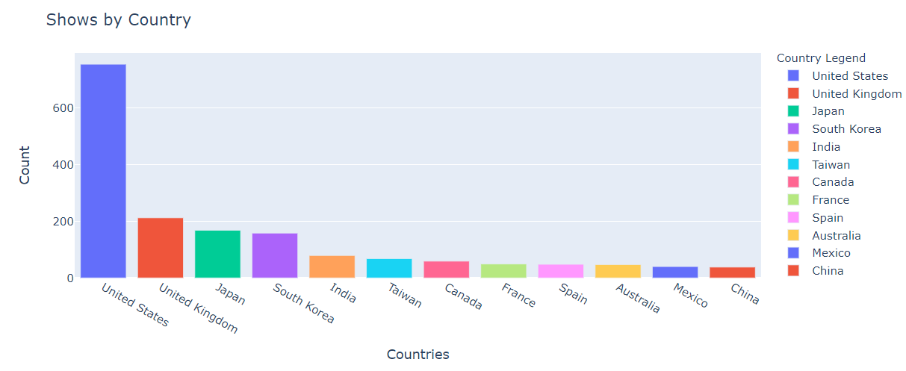
As we can see the most popular countries, outside of the US, with TV shows are from the UK, Japan, and South Korea.

Slide 11
Conclusion
For Netflix to continue increasing its subscriber base they should focus their efforts on TV shows with a long shelf life, such as International TV Shows, TV Comedies, and TV Dramas.
In terms of expanding its subscriber base abroad even further it should concentrate on producing shows in the UK, Japan, and Korea.

Slide 12
Possible Future Work
Take a deeper look into the longer TV genres to see which demographics are mainly viewing them to further focus efforts on them.
Look into the genres of the shows that are coming from the most popular countries in order to try and expand the international subscribers.

Slide 13
Citations:
https://csimarket.com/stocks/growthrates.php?code=NFLX
https://en.wikipedia.org/wiki/Netflix#Historical_financials_and_membership_growth

