Slide 1

Intro to Python Objects – Part 1

Slide 2
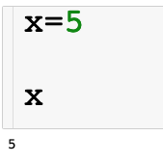
Creating Variables
Let’s create our first variables
Code cell
The code executes from top to bottom

Slide 3
Creating Variables
Let’s create our first variables

Slide 4
Creating Variables
Let’s create our first variables

Slide 5
Python Objects
Variables are simply names that are used to keep track of information.
Variables are created when they are first assigned a value.
Variables must be assigned before they can be used.
Variables will take the form of Python objects. We will use 3 different objects:
Numbers: integers, real number, etc …
Strings: ordered sequences of characters
Lists: ordered collection of objects
Python objects are dynamically typed, meaning you don’t have to declare the type of the variable upon creation.

Slide 6
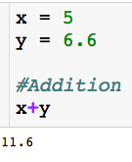
Arithmetic Operations
# = comment

Slide 7
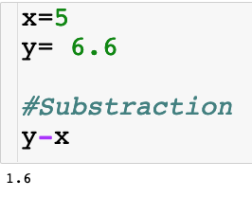
Arithmetic Operations

Slide 8
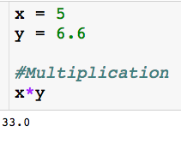
Arithmetic Operations

Slide 9
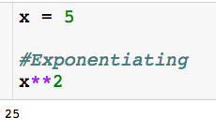
Arithmetic Operations

Slide 10
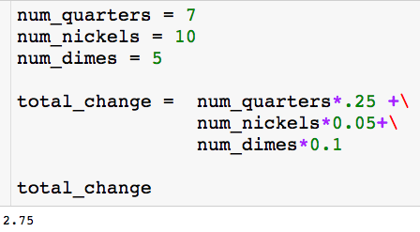
Using Variables
Use description variable name
Rule for creating variable names:
Be descriptive and separate words with underscore
No spaces
No punctuation other than underscore

Slide 11
Using Variables
Use description variable name
The backslash lets you continue your block of code on the next line.

Slide 12
Using Variables
Use description variable name
I can create variables that are a function of other variables
The backslash lets you continue your block of code on the next line.

Slide 13
Using Variables

Slide 14
Using Variables

Slide 15
Using Variables

Slide 16
Using Variables

Slide 17
Using Variables
This just prints the value stored in the variable so we can see it.

Slide 18

Using Variables
You will often find yourself updating variables:
Some other code executes…want to add 1 to count

Slide 19
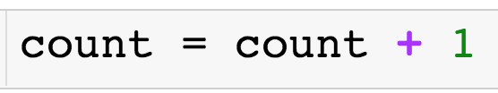
Using Variables
You will often find yourself updating variables:
Some other code executes…want to add 1 to count

Slide 20
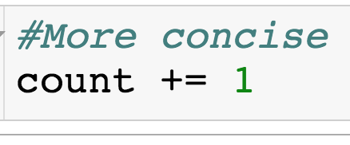
Using Variables
You will often find yourself updating variables:
Some other code executes…want to add 1 to count

Slide 21
Booleans
The Boolean type can be viewed as numeric in nature because its values (True and False) are just customized versions of the integers 1 and 0.
The True and False behave in the same way as 1 and 0, they just make the code more readable.
Booleans are the type returned when we check if a condition is true

Slide 22
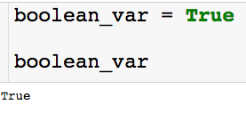

Booleans
Creating boolean variable:
Note that the boolean does behave exactly like a 1:

Slide 23



Conditional Tests
Sets the variables x equal to 5.
Asks if x is equal to 5. Returns boolean.
Asks if x is less than or equal to 4. Returns boolean.

Slide 24
Strings
Python strings are an ordered collection of characters (usually these characters will be letters and numbers) used to represent text.
String are created by placing single or double quotation marks around a sequence of characters.
Strings support the following operations
concatenation (combining strings)
slicing (extracting sections)
Indexing (fetching by offset)
the list goes on ….

Slide 25
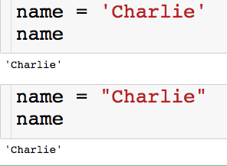
Strings
Let’s create our first strings
You can create a string with either single or double quotes.
There is a left to right ordering that we will explore on the next slide

Slide 26

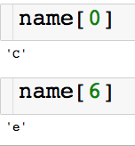
Indexing Strings
We can access the characters of the string through their index
Slicing single characters through index:
(pretend there aren’t spaces between the letters)

Slide 27

Slicing Strings
We can access the characters of the string through their index
Slicing contiguous characters:
(pretend there aren’t spaces between the letters)
start
finish (non-inclusive)

Slide 28
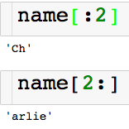
Slicing Strings
We can access the characters of the string through their index
Slicing contiguous characters:
(pretend there aren’t spaces between the letters)
If start index is left blank defaults to 0
If end index is left blank defaults to end of the string

Slide 29
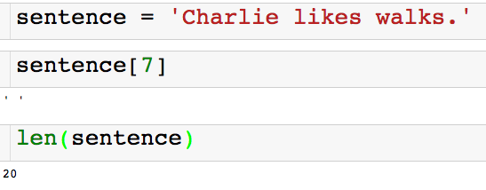
Slicing Strings
We can access the characters of the string through their index
Spaces and punctuation count in the indexing of a string!

Slide 30
Slicing Strings
We can access the characters of the string through their index
Returns the number of characters in the string

Slide 31
String Concatenation
I can combine strings using the + operator.
So the + operator between two numbers add them and the + operator between two strings concatenates them! This is called polymorphism.

Slide 32
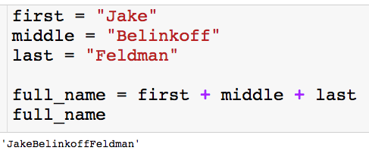
String Concatenation
I can combine strings using the + operator.
So the + operator between two numbers add them and the + operator between two strings concatenates them! This is called polymorphism.
If we want a space, we have to say so.

Slide 33
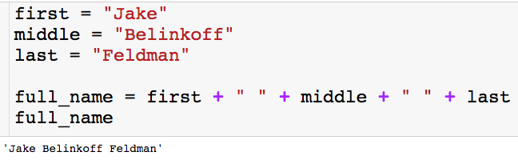
String Concatenation
I can combine strings using the + operator.
So the + operator between two numbers add them and the + operator between two strings concatenates them! This is called polymorphism.
With the space

Slide 34
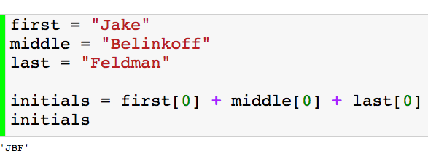
String Concatenation
I can combine strings using the + operator.
So the + operator between two numbers add them and the + operator between two strings concatenates them! This is called polymorphism.
Another example

Slide 35
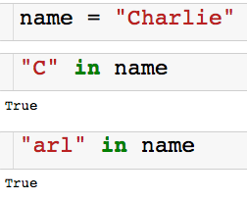

Using In
We can use the keyword in to check if a string is contained in another string.
There is also a not in:

Slide 36
Lists
Ordered collection of arbitrary objects.
There is a left to right ordering (just like string).
Can contain numbers, string, or even other lists.
Elements accessed by offset.
You can fetch elements by index (just like string).
You can also do slicing and concatenation.
Variable in length and arbitrarily nestable.
Lists can grow and shrink in-place.
You can have lists of lists of lists…

Slide 37
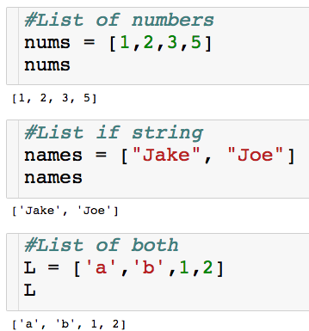
Lists
Lets create our first lists
Elements enclosed in square brackets.

Slide 38
Lists
Lets create our first lists
Elements enclosed in square brackets.
Elements separated by commas.

Slide 39

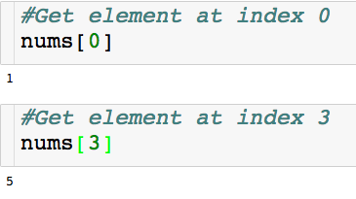
Indexing Lists
Indexing for lists is very similar to strings

Slide 40
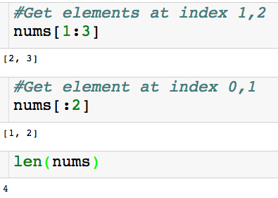
Slicing Lists
Slicing for lists I also very similar to strings
Returns lists

Slide 41
Slicing Lists
Slicing for lists I also very similar to strings
Returns lists
Returns # of elements in list

Slide 42

Nested Lists
Creating a nested list:
There are two elements in the list nested_L.
There is a list of numbers in index 0.
There is a list of string of index 1.

Slide 43
Indexing Nested Lists
Creating a nested list:
How do I pick out the 2 in the first list?

Slide 44

Indexing Nested Lists
Creating a nested list:
How do I pick out the 2 in the first list?
First pick out the list of numbers, then from that pick out the
Stack the indexing

Slide 45
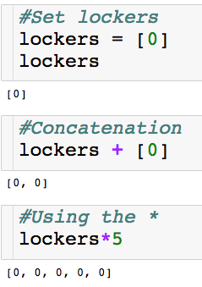
Polymorphism with Lists
The + and * operator work on lists as well!

Slide 46
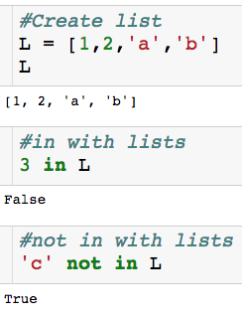
Using in with Lists
Keywords in and not in work with lists as well.

Slide 47
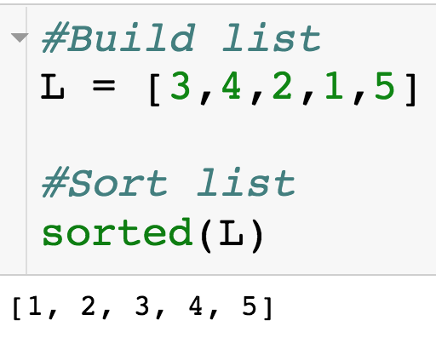
Sorting Lists
We can sort lists with the built-in sorted() function.
Returns sorted version of list

Slide 48
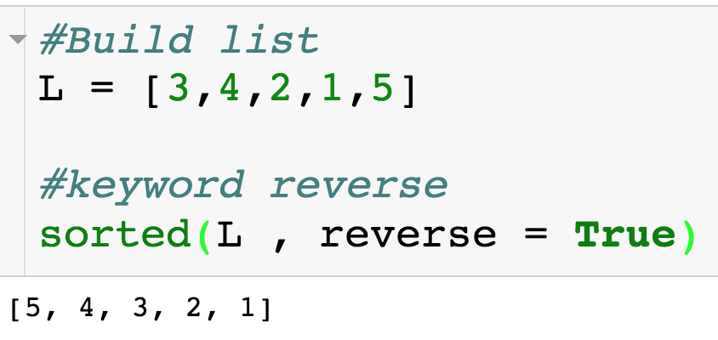
Sorting Lists
We can sort lists with the built-in sorted() function.
Sort list descending
Default is reverse = False

Slide 49
Sorting Lists
We can sort lists with the built-in sorted() function.
Sort list descending
Default is reverse = False
Next session we will see how to sort L “inplace”.

Slide 50
Intro to Python Objects – Part 2

Slide 51
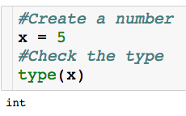
Checking the Type
For any variable, we can check what kind of object it is:
Built in type function

Slide 52
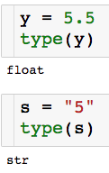
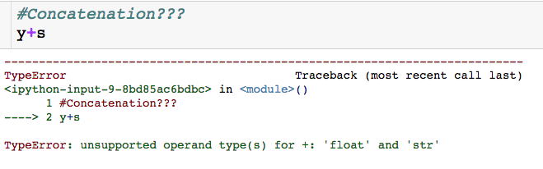
Why the Type Matters
We can’t concatenate a string and a number…and we shouldn’t be able

Slide 53
Why the Type Matters
type() can be helpful for debugging
Another reason to have descriptive variable names

Slide 54
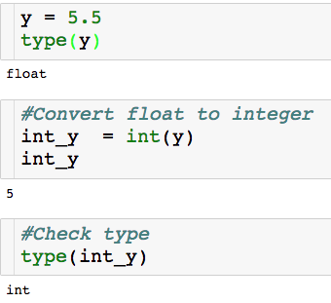
Converting Types
Built in int() function
int() is one way to perform a floor operation

Slide 55
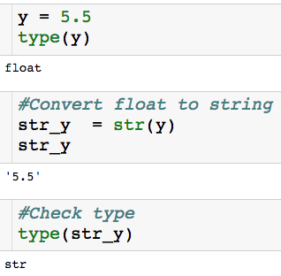
Converting Types
Built in str() function

Slide 56
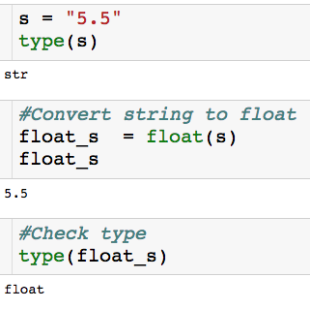
Converting Types
Built in float() function

Slide 57
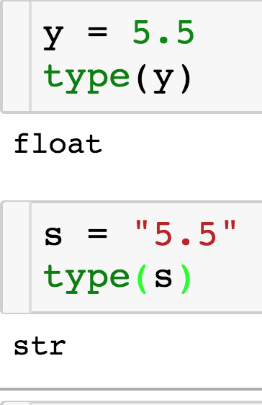
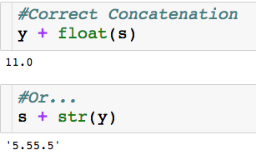
Why the Type Matters

Slide 58
Digging Deeper into Python Objects
Every Python Object is either mutable or immutable
Mutable: Can be changed once created - a list L can have its first element replaced.
Immutable: Can’t be changed once creating – a string S cannot have its first letter changed.

Slide 59
Digging Deeper into Python Objects
Every Python Object is either mutable or immutable
Mutable: Can be changed once created - a list L can have its first element replaced.
Immutable: Can’t be changed once creating – a string S cannot have its first letter changed.
What we know so far:
Numbers = Immutable
String = Immutable
Lists = Mutable

Slide 60
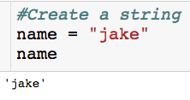
Example of Immutability
Let’s say I want to change the first letter of name to a “J”

Slide 61
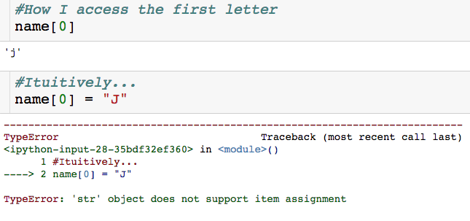
Example of Immutability
Let’s say I want to change the first letter of name to a “J”
Can’t change name once it is created!

Slide 62
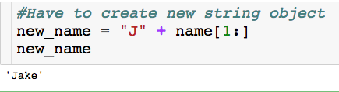
Example of Immutability
Let’s say I want to change the first letter of name to a “J”

Slide 63
Example of Immutability
Let’s say I want to change the first letter of name to a “J”
We will see an easier way to do this…

Slide 64
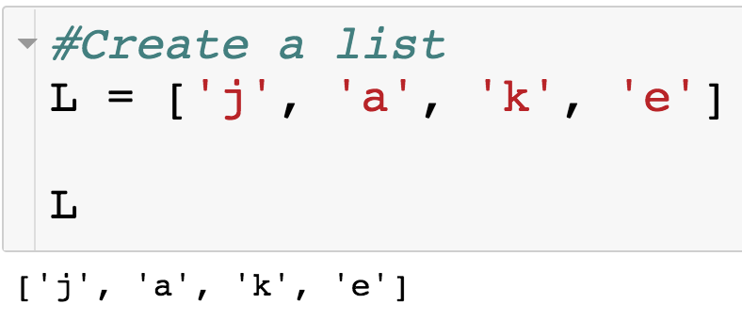
Example of Mutability
Let’s say I want to change the string in index 0 to a “J”.

Slide 65
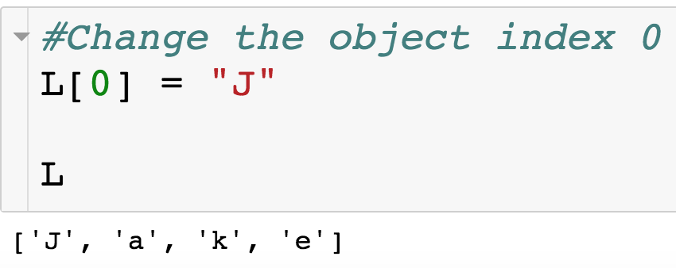
Example of Mutability
Let’s say I want to change the string in index 0 to a “J”.
Since lists are mutable, we change an any part of list after it has been created.

