Slide 1


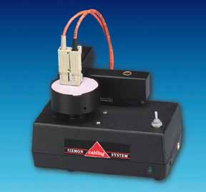
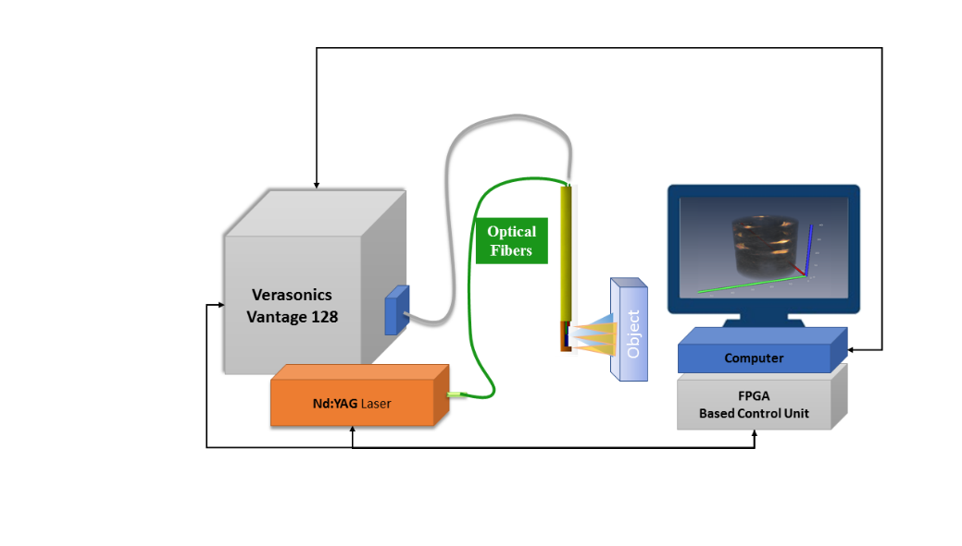
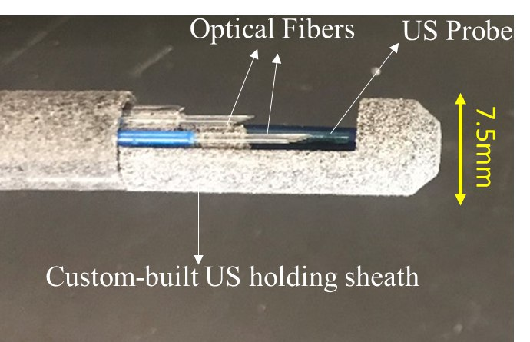
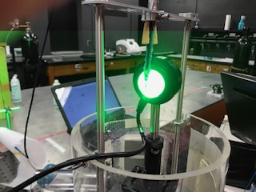
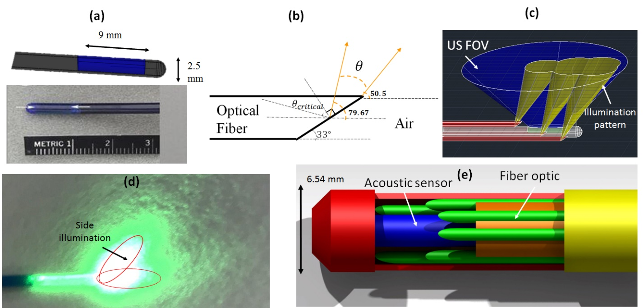
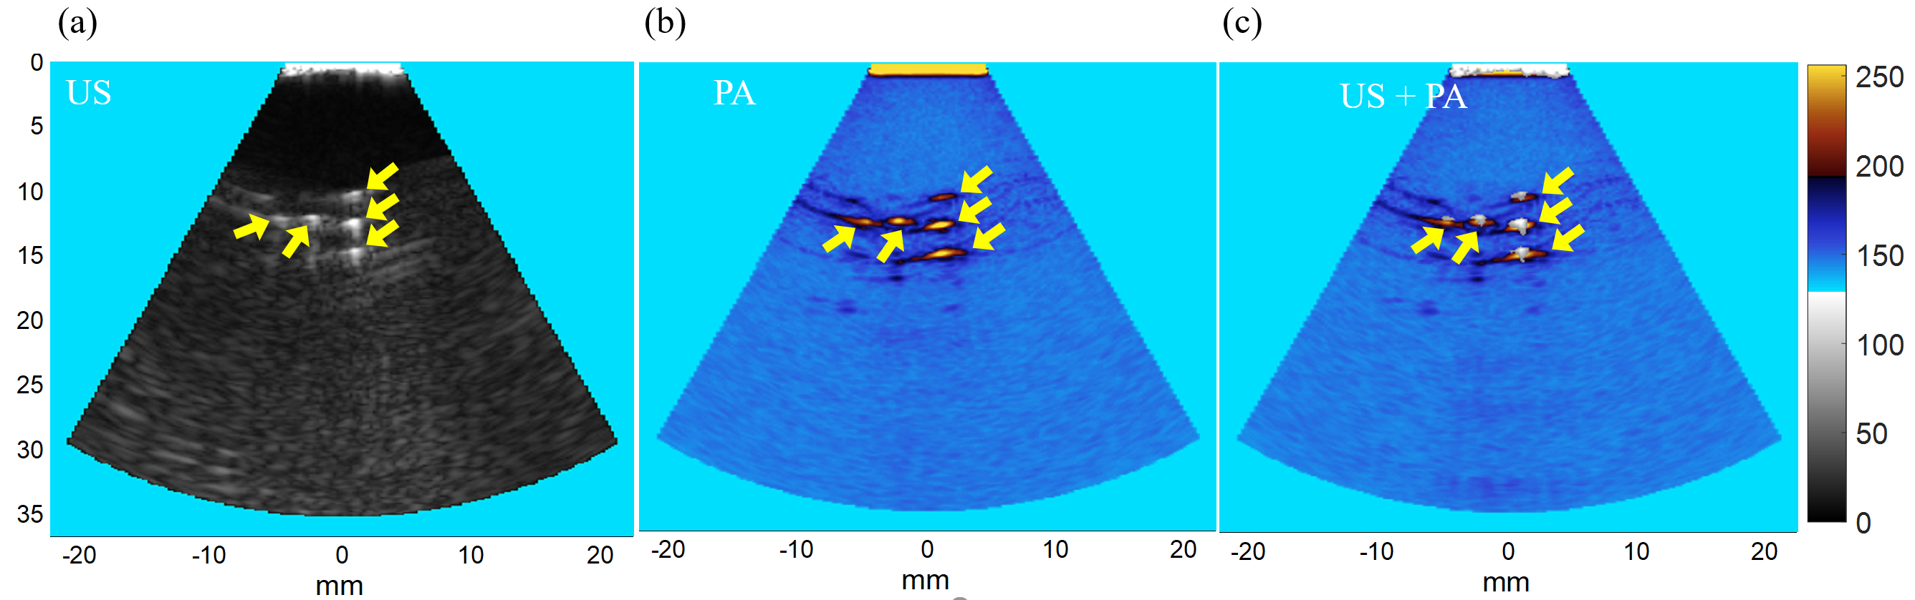

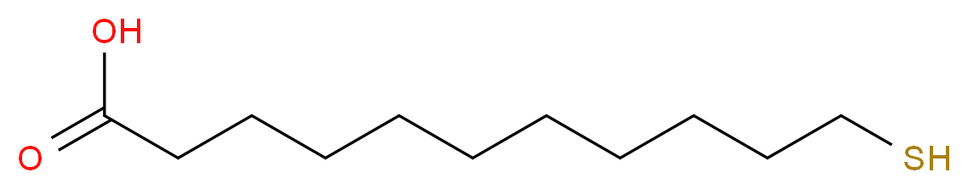
Development of a Combined Ultrasound and Photoacoustic Endoscope for Gynecological Cancer Imaging
Timothy Burton, Maryam Basij, Dr. Mohammad Mehrmohammadi
College of Engineering, Wayne State University, Detroit, MI 48202
Introduction
Discussion
Gynecological cancers such as uterine cancer, ovarian cancer, and cervical malignancies impact around 18 percent of women during their lifetime around the world. Due to the symptoms of this type of cancer being similar to normal symptoms of aging, menopause, or previous pregnancies, gynecological cancer go unnoticed until it hits the later stages. This causes normal treatment to be extremely invasive with unfortunate side effects including pain, menopausal symptoms, sexual difficulties, infertility, and decreased physical function. Creating an effective method of imaging gynecological cancer prior to problematic symptoms and invasive treatment will improve such side effects for patients and improve their quality of life. Also, with such a high mortality rate for these cancers it’s imperative that a sufficient, non-invasive testing method be procured as catching these cancers early enough vastly lowers the mortality rate.
To accurately proceed with this side-firing approach the optical fibers needed to be polished at specific angles to meet a criterion of internal reflection.
Using the equations from research about fiber polishing angles implies that with the fibers be polished to an angle of 33 degrees. This would allow the fibers to provide a light beam range of 50.5-79.67 degrees to the horizontal axis. 33 degrees was chosen as the polishing angle based on simulation studies to optimize the largest illumination possible.
Fig. 2: Picture of Siemons FPOL Polishing Machine
Fig. 7: Absorption spectrum of 0.065 mg/ml dye vs. PA amplitude
Further spectroscopic PA testing proved the accuracy of this device. The testing took a vial filled with 0.065 mg/ml dye and tested it with the laser beam at various wavelengths. The maximum absorption was found between 750-820 nm. The PA amplitude showed peak absorption at 800 nm which matched the optical properties of the dye.
All of this testing together shows the efficacy of this device. Further testing is warranted to show how the device will work with a moving target. Other further experiments will take place. This project was held back by the polishing of the fibers. Polishing by hand was inefficient and a long period of time was lost on this project due to inefficient polishing.
0%
10%
Tools currently used in imaging all have their inefficiencies:
Magnetic Resonance Imaging (MRI) -> High Cost
Computed Tomography (CT) -> Inefficient (limited specificity and sensitivity)
Optical Imaging -> Low depth penetration
20%
30%
Fig. 3: Diagram of imaging system
Due to the faults of other imaging methods on this we decided to use a combination of ultrasound and photoacoustic imaging in order to receive functional and molecular information from the region in question.
Results
Conclusion
The investigation into the development of this endocervical endoscope in this study was a noninvasive, low cost, efficient, nonionizing imaging device with the purpose to create precise images of cervical cancer in the body. The 7.5 mm diameter probe uses a commercially available ultrasound probe in conjunction with six polished optical fibers for light delivery. The endoscope was shown to create images of abnormal tissue using ultrasound and photoacoustic imaging modalities. This allows for the belief that in the future with more testing this application can be used as a means of easily imaging different forms of cervical cancer by physicians.
Materials and Methods
Fig. 4: Full endoscope with 6 optical fibers, ultrasound probe, and holding sheath
Fig. 5: Endoscope energy experiment setup
The endoscope put together with the polished fibers surrounding the ultrasound probe and the sheath to hold all of the parts together with a cap to prevent the fibers from breaking.
Primary energy experimentation was completed to make sure the required energy threshold was met by the optical fibers.
Fig. 1: (a) ICE US probe (core of the endoscope). (b) Schematic of a side-firing fiber indicating the illumination pattern. (c) Simulated US field of view (FOV) and overlapping illumination pattern. (d) Photograph of a side firing fiber polished at 33 degrees. (e) Schematic of the final proposed endoscope including biocompatible sheath.
References & Acknowledgements
To complete this development we wanted to utilize an intra-cardiac echocardiography ultrasound catheter that operates at a frequency range of 5-8 MHz as a probe which allowed for high-resolution images in 90-degrees sector. Needing a light delivery system for accurate imaging the endoscope included six optical fibers with a silica core/cladding of 600 µm in diameter. In order to provide light to the space in front of the endoscope a side-firing approach was implemented.
[1] K. Hodgkinson, P. Butow, A. Fuchs et al., “Long-term survival from gynecologic cancer: psychosocial outcomes, supportive care needs and positive outcomes,” Gynecol Oncol, 104(2), 381-9 (2007).
[2] R. Siegel, D. Naishadham, and A. Jemal, “Cancer statistics, 2013,” CA Cancer J Clin, 63(1), 11-30 (2013).
[3] B. D. Gonzalez, S. L. Manne, J. Stapleton et al., “Quality of life trajectories after diagnosis of gynecologic cancer: a theoretically based approach,” Support Care Cancer, 25(2), 589-598 (2017).
[4] I. Teo, Y. B. Cheung, T. Y. K. Lim et al., “The relationship between symptom prevalence, body image, and quality of life in Asian gynecologic cancer patients,” Psycho-Oncology, n/a-n/a.
[5] J. H. Lee, G. Traverso, C. M. Schoellhammer et al., “Towards Wireless Capsule Endoscopic Ultrasound (WCEU),” 2014 Ieee International Ultrasonics Symposium (Ius), 734-737 (2014).
[6] S. S. Tang, J. Chen, P. Samant et al., “Transurethral Photoacoustic Endoscopy for Prostate Cancer: A Simulation Study,” Ieee Transactions on Medical Imaging, 35(7), 1780-1787 (2016).
[7] C. D. Lehman, C. Gatsonis, C. K. Kuhl et al., “MRI evaluation of the contralateral breast in women with recently diagnosed breast cancer,” N Engl J Med, 356(13), 1295-303 (2007).
[8] S. Mallidi, G. P. Luke, and S. Emelianov, “Photoacoustic imaging in cancer detection, diagnosis, and treatment guidance,” Trends in Biotechnology, 29(5), 213-221 (2011).
Fig. 6: Ultrasound and photoacoustic phantom experiment a) US b) PA c) US + PA
Collagen phantom testing with scattered cellulose particles was completed and imaged. The US created an image of the molecular background of the phantom and the PA created an image of the functional parts within the phantom.

