Slide 1
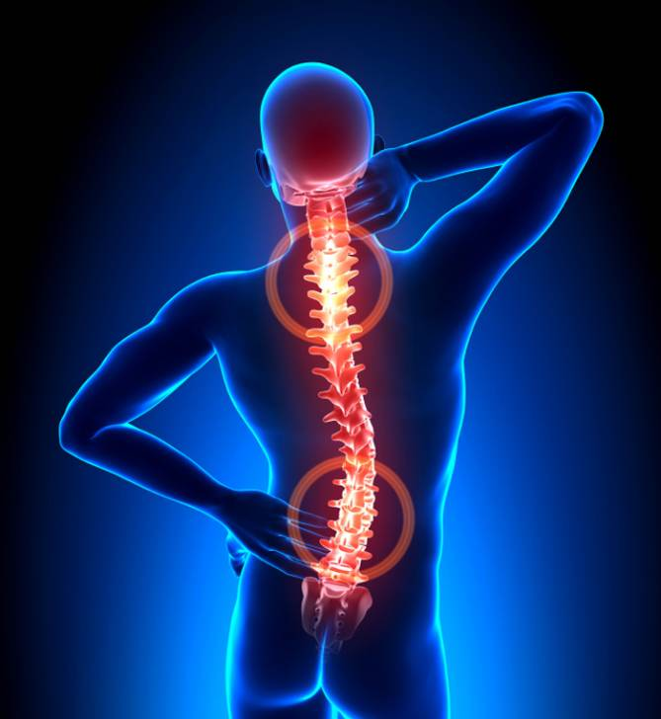
THE BACKACHE
This is a painful symptom which affects about 8 out of 10 people, men and women equally.
Further studies have implicated sitting for long periods without interruption has been shown to cause backache.
It can even creates muscle dysfunction.
But the main problem is that backache is esponentially growing up in our society.

Slide 2
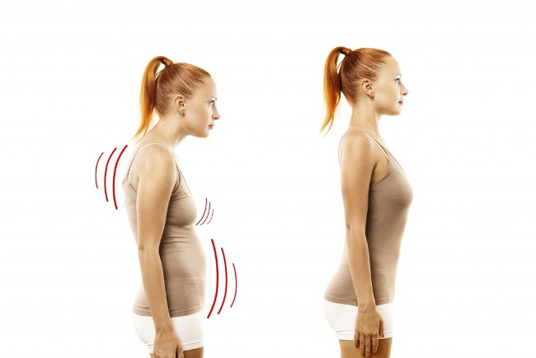
THE SOLUTION
That's why we decided to help you creating a revolutionary device which can save your spine and constantly check your posture.
Discrete
Simple
This smart device will alerts you whenever you get a wrong posture with a small and soft vibration.

