Slide 1
Neural Networks and SINDy
Based on
Data-driven discovery of coordinates and governing equations
by Champion et al.
Special Topics
Group
Intermediate Project Report
Leo and Timo
Notes:
Sparse identifi cation of nonlinear dynamics (SINDy)

Slide 2
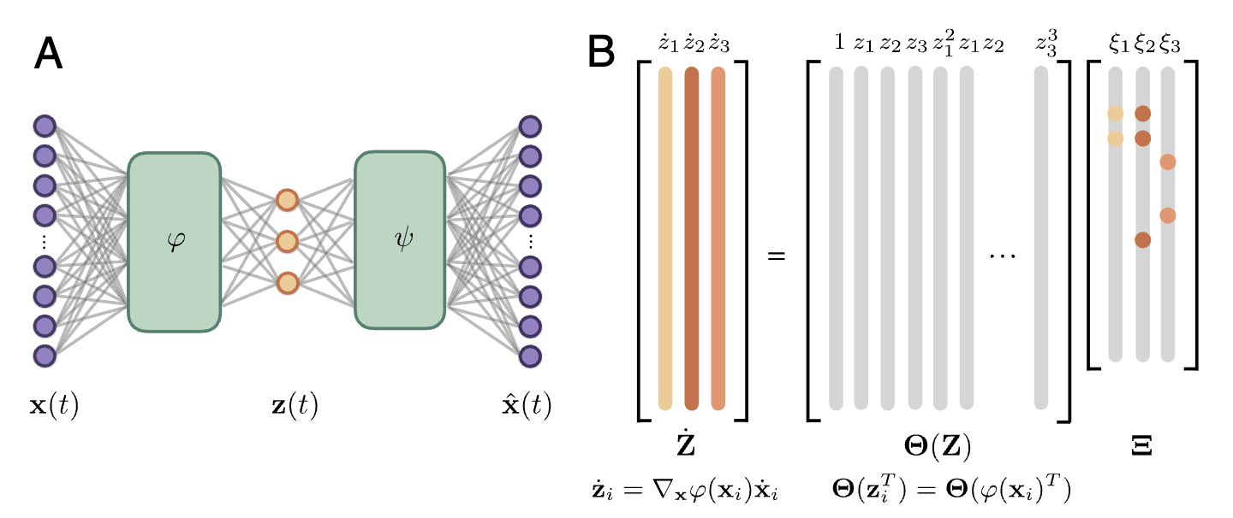
How it works
Notes:
An autoencoder architecture is used to discover intrinsic coordinates z from high-dimensional input data x.
The network consists of 2 components:
an encoder phi(x), which maps the input data to the intrinsic coordinates z,
a decoder psi(z), which reconstructs x from the intrinsic coordinates.
(B) A SINDy model captures the dynamics of the intrinsic coordinates. The active terms in the dynamics are identified by the nonzero elements in Omega , which are learned as part of the NN training. The time derivatives of z are calculated using the derivatives of x and the gradient of the encoder . Inset shows the pointwise loss function used to train the network. The loss function encourages the network to minimize both the autoencoder reconstruction error and the SINDy loss in z and x. L1 regularization on OMEGA is also included to encourage parsimonious dynamics.

Slide 3
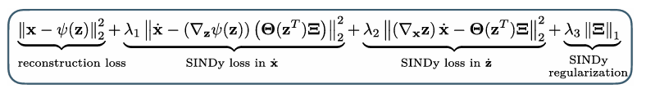
How it works
Notes:
An autoencoder architecture is used to discover intrinsic coordinates z from high-dimensional input data x.
The network consists of 2 components:
an encoder phi(x), which maps the input data to the intrinsic coordinates z,
a decoder psi(z), which reconstructs x from the intrinsic coordinates.
(B) A SINDy model captures the dynamics of the intrinsic coordinates. The active terms in the dynamics are identified by the nonzero elements in , which are learned as part of the NN training. The time derivatives of z are calculated using the derivatives of x and the gradient of the encoder . Inset shows the pointwise loss function used to train the network. The loss function encourages the network to minimize both the autoencoder reconstruction error and the SINDy loss in z and x. L1 regularization on OMEGA is also included to encourage parsimonious dynamics.

Slide 4

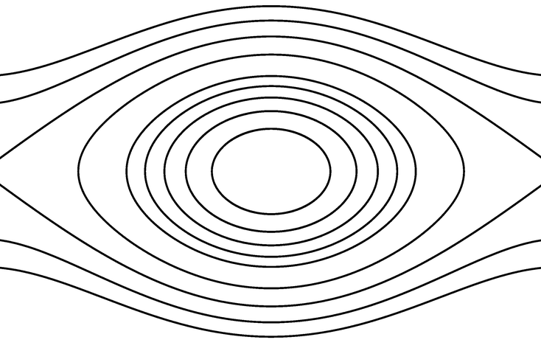
Our System
Nonlinear Pendulum
Notes:
Z is the angle

Slide 5
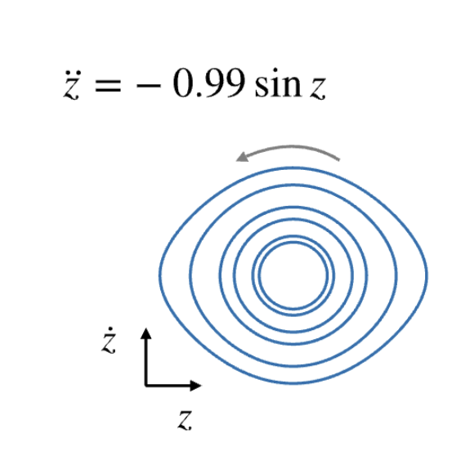
Our System
Result in the paper

Slide 6
Our Plan
Reproduce findings
The impact of noise
Test for a forced system

Slide 7



Reproduction
all parameters eliminated
$$−0.46x$$

Slide 8




Reproduction
$$0.43 dx2 −1.12 xdx2$$
$$0.37 + -0.22 x2 + 0.12 dx2$$

Slide 9


Noise
10 % Gaussian
$$0.46dx^{2}−1.00xdx^{2}$$
$$0.12−0.72sin(x)$$

Slide 10


Noise
10 % Gaussian
$$0.15+0.71xdx^{2}−0.77sin(x)$$

Slide 11


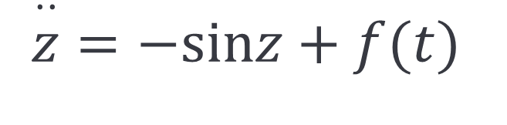
Can we learn the manifold …
… and predict a forced system?
?
$$\overset{··}{z}=−sinz$$
$$\overset{··}{z}=−sinz+f(t)$$

