Slide 1
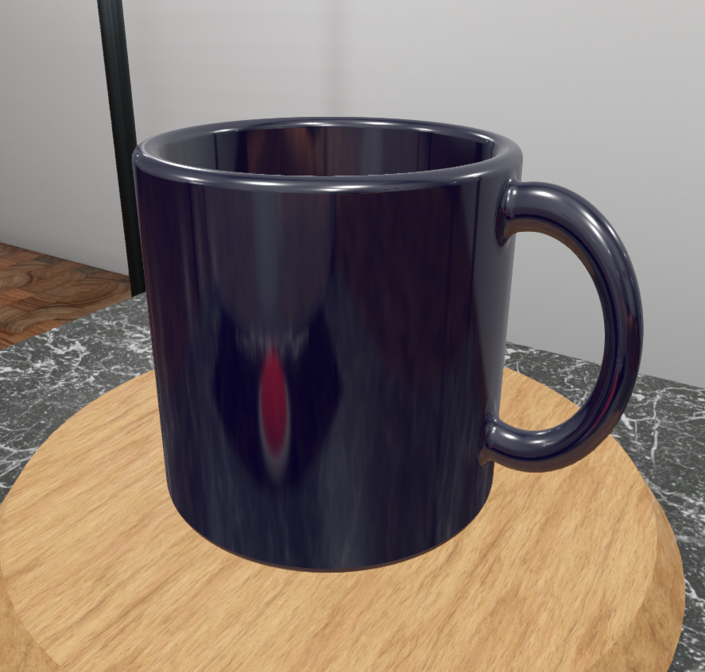
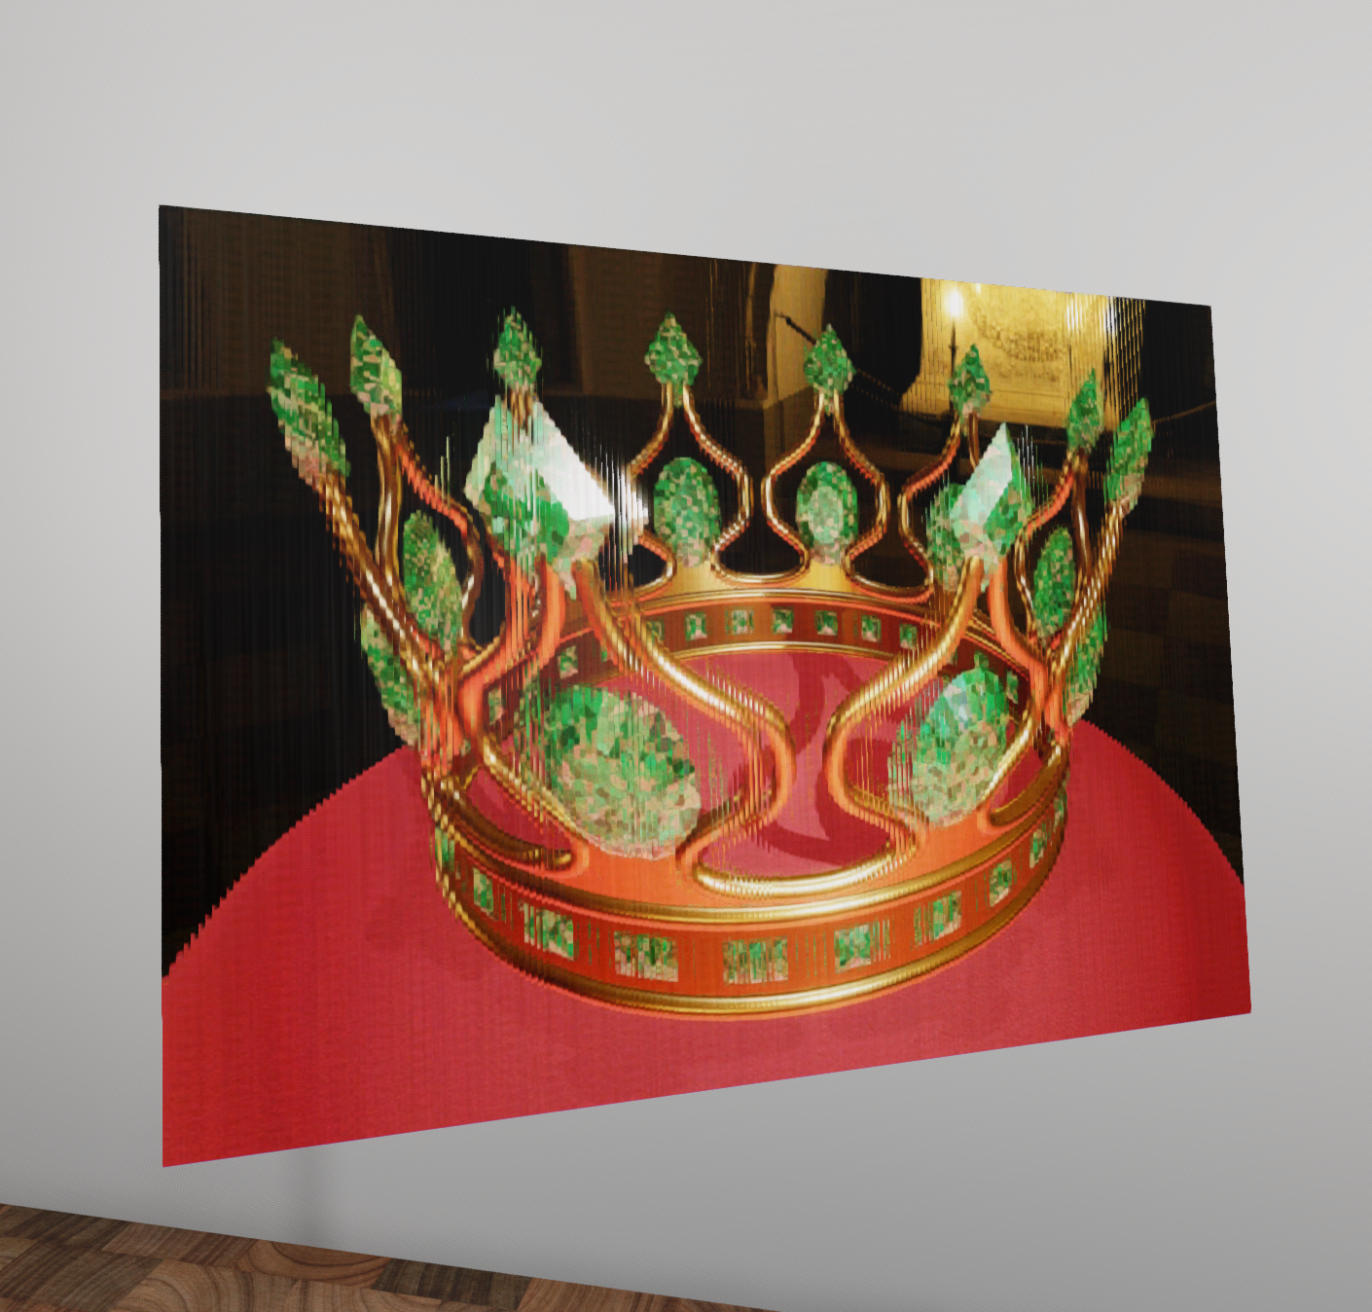
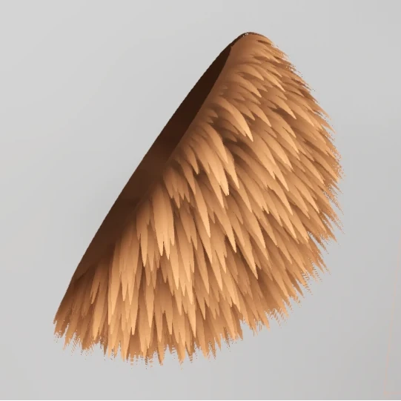
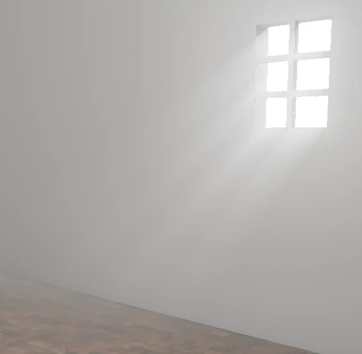
Project 4:
Interactive Museum
Realtime Graphics
Timo Eberl (te038)

Slide 2
Exhibit 1: SDF (Image-based Rendering)
Ray marching
Interaction with the rest of the scene
  Reflections
  Occlusion
Original goal: glass with refraction
  Godot limitation: No access to reflection probe texture

Slide 3
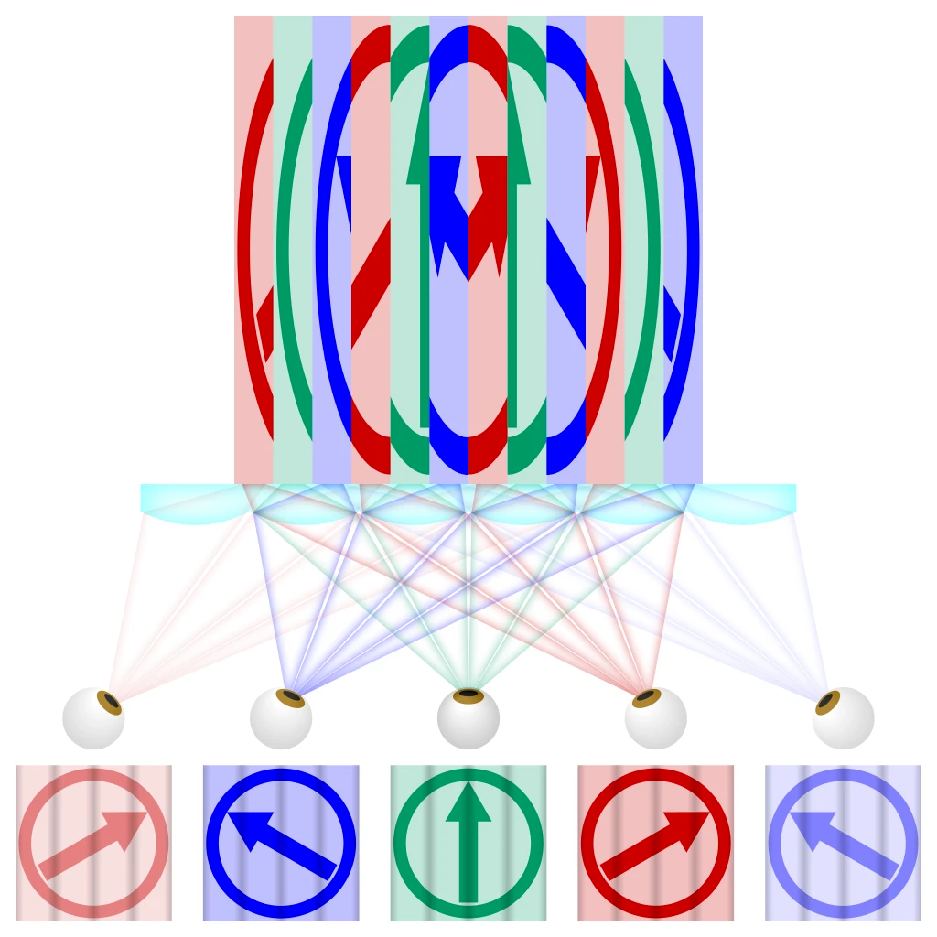
Exhibit 2: Lenticular Card (Materials)
„Wiggle picture“ / „Wackelkarte“
Creation
  Collect source images
  Create interlaced image
  Add lenticular sheet
Source: https://en.wikipedia.org/wiki/Lenticular_printing#/media/File:Lenticular_printing_principle.svg

Slide 4
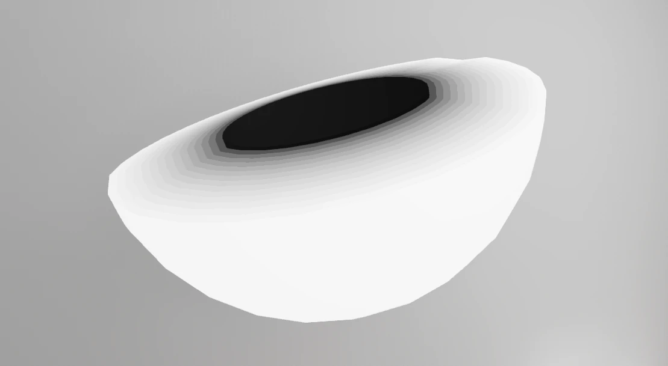
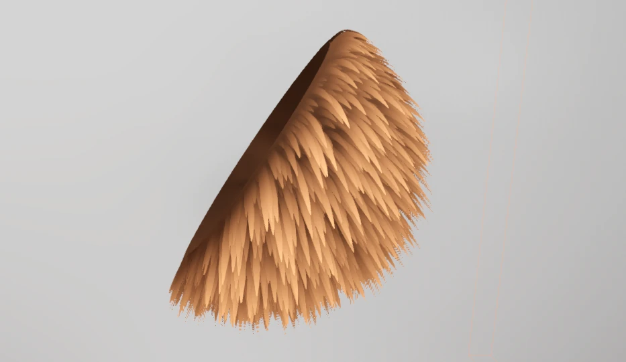
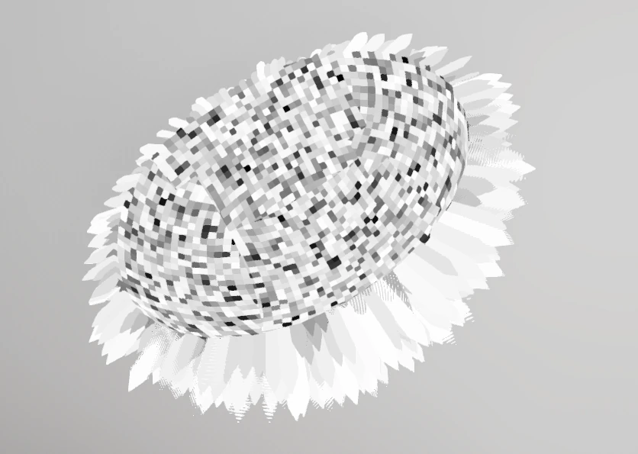
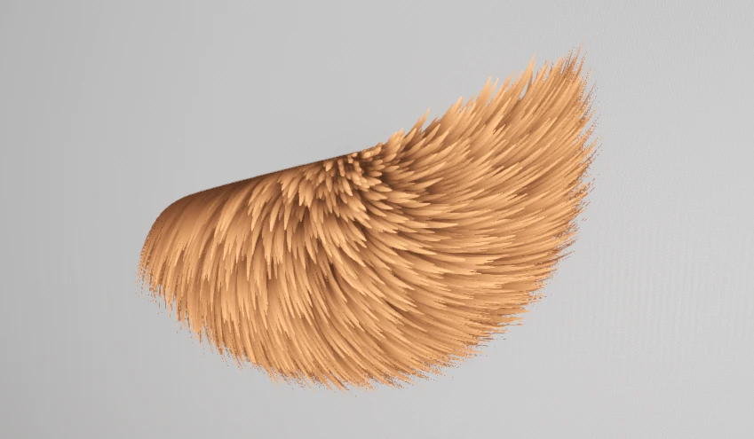
Exhibit 3: Fur with Physics (Animated Geometry)
Uses established technique: shell texturing

Slide 5

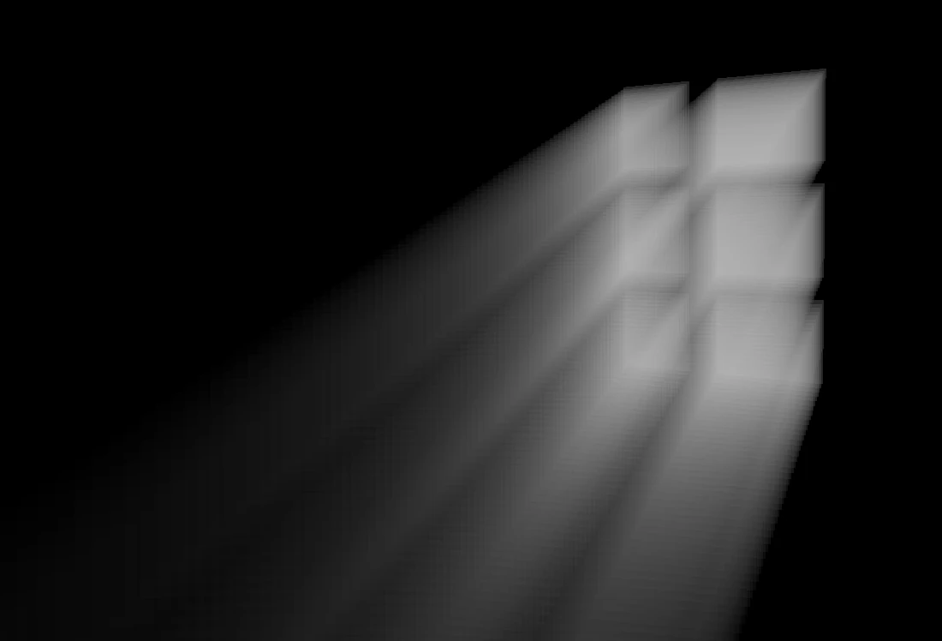
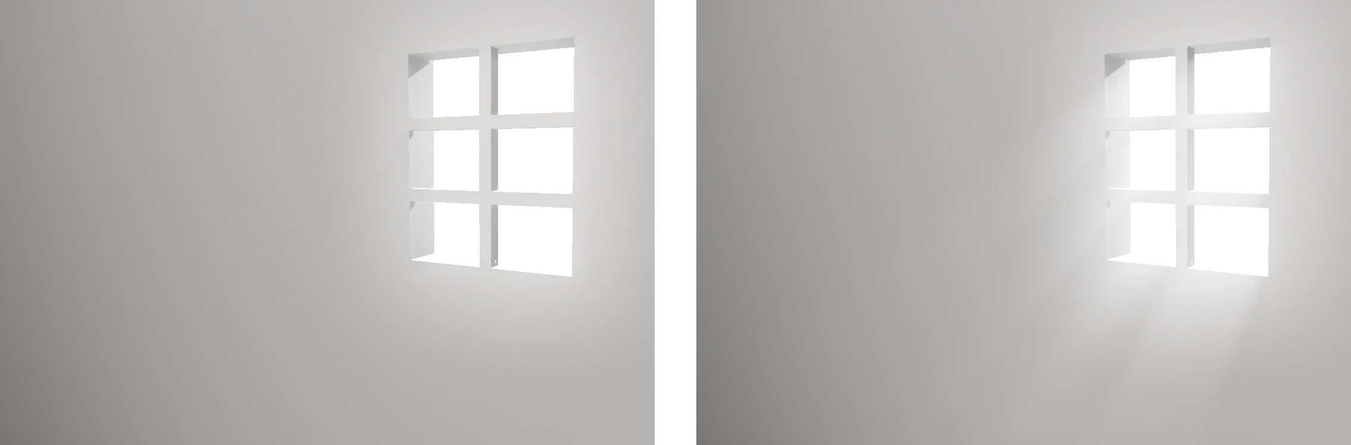
Exhibit 4: Crepuscular Rays (Voluemtric Rendering)

