Slide 1

Starter Task
Complete the SDD implementation starter task
Attempt all questions on both sides

Slide 2
Learning intentions and success criteria
I am learning…
I can…
About 1-D Arrays
How to implement 1-D arrays in Visual Basic
Describe what an array is and what they are used for
Write programs using 1-D arrays

Slide 3

Recap: Predefined Functions
A block of code already written and built into a programming language or software.
There are three you need to know in National 5:
Round
Length
Random

Slide 4
The Round Function
Round has two “Parameters” - pieces of data you put between the brackets of a function:
The first piece of information is the number you want to round
The second piece of information is the number of decimal places you want to round the number to
The rounded number can be stored inside a variable
result = Math.Round( 3.14159 , 2 )
result = 3.14

Slide 5
The Length Function
The Len() function calculates how many characters there are in a string.
Example:
  Dim my_word As String
  Dim word_length As Integer
  my_word = “MrWang4Eva”
  word_length = len(my_word)
word_length will have a value of 10

Slide 6
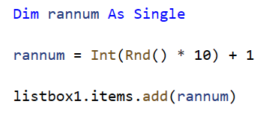
The Random Function
The Rnd() function generates a random number between 0-1:
The above program generates a number between 1 and 10
We also use the Int() function to convert the a real number to an integer
The formula to use is:
Variable = Int(RND() * Possibilities) + Lowest

Slide 7
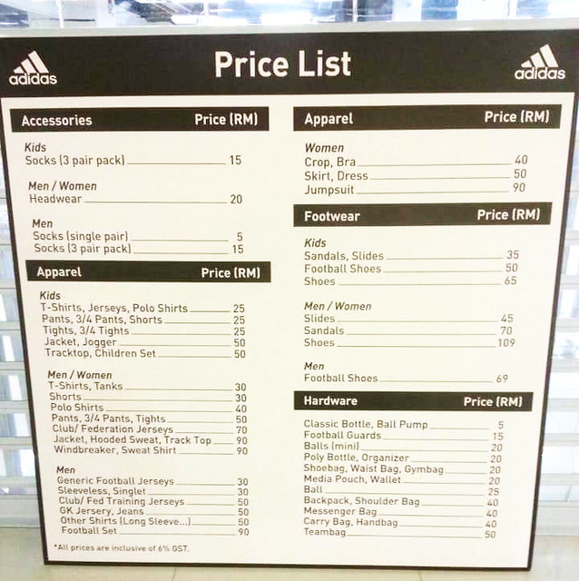
Creating Lists in Programming
Sometimes, you might need multiple pieces of related data for a program, for example:
A list of names in a class
A list of scores in a football tournament
A list of prices in a shop
So far, you might do something like this:
  name1 = “Alice”
  name2 = “Bob”
  name3 = “Charlie
  name4 = “Mr Wang”
But there is a better way to store this information!

Slide 8
Introducing Arrays
Instead of:
  name1 = “Alice”
  name2 = “Bob”
  name3 = “Charlie
  name4 = “Mr Wang”
We can do this:
names = [ “Alice” , “Bob” , “Charlie” , “Mr Wang” ]
In this example, names is a 1-D Array.
An array is a data-type, just like a String or an Integer

Slide 9
Using Arrays
Just like String variables hold text, or Integer variables hold whole numbers, Arrays hold a list of values:
The values must be the same type
For example, a list of names (string) or a list of ages (integer)
names = [ “Alice” , “Bob” , “Charlie” , “Mr Wang” ]
You can access the values in an array by using its position in the array:
DISPLAY names[0] → “Alice”
DISPLAY names[1] → “Bob”
DISPLAY names[2] → “Charlie”
DISPLAY names[3] → “Mr Wang”

Slide 10
Declaring Arrays
When you make an array, you must declare its size and type:
i.e. How many values the list can hold and the data type of those values
For example, a list of 5 strings or a list of 10 real numbers
In pseudocode:
DECLARE names AS ARRAY OF STRING INITIALLY [“ “]*4
This will make an array called names which can store four string values:
Each value is given an initial value of “” (an empty string)
names = [ “ ” , “ ” , “ ” , “ ” ]

Slide 11
Populating Arrays
After making the empty array, you can set its values one-by-one:
names = [ “ ” , “ ” , “ ” , “ ” ]
names[0] = “Tony”
names = [ “Tony” , “ ” , “ ” , “ ” ]
names[2] = “Elsie”
names = [ “Tony” , “ ” , “Elsie” , “ ” ]
names[1] = “Miriam”
names[3] = “Darth Vader”
names = [ “Tony” , “Miriam” , “Elsie” , “Darth Vader” ]

Slide 12
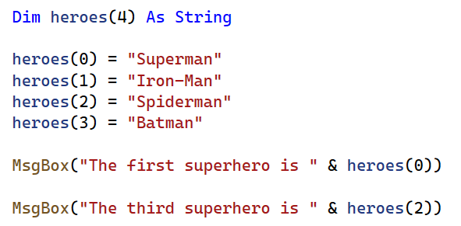
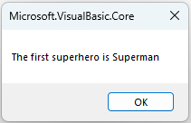
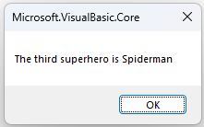
In Visual Basic
Below is an example of a String Array program in Visual Basic:
Name and length of array
Data-type of array
Setting the values one-by-one
Accessing the values

Slide 13
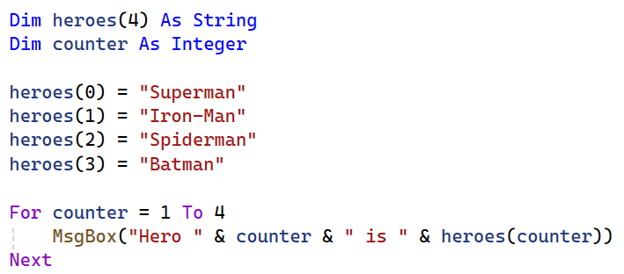
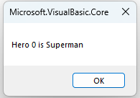
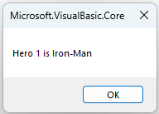
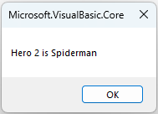
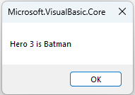
Traversing a 1-D Array
We can use a fixed loop to display each value in the array one-by-one:
Use a loop to display each value in the array

Slide 14
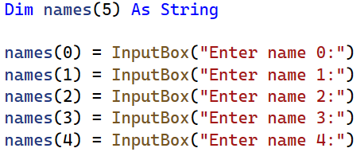
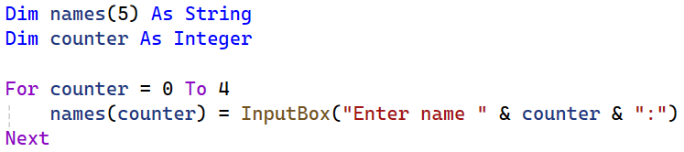
Populating an Array using a Loop
We could ask the user to fill in the array, for example:
This has a lot of repetition – instead, we can use a fixed loop to traverse the array:

Slide 15
Learning intentions and success criteria
I am learning…
I can…
About 1-D Arrays
How to implement 1-D arrays in Visual Basic
Describe what an array is and what they are used for
Write programs using 1-D arrays

