Slide 1
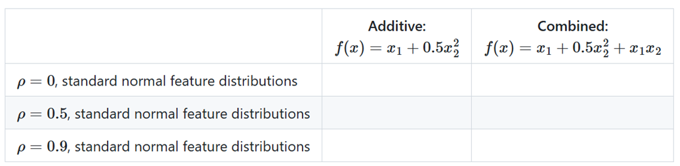


Recap: simulation set-up
1000 training samples
SNRs: 10, 5
20 repetitions on samples drawn with different random seeds
additionally: 2 uncorrelated random noise features with same marginals
Data Generating Mechanism
ML algorithms
GAM (correctly specified + full)
XGBoost (interactions correctly specified + full)
SVM with RBF-kernel
each tuned well for 200 iterations with TPE w.r.t. their 5-CV MSE
Feature effect methods
PDP (1D)
ALE (1D)
Performance Measures
Model Performance: MSE, MAE and R2-Score on holdout test set (10000 samples).
Feature Effect Error: Average pointwise L2-loss between centered estimated model PD (ALE) and estimated groundtruth PD (ALE) at 100 grid points on training data

Slide 2
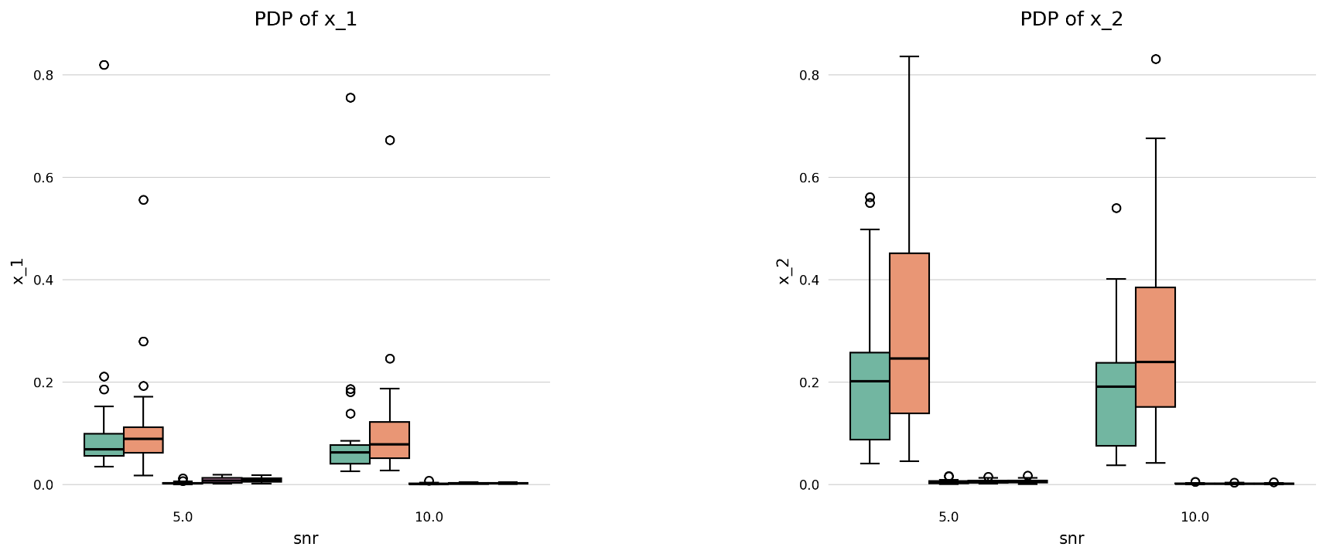
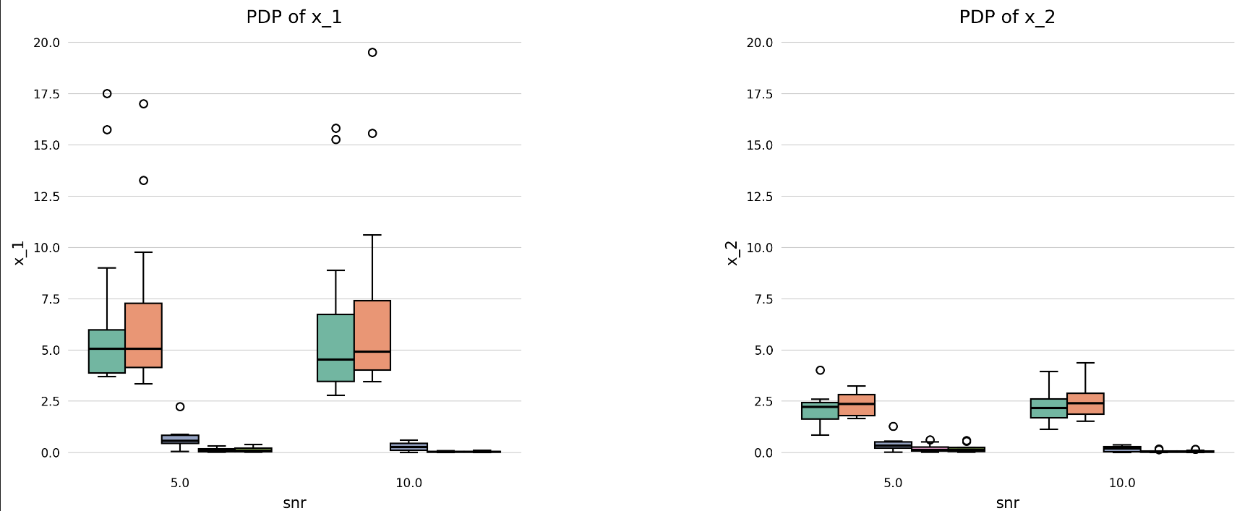
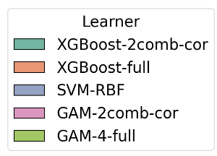
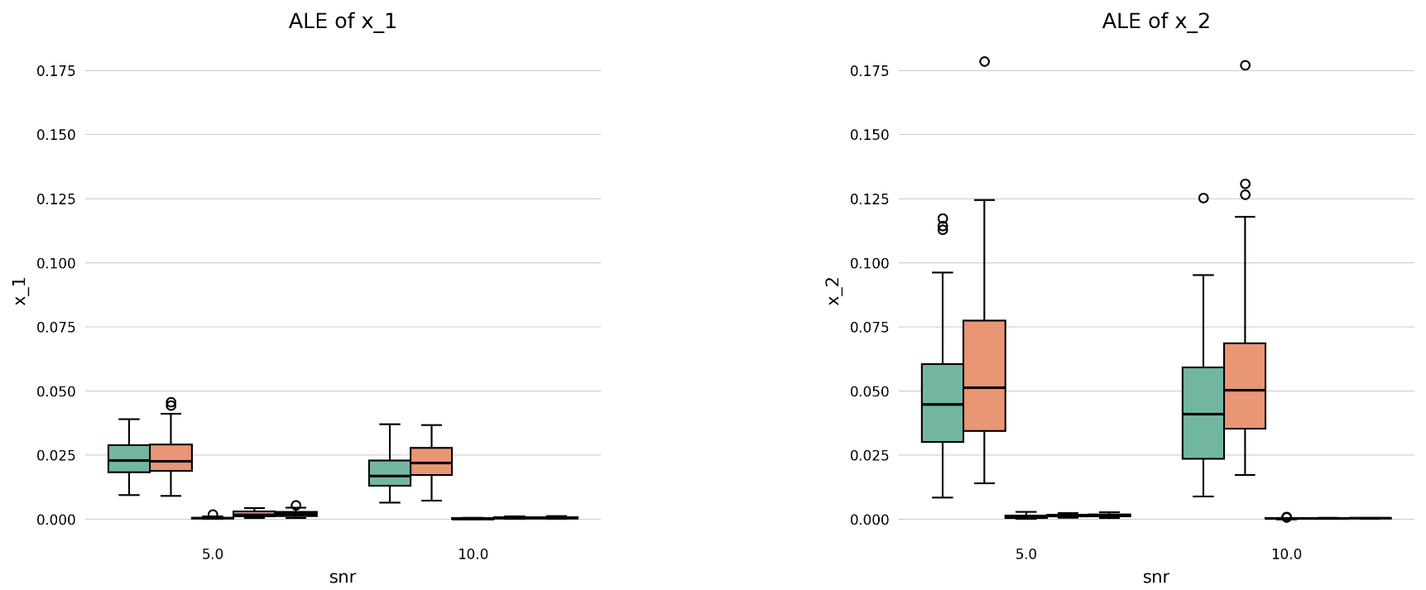
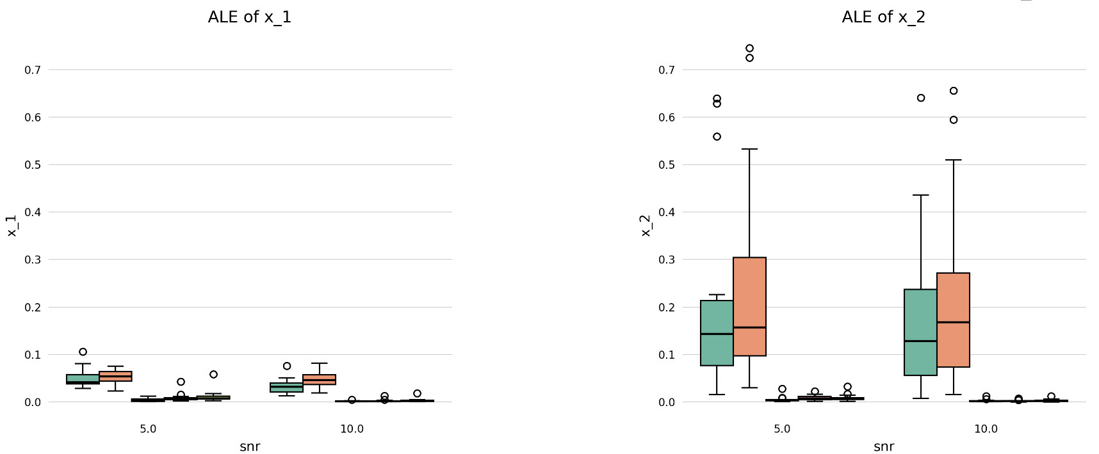

Interesting finding: surprisingly high feature effect error for certain models for PDP of x₁ in the following scenario
Groundtruth: $x_{1}+\frac{1}{2}x_{2}^{2}+x_{1}x_{2}$
corr = 0
corr = 0.9
Feature effect error
higher
lower
Error for x₂ always higher for both ALE & PDP
For PDP, error for x₁ is now higher (for XGBoost, SVM), while for ALE x₂ error still higher → WHY?
higher
higher

Slide 3
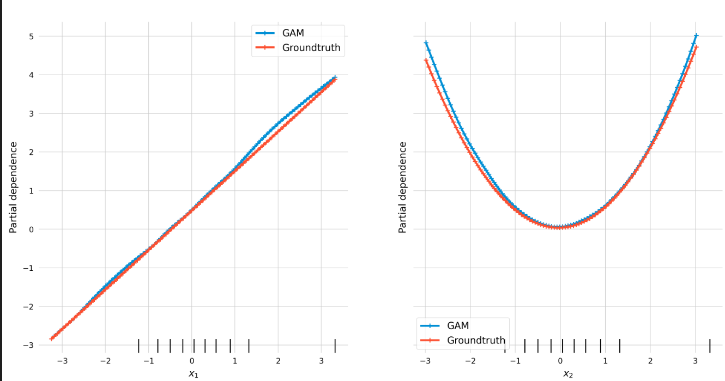
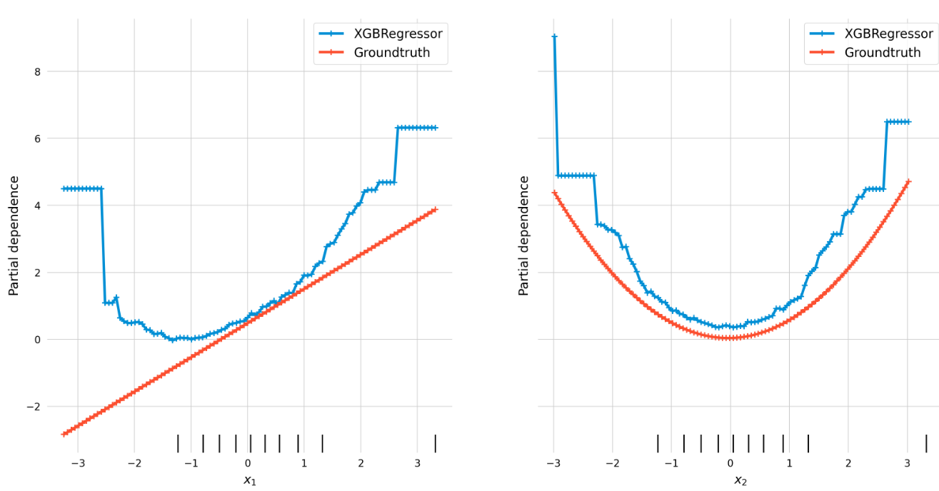
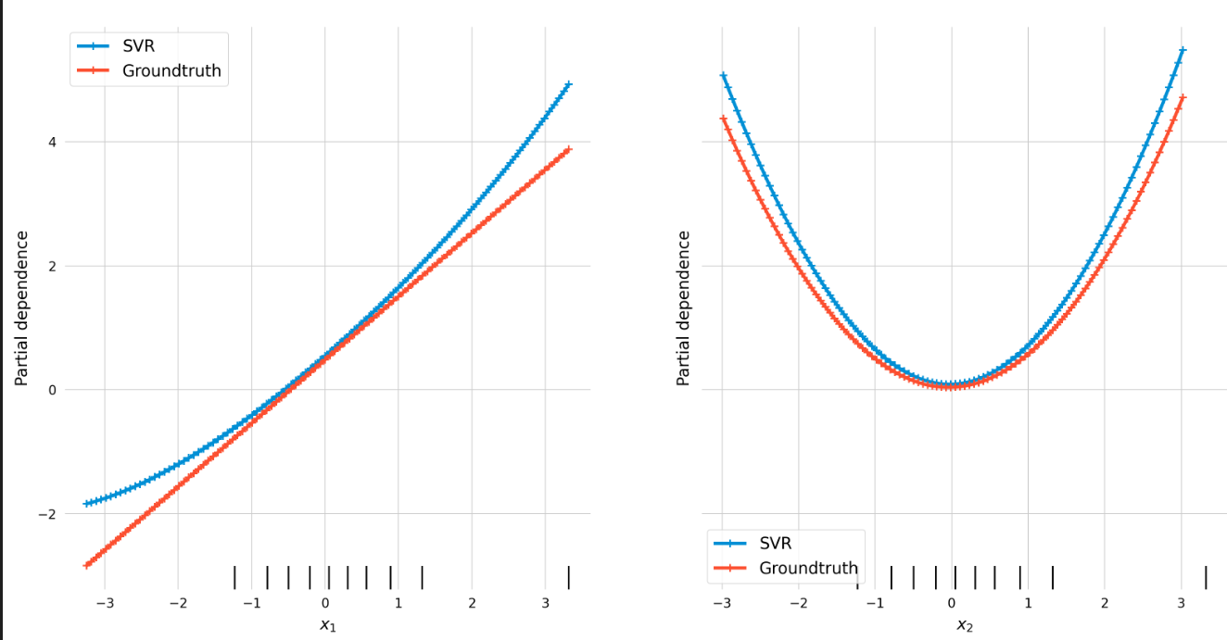
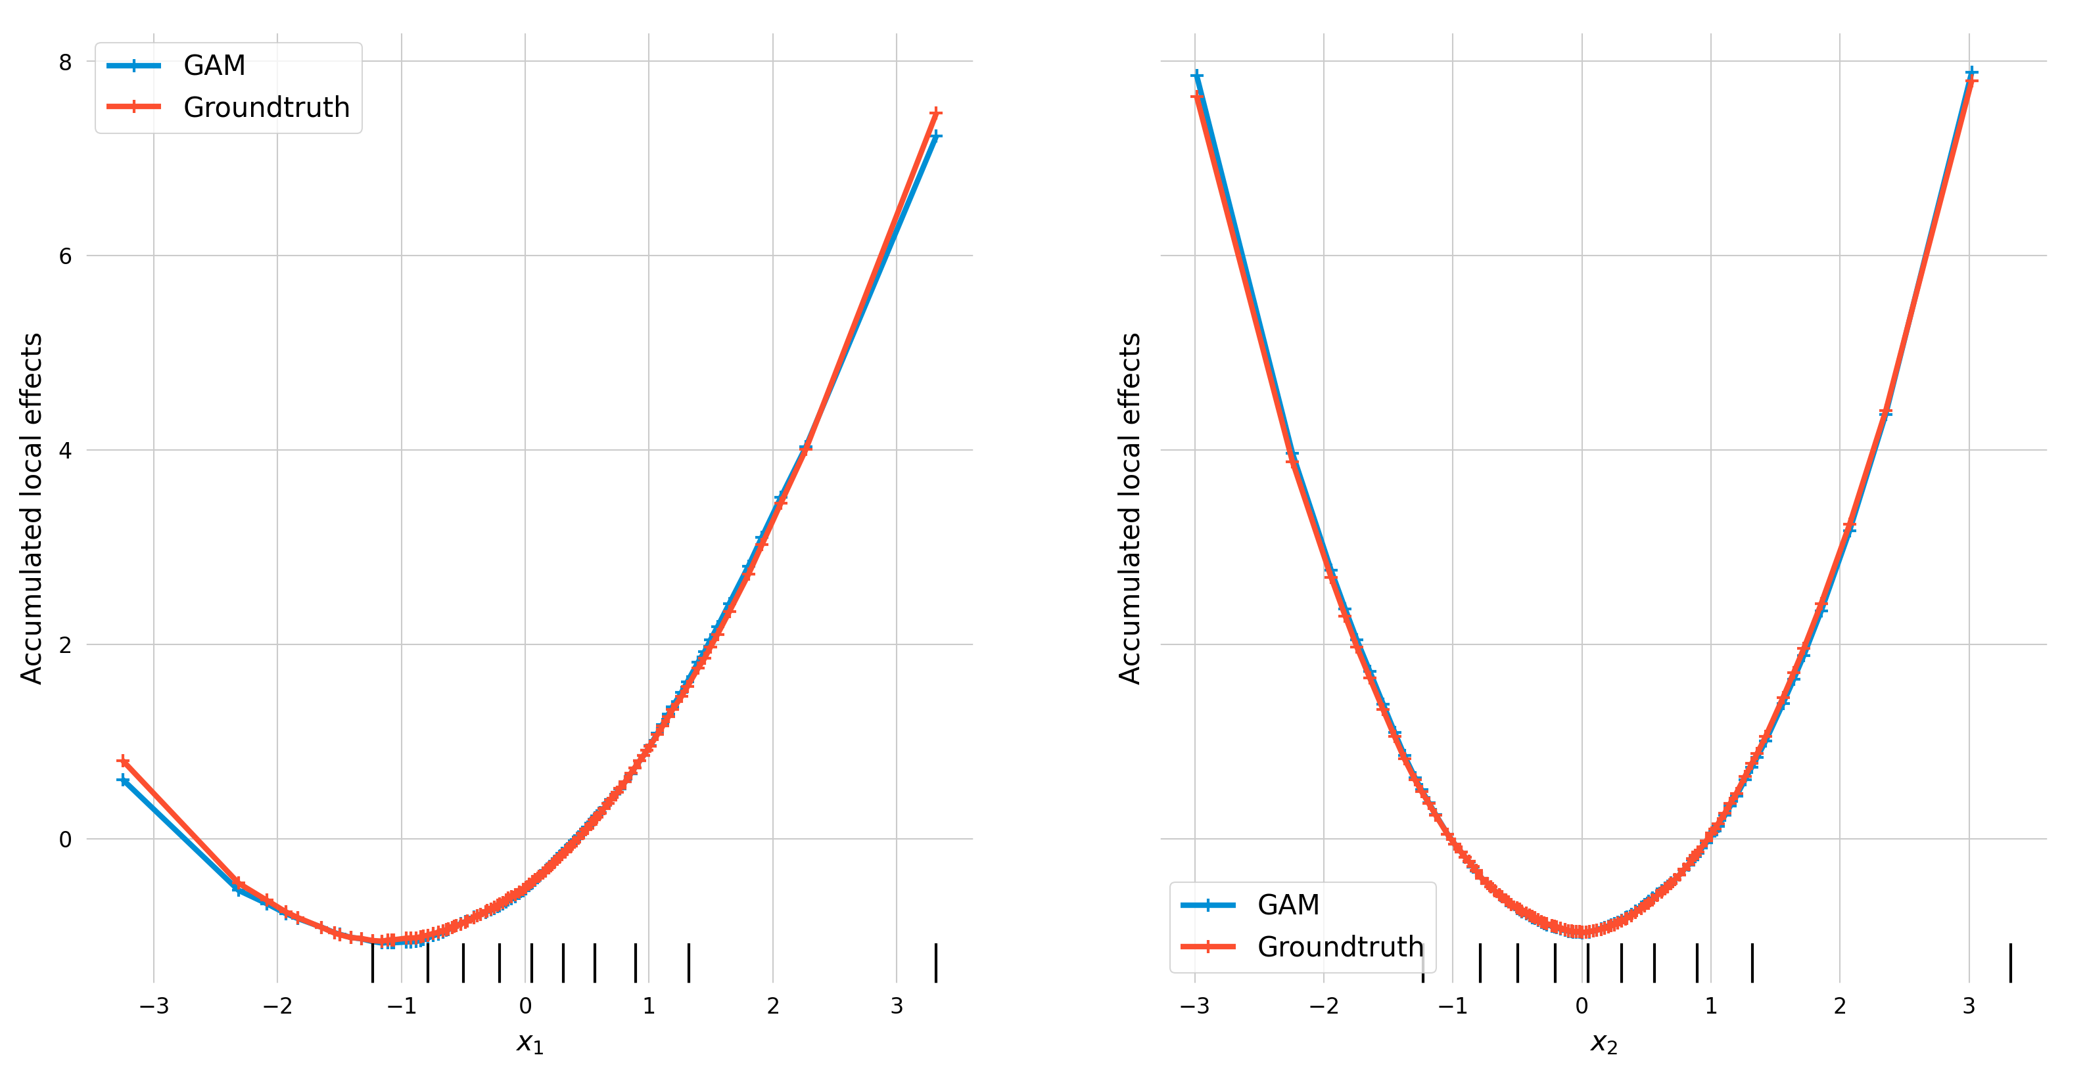
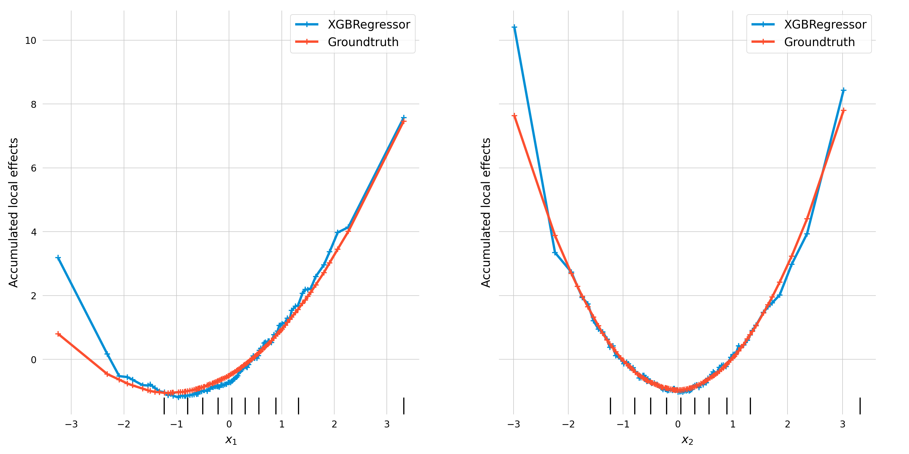
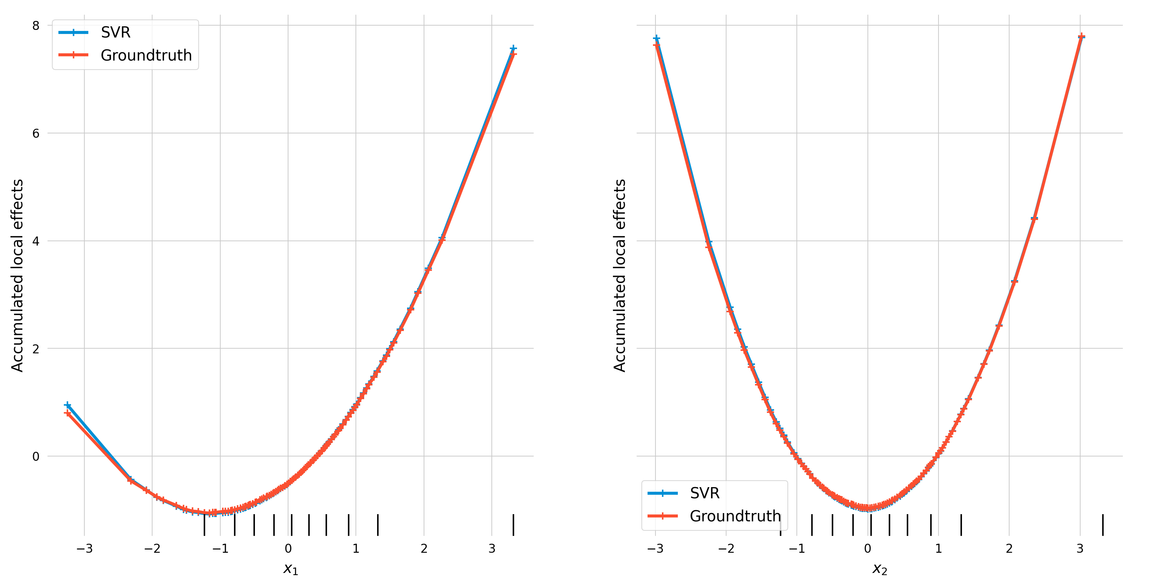
Deeper insights with concrete examples: feature effect curves from 1st simulation with snr=10 for corr=0.9
GAM (correctly specified)
XGBoost (interactions specified)
SVM
PDP
both PDP & ALE of the GAM match with the groundtruths for both x₁ and x₂
for x₁, XGBoost PDP extremely differs from groundtruth PDP, while ALE similar to groundtruth ALE
for x₁, SVM PDP has a slightly different shape than groundtruth PDP, while similar shapes in case of ALE
ALE
Although not showing linear effect, this is expected behavior of ALE as it accounts for interacting/correlated features

Slide 4
Additional notes:
The described effect is also visible in weakened form for corr=0.5 (but not for corr=0)
For purely additive groundtruths (i.e. no interaction), this effect is not visible at all (holds for all correlation strengths between the features)

