Slide 1
Presented By :
Timothy Ajayi
Customer Churn Prediction
Applying machine learning to predict customer churn and strengthen long-term customer relationships

Slide 2
INTRODUCTION
Customer churn is a major challenge for banks because losing customers reduces long-term revenue and customer lifetime value.
Since acquiring new customers is more expensive than retaining existing ones, early identification of at-risk customers is critical.
This project uses machine learning to predict customer churn and support proactive, data-driven retention strategies.
Notes:
Customer churn reduces long-term revenue for banks, and retaining customers is far cheaper than acquiring new ones. This project applies machine learning to predict churn and help banks take proactive, data-driven actions to retain customers.

Slide 3
Objective:
The main objective of this project is to develop a predictive model that identifies customers who are likely to churn.
Specific goals include:
Predict which customers are at risk of leaving the bank
Identify key factors that influence churn
Compare multiple machine learning models
Provide insights that support customer retention strategies
By accurately identifying high-risk customers, the bank can take preventive actions before customers leave.
Notes:
The objective of this project is to predict which customers are at risk of leaving the bank. By identifying key churn drivers and comparing different machine learning models, the goal is to provide insights that support proactive customer retention.
Banks benefit from identifying at-risk customers early so they can implement targeted retention strategies. This project demonstrates how machine learning can support data-driven decision making in customer retention.

Slide 4


About the Dataset
The dataset contains 10,000 banking customers with demographic and financial information such as age, credit score, balance, tenure, and product usage.
The target variable Exited indicates whether a customer churned (1) or stayed (0), enabling analysis of patterns behind customer churn.

Slide 5
Methodology
Business Understanding
Data Exploration
Exploratory Data Analysis
Data Preparation
Model Development
Model Evaluation
Business Insights
Notes:
The project follows a structured data science workflow. First, we define the business problem and understand why predicting churn matters. Then we explore and analyze the data to identify patterns related to customer behavior. After preparing the data, we train several machine learning models to predict churn. These models are evaluated using appropriate metrics, and finally the results are translated into business insights and recommendations to help the bank improve customer retention.

Slide 6
Methodology
Business Understanding
Define the business problem, stakeholder needs, and project objectives.
Data Exploration
Load the dataset and examine its structure, variables, and target distribution.
Exploratory Data Analysis (EDA)
Identify patterns and relationships between customer features and churn through visualizations and statistical analysis.
Data Preparation
Clean the data, encode categorical variables, scale numerical features, and split the dataset into training and testing sets.

Slide 7
Methodology
Model Development
Train multiple machine learning models such as Logistic Regression, Random Forest, and Gradient Boosting.
Model Evaluation
Compare model performance using metrics such as ROC-AUC, Precision, Recall, and F1-score.
Business Insights & Recommendations
Translate model results into actionable strategies to reduce customer churn.

Slide 8
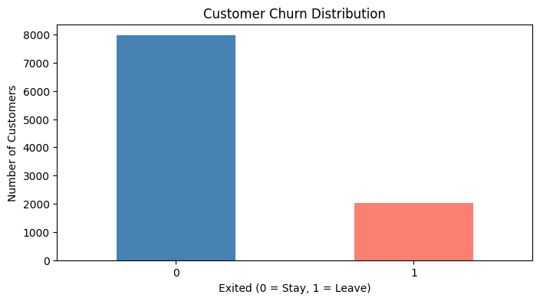
This graph shows that the dataset is imbalanced
This chart shows the distribution of customers who stayed in the bank versus those who churned. About 80% of customers remain with the bank while roughly 20% leave.
Notes:
This imbalance means that accuracy alone is not a reliable metric for evaluating our models. Instead, we focus on metrics such as recall and F1-score to better capture the model’s ability to detect customers who are likely to churn.

Slide 9
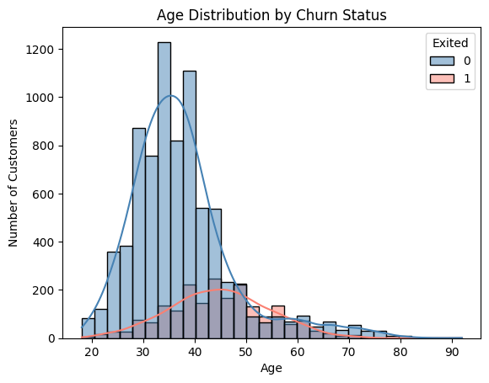
The distribution shows that churned customers tend to be slightly older, suggesting that age may influence the likelihood of leaving the bank.
Notes:
The visualization shows that churned customers tend to be slightly older on average, while younger customers are more likely to stay. This suggests that age may influence customer retention and therefore should be considered an important feature in the predictive churn model.

Slide 10
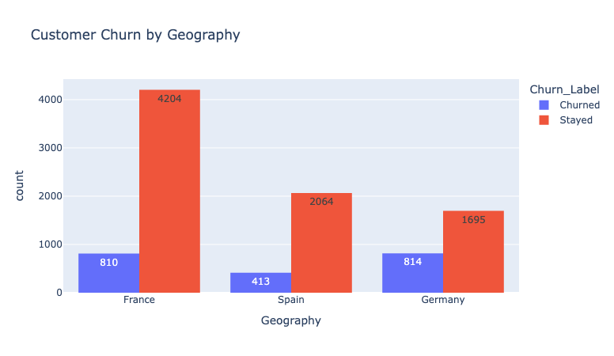
Customers in Germany appear to churn more frequently compared to those in France and Spain.
Notes:
Where should the bank focus retention strategies?
With this I deed advise the bank to focus their retention strategies in Germany

Slide 11
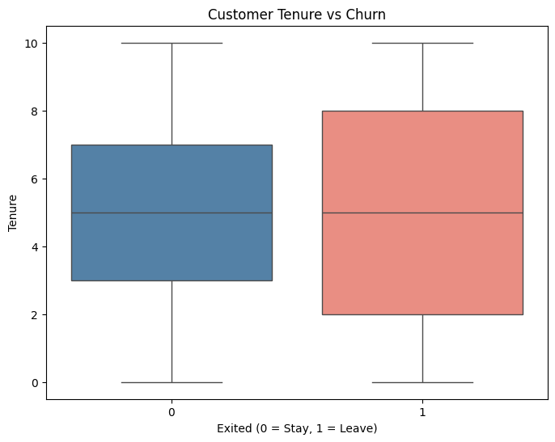
Customers with lower tenure are more likely to churn.
Notes:
onboarding programs
early customer engagement

Slide 12
Models
Multiple machine learning models were trained to compare performance, including:
Logistic Regression
Decision Tree
Random Forest
Gradient Boosting
XGBoost
LightGBM
Artificial Neural Network (ANN)

Slide 13
Model Evaluation
Because churn prediction focuses on identifying customers who may leave, the models were evaluated using metrics that measure the ability to detect churn cases.
Key evaluation metrics included:
Recall (ability to identify churn customers)
F1-score (balance between correct predictions and false alarms)
Accuracy (overall prediction performance)
Notes:
To evaluate the model, we use several metrics. Accuracy shows how often the model is correct overall. Precision measures how many predicted churn cases are actually correct, while recall tells us how well the model identifies customers who truly churn. The F1-score balances precision and recall, and ROC-AUC measures how well the model distinguishes between churned and non-churned customers.

Slide 14
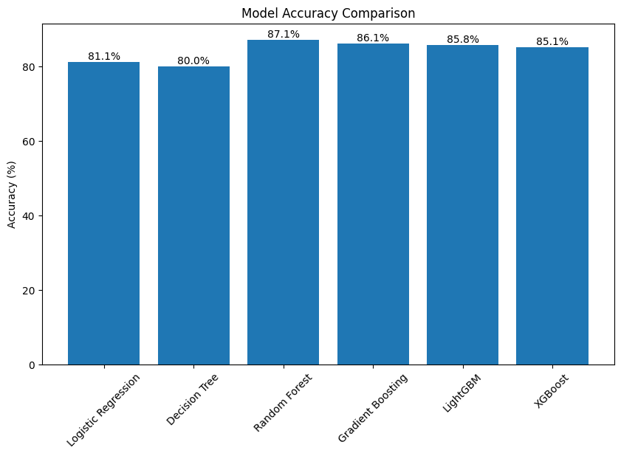
This chart compares how well different machine learning models predict customer churn. The models perform similarly, with Random Forest and Gradient Boosting achieving the highest accuracy at around 87%.
Notes:
Different machine learning algorithms capture patterns in data differently. I tested multiple models—such as Logistic Regression, Random Forest, Gradient Boosting, and XGBoost—to compare their predictive performance. Ensemble models like Random Forest and Gradient Boosting often perform well because they combine multiple decision trees and reduce variance, which can improve prediction accuracy.

Slide 15
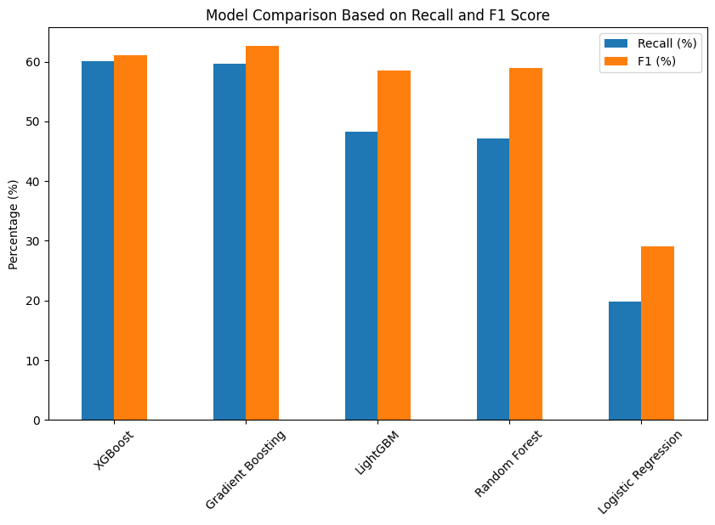
Gradient Boosting and XGBoost achieved the highest Recall and F1-scores, indicating that these models are more effective at identifying customers who are likely to churn.
Notes:
This chart compares how well each model detects customers who are likely to leave the bank. Recall measures how many churn customers the model successfully identifies, while the F1 score shows the overall balance between correctly detecting churn and avoiding false alarms.
Additional behavioral data would likely improve predictions. For example, transaction frequency, digital banking usage, customer support interactions, and complaint history could provide deeper insights into customer engagement and satisfaction, which are strong indicators of churn risk.

Slide 16
Key Results
Model | ROC-AUC | Precision | Recall | F1 Score
Logistic Regression | 0.77 | 0.48 | 0.52 | 0.49
Gradient Boosting | 0.87 | 0.66 | 0.63 | 0.61
LGBMClassifier | 0.85 | 0.64 | 0.61 | 0.62
XGBoost | 0.86 | 0.69 | 0.55 | 0.61
Notes:
Why focus on recall and F1-score instead of just accuracy?
Suggested Answer:
Recall is important because it measures how well the model identifies customers who actually churn. Missing a churner could mean losing a valuable customer. F1-score balances precision and recall, which helps evaluate the model when dealing with imbalanced data.
In future improvements, techniques like SMOTE, class weighting, or resampling could be used to help the model learn the minority class more effectively.

Slide 17
Key Findings
Exploratory Data Analysis revealed several important patterns:
Approximately 20% of customers churned, indicating a notable churn problem.
Inactive customers are significantly more likely to churn.
Customers with fewer banking products show higher churn rates.
Older customers tend to churn more frequently.
Churn behavior varied across geographic regions.
These findings suggest that customer engagement and product adoption are key drivers of retention.

Slide 18
Recommendations
Improve customer engagement
Encourage active use of banking services
Promote cross-selling strategies
Customers with multiple products show lower churn rates
Target high-risk customers
Use churn predictions to identify customers likely to leave
Personalized retention campaigns
Offer incentives, financial advice, or tailored services to at-risk customers
Use region-specific strategies
Tailor retention campaigns to geographic differences.
Notes:
Based on the analysis and model results, several recommendations can be made to help reduce churn and improve customer loyalty :

Slide 19
02. - 06.03.
• Define project topic
16. – 20.03.
• Improve model performance
23. – 27.03.
• Hyperparameter tuning
09. – 13.03.
• Exploratory Data Analysis (EDA)
• Identify business problem
• Select and understand dataset
• Feature preparation
• Train and evaluate ML models
• Build Artificial Neural Network (ANN)
• Explore additional insights
• Final model evaluation
• Prepare presentation & documentation
Timeline

Slide 20
Next Steps
Hyperparameter tuning to further improve model performance
Testing additional models such as Support Vector Machines or Neural Networks such as ANN
Feature engineering to capture more complex customer behavior
Make a streamlit app for visualization and prediction
Model deployment as an API for real-time churn prediction
Notes:
The dataset appears to be imbalanced with around 80% non-churn and 20% churn. How did you address this imbalance during model training?
Possible follow-up:
Did you use SMOTE, class weighting, or resampling?

Slide 21
Next Steps
Deploy the churn prediction model
Integrate the model into banking systems to monitor customer churn risk in real time
Build an AI recommendation system
Automatically suggest retention actions for high-risk customers
Examples:
personalized financial offers
loyalty rewards
targeted marketing campaigns
Notes:
Several future improvements could enhance the project and transform it from a predictive model into a decision-support system for customer retention.

Slide 22
Presented By :
Timothy Ajayi
THANK
YOU

Slide 23
CONCLUSION
In summary, Kickstarter success depends heavily on category, timing, and setting a reasonable goal.
These insights help creators launch more strategic projects and increase their chances of success.”

