Slide 1
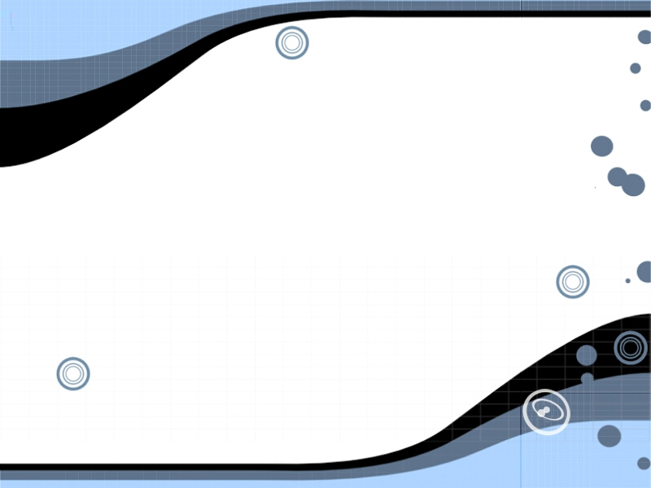
TINZ
(This Is Not Zelda)
Divya Gunasekaran and
Tim Tregubov

Slide 2
Specs
2-axis accelerometer for input
8x8 rgb led dot-matrix for gameboard
store multiple animated levels in ROM
supports multiple ‘types’ of objects on the board, powerups, enemies, a finish, and now heat-seeking ghosts.
annoying buzzer sound
game timer and score (based on number of moves, less is better)
Move the player character through the game levels avoiding enemies, getting powerups and getting to the
finish on time!

Slide 3
Datapath and Controller
MainController
Accelerometer
Player
GameLogic
GameTimer
Noises
HeatSeaker
GameBoard
Display
GameBoardROM
PlayerColor
Sequences
LEDdriver
SequenceROMS

Slide 4
