Slide 1
HANDYCAT
For Teknoys yay

Slide 2
WHAT IS HANDYCAT?
Handycat is an app created to address the problem of most Technologians regarding their difficulty in looking for affordable learning materials for school.

Slide 3
PERSONA
Timmy is a senior high school student who is having a hard time looking for the book that their teacher requires for class next week. How can we help Timmy?

Slide 4
SOLUTION!

Slide 5

HANDYCAT

Slide 6
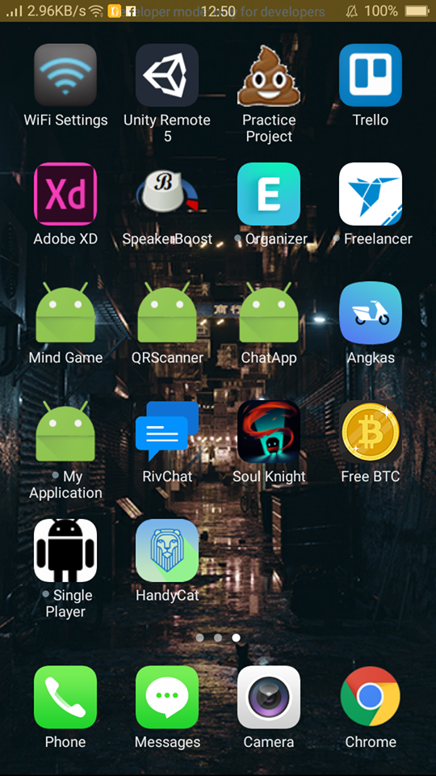
VIRTUAL TOUR
Hey, Handycat!

Slide 7

VIRTUAL TOUR
Landing Screen

Slide 8
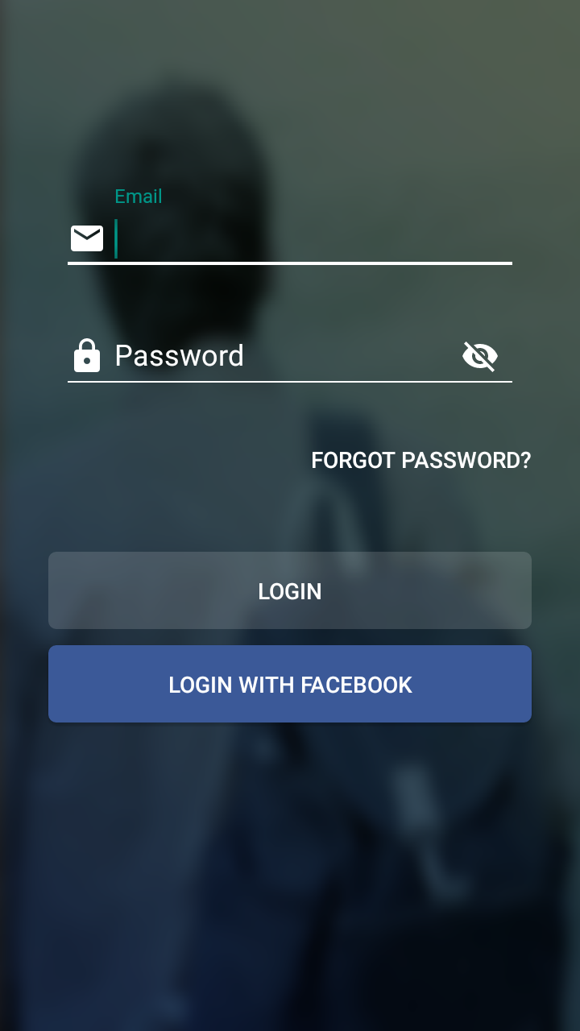
VIRTUAL TOUR
Login Screen

Slide 9
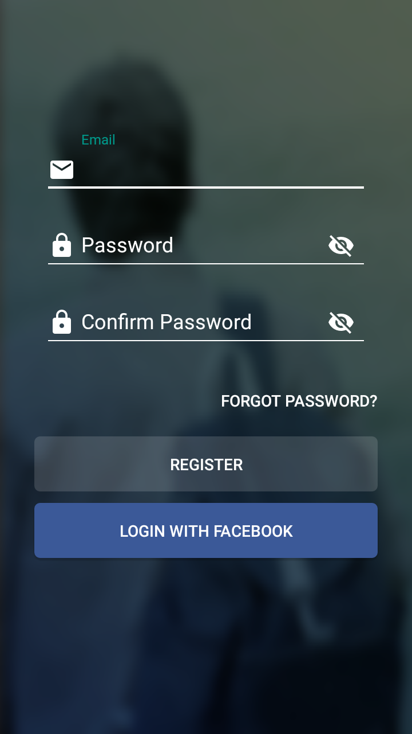
VIRTUAL TOUR
Registration Screen

Slide 10

VIRTUAL TOUR
Tutorials Section

Slide 11
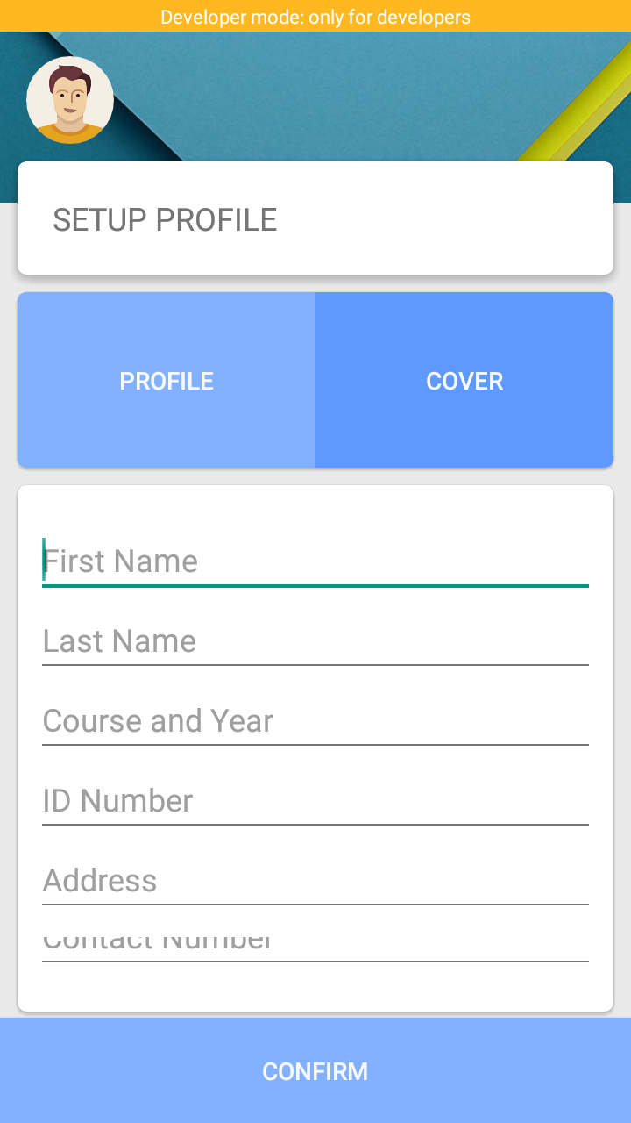
VIRTUAL TOUR
Setting up your Profile

Slide 12
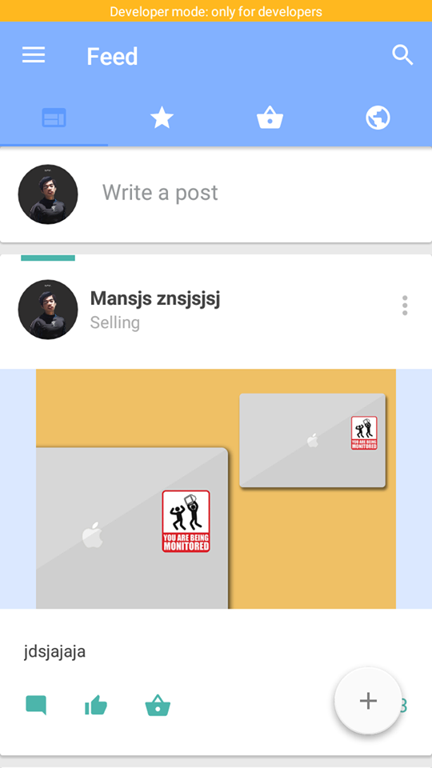
VIRTUAL TOUR
Newsfeed

Slide 13
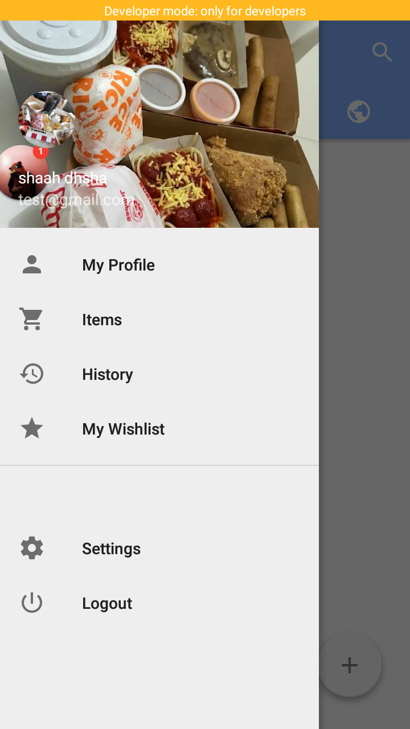
VIRTUAL TOUR
Side Drawer

Slide 14
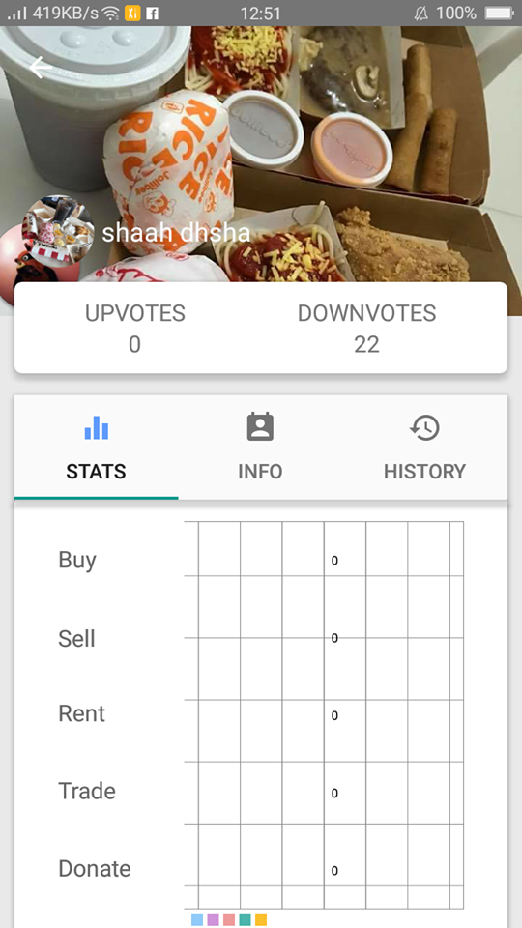
VIRTUAL TOUR
User Profile and Stats

Slide 15
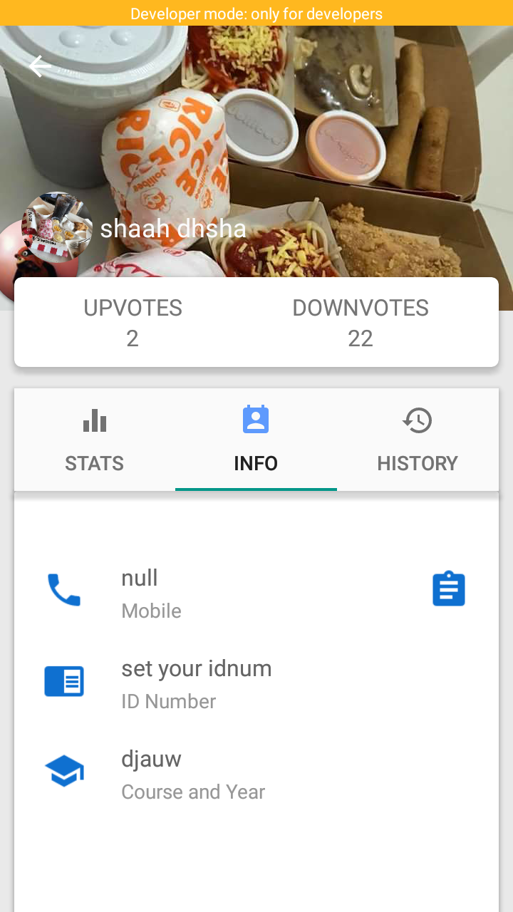
VIRTUAL TOUR
User Profile and Info

Slide 16
VIRTUAL TOUR
Newsfeed

Slide 17
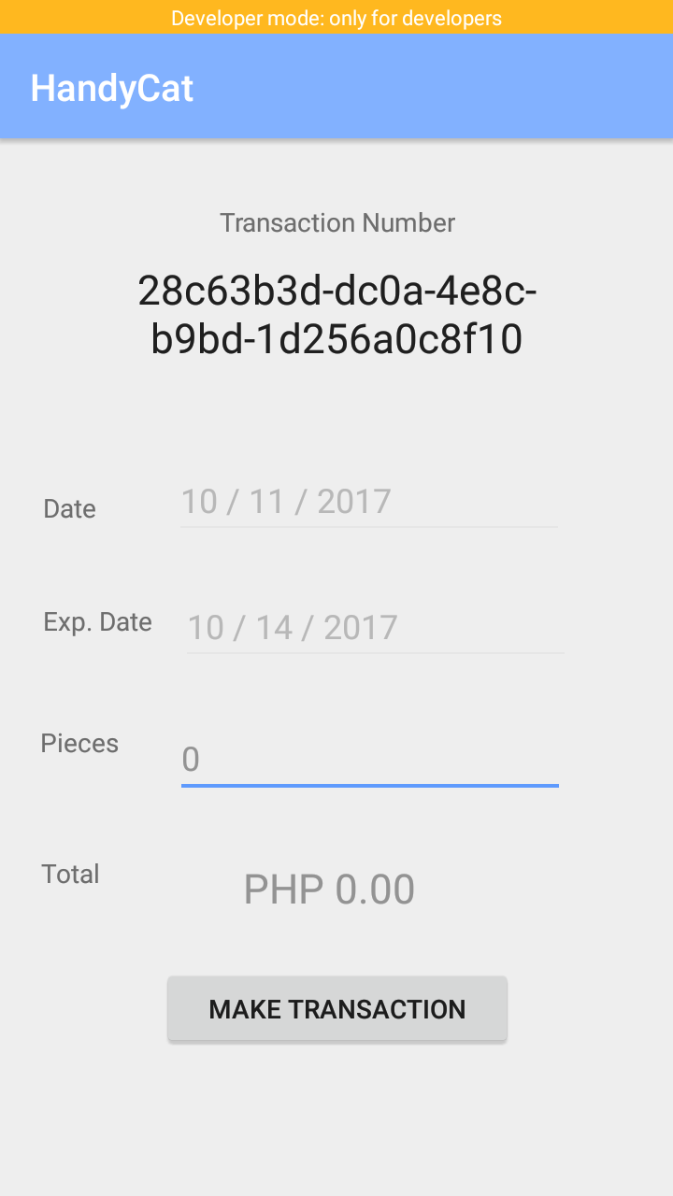
VIRTUAL TOUR
Make a New Transaction

Slide 18
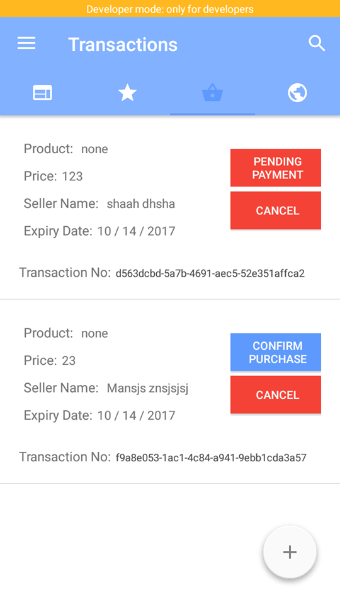
VIRTUAL TOUR
Transactions

Slide 19
DEMO

