Slide 1
🎉 Wien Talks 🎉
Share and discover funny moments around you!
Because the world’s a lot more fun when we laugh together!

Slide 2
🤔 What is Wien Talks?
Wien Talks is a playful app where you can:
✨ Share funny events you encounter
✨ Pin them on a live map
✨ Explore laughs from people nearby
Because the world is funnier when shared!
💡 Laugh together
📍 Discover hidden gems of humor
🎭 Create a map full of joy

Slide 3
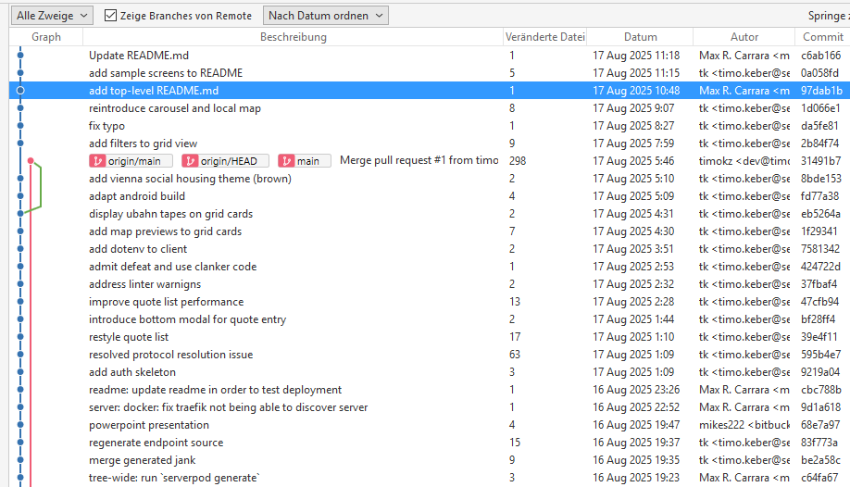
Die Grätzl-Goblins
Github: https://github.com/timokz/flutter-vienna-hackathon-25

Slide 4
🌍 Stack
Server:
Serverpod
streams, codegen
Docker, PostgreSQL, Proxmox VE, Traefik, GNU make
Client:
Flutter
carousel_slider, go_router, location, mapsforge_flutter, rxdart, google-cloud-api

Slide 5

🤔 What we learned?

