Slide 1
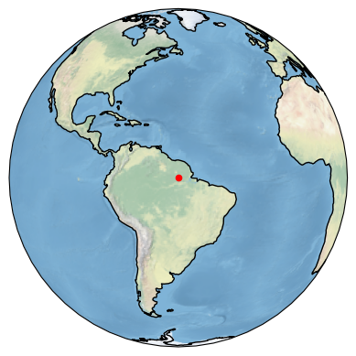

.
.
$$r$$
$$$$
$$r+s$$

Slide 2
.
.
$$r$$
$$$$
$$r+s$$

Slide 3
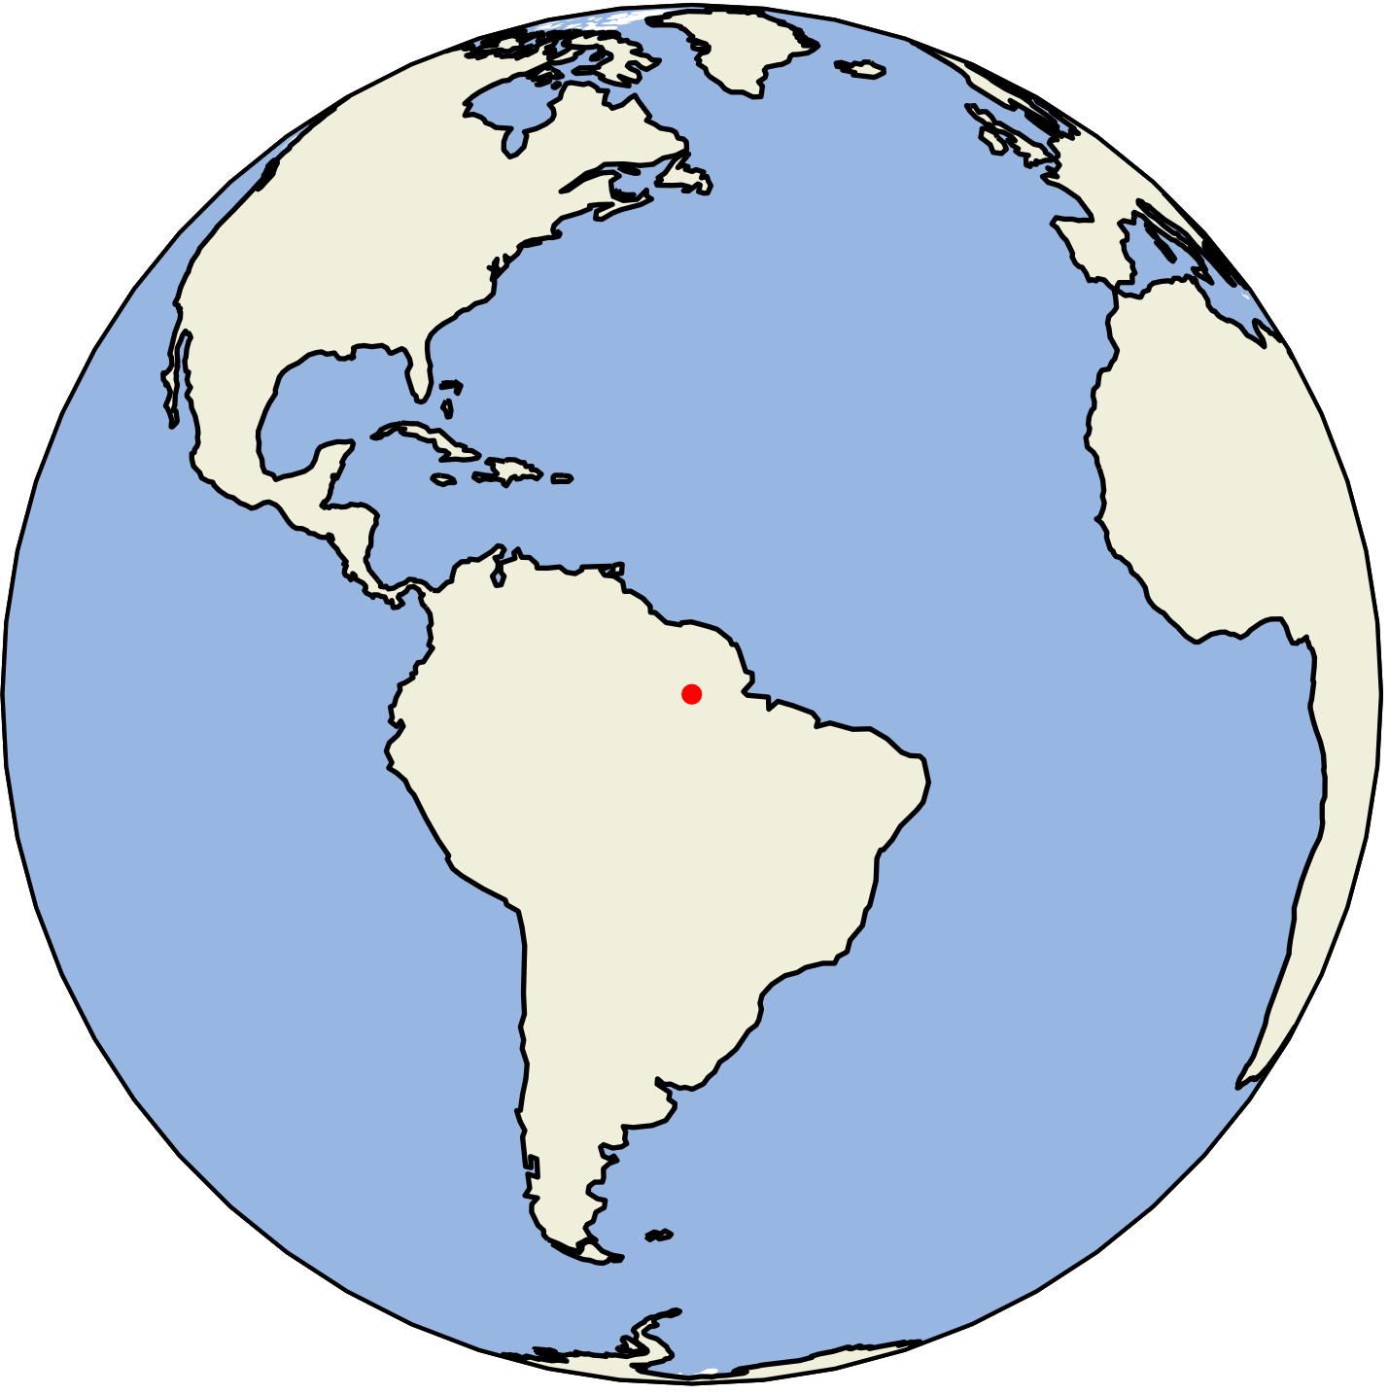
.
.
r
γ
r+s

Slide 4
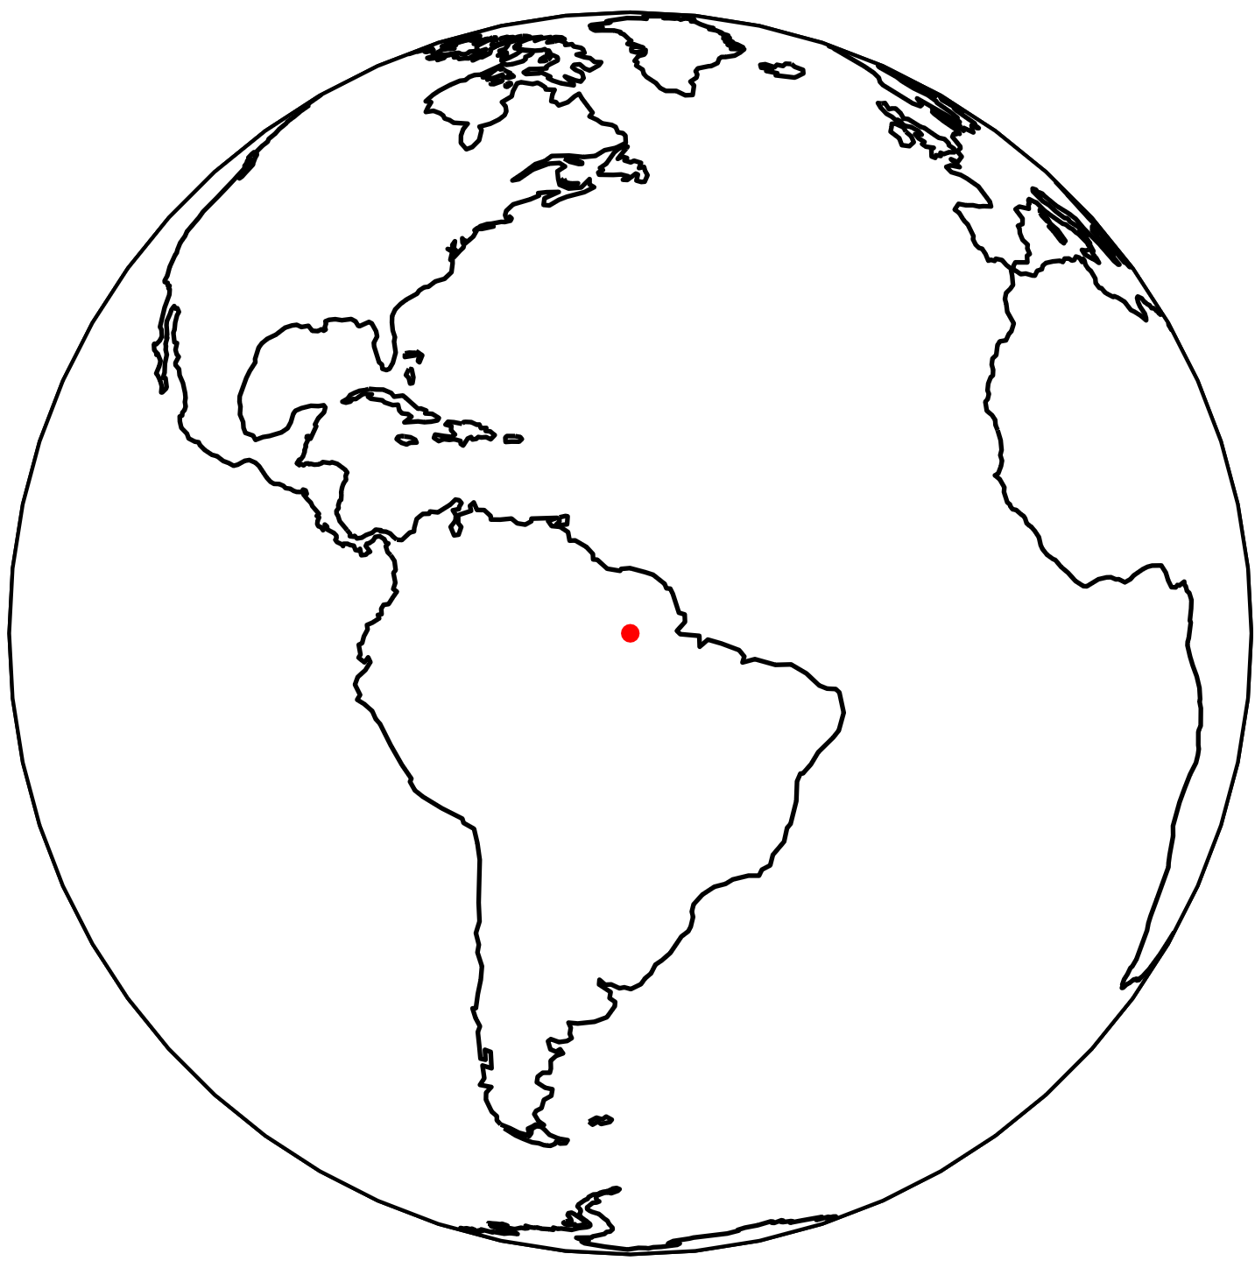
.
.
r
γ
r+s

Slide 5
