Slide 1
Exploration of attributes of best employers globally and contributing factors
Project 1 | Group 6
Gavin; Rohan; Timo; Javier

Slide 2

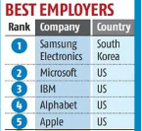
Research Questions
Starting point: Forbes 2022 Ranking of 100 Best Employers
What is it?
How is it formulated?
Why are we interested?
Complemented with: Glassdoor Preferred Employer Scores
Our research questions:
What are the attributes of good employers?
Are good employers good companies?
Are there any other factors that may contribute to being good employer?
Notes:
Forbes b/g: The initial research was undertaken Statista, who surveyed 150,000 full-time and part-time workers from 57 countries working for multinational companies and institutions to measure their performance on tenants such as: corporate impact and image, talent development, gender equality and social responsibility.
Context (why): Since covid, a) employee priorities have shifted
b) employers: have had the talent pool depleted, have had to offer more flexibility to attract, retain.
c) 2022 list: those frictions have played out and had time to feed into the 2022 list.
Questions: State as above.

Slide 3
Pleminary Analysis – Look into Forbes / Glassdoor
Source:
Kaggle dataset (https://www.kaggle.com/datasets/devrimtuner/worlds-best-employers-top-100)
Glassdoor Rating site
Geoapify
Note - Approach: Combine Dataset from Kaggle and Glassdoor ratings to see what sector made it to top 100, which area most of the company came from, also to see if there’s a correlation between top 100 companies and their Company Ratings
[Timo’s graph here]
Employee size – (Small (< 50000) ,Medium (50000 – 200000), and Large (>200000 Enterprise)
Country -
Glassdoor
Anything else?
Notes:
Our approach part 1: exploration of the source research to look at the features/attributes of the ‘Top 100’
What kind of companies made up the top 100?

Slide 4
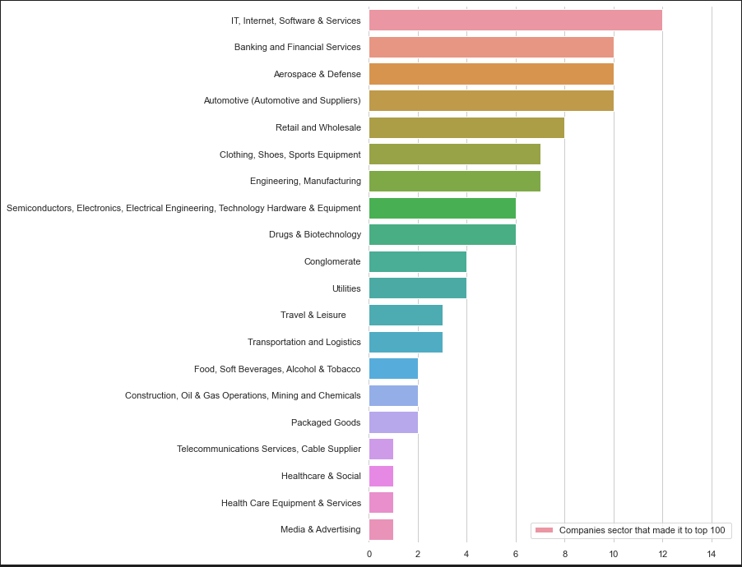
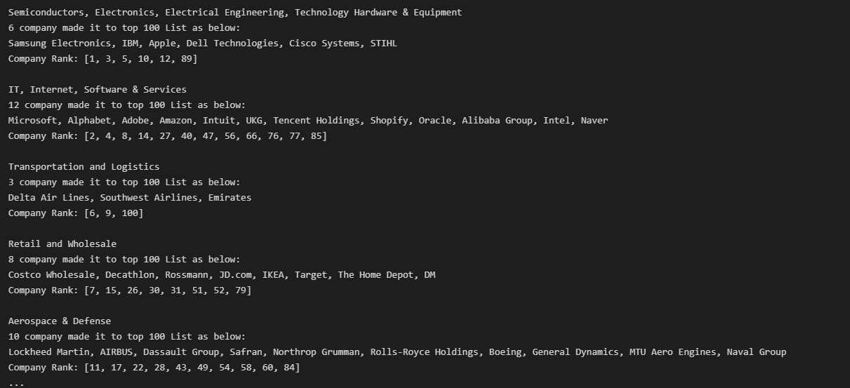
Pleminary Analysis – Sector Analysis
There are 20 sectors that made it into top 100 employers in 2022
[Timo’s graph here]

Slide 5
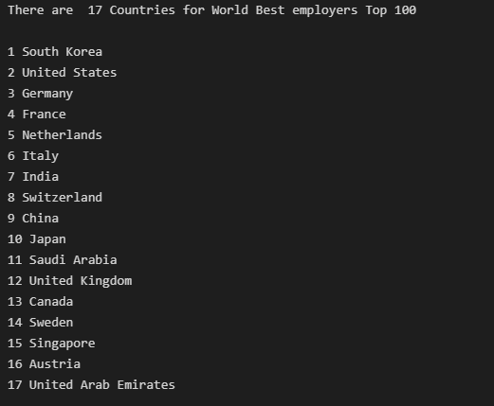
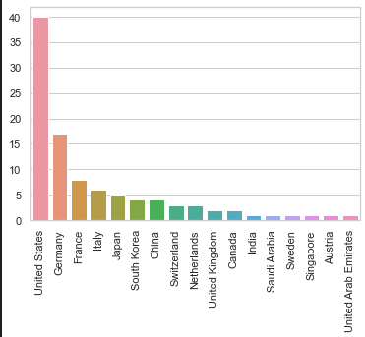
Pleminary Analysis – Company Analysis Number of companies in each country in top 100

Slide 6
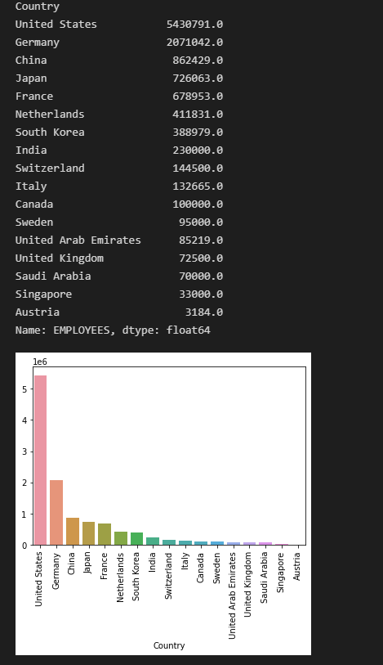

Slide 7
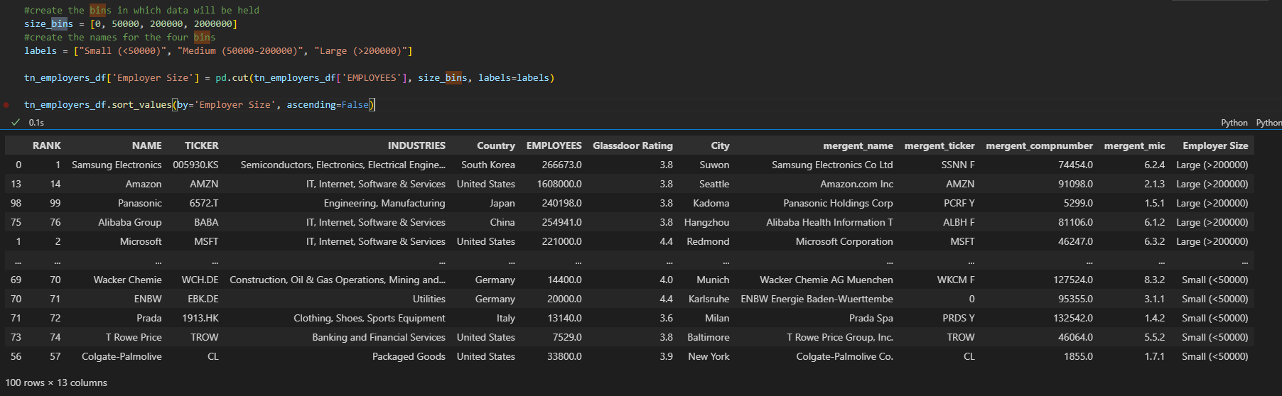
Pleminary Analysis – Company Analysis

Slide 8
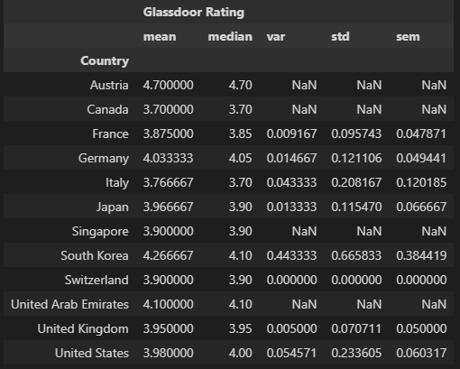
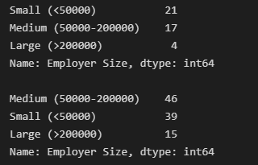
base on this,we going to use USA

Slide 9
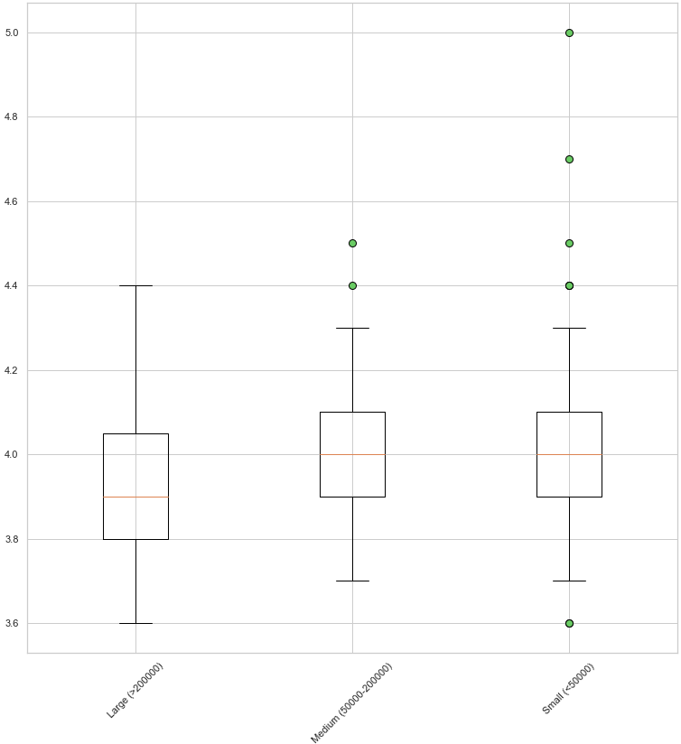
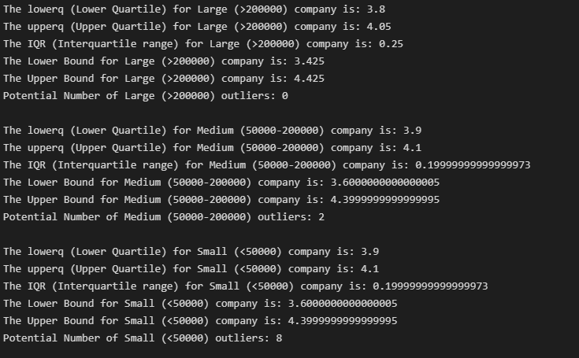

Slide 10
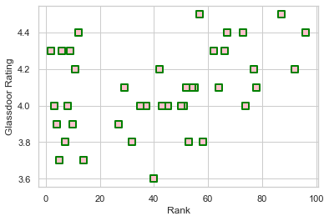
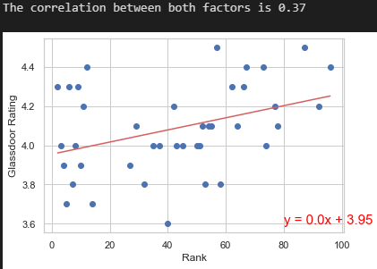

Slide 11
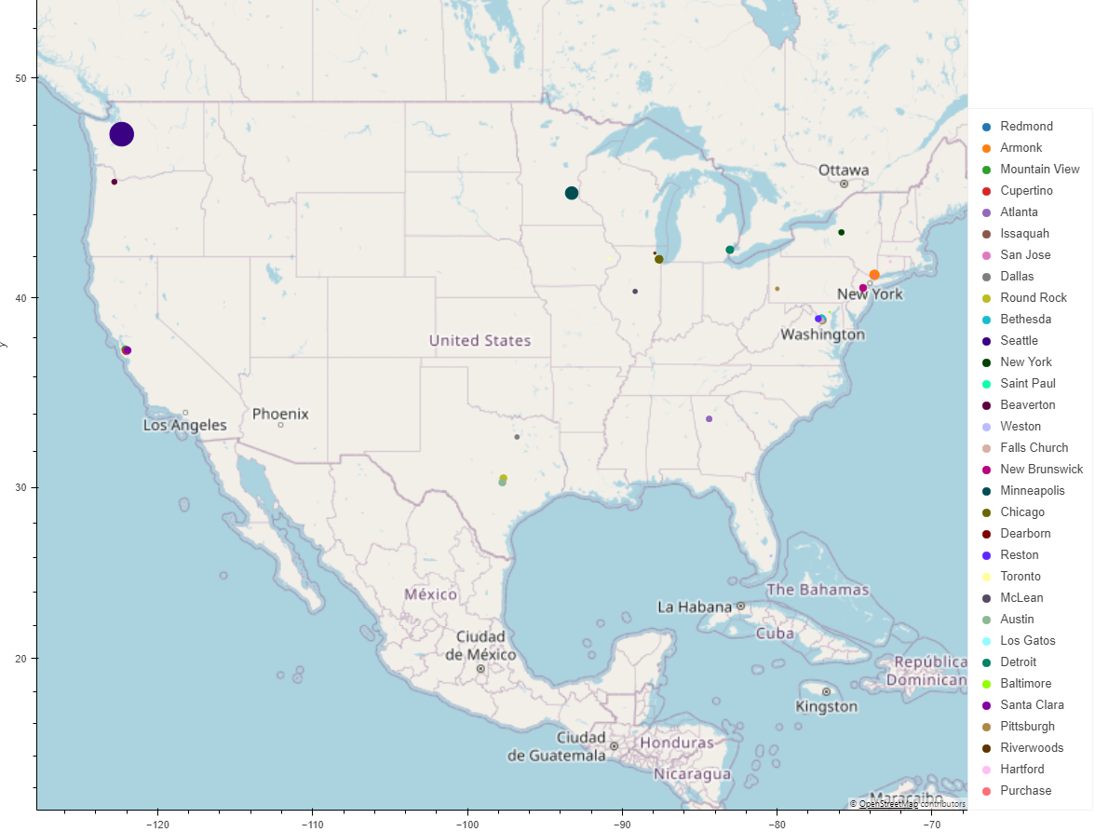

Slide 12
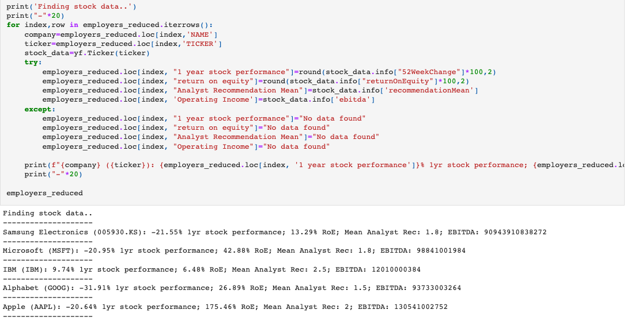
Are good employers good companies? – Look within Top 100
Source : Yahoo Finance data feed
Approach: Bring in finance data via the ticker code to see whether success as an acclaimed employer converts to financial performance.
Notes:
Our approach part 1: bringing in finance data via the ticker code so see whether success as an acclaimed employer converts to financial performance.
Yahoo Finance library wrapper.
Financial metrics:
12-month stock performance, ROE (shareholder value),
average of analyst recommendations (1 strong buy, 5 strong sell), operating income per all available in the yf.ticker.info method.
Results (raw) :
Appears to be no correlation between ranking in the top 100, and financial performance.
Already 100 high performing companies, multinationals, likely got in that position by being financially sound.
Results (standardized):
Cluster around mean, particularly ROE.
Stock price contained more variation, this may have to do with broader sector performance,
Segue to Javier’s approach.

Slide 13
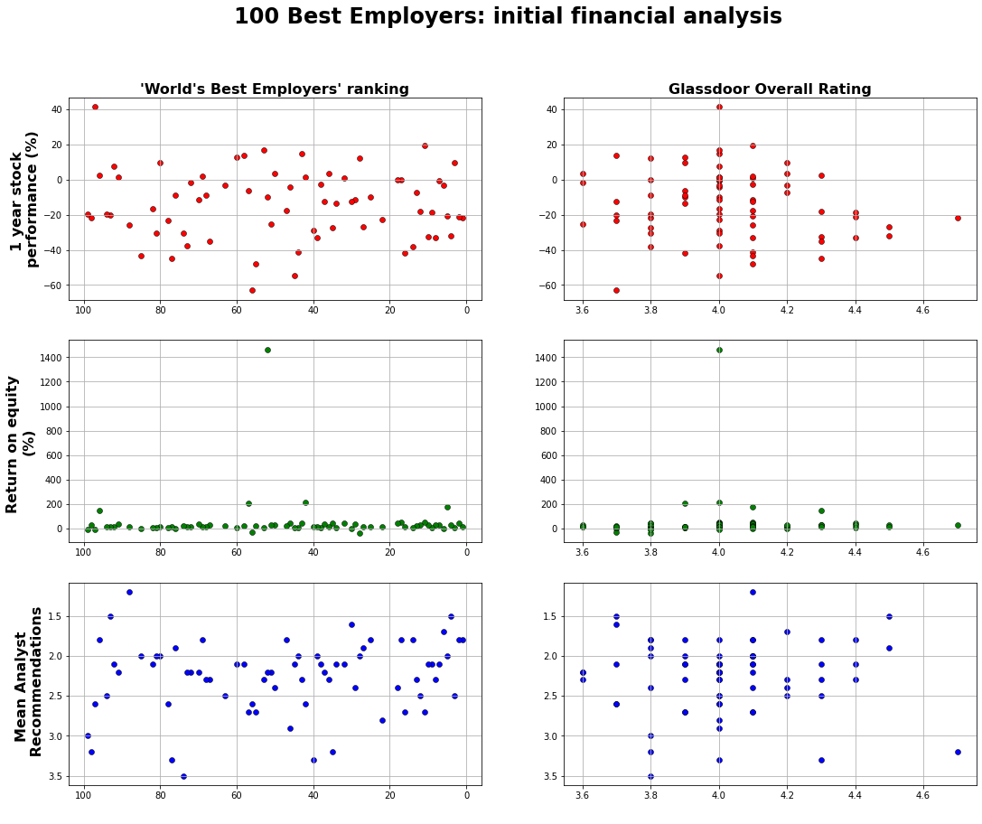
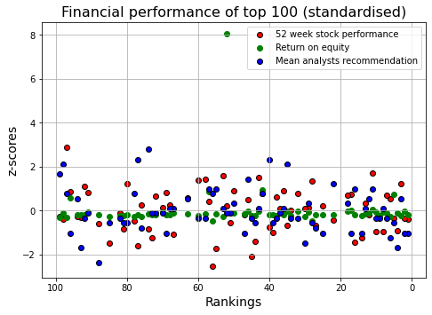
Are good employers good companies? – Look within Top 100
Approach: Plot the employer rankings/ratings against chosen financial metrics
Notes:
Our approach part 1: bringing in finance data via the ticker code so see whether success as an acclaimed employer converts to financial performance.
Yahoo Finance library wrapper.
Financial metrics:
12-month stock performance, ROE (shareholder value),
average of analyst recommendations (1 strong buy, 5 strong sell), operating income per all available in the yf.ticker.info method.
Results (raw) :
Appears to be no correlation between ranking in the top 100, and financial performance.
Already 100 high performing companies, multinationals, likely got in that position by being financially sound.
Results (standardized):
Cluster around mean, particularly ROE.
Stock price contained more variation, this may have to do with broader sector performance,
Segue to Javier’s approach.

Slide 14
Are good employers good companies – Look at sector peers
Source : Nasdaq API data feed
Bring in finance data via the ticker code to see whether success as an acclaimed employer converts to financial performance.
[Javier’s graph here]
Discussion
Financial Analysis
‘Nasdaq API’ and ’Mergent Global Finance’ data feed
Financial measures selected
Data cleaning
Results
Conclusions
Notes:
Our approach part 2: Financial information for Top 100 relative to their industry peers.

Slide 15
Other factor contributing to being good employer
Analyse demographics for country of HQ
[Rohan’s graphs here]
Discussion
Country Analysis
Any country-specific qualities affecting company performance in Forbes ranking or Glassdoor scores
Conclusions
Notes:
Our approach part 3: Many countries represented in the top 100 (though mostly US and Germany)
Geographical factors?
i.e. Is there something about employees from these countries that predisposed them to feel a certain way about their employers?
Rohan findings.

Slide 16
Conclusions
Overall we conclude:
Established, longstanding companies
High brand recognition/value
Would investigate this further
Difficulties and limitations
Did the data uncover any answers to our initial research questions?

