Slide 1
Exploration of attributes of best employers globally and contributing factors
Project 1 | Group 6
Gavin; Rohan; Timo; Javier

Slide 2

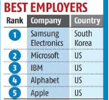
Research Questions
Starting point: Forbes 2022 Ranking of 100 Best Employers
What is it?
How is it formulated?
Why are we interested?
Complemented with: Glassdoor Preferred Employer Scores
Our research questions:
What are the attributes of good employers?
Are good employers good companies?
Are there any other factors that may contribute to being good employer?
Notes:
Forbes background: The initial research was undertaken Statista, who surveyed 150,000 full-time and part-time workers from 57 countries working for multinational companies and institutions to measure their performance on tenants such as: corporate impact and image, talent development, gender equality and social responsibility.
Context (why): Since covid: a) employee priorities have shifted in terms of what they are looking for in an employer (for example, flexible working arrangements, working from home allowance).
b) employers: have had to compete for labour in a depleted talent pool - have had to offer more flexibility to attract, retain.
We believe that the survey responses for the 2022 list will have captured those frictions
Questions: What are the characteristics of the world’s best employers (as determined by Forbes/Statista)?
Does a good employer make a good company and/or a good investment?
Are there potentially other factors that may contribute to people’s perceptions of the companies they work for? Geography? Alignment with the union movement? General pay and conditions?

Slide 3
Attributes of good employers – Look into Forbes / Glassdoor
[Timo’s graph here]
Initial Analysis of Data
Sector analysis
Employee size
Country
Glassdoor
Anything else?
Conclusions
Notes:
Our approach part 1: exploration of the source research to look at the features/attributes of the ‘Top 100’
What kind of companies made up the top 100?

Slide 4
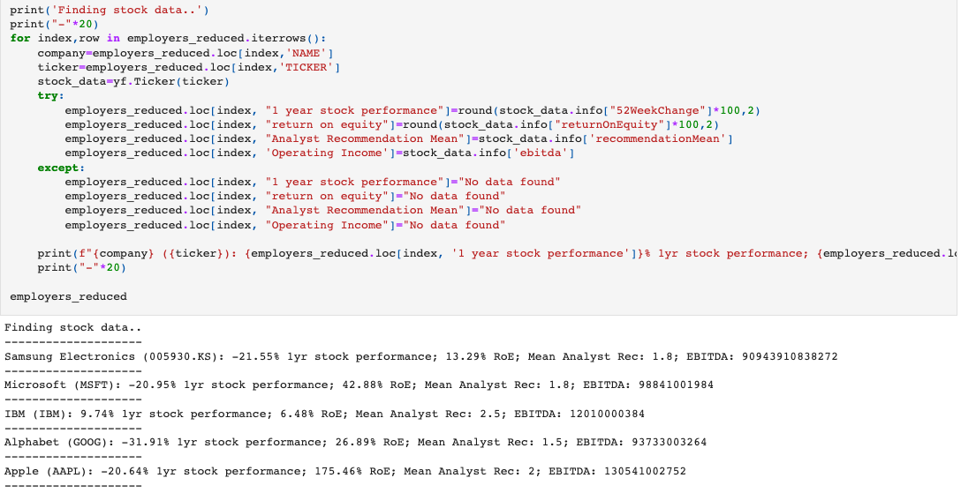
Are good employers good companies? – Look within Top 100
Source : Yahoo Finance data feed
Approach (step 1): Bring in finance data via the ticker code to see whether success as an acclaimed employer converts to financial performance.
Notes:
Our approach part 1: After drawing out the key characteristics of the Top 100 employers, and combining the Glassdoor rating, we brought in some key financial metrics on each of the companies to measure the financial health/outlook of the companies, and whether it was related to performance as an employer.
We did this using the Yahoo Finance library wrapper. It is a library that makes an unofficial API call to the Yahoo Finance server, and returns a dictionary of financial information for each listed company in the world.
Our financial metrics of interest:
12-month stock performance,
Return on equity (Net income / shareholder’s equity),
average of analyst recommendations (1 strong buy, 5 strong sell), operating income per all available in the yf.ticker.info method.

Slide 5
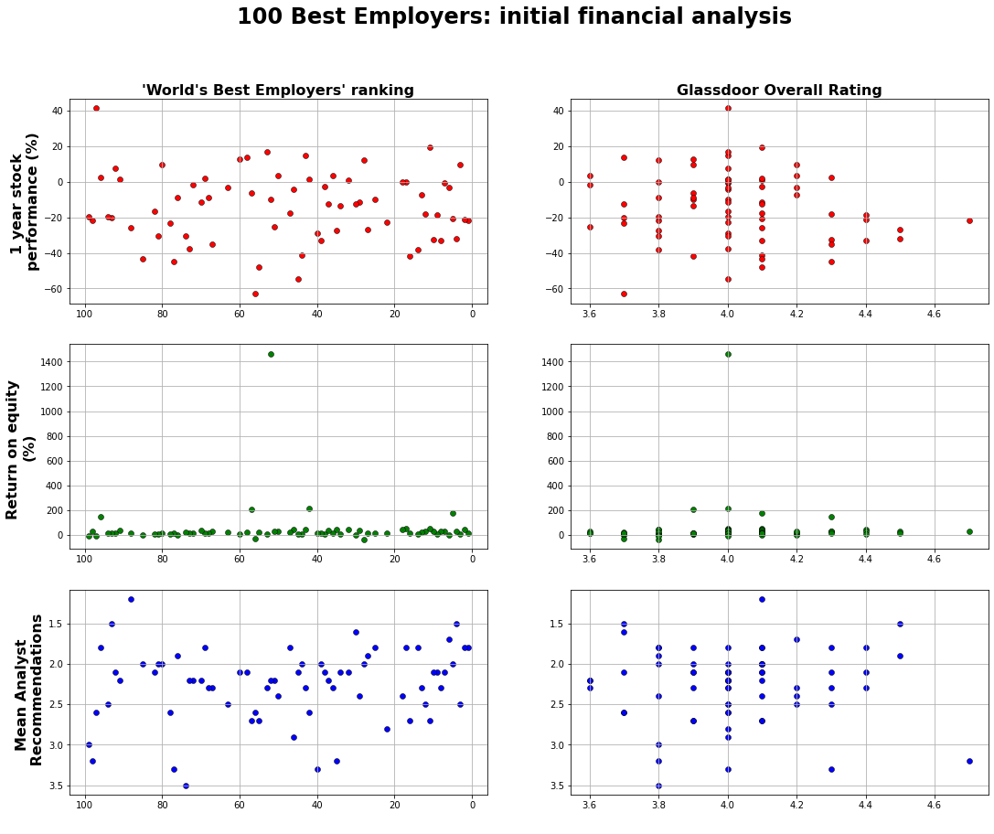
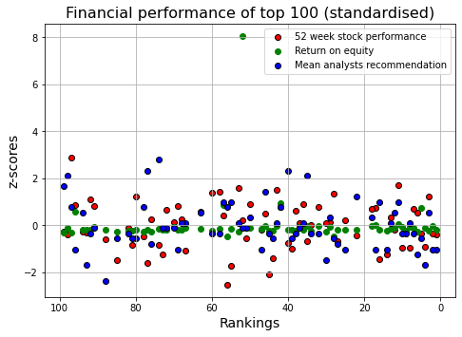
Are good employers good companies? – Look within Top 100
Approach (step 2): Plot the employer rankings/ratings against chosen financial metrics
Notes:
Our approach part 1:
Results (raw) :
Appears to be no correlation between ranking in the top 100, and financial performance.
Already 100 high performing companies, multinationals, likely got in that position by being financially sound.
Results (standardized):
Cluster around mean, particularly ROE.
Stock price contained more variation, this may have to do with broader sector performance,
Segue to Javier’s approach.

Slide 6
Are good employers good companies – Look at sector peers
Source : Nasdaq API data feed
Bring in finance data via the ticker code to see whether success as an acclaimed employer converts to financial performance.
[Javier’s graph here]
Discussion
Financial Analysis
‘Nasdaq API’ and ’Mergent Global Finance’ data feed
Financial measures selected
Data cleaning
Results
Conclusions
Notes:
Our approach part 2: Financial information for Top 100 relative to their industry peers.

Slide 7
Other factor contributing to being good employer
Analyse demographics for country of HQ
[Rohan’s graphs here]
Discussion
Country Analysis
Any country-specific qualities affecting company performance in Forbes ranking or Glassdoor scores
Conclusions
Notes:
Our approach part 3: Many countries represented in the top 100 (though mostly US and Germany)
Geographical factors?
i.e. Is there something about employees from these countries that predisposed them to feel a certain way about their employers?
Rohan findings.

Slide 8
Conclusions
Overall we conclude:
Established, longstanding companies
High brand recognition/value
Would investigate this further
Difficulties and limitations
Did the data uncover any answers to our initial research questions?

