Slide 1
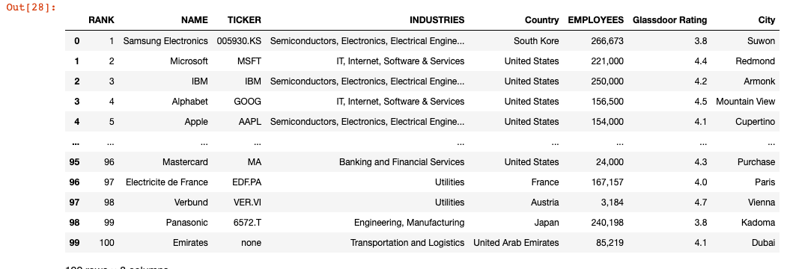
Our research questions:
a) What are the attributes of good employers?
b) Are good employers good companies?
c) Are there any other factors that may contribute?
Notes:
Forbes b/g: The initial research was undertaken Statista, who surveyed 150,000 full-time and part-time workers from 57 countries working for multinational companies and institutions to measure their performance on tenants such as: corporate impact and image, talent development, gender equality and social responsibility.
Context (Why): Since covid, a) employee priorities have shifted
b) employers: have had the talent pool depleted, have had to offer more flexibility to attract, retain.
c) 2022 list: those frictions have played out and had time to feed into the 2022 list.
Questions: State as above.

Slide 2
Approach part one: Forbes data + Glassdoor
*Insert Tim’s graphs here*
Discussion:
Preliminary Analysis:
Sector analysis
Employee size
Country?
Glassdoor
anything else?
Preliminary conclusions?
Notes:
Our approach part 1: exploration of the source research to look at the features/attributes of the ‘Top 100’
What kind of companies made up the top 100?

Slide 3
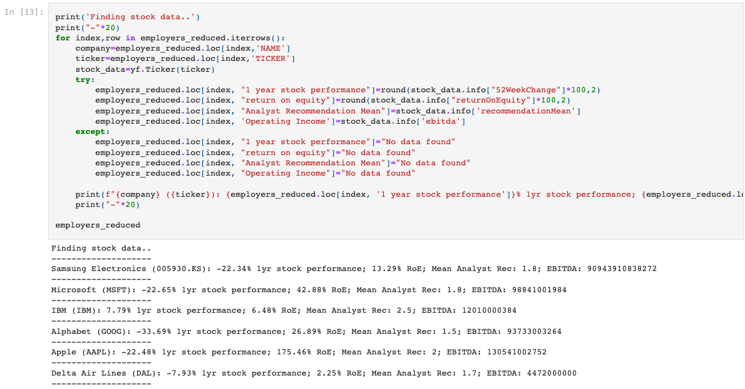
Approach part two a): Yahoo Finance library
Notes:
Our approach part 2: bringing in finance data via the ticker code so see whether success as an acclaimed employer converts to financial performance.
Yahoo Finance library wrapper:
Financial metrics: 12 month stock performance, ROE (shareholder value), Average of analyst recommendations (1 strong buy, 5 strong sell), operating income per
all available in the yf.ticker.info method.
Results (raw) : appears to be no correlation between ranking in the top 100, and financial performance.
a) Already 100 high performing companies, multinationals, likely got in that position by being financially sound.
Results (standardized): cluster around mean, particularly ROE. Stock price contained more variation, this may have to do with broader sector performance,
Segue to Javier’s approach.

Slide 4
Approach part two a): Yahoo Finance library

Slide 5
Approach part two b): NASDAQ API
*Insert Javier’s graphs here*
Discussion:
Financial Analysis:
NASDAQ API wrapper
financial measures selected
data cleaning
results
conclusions?
Notes:
Our approach part 2: Financial information for Top 100 relative to their industry peers.

Slide 6
Approach part three: Country of HQ Data
*Insert Rohan’s graphs here*
Discussion:
Country Analysis:
Are there country-specific qualities that are affecting company performance in the rankings / or Glassdoor
conclusions?
Notes:
Our approach part 4: Many countries represented in the top 100 (though mostly US and Germany)
Geographical factors? i.e. Is there something about employees from these countries that predisposed them to feel a certain way about their employers?
Rohan findings.

Slide 7
Overall conclusions
Overall conclusions?
- Established, longstanding companies
High brand recognition/value
Would investigate this further
Difficulties and limitations
Did data uncover any answers to our initial research questions?

