Slide 1


Team One:
Anna Dobler, Ranna Alemi, Sven Schuler,
Tim Brecht, Timo Schwind

Slide 2
Agenda
Milestone
Group structure
Goal
Mission statement
Mission objectives
User views (use cases)
List of requirements
Milestone
All SQL code
Java or source code of project
Sql-code for data loading
list of successful and failed test cases
Milestone
Conceptual data model on paper
Data catalogue
List of all relevant entities and
relationships for each user view
Milestone
Conceptual Data Model In Case-tool
Logical Data Model
Proof that all relations are in BCNF or
explanation why not

Slide 3
1. Milestone
Group Structure
Projekt Manager
Sven Schuler
Ranna
Timo
Backend
(MS SQL Server Datenbank,
Java (Spring Boot))
Tim
Frontend
(HML, CSS, JavaFX)
Anna
Sven

Slide 4
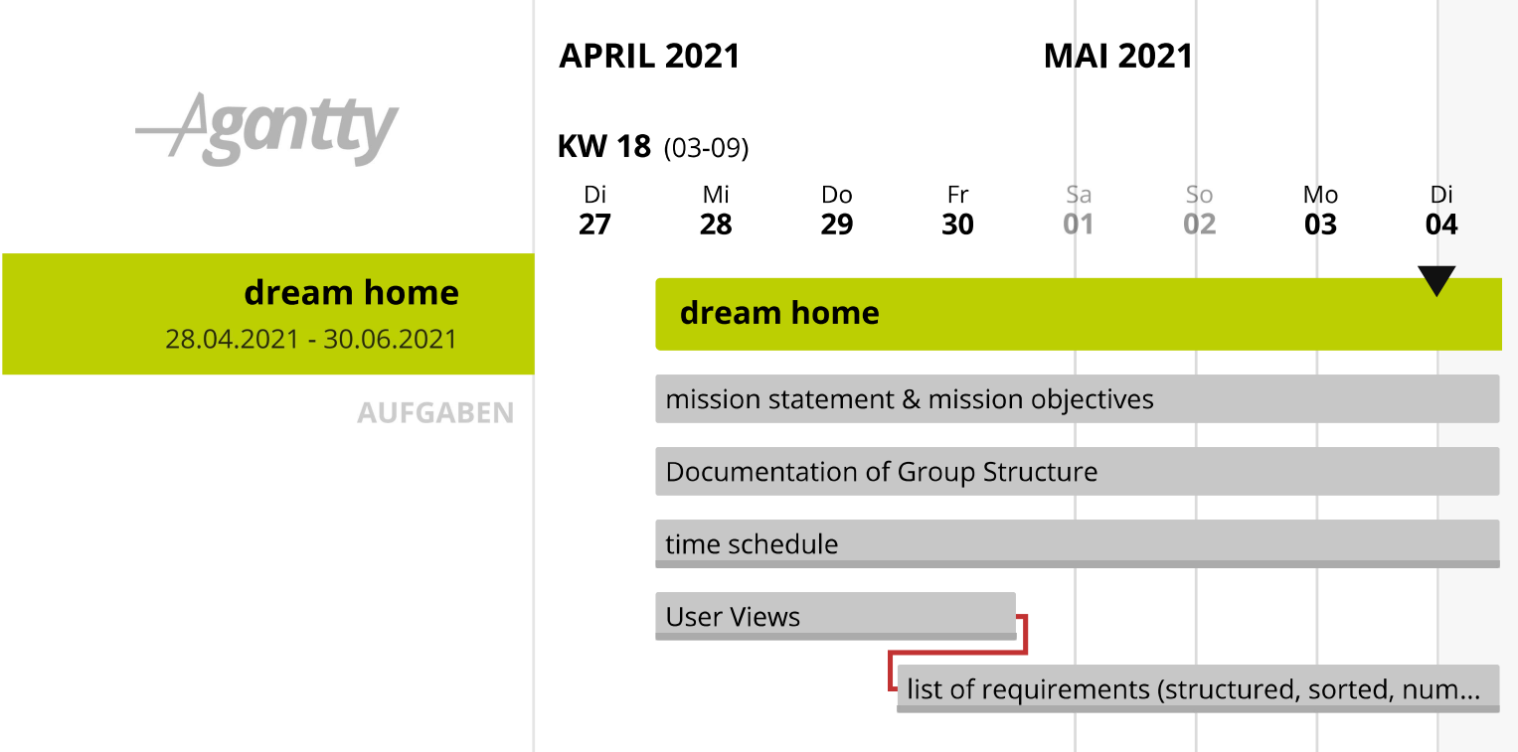
1. Milestone
Goal: To organize the team and define the borders of the projects and to documented the first user views and requirements.

Slide 5
1. Milestone
Mission statement | Mission objectives
The property management/E-Ship Information System is used by employee of Dream Home: to manage the daily business regarding monitoring and handling incoming payment in relation to the managed properties. The main focus will be on the automatic processing and validation of the data. | Display paid rents. Upload, decomposition and transformation of account detail. Partitioning of the costs for the clients and display them via PDF or CSV.

Slide 6
1. Milestone
1. Use Case:
Actor | employee of Dream Home
Preconditions | new monthly statement of bank account available
Trigger | Employee starts the upload manually
Basic Flow | Every month an employee of Dream Home loads up the csv file to receive information about the bank account and it’s transactions. The system divides up the transactions to the renters and homes. To divide up the operating costs the system uses several allocation keys. (number of persons living in the flat – get from lease contract; Behälter – get from lease contract; Wohnfläche get from lease contract; Einzelabrechnung – get from number of flats)
Alternative Flow | If wrong file with wrong information, print error message for user. If no new information is available, print error message for user. If allocation keys can’t be found, print error message for user.

Slide 7
1. Milestone
1. Use Case:
Actor | employee of Dream Home
Preconditions | new monthly statement of bank account available
Trigger | Employee starts the upload manually
Basic Flow | Every month an employee of Dream Home loads up the csv file to receive information about the bank account and it’s transactions. The system divides up the transactions to the renters and homes. To divide up the operating costs the system uses several allocation keys. (number of persons living in the flat – get from lease contract; Behälter – get from lease contract; Wohnfläche get from lease contract; Einzelabrechnung – get from number of flats)
Alternative Flow | If wrong file with wrong information, print error message for user. If no new information is available, print error message for user. If allocation keys can’t be found, print error message for user.

Slide 8
1. Milestone
2. Use Case:
Actor | Employee of Dream Home
Preconditions | Csv file uploaded
Trigger | new month/ new year; request of customer
Basic Flow | The system searches for specific customer figures (already allocated). The system checks whether there have been some positive or negative transfers/ pre-payments of the specific renter and add these to the operating cost statement. The system sums up the operating costs of specific renter and substracts the sum of pre-payments of specific renter. After this all operating cost statement are going to be send to renters.
Alternative Flow | If system can’t find information of customers, print error message for user.

Slide 9
1. Milestone
3. Use Case:
Actor | Employee of Dream Home
Preconditions | Csv file uploaded
Trigger | new month
Basic Flow | The system searches for specific customer figures. The system stores all payments of specific customer in an accounting file and shows difference. The system checks if the customer has payed this month. The system checks if there are some open payments for the last months.
Alternative Flow | If check (or calculation) of accounting file can’t be done, print error message for user.

Slide 10
1. Milestone
Functional requirements | Non-functional requirements
The information system must verify the statement of bank accounts. be able to receive statement of bank account csv files. be able to print tables and information (operating cost statement; missing payments) as a pdf. be able to show operating cost statements and missing payments. calculate the operating cost statement. relate the cost positions to a building and distribute the costs to the different renters by a certain key. give the user the possibility to create, update and delete renters. not send the operating cost statements per e-mail. | The information system must use a MS SQL Server. The logic should (if possible) run on the database server. The information system needs a graphical interface

Slide 11
Agenda
Milestone
Goal
Mission statement
Mission objectives
User views (use cases)
List of requirements
Milestone
All SQL code
Java or source code of project
Sql-code for data loading
list of successful and failed test cases
Milestone
Conceptual data model on paper
Data catalogue
List of all relevant entities and
relationships for each user view
Milestone
Conceptual Data Model In Case-tool
Logical Data Model
Proof that all relations are in BCNF or
explanation why not

Slide 12
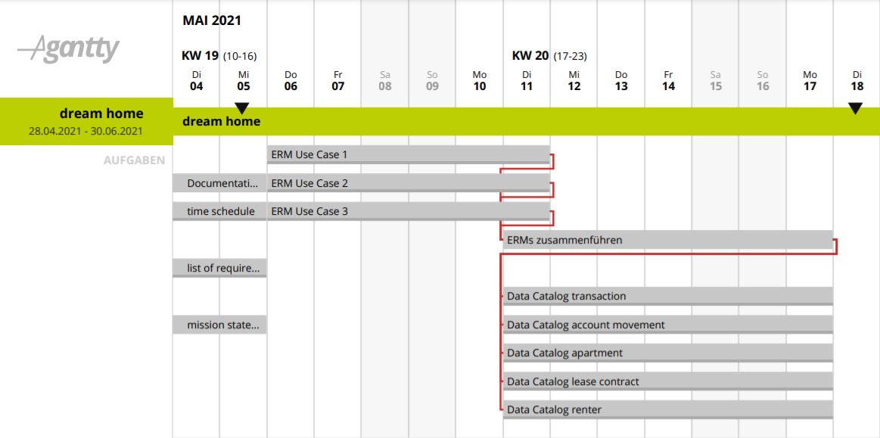
2. Milestone
Gantt Diagramm

Slide 13
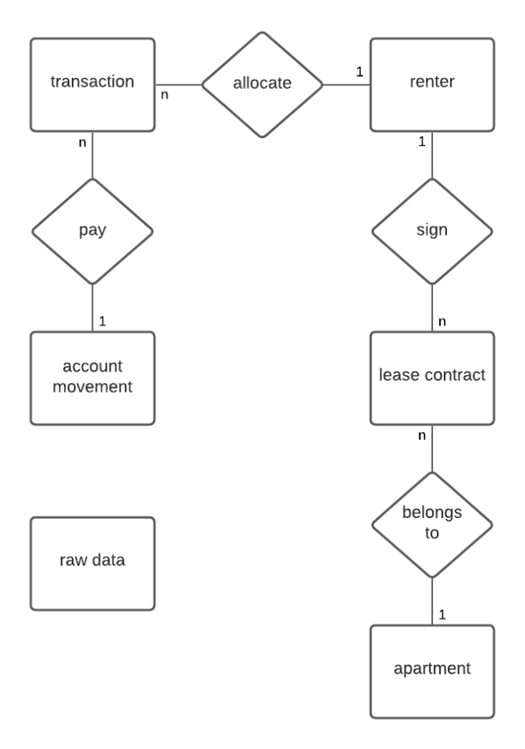
2. Milestone
ERM 1: Csv file upload
Relevant entities and relationships
PostingDate
PaymentReason
AmmountOfPayment
DebtorCreditor_ID
Renter_ID
NumberOfPersons
Size
Lease_Amount
AdditionalCost

Slide 14
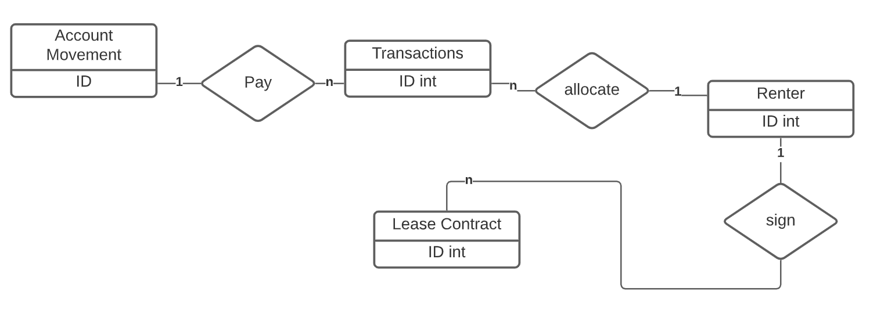
2. Milestone
ERM 2: Operating cost statement

Slide 15
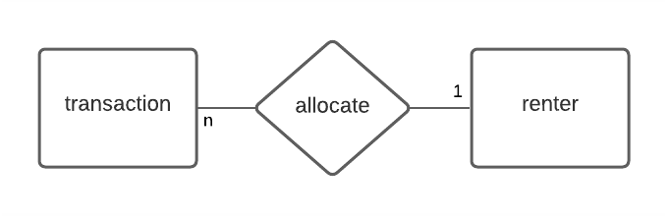
2. Milestone
ERM 3
Relevant entities and relationships
Renter_ID
TransactionAmount

Slide 16
2. Milestone
Entity Name | Attributes | Description | Data Type & length | Constraints
Transaction | AccountMovement_ID | FK from Table Account Movement | int | Foreign Key (composite key1)
 | Renter_ID | FK from Table Renter | int | Foreign Key (composite key2)
 | PostingDate | Date of the transaction | Date | Not Null
 | PaymentReason | Explanation of the transaction | varchar | Not Null
 | TransactionAmount | Amount of money | money | Not Null
Renter | Renter_ID | Unique identification | int | Primary Key
 | rLastname | Last Name of the tenant | varchar | Not Null
 | rFirstname | First Name of the tenant | varchar | Not Null
 | rPostcode | Adress of the tenant | int | Not Null
 | rCity |  | varchar | Not Null
 | rStreet |  | varchar | Not Null
 | rGender | Gender of the tenant | char | Not Null
Account Movement | AccountMovement_ID | Unique identification | int | Primary Key
 | PostingDate | Date of the transaction | Date | Not Null
 | PaymentReason | Explanation of the transaction | varchar | Not Null
 | AmountOfPayment | Amount of money | money | Not Null
 | DebtorCreditor_ID | Name of Payer | varchar | Not Null
 | RawData_ID | FK from Table raw data | int | Foreign Key
Lease Contract | Contract_ID | Unique identification | int | Primary Key
 | Renter_ID | FK from Table Renter | int | Foreign Key
 | Appartment_ID | FK from Table Apartment | int | Foreign Key
 | Lease_amount | Monthly Lease | money | Not Null
 | DateOfSignature | Date the lease was signed | Date | Not Null
 | NumberOfPersons |  | int | Not Null
 | Additional costs | Information about add. costs | money | Not Null
 | Security_Deposit | Amount of money | money | Not Null
Appartment | Appartment_ID | Unique identification | int | Primary Key
 | Max_Renter | Number of maximum renters in this appartment | int | Not Null
 | Size | Size of appartment in m² | float | Not Null
 | Appartment_number | number of appartments in house | int | Not Null
 | Number_rooms | Number of rooms in appartments | int | Not Null
 | House_Number | get number of appartments in house | int | Not Null

Slide 17
2. Milestone
GUI Sites
Renter, Apartment and lease contract: overview, details and new
Upload CSV file
Open positions
Operating cost statements

Slide 18
Agenda
Milestone
Goal
Mission statement
Mission objectives
User views (use cases)
List of requirements
Milestone
All SQL code
Java or source code of project
Sql-code for data loading
list of successful and failed test cases
Milestone
Conceptual data model on paper
Data catalogue
List of all relevant entities and
relationships for each user view
Milestone
Conceptual Data Model In Case-tool
Logical Data Model
Proof that all relations are in BCNF or
explanation why not

Slide 19
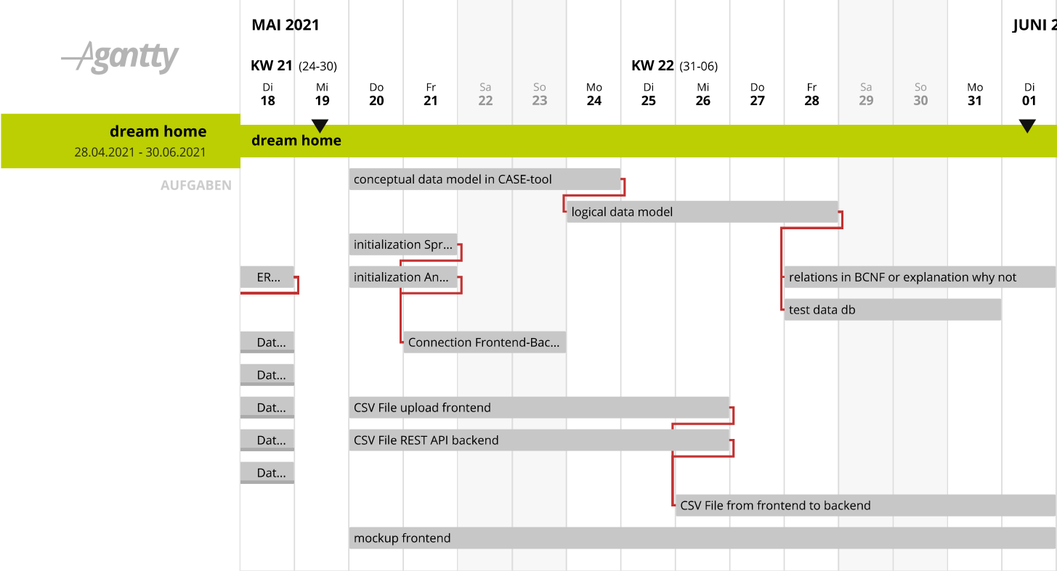
3. Milestone
Gantt Diagramm

Slide 20
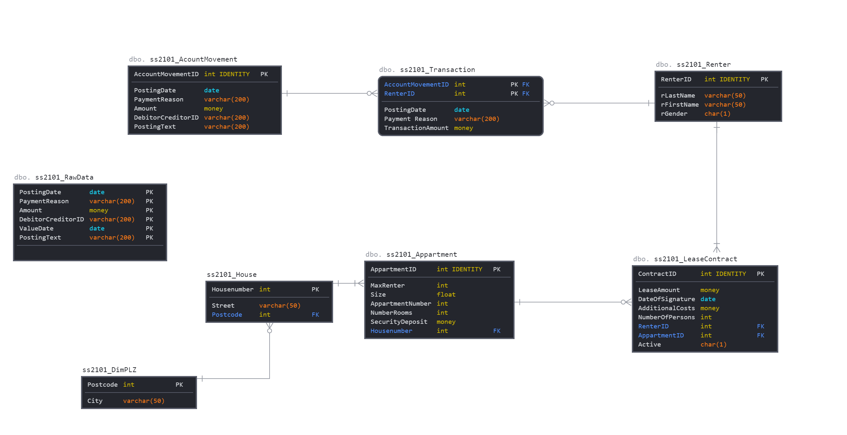
3. Milestone

Slide 21
3. Milestone - SS2101_AccountMovement
Account MovementID | PostingDate | Payment Reason | Amount | Debitor CreditorID | PostingText
PK
No Transitive Dependencies (No additional Debitor-Creditor Info)
No Partial Dependencies (Due to no composite PK)
Every Determinant is a candidate key

Slide 22
3. Milestone - SS2101_Transaction
Account MovementID | RenterID | PostingDate | Payment Reason | Transaction Amount
Composit PK
CK
No Transitive Dependencies
3 Partial Dependencies

Slide 23
3. Milestone - SS2101_Renter
RenterID | rLastname | rFirstname | rGender
PK
No Transitive Dependencies (No additional Debitor-Creditor Info)
No Partial Dependencies (Due to no composite PK)
Every Determinant is a candidate key

Slide 24
3. Milestone - SS2101_LeaseContract
Contract ID | Lease Amount | DateOf-Signature | Additional Costs | Security Deposit | NumberOf Persons | RenterID | Appart-mentID | Active
PK
Assumption: max. 1 LeaseContract per Day per Appartment
Assumption: Renter can only sign for 1 Appartment a day
Transitive Abh. -> Security Deposit in Apparment

Slide 25
3. Milestone - SS2101_Appartment
AppartmentID | MaxRenter | Size | Apparment Number | Number Rooms | PLZ | City | Street | HouseNumber | Security Deposit
PK
Transitive Dependency
RenterID -> rPostcode rPostcode -> rCity
= Insert Postcode Table
No Partial Dependencies (Due to no composite PK)
Every Determinant is a candidate key
Transitive Dependency
AppartmentID -> HouseNumber
HouseNumber -> (Street,PLZ)
= Insert House Table
PLZ
City
Appartment
ID
MaxRenter
Size
ApparmentNumber
NumberRooms
House
Number
Security Deposit
PK
HouseNumber
Street
PLZ

Slide 26
Agenda
Milestone
Goal
Mission statement
Mission objectives
User views (use cases)
List of requirements
Milestone
All SQL code
Java or source code of project
Sql-code for data loading
list of successful and failed test cases
Milestone
Conceptual data model on paper
Data catalogue
List of all relevant entities and
relationships for each user view
Milestone
Conceptual Data Model In Case-tool
Logical Data Model
Proof that all relations are in BCNF or
explanation why not

Slide 27
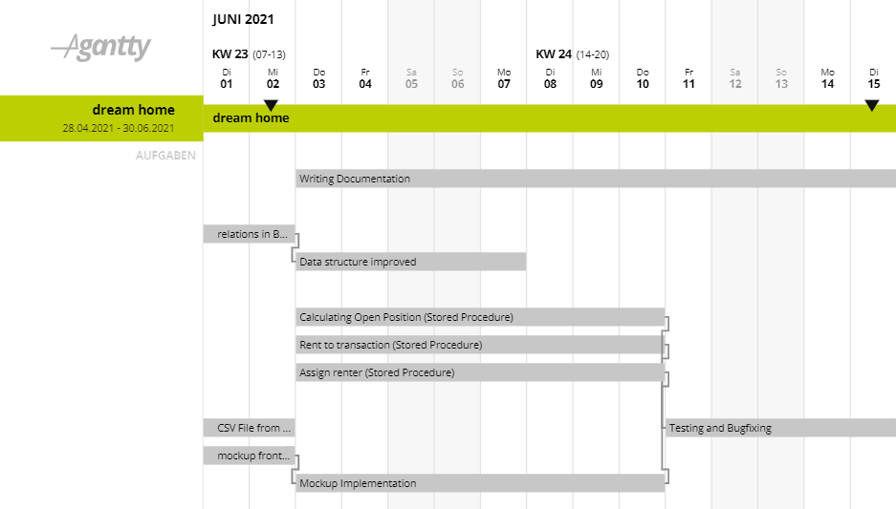
4. Milestone
Gantt Diagramm:
ddd

Slide 28
Thank you for your attention!

