Slide 1

Bioinformatic approaches to regulatory genomics and epigenomics
376-​1347-00L | week 08
Pierre-Luc Germain

Slide 2
Today’s plan
Debriefing on the assignment
Follow-up on last week
Visualizing signals around selected motifs
Motif accessibility analysis
chromVAR, and working with SummarizedExperiment objects
Differential motif accessibility analysis

Slide 3
Debriefing on the assignments
Obtaining mono-nucleosome fragments - cuts:
bam2bw(bam, output_bw = "mono_cuts.bw", paired=TRUE, binWidth=5L, minFragLength=140, maxFragLength=220, type="ends", forceSeqlevelsStyle = "Ensembl")
Obtaining mono-nucleosome fragments - centers:
bam2bw(bam, output_bw = "mono_cuts.bw", paired=TRUE, binWidth=5L, minFragLength=140, maxFragLength=220, type="centers", forceSeqlevelsStyle = "Ensembl")
Notes:
also no enrichment analysis needed for the second question

Slide 4

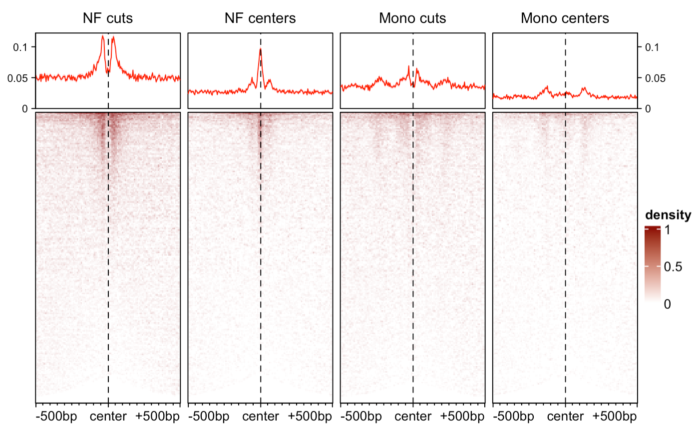

Slide 5


Slide 6
Plotting arguments
plotEnrichedHeatmaps(smb, trim=0.95, colors = c("white","darkred"), minRowVal=15)
Error in if (r[[1]] == r[[2]]) r <- range(unlist(lapply(ml, range))) :
missing value where TRUE/FALSE needed
=> After filtering for a minimal count of 15 per row (i.e. region), there might be no / too little signal across the motif for some TFs for the respective experiment. This leads to no rows being included in the plot.
plotEnrichedHeatmaps(smb, trim=0.95, colors = c("white","darkred"), minRowVal=0)
=> Works because there is no filtering (just very little signal)

Slide 7
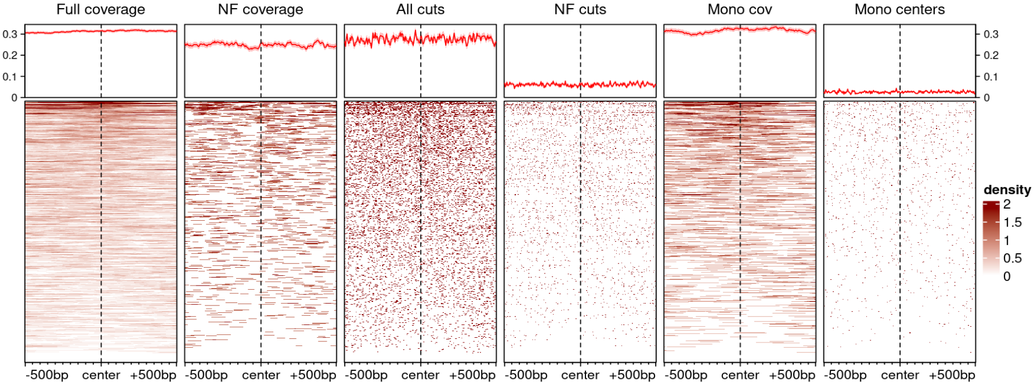
Follow-up on last week
Signal around occurrences of the GATA1 motif in mESC, where the factor is not expressed

Slide 8
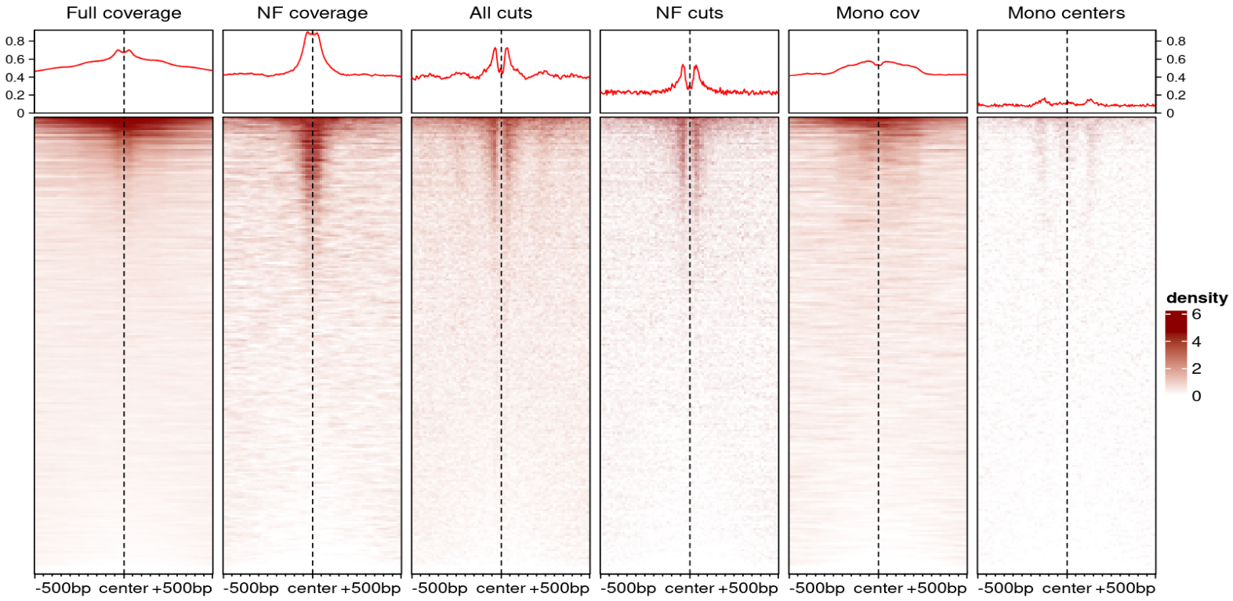
Follow-up on last week
Signal around occurrences of the CTCF motif in mESC
Instances of the CTCF motif that are actually bound
Instances of the CTCF motif that are not bound

Slide 9
Follow-up on last week
Signal around occurrences of the CTCF motif in mESC
Instances of the CTCF motif that are actually bound
Instances of the CTCF motif that are not bound
While this is useful to get an overall picture, most of the time we want to concentrate on the actual sites bound

Slide 10
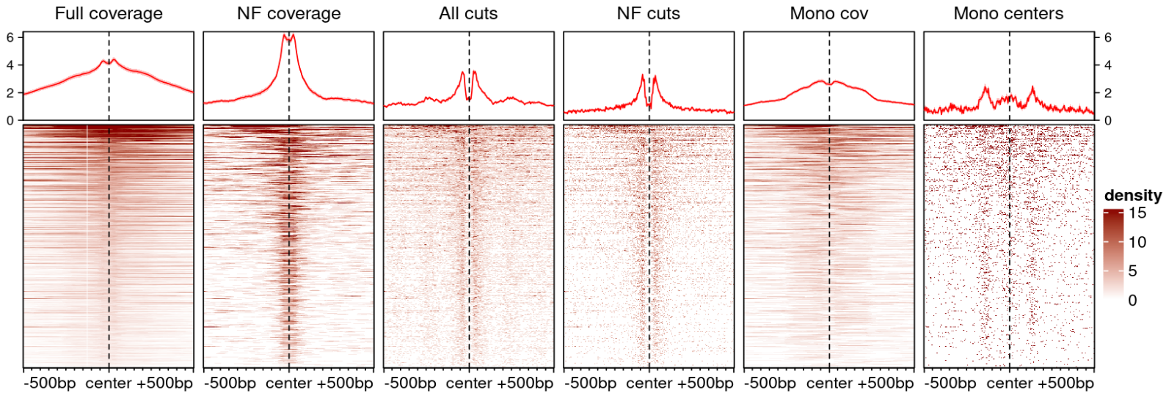
Follow-up on last week
To concentrate on these actual binding events, we can simply restrict the motif occurrences to those within ATAC peaks:
moi <- moi[overlapsAny(moi,peaks)]
Signal around occurrences of the CTCF motif in ATAC-seq peaks

Slide 11
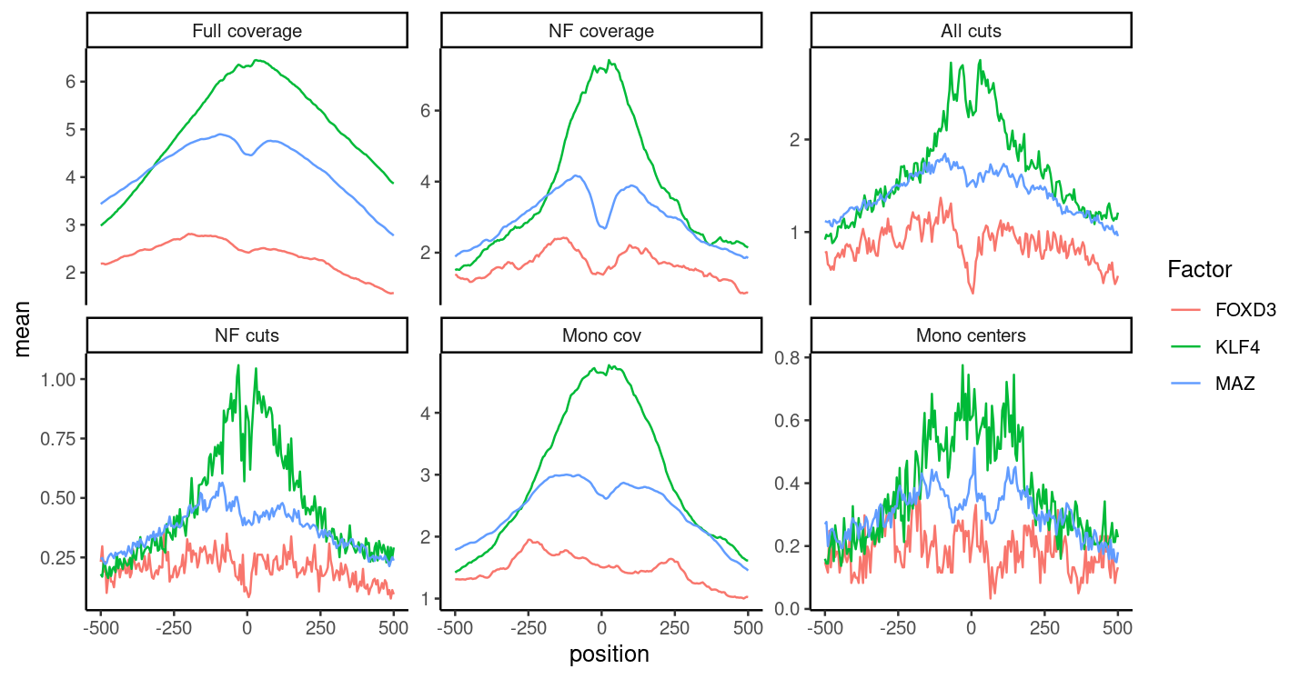
Follow-up on the assignment

Slide 12
Motif accessibility analysis
What if, rather than looking at a few motifs at a time, we could simply quantify the accessibility/activity of every motif?
Several methods have been developed to do this.
(At the moment, it’s unclear which is best.)

Slide 13
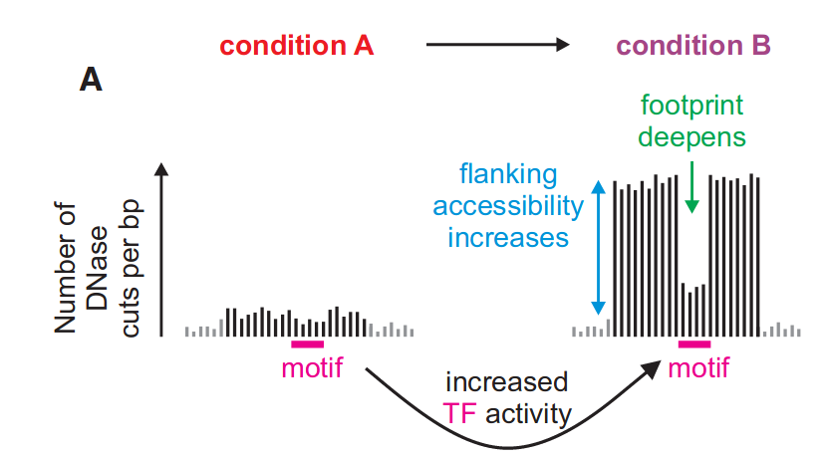
Estimating TF activity from accessibility and footprints
(Baek, Goldstein and Hager, Cell Reports 2017)

Slide 14
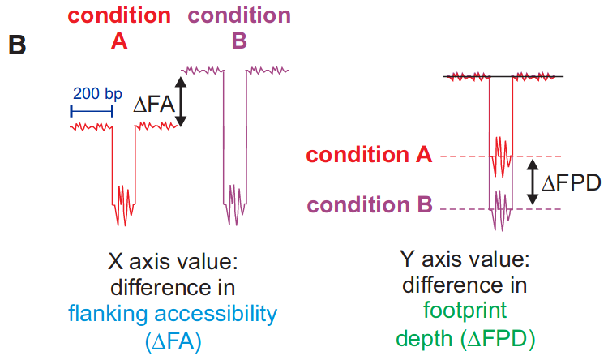
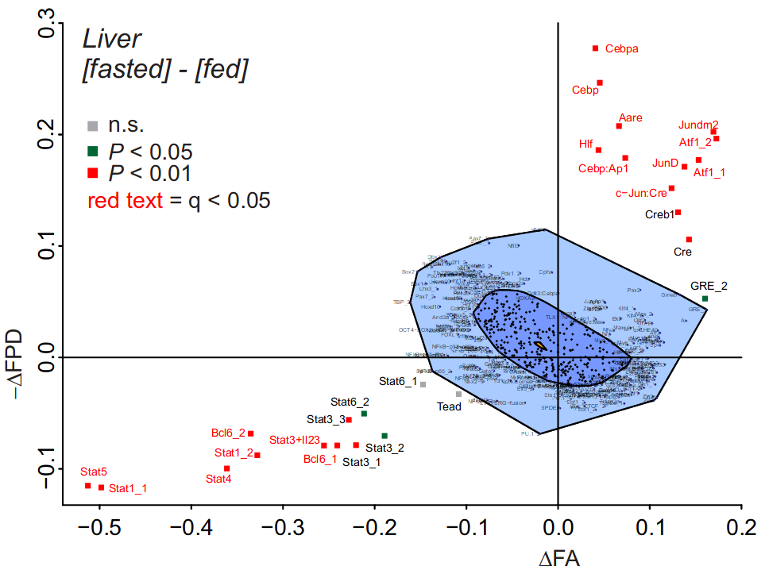
Estimating TF activity from accessibility and footprints
(Baek, Goldstein and Hager, Cell Reports 2017)

Slide 15
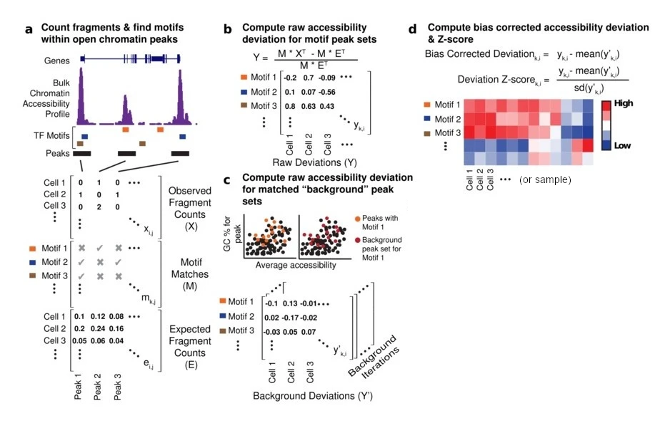
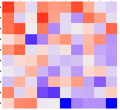
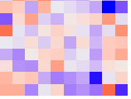
ChromVAR
documentation
chromVAR uses a simpler (and considerably faster) method, which essentially sums the counts of peaks that contain each motif, and compares this to a null distribution of similar peaks that don’t.
samples
samples
peaks
motifs
(adapted from Schep et al.,
Nature Methods 2017)
Although it’s been developed especially for single-cell data, it’s also routinely used for bulk.

Slide 16
Practical:
Motif accessibility analysis with chromVAR

Slide 17
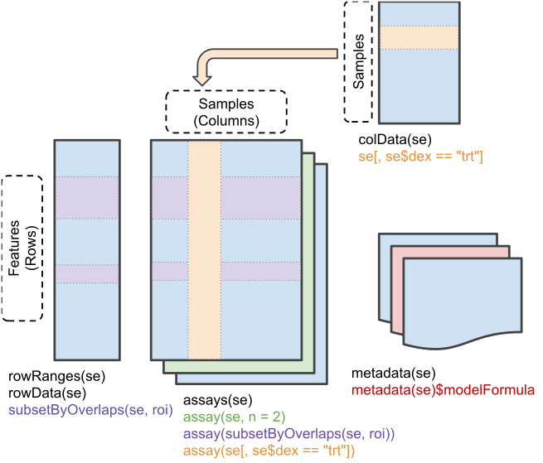
The SummarizedExperiment structure
Documentation

Slide 18
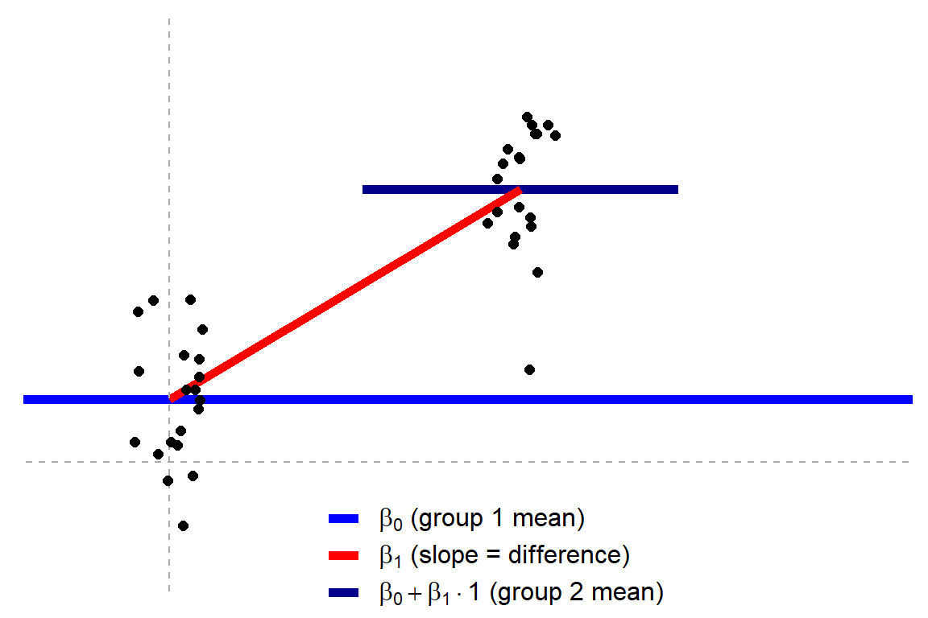
Working with linear models
Most of the common statistical tests can be formulated as linear regression problems
Consider the t-test :
(Taken from an excellent explanation by Jonas Kristoffer Lindeløv)
y~β₀+x*β₁
Where x=0 for group 1 and x=1 for group 2

Slide 19
Working with linear models - some simple examples
For a two group comparison:
~group (equivalent to ~1+group)
Comparing between two groups, correcting for the effect of sex:
~sex+group → then we can still decide to test for the effects of the group by dropping that coefficient
Finding sex-specific effects
~sex*group → equivalent to ~1+sex+group+sex:group

Slide 20
Assignment
Download (a subset of) ATAC-seq peak counts in the hippocampus upon stress (already in SummarizedExperiment format) :
https://ethz-ins.org/content/mouse_mm38_hippocampus.peakCounts.SE.rds
Using this object, perform a chromVAR motif analysis, and run 2 differential motif accessibility analyses, respectively:
comparing stressed (denoted ‘FSS’ – forced swim stress) and control animals
comparing male and female animals
For each analysis, report the top most significant motifs, plot a heatmap of the normalized accessibility scores across the samples for those motifs, and write a short paragraph interpreting the results.

