Slide 1

Bioinformatic approaches to regulatory genomics and epigenomics
376-​1347-00L | week 09
Pierre-Luc Germain

Slide 2
Plan for today
Debriefing on the assignment
Quick primer on count-based (discrete) statistics
Our case study for the practical: GDVS
Differential binding analysis
Normalization methods

Slide 3
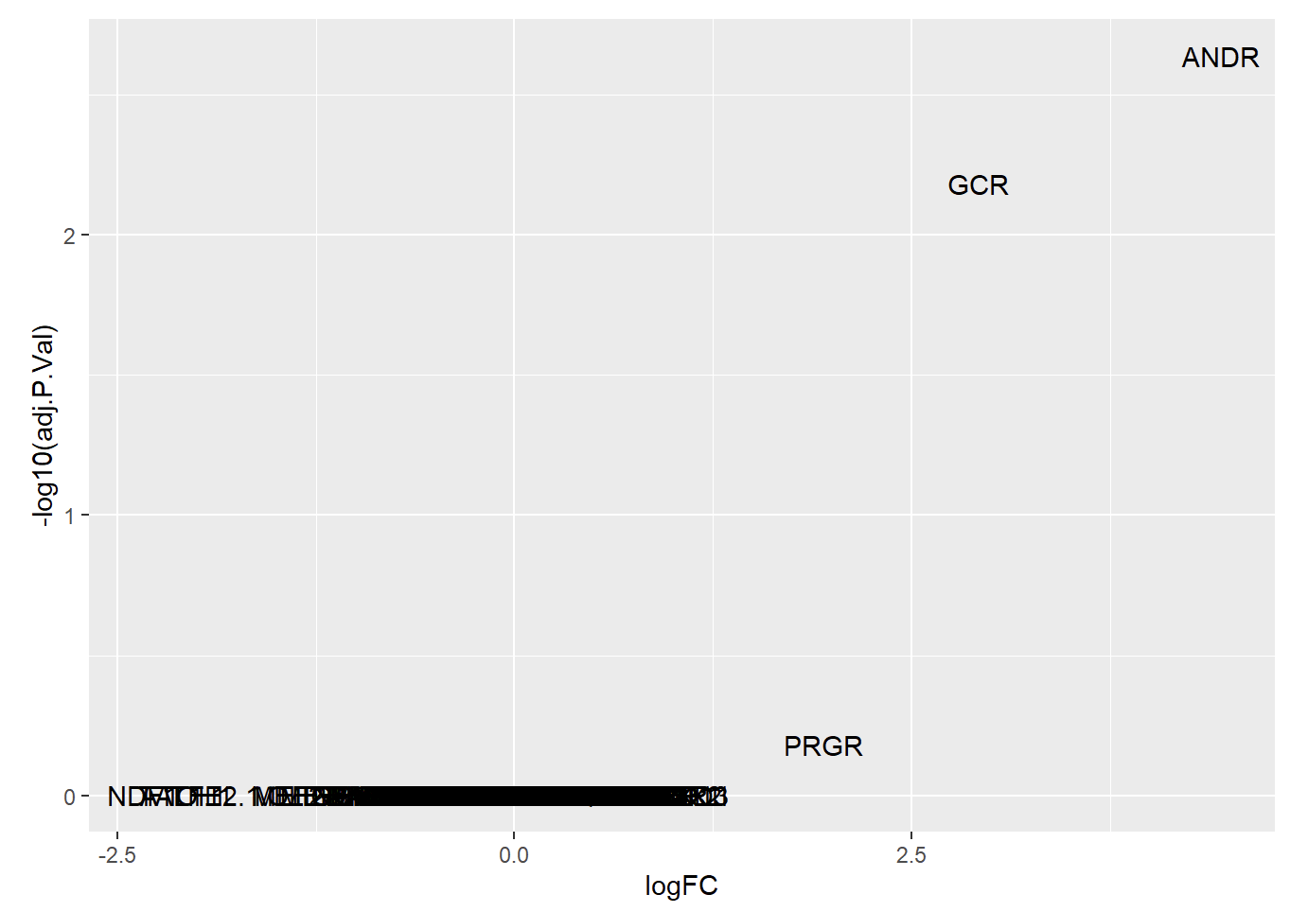
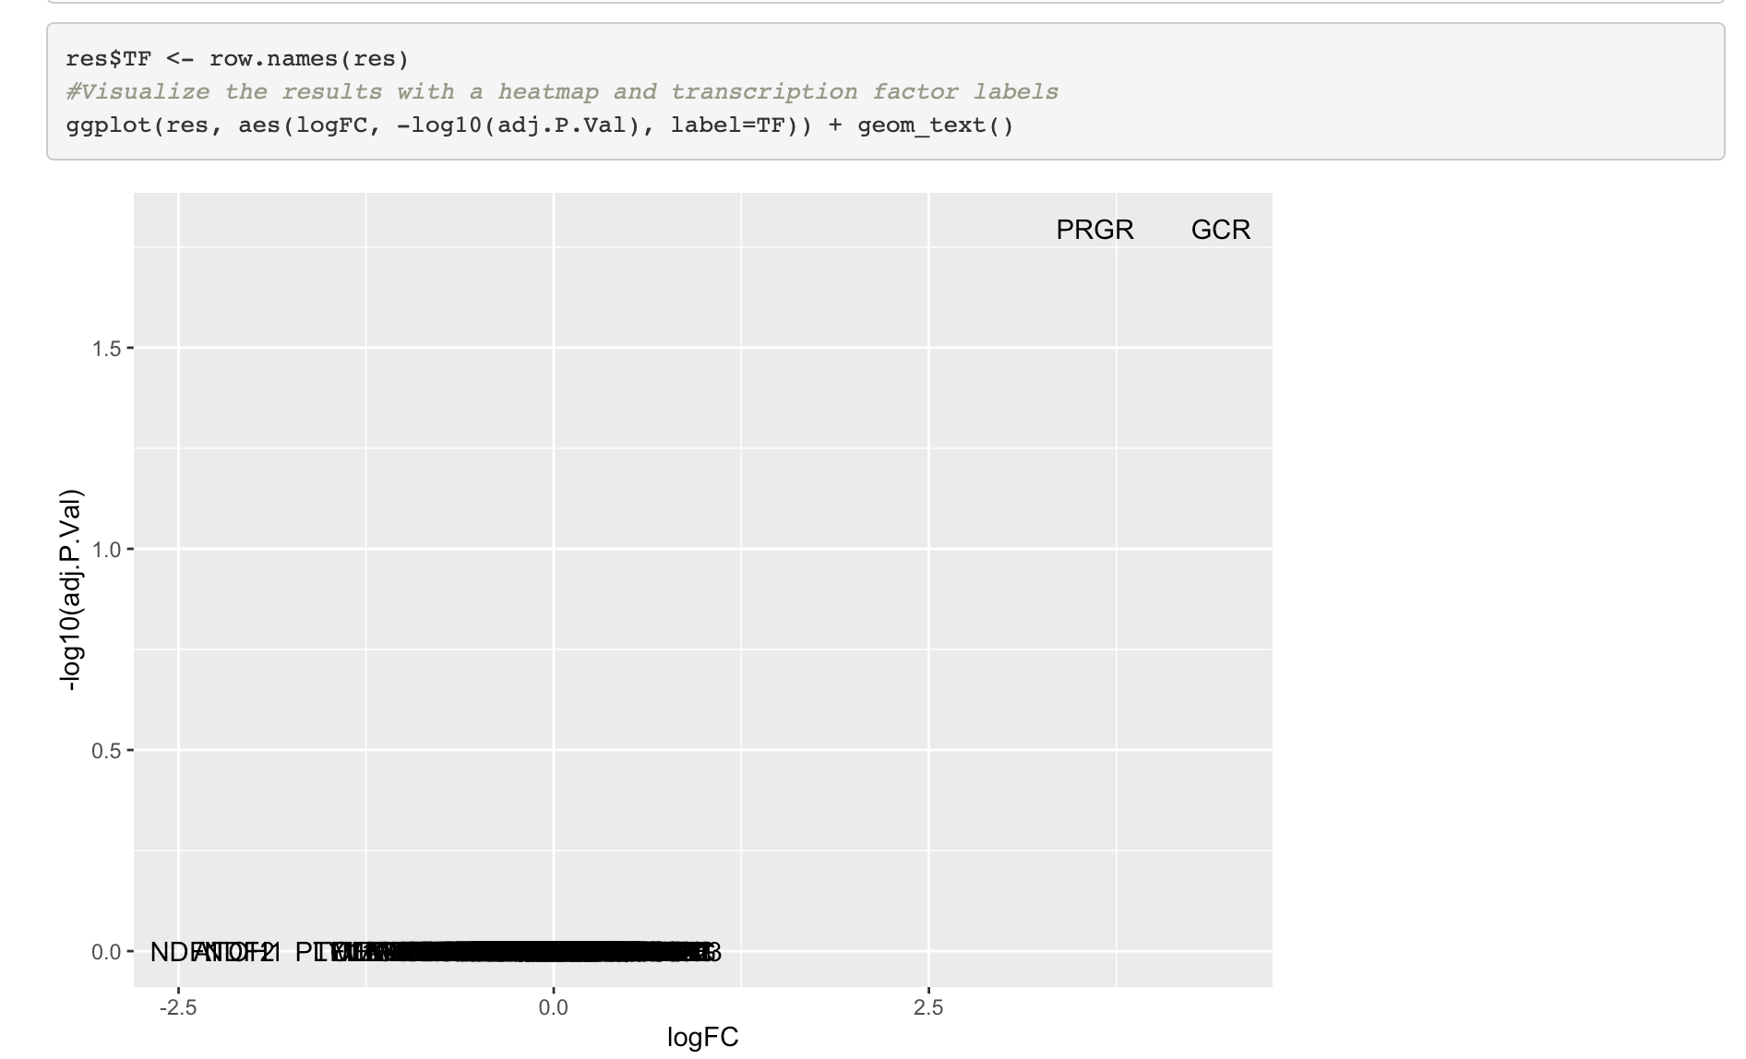
Debriefing on the assignments
Check species!

Slide 4
Debriefing on the assignments
Statistical testing:
mm <- model.matrix(~sex+condition, ...)
and
mm <- model.matrix(~sex, ...)
mm <- model.matrix(~condition, ...)
is not equivalent!

Slide 5
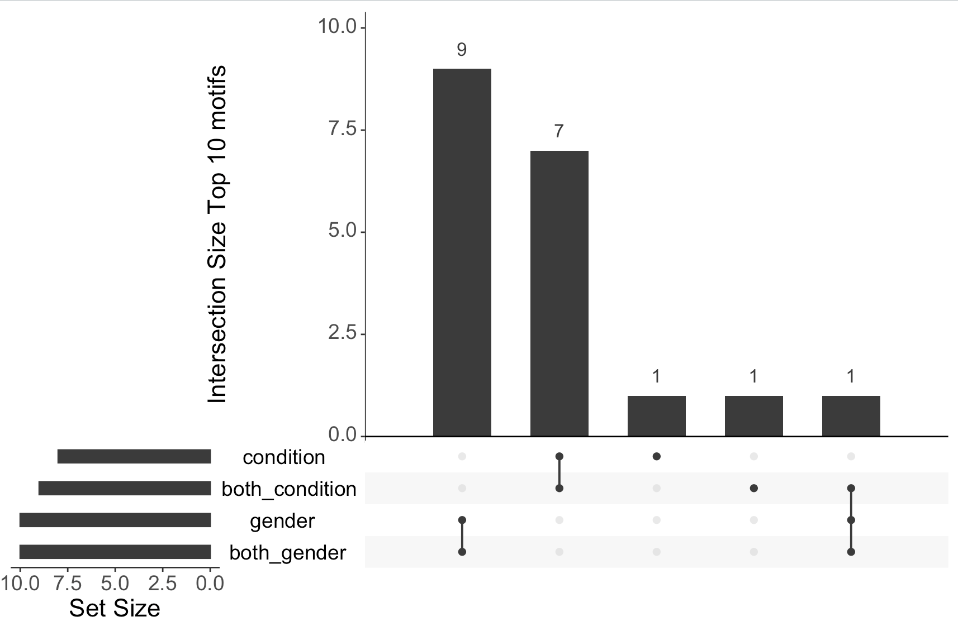

Slide 6
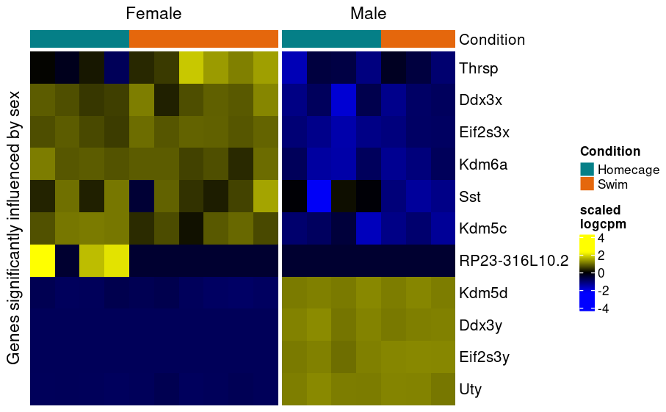
An example (from RNAseq)
Since some genes are stress-responsive, if the model does not include the condition the variability might appear high, leading to a failure to detect sex differences.

Slide 7
Count-based statistics

Slide 8
Count-based statistics
The number of fragments overlapping a given peak is not a continuous variable, but a discrete variable: it can only be non-negative integers.
We must consider this information in the statistical analysis of count data, and so we can’t use statistics based on a normal distribution (e.g. t-tests or standard linear models).
We’ll use generalized linear models, which can be applied on different types of data distributions.

Slide 9

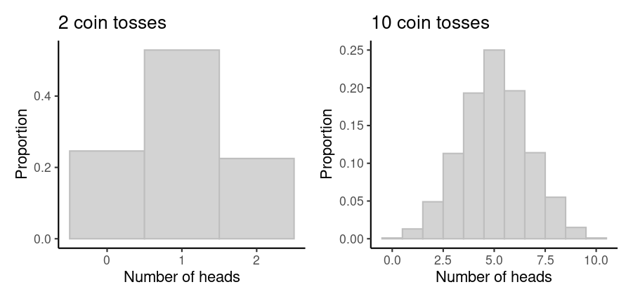
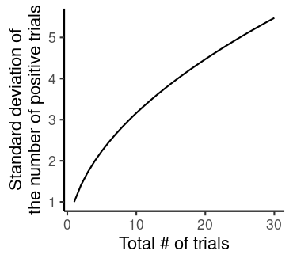
Count-based statistics
Consider coin tossing, where each toss can result in two outcomes.
Suppose each of us toss a coin X times, and we count the number of ‘heads’.
The results are Poisson-distributed,
meaning that the variance is equal to the number of tosses

Slide 10
Count-based statistics
However, counts coming from real phenomena (more complicated than coin tossing) are typically not quite Poisson-distributed: the variance typically increases more than would be expected, in other words they show over-dispersion.
This is typically because of sources of variation other than the random sampling process, which are typically unknown.
For this reason, count statistics are most often analyzed with the negative binomial distribution, which includes an extra dispersion parameter.

Slide 11
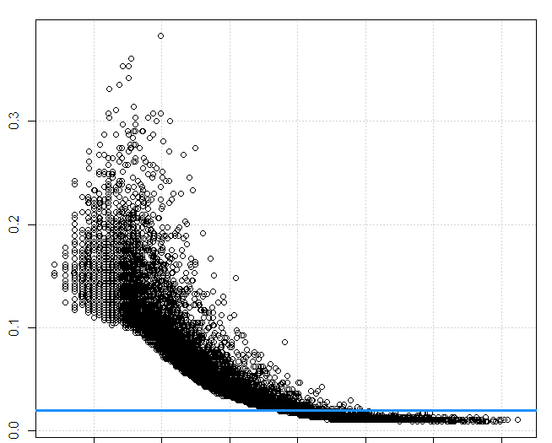
Information-sharing across features
In principle, each feature (e.g. gene or peak) we are analyzing could have a different degree over-dispersion, so that we would have to estimate this parameter separately for each of them.
Typically, we don’t have enough samples to do this accurately.
RNAseq analysis packages such as edgeR therefore rely on a trend between average counts and their overdispersion to moderate those estimates.
We can rely on the same packages for epigenomic data.
Dispersion
log-mean count

Slide 12
Our case study today
Lymphoblastoid cells from patients with Gabriele-de Vries syndrome (and controls)
OMIM:
“Gabriele-de Vries syndrome is an autosomal dominant neurodevelopmental disorder characterized by delayed psychomotor development, variable cognitive impairment, often with behavioral problems, feeding problems, some movement abnormalities, and dysmorphic facial features. Affected individuals may also have a variety of congenital abnormalities.”
Caused by haploinsufficiency in the YY1 gene
Data: YY1 ChIP-seq in mutant and control lymphoblastoid lines
(Gabriele, Vulto-van Silfhout, Germain et al., AJHG 2017)

Slide 13
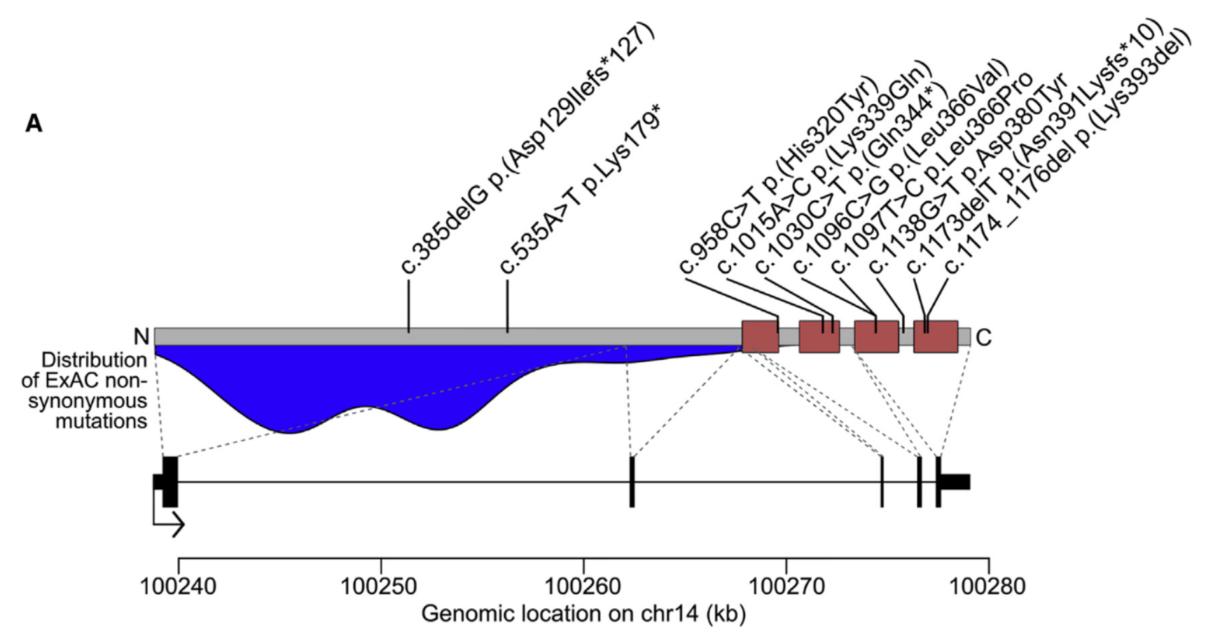
Our case study today
YY1
(Gabriele, Vulto-van Silfhout, Germain et al., AJHG 2017)

Slide 14
Practical

Slide 15
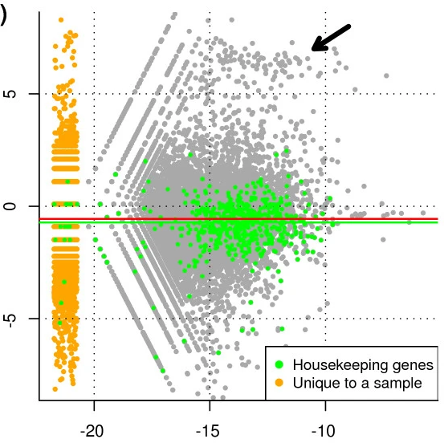
Normalization
Standard TMM normalization in edgeR assumes that the majority of regions don’t change across condition.
M = log2(foldchange) between samples
A = mean log-expression across samples
(Adapted from Robinson & Oshlack, Genome Biology 2010)

Slide 16
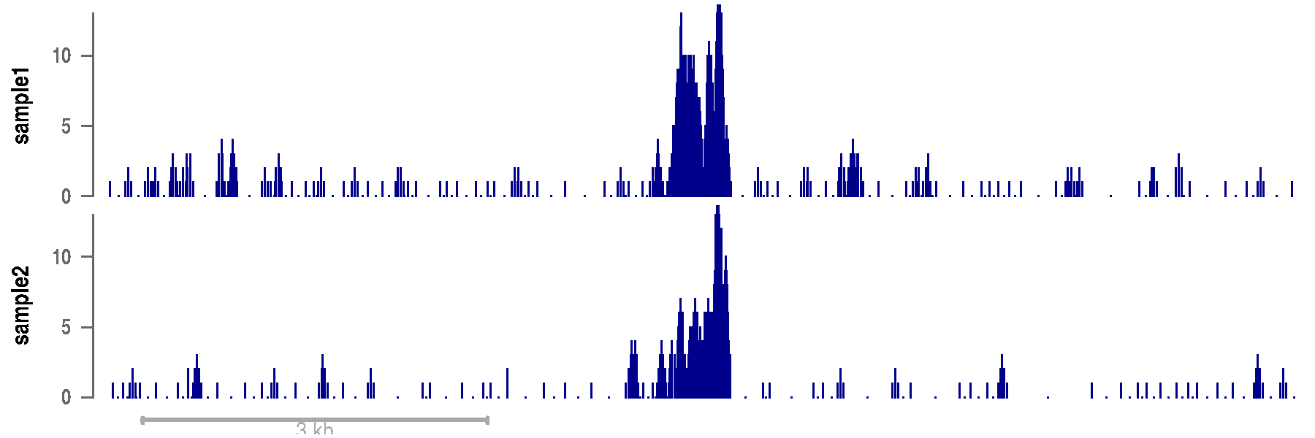
Normalization
Standard TMM normalization in edgeR assumes that the majority of regions don’t change across condition.
This does not work when there are global increases or decreases (i.e. at most sites) between conditions
Background normalization assumes that the background noise is the same across experiments

Slide 17
Normalization
Standard TMM normalization in edgeR assumes that the majority of regions don’t change across condition.
This does not work when there are global increases or decreases (i.e. at most sites) between conditions
Background normalization assumes that the background noise is the same across experiments
This often works nicely, but can create artifactual differences in highly-enriched regions when the quality of the enrichment differs a lot between experiments
Common (or top) peak normalization (e.g. MAnorm, Shao et al., Genome Biology 2012) assumes that the regions that are significantly enriched in both conditions don’t change
S3norm (Xiang et al., NAR 2020) performs both background and common peak normalization

Slide 18
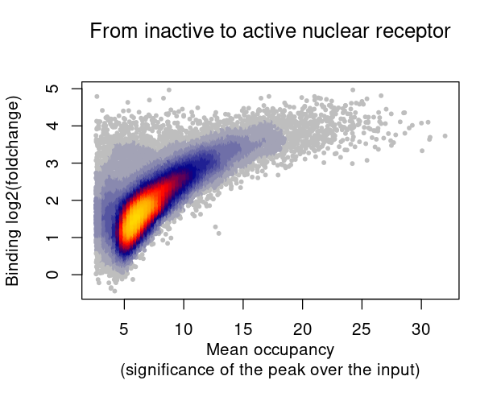
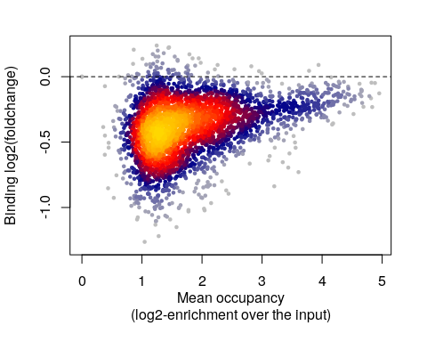
When the amount/activity of a TF is changed, not all sites change in binding equally
YY1 haploinsufficiency
When activating a TF that wasn’t active at all, the TF goes to high-occupancy sites, and these sites tend to show the largest changes in binding
When reducing a TF that’s already active, the TF also tends to keep going to the high-occupancy sites, so the low-occupancy sites are those that tend to show the largest change
* co-factors can influence these dynamics

Slide 19
Assignment
Until next week, come up with a preliminary plan for your project, summarizing:
What is the topic?
What data will you be using?
What are the analyses you wish to reproduce, or the questions you wish to answer?
This is not a final plan, but the start of a discussion!
Write that up in a Rmarkdown that you can render and upload to your repository.

