Slide 1

Bioinformatic approaches to regulatory genomics and epigenomics
376-​1347-00L | week 07
Pierre-Luc Germain

Slide 2
Today’s plan
(update epiwraps, download data)
Debriefing on the assignment
DNA accessibility
ATAC-seq analysis (practical)
Nucleosome positioning

Slide 3
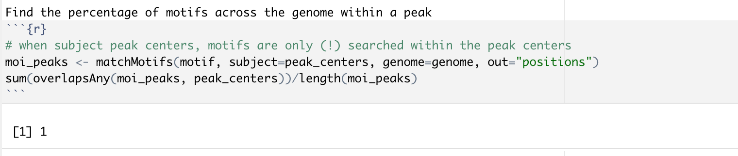
Debriefing on the assignments
Searching for matches: choose the subject carefully !

Slide 4
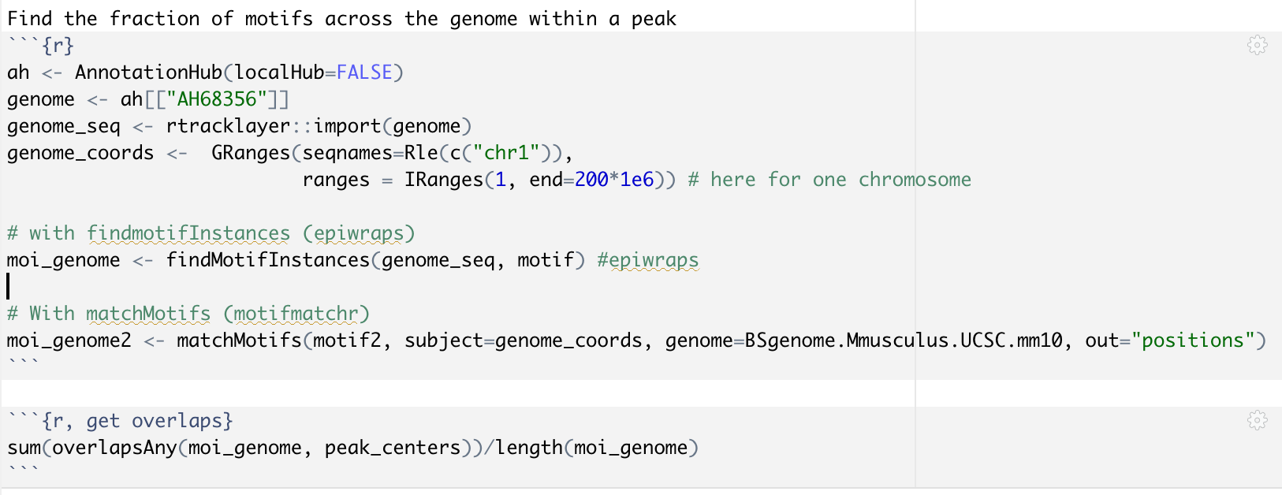
Debriefing on the assignments
Searching for matches: choose the subject carefully !
correct:
Notes:
also no enrichment analysis needed for the second question

Slide 5
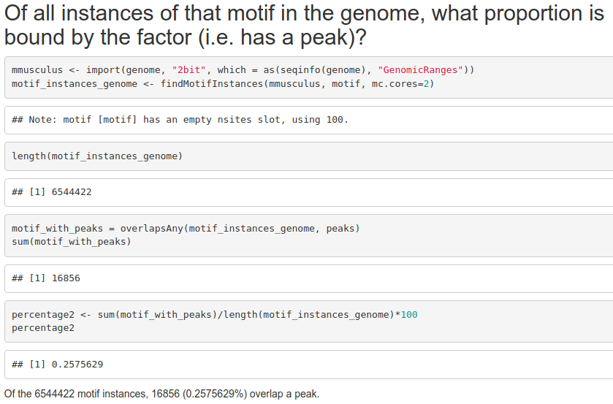
TF: GATA1
Of the 9675 GATA1 peaks, 7277 (~75%) contain a GATA1 motif, but…

Slide 6
Debriefing on the assignment – wrapping up
The proportion of binding sites that show the motif depends on the TF (ranging from roughly 20 to 95%)
The proportion of (genome-wide) motif instances that are bound by the factor is typically very very small
This means that something else determines whether a genomic region will be bound

Slide 7
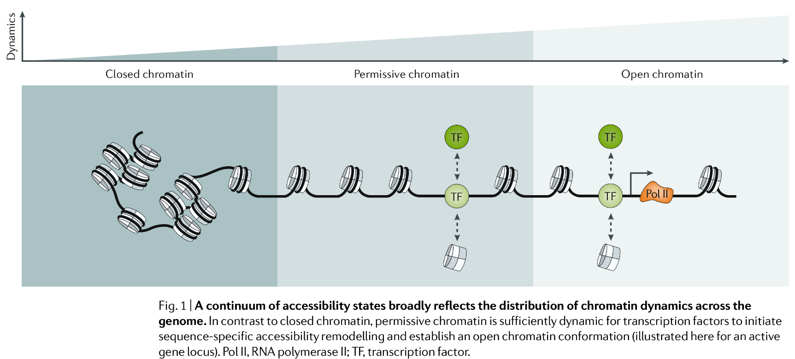
DNA accessibility, which is associated to lower nucleosome density, reflects activity
(Klemm, Shipony and Greenleaf, 2019)

Slide 8
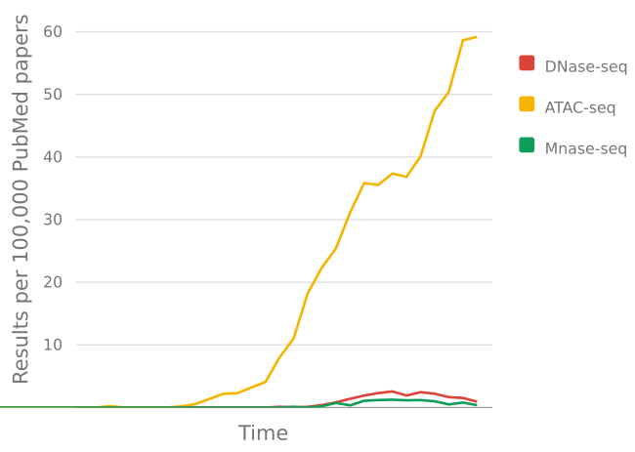
Returning to our very brief history of genetics & genomics
…
1900 - Rediscovery of Mendel’s work (1860s)
1913 - Chromosomes are linear arrays of genes
1941 - the one-gene-one-enzyme hypothesis
1944 - DNA is the genetic material
1951 - First protein sequenced
1977 - DNA sequencing
1977 - Eukaryotic genes are spliced
1995 - First bacterial genomes sequenced
2000 - Next Generation Sequencing (NGS)
2001 - Draft of the human genome
2003 - RNA-seq
2006 - ChIP-seq
2008 - DNAse-seq, MNase-seq
2012 - ATAC-seq
…
Accessibility
assays

Slide 9
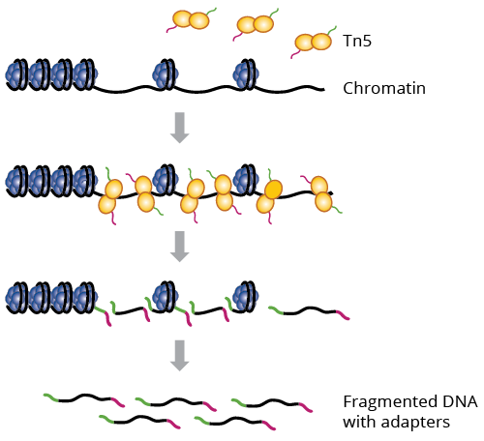
ATAC-seq
ATAC-seq recently became extremely popular due to its information content and low material requirement (i.e. # cells)

Slide 10
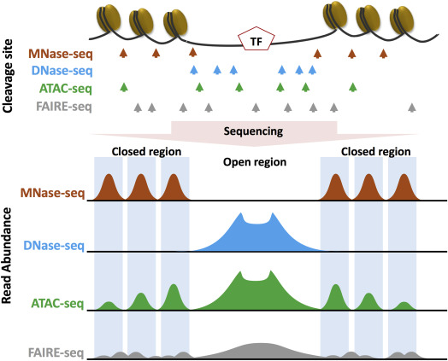
Chromatin accessibility assays
Nucleosome positions
DNase1-hypersensitive sites (DHS) → regulatory elements
Both
(Hsu et al., Epigenetics in Human Disease, 2018)

Slide 11
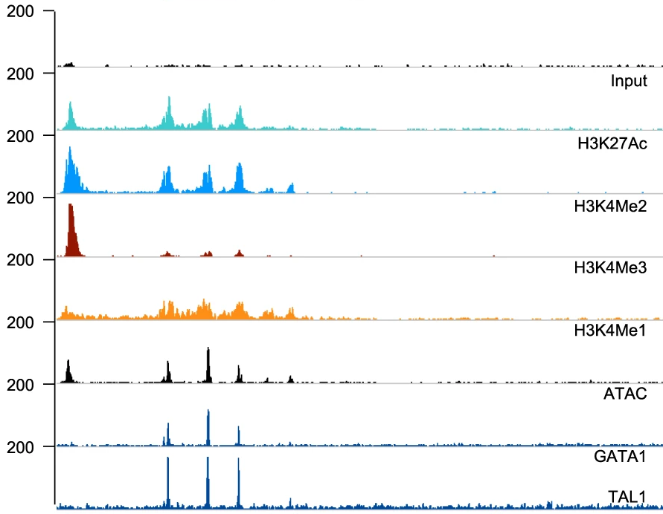
ATAC signal tells us that something is happening, it just doesn’t tell us what exactly…
ChIP-seq
ChIP-seq
(Adapted from Fox et al., Nat Comm 2020)

Slide 12
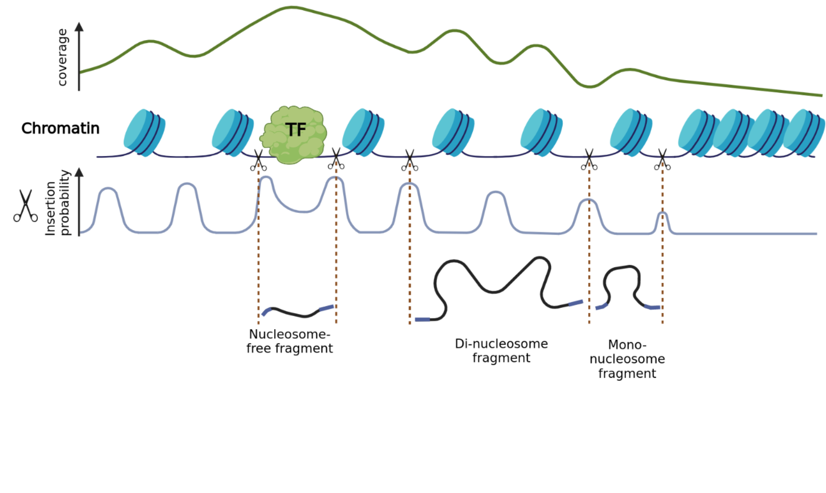
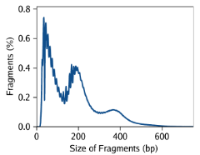
ATACseq
% fragments
NF mono- di-
(CC BY-SA plger, made with Biorender)

Slide 13
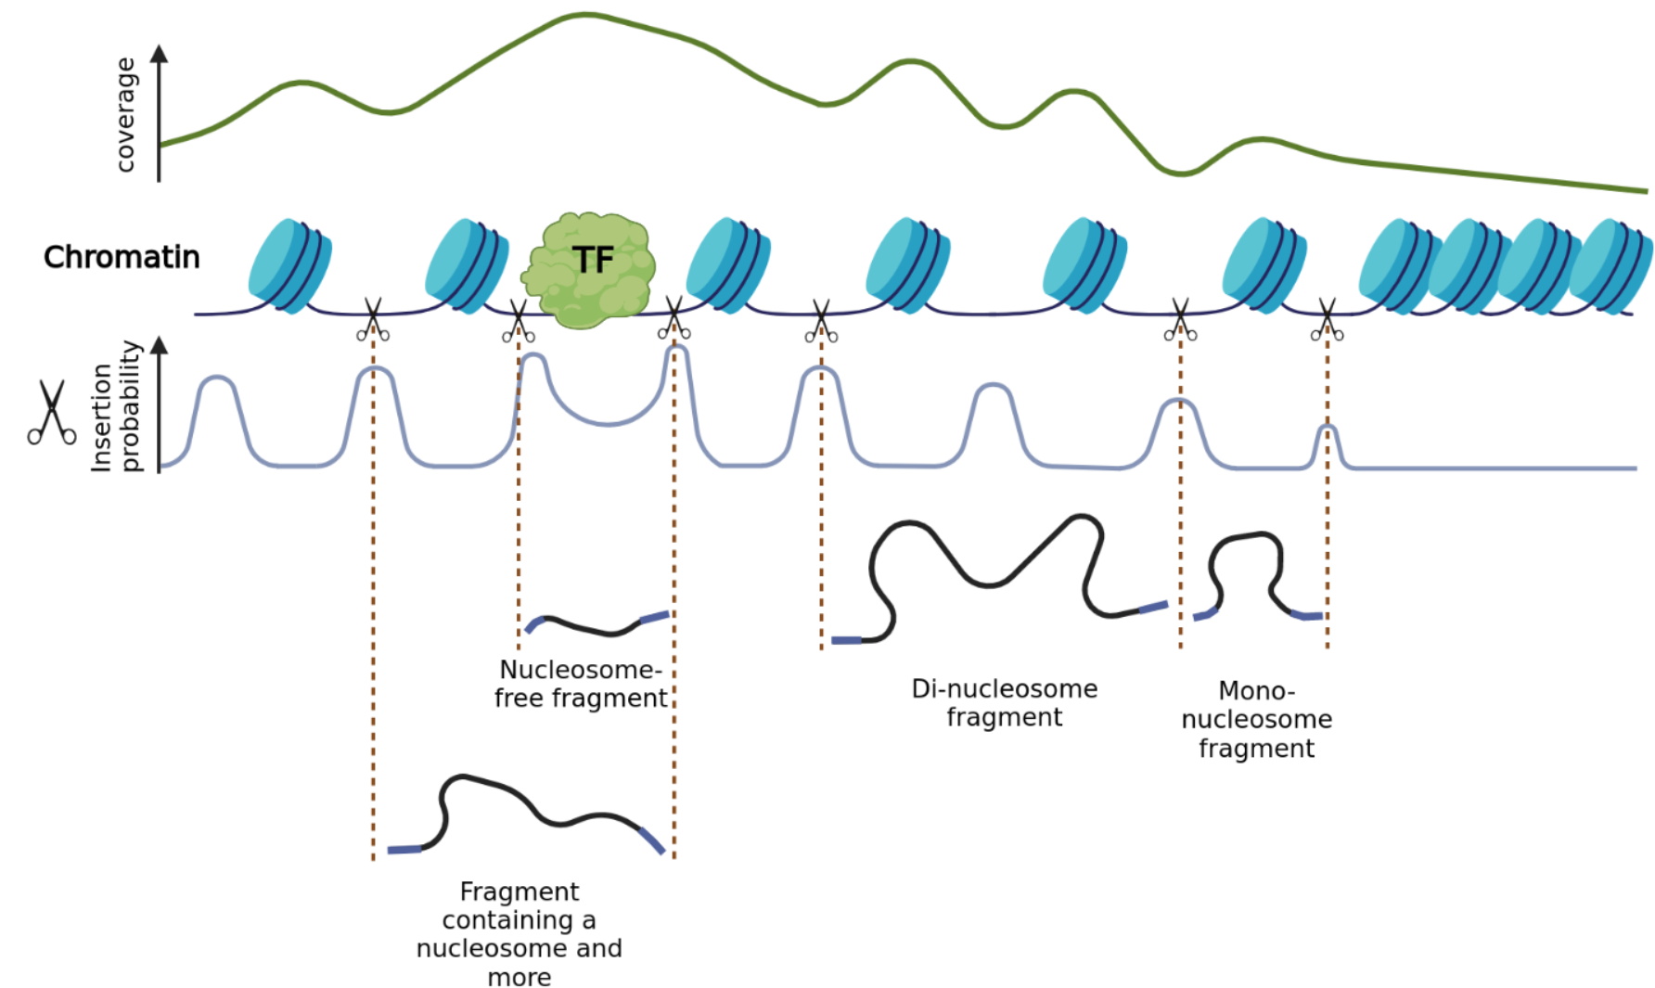
ATACseq
NF mono- di-
(CC BY-SA plger, made with Biorender)

Slide 14
This means that once we have the data, we can split the fragments according to size in order to obtain specific information about different kinds of chromatin signals
Nucleosome-free signal → Transcription factors
Nucleosome
signal

Slide 15
Practical

Slide 16
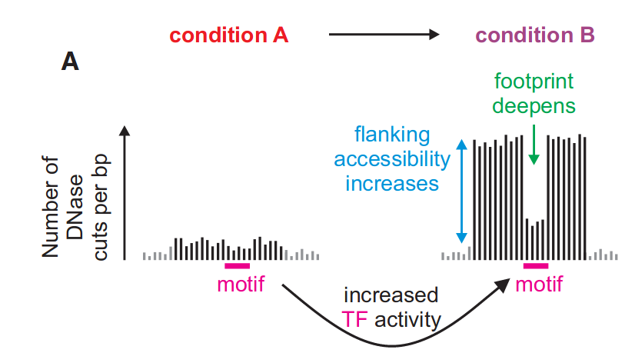
Estimating TF activity from accessibility and footprints
(Baek, Goldstein and Hager, Cell Reports 2017)

Slide 17
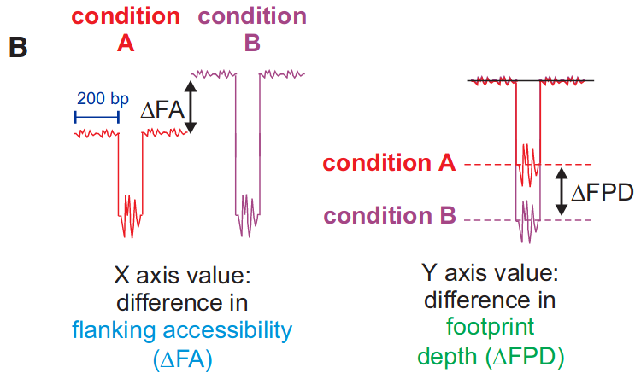
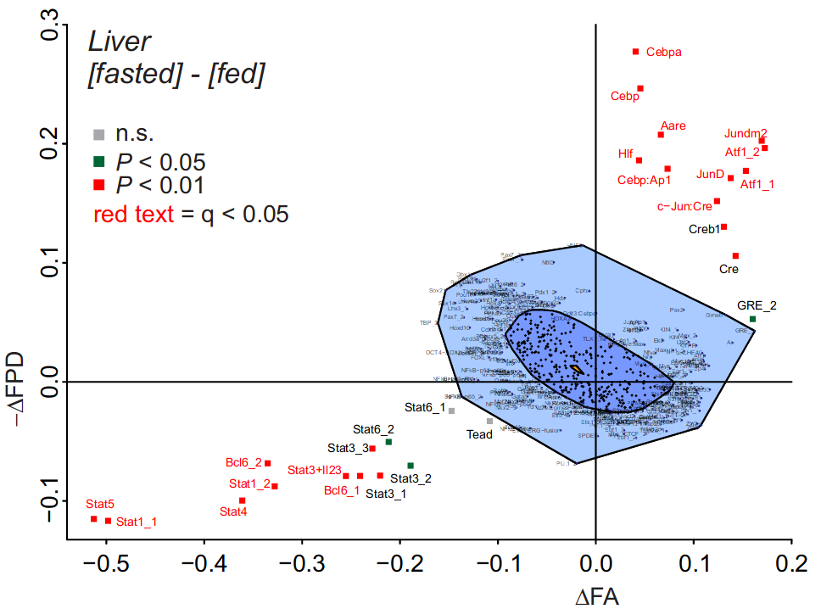
Estimating TF activity from accessibility and footprints
(Baek, Goldstein and Hager, Cell Reports 2017)

Slide 18
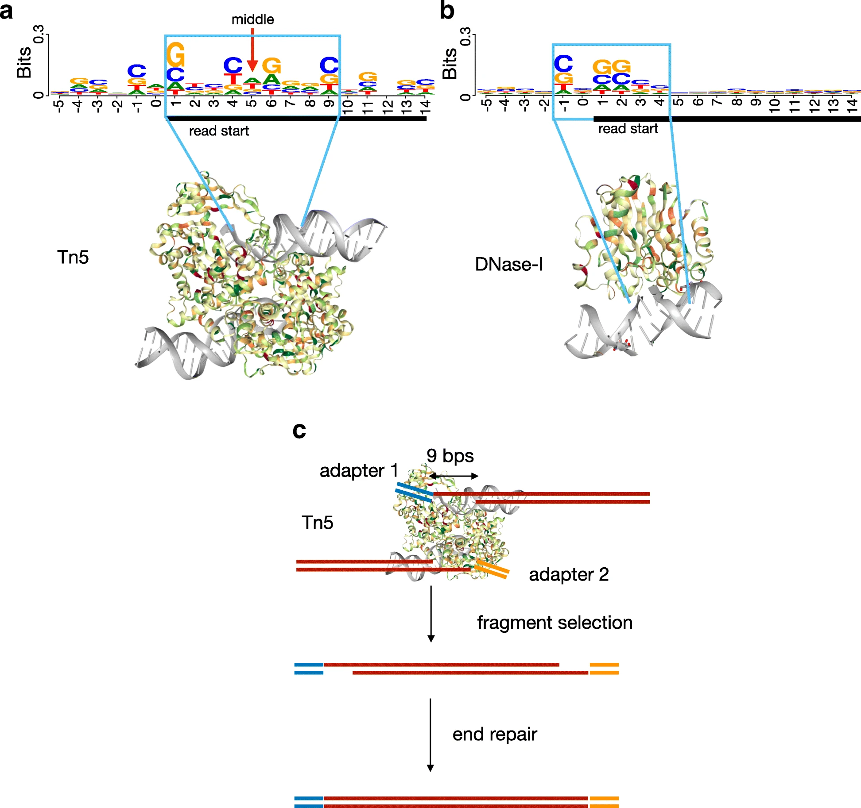
“Shifting” ATAC-seq
alignments
(adapted from Zhijian et al.,
Genome Biology 2019)
From a given ATAC-seq insertion site, the exact region that is accessible is a few nucleotides from the start of the read
When doing high-resolution things like footprinting, one therefore typically shifts the cut sites by +4/-5nt, so that it is placed in the middle of where the Tn5 was binding
(For most other purposes, this is too fine-grained to make a difference)

Slide 19
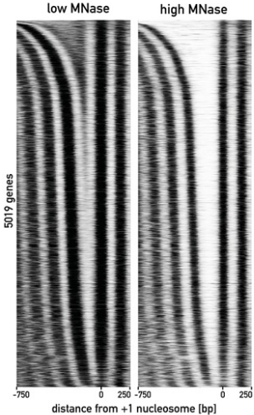
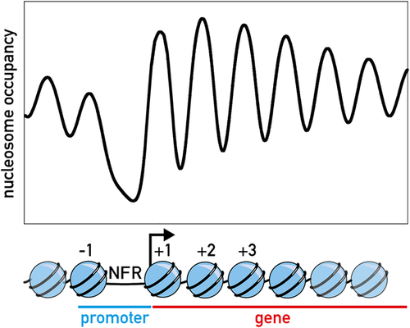
Nucleosome positioning
(Kubik, Bruzzone and Shore, 2017)

Slide 20
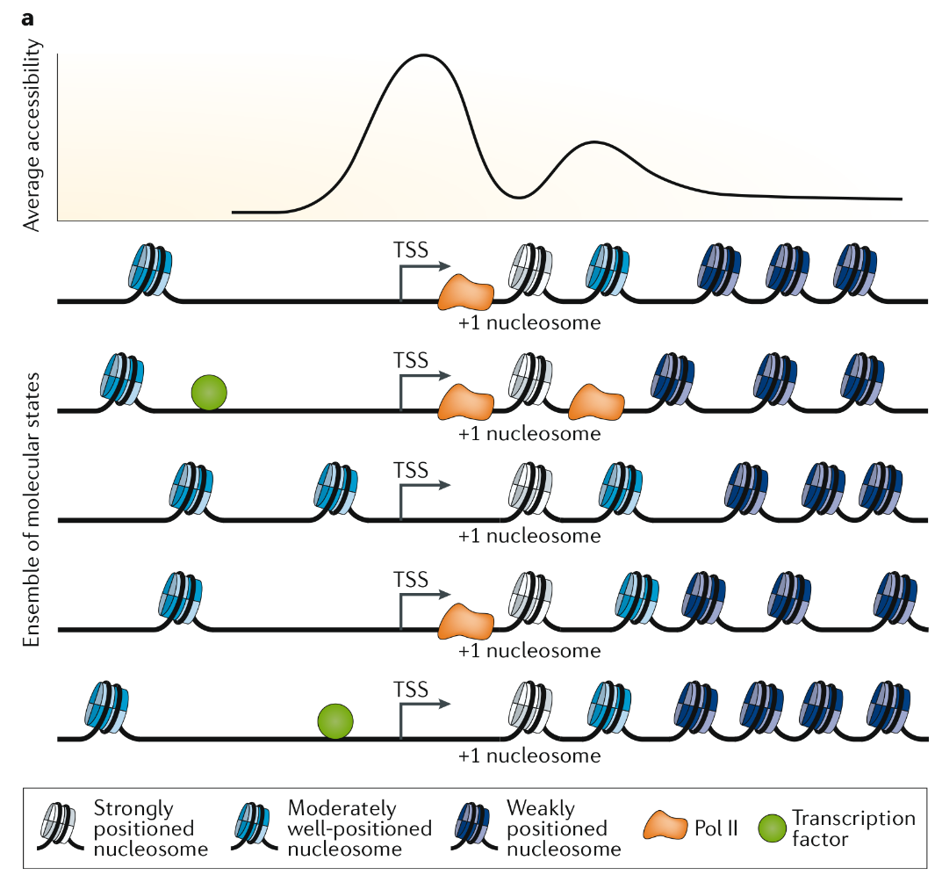
(Klemm, Shipony and Greenleaf, 2019)

Slide 21
Assignment
In the same dataset of ATAC on chr19, plot the insertion (i.e. ‘cuts’) profile of, respectively, nucleosome-free and nucleosome-containing fragments, around the high-confidence motifs of two factors. You can choose your own factors of interest, or for instance use GATA1, REST and/or the glucocorticoid receptor (search “GCR”)
Expected form of the answer: 2 figures (one for each factor), each containing the two signals around the motifs
Don't forget to render your markdown and push it as assignment.html !

