Slide 1

Bioinformatic approaches to regulatory genomics and epigenomics
376-​1347-00L | week 05
Pierre-Luc Germain

Slide 2
Plan
Debriefing on the assignment
The ‘histone code’ & functional elements
More on overlaps and comparing signals

Slide 3
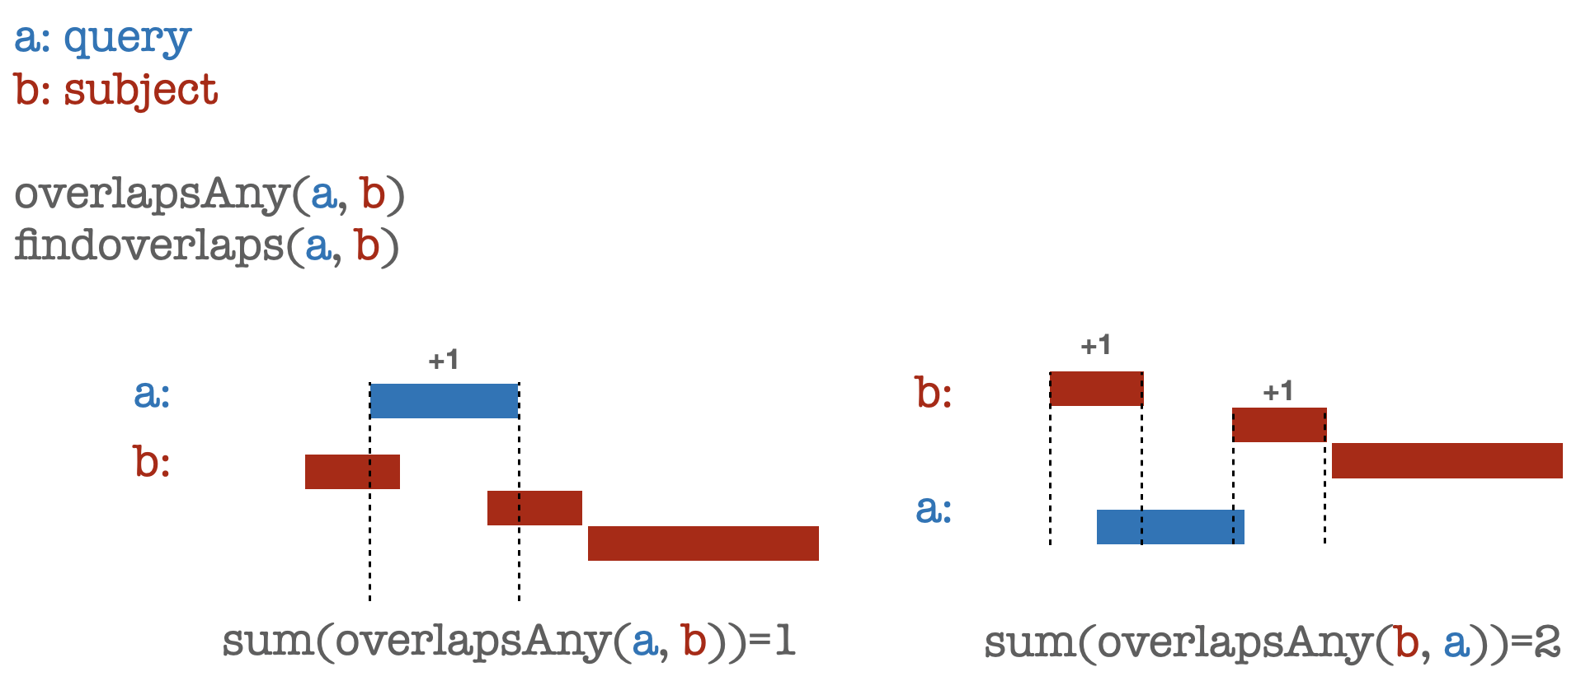
Debriefing on the assignments
Symmetry of overlaps:

Slide 4
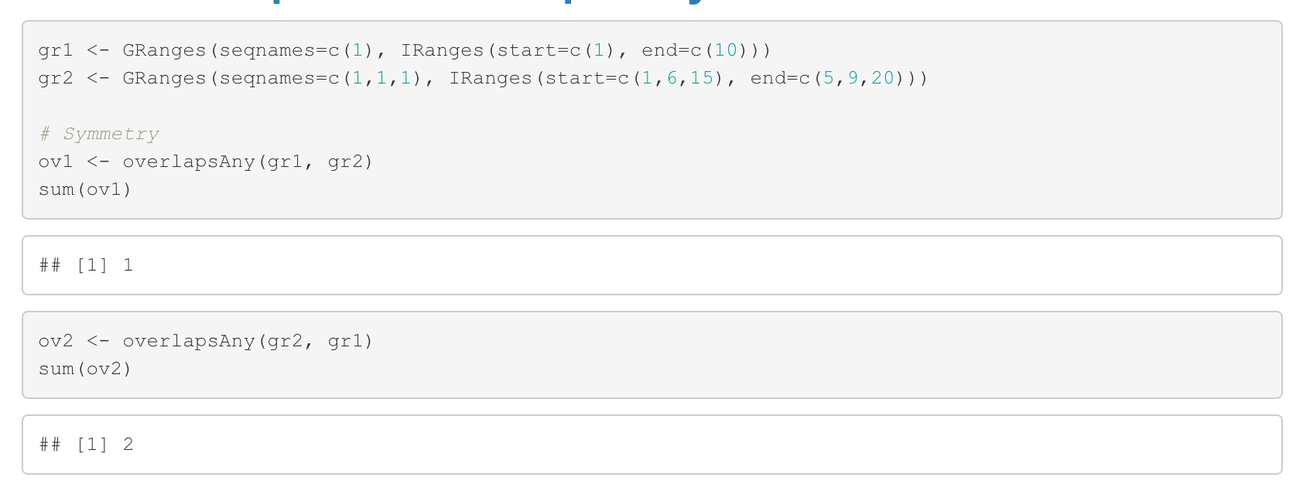
Debriefing on the assignments
Symmetry of overlaps:

Slide 5
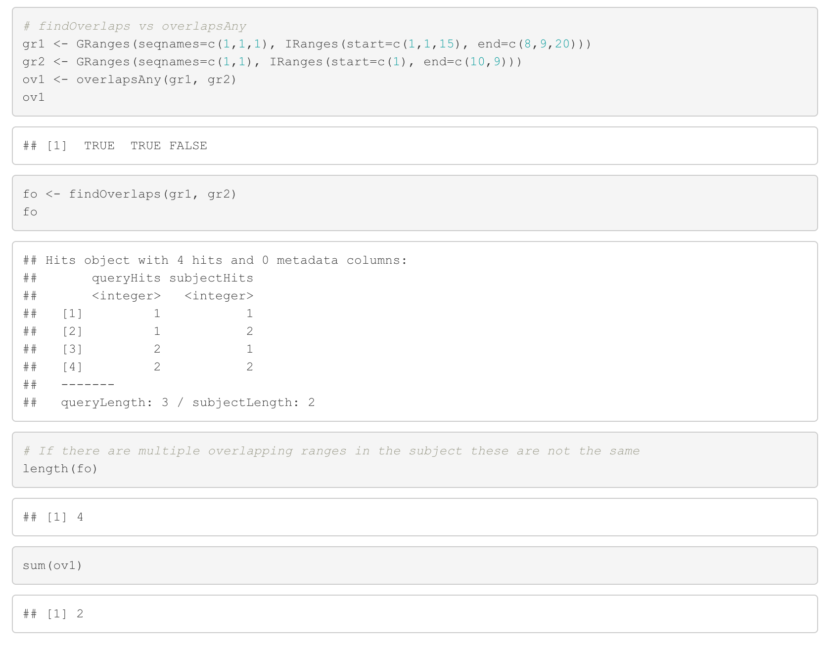
Debriefing on the assignments
Difference findOverlaps() vs overlapsAny():

Slide 6
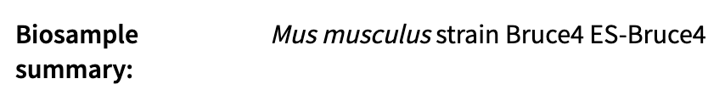
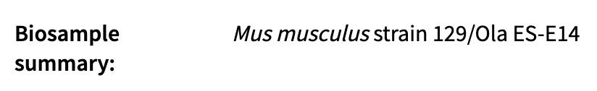
p300:
H3K4me1:

Slide 7
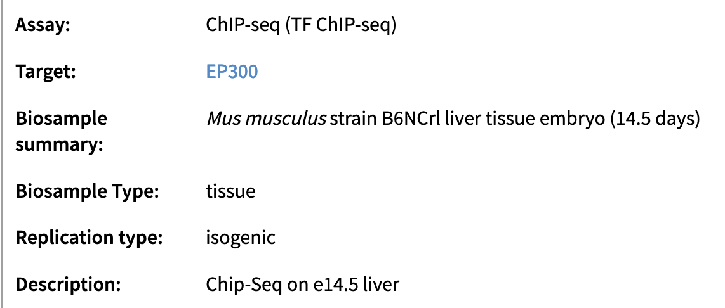
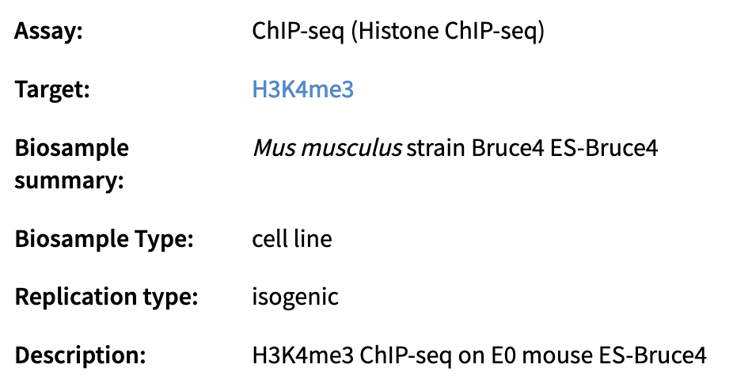

Slide 8
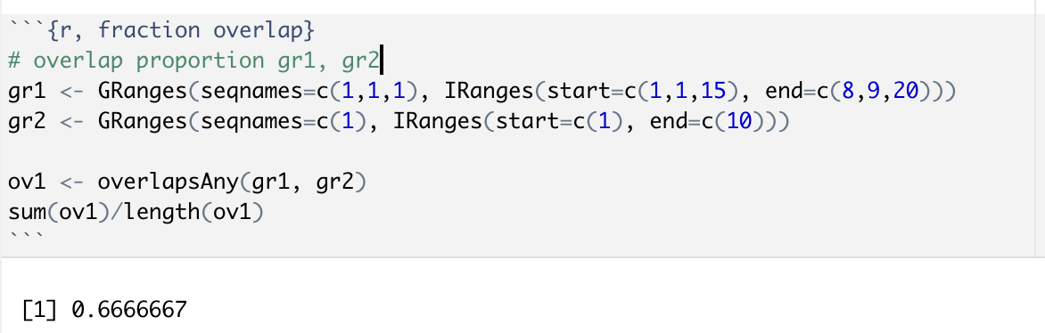
Overlapping proportion:

Slide 9
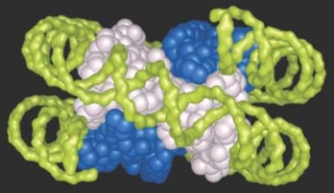
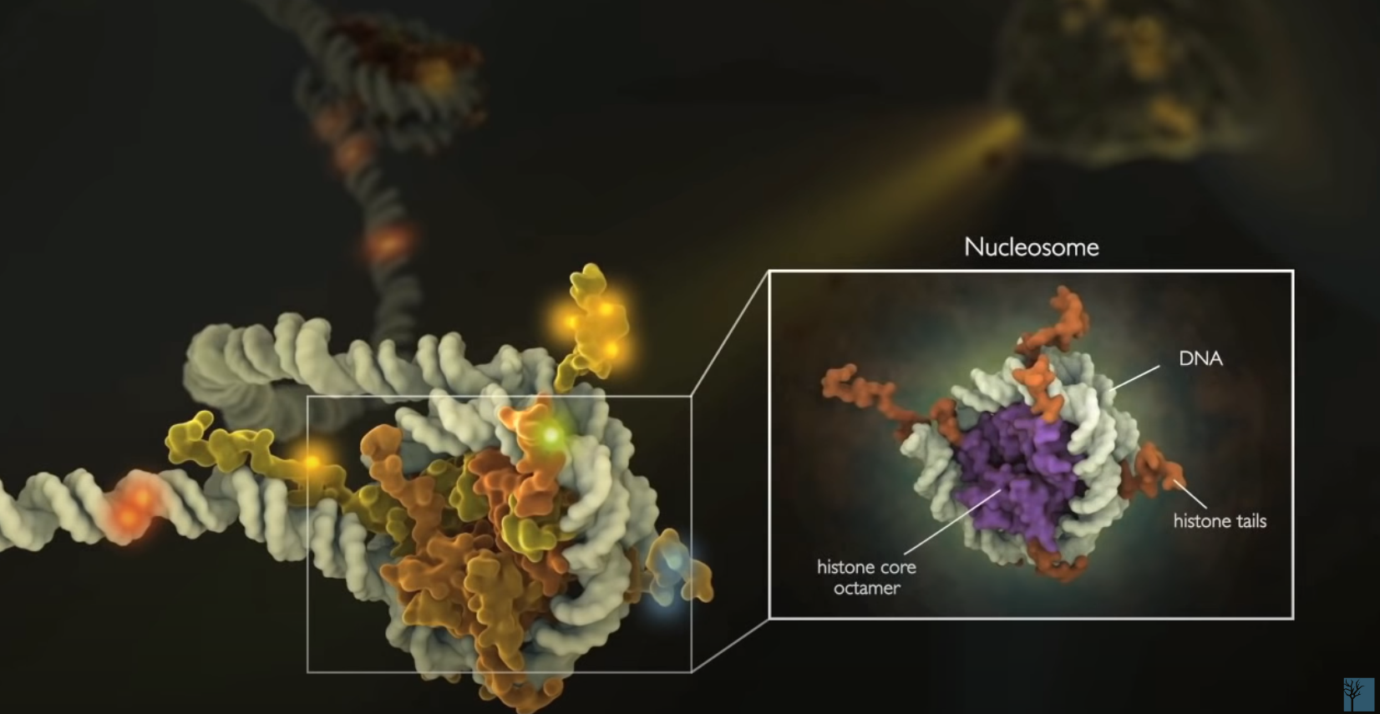
Nucleosome
(Krebs et al., 2018)
Cell Signaling

Slide 10
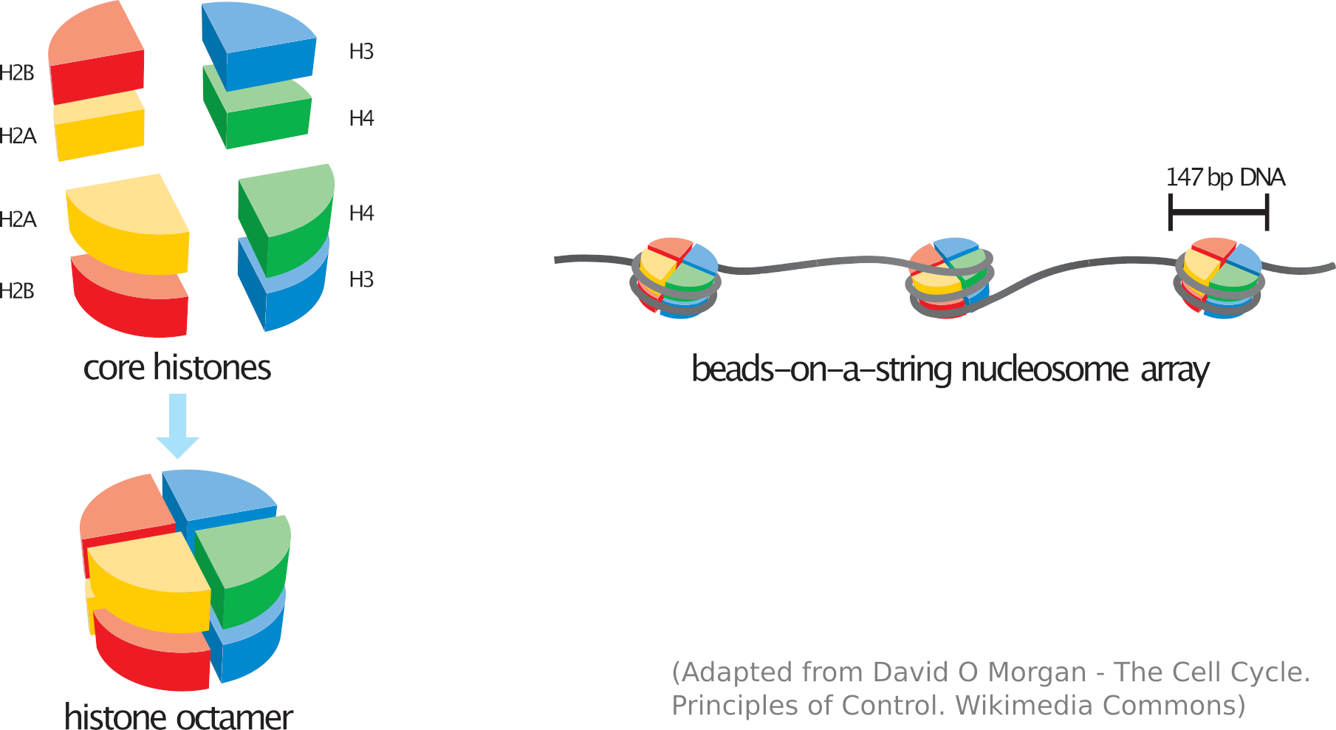
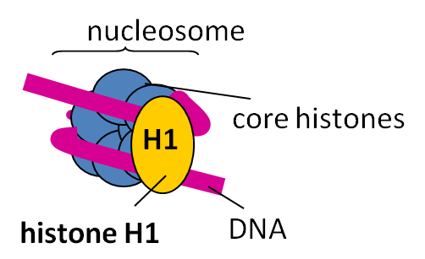

Slide 11
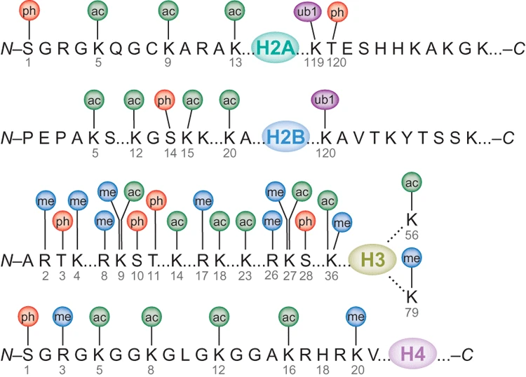
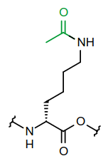
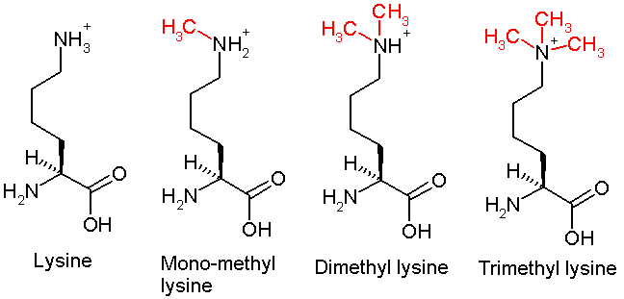
Many residues on the histone tails can be post-translationally modified
H3K27ac
(Bhaumik, Smith and Shilatifard 2007)
H3K27… me me2 me3

Slide 12
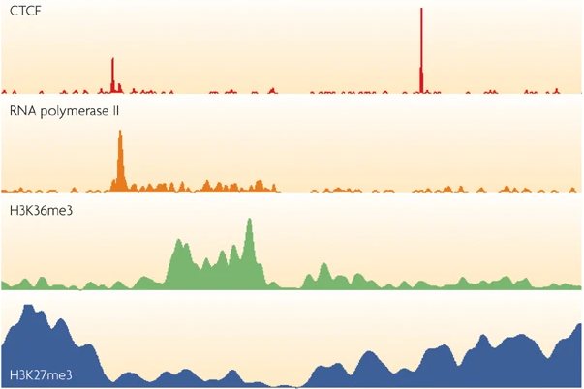
Some histone modifications appear to be very localized, e.g. happening on a specific nucleosome, while most are much more broadly distributed
The strategy of calling ‘peaks’ must therefore be adapted
(e.g. “broad” option of most peak-callers)
(Park, Nat Rev Gen 2009)

Slide 13
There is a very strong association of certain histone marks and activation or repression
Repressive complex
Polycomb
Trithorax
Activating complex
mutually
exclusive
H3K27ac
H3K27me3
Histone modifications
H3K4me
Repressed
Active
Gene expression
But which comes first?

Slide 14

Causality or correlation?
Are histone modifications responsible for activation/repression, or are they merely associated side-effects?
( https://xkcd.com/552 )

Slide 15
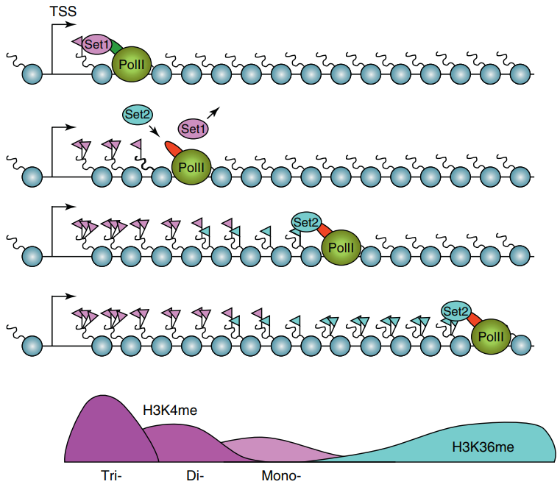
Transcription-mediated histone modification
(Henikoff and Shilatifard 2011)

Slide 16
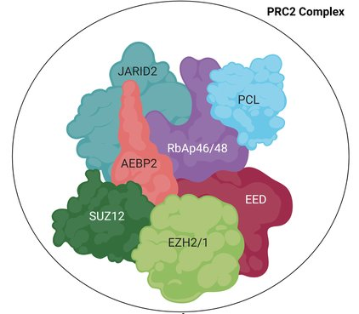
The example of H3K27me3, chiefly deposited by the
polycomb repressive complex (PRC2)
EHZ2’s SET domain catalyzes the addition of a 3rd methyl group to H3K27,
i.e. H3K27me2 → H3K27me3
(Adapted from Zoroddu et al., 2021)

Slide 17
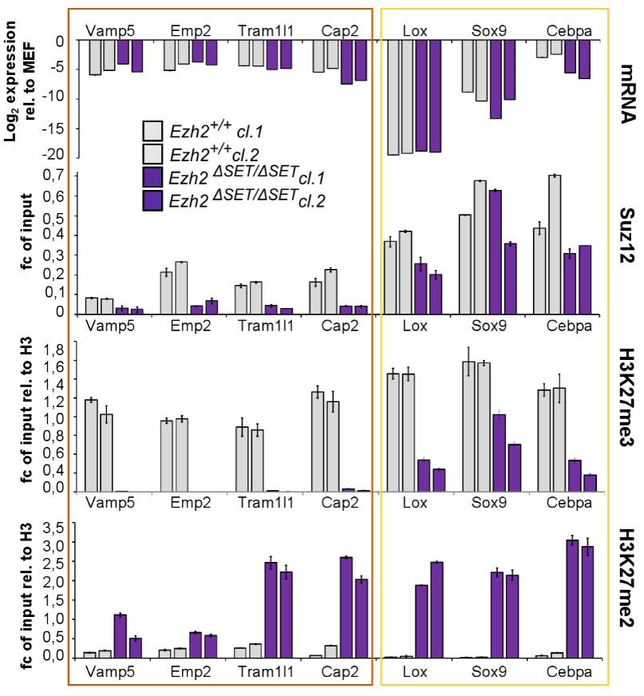
Abolishing the enzymatic activity of Ezh2, the gene responsible for depositing H3K27me3, abolishes (most of) the mark but does not prevent the repression of the target genes, nor cellular reprogramming
(Fragola et al., PLoS Genetics 2013)
Similarly, the loss of H3K4me3 appears to have no effect on nascent transcription
(Murray et al., bioRxiv 2019)

Slide 18
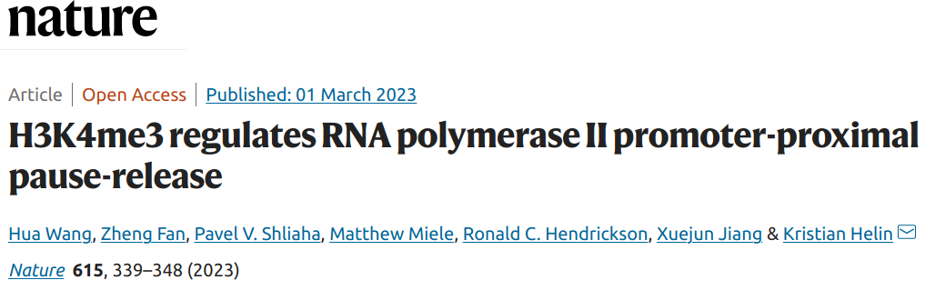
“acute loss of H3K4me3 does not have detectable effects on transcriptional initiation but leads to a widespread decrease in transcriptional output, an increase in RNA polymerase II (RNAPII) pausing and slower elongation. We show that H3K4me3 is required for the recruitment of the integrator complex subunit 11 (INTS11), which is essential for the eviction of paused RNAPII and transcriptional elongation.”

Slide 19
Causality or correlation?
Histone modifications
attract/
repel
deposit
Most likely somewhere in the middle, depending on the modification/context
Protein complexes
Functional
impact
Whether they’re causative or not, they can serve as proxies for function.
This means that profiling a few histone modifications gives an overview of the epigenomic landscape of a cellular state which would otherwise require profiling all the potentially-relevant factors/complexes

Slide 20
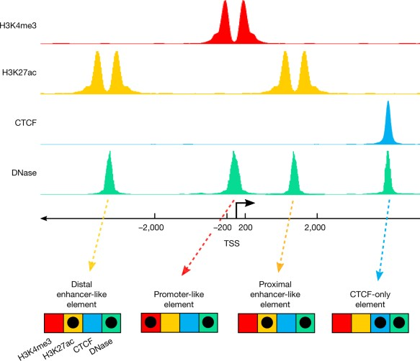
A signature-based encyclopedia of DNA elements
segmentation
enh
prom
enh
ENCODE’s “signature strategy”:
Different types of functional genetic elements are associated with different chemical signatures
We can identify functional elements by identifying these signatures genome-wide

Slide 21
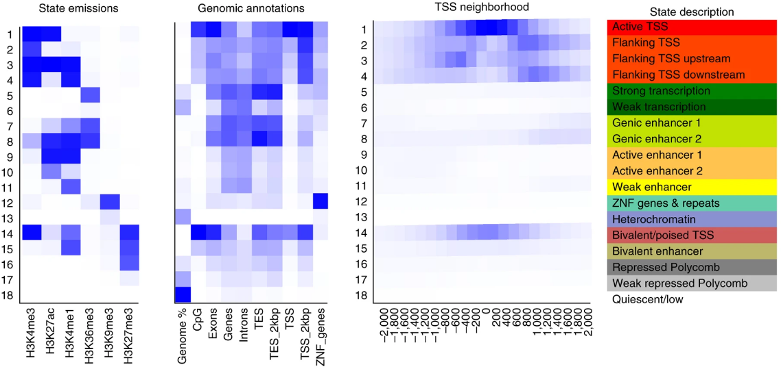
So how many kinds of functional elements/states are there?
(Ernst and Kellis, Nat Protoc 2017)

Slide 22
Some stuff is pretty clear:
Transcription start site (TSS):
H3K4me3 is almost always associated with active/poised TSS
Active TSS are marked by H3K27ac
So-called “poised” (or bivalent) TSS are instead marked by both H3K4me3 and H3K27me3
Enhancers:
Most enhancers have H3K4me1
Active enhancers are marked by H3K27ac
So-called “poised” (or bivalent) enhancers are marked by H3K4me1 and H3K27me3
Repressed elements are marked by H3K27me3
Heterochromatin is marked by H3K9me3
Insulators: CTCF+cohesin

Slide 23
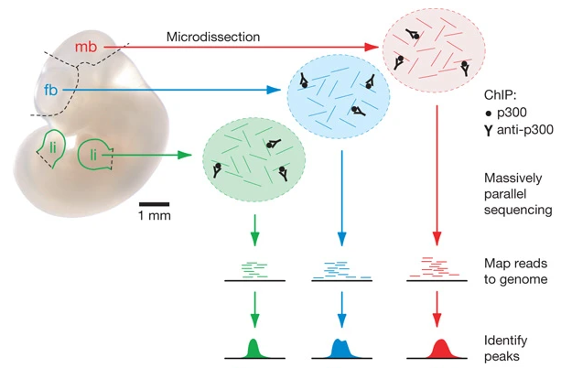
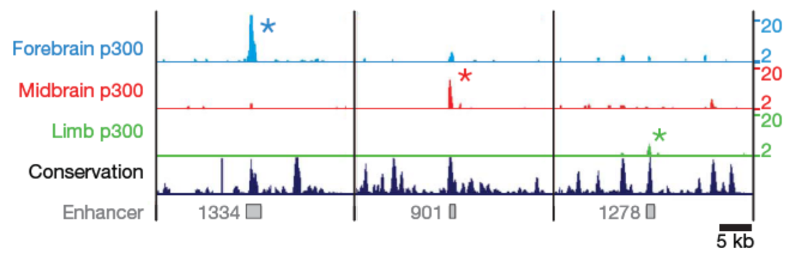
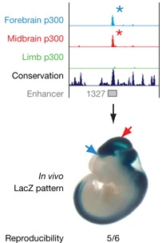
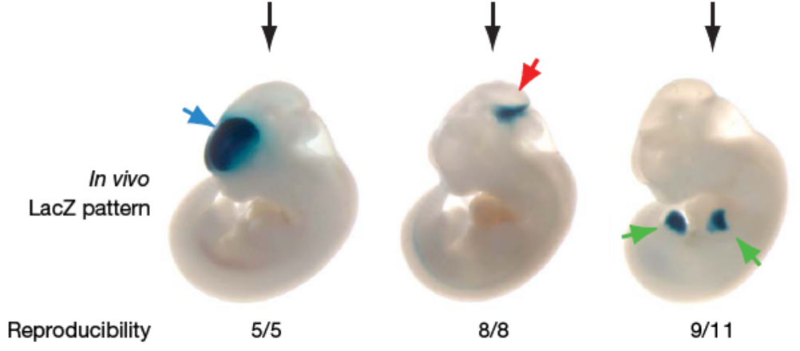
p300 and validation of enhancer activity
sequence
clone into a reporter vector
enhancer sequence
mp
reporter
(Adapted from Visel et al., 2009)
vista enhancers: http://enhancer.lbl.gov

Slide 24
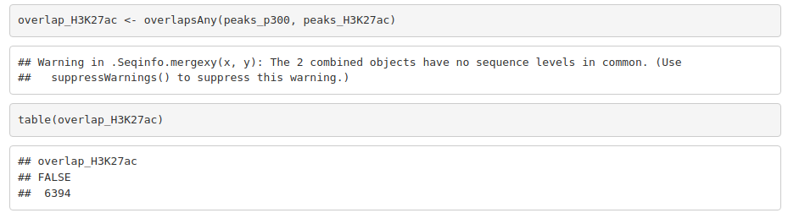
Inconsistent seqlevels

Slide 25
Assignment
Using the peaks you downloaded last week, identify bivalent domains (H3K27me3 + H3K4me3) in mouse embryonic stem cells (mESC)
Split those bivalent domains into those that overlap a TSS, and those that don’t.
What happens to those regions upon differentiation?
Choose a differentiated cell type (e.g. hepatocytes, neural progenitor, or smooth muscle cells)
Download the H3K27me3 and H3K4me3 peaks from this cell type
How many of the mESC bivalent domains are, in this differentiated cell type, overlapping either mark or their combination?
Provide a separate answer for domains that overlap a TSS and those that don’t.

