Slide 1

Bioinformatic approaches to regulatory genomics and epigenomics
376-​1347-00L | week 03
Pierre-Luc Germain

Slide 2
Plan for today
Debriefing on the assignments
Overview of NGS technologies, ChIP-seq and its analysis
Practical:
primary processing of a ChIP-seq experiment (to be continued next week)

Slide 3
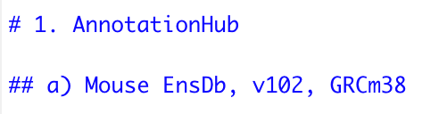
Debriefing on the assignments
Handing in the exercises etc.:
Handing in the exercises: Please name the exercises files just assignment.html
Sync fork before committing:
Please join the help channel for hints & questions concerning the exercises, git, package installation etc.
Use titles and subtitles with #/## for the separate questions. Makes the documents structured and easier to read
!!!

Slide 4
Debriefing on the assignments
Exercise 2
Gene ids vs gene names vs gene symbols
gene ids: stable ID from Ensembl, truly unique, e.g. “ENSMUSG00000005677”
gene symbols: HGNC symbol from the HUGO Gene Nomenclature Committee
variable naming: exons_mouse <- width(exsPerTx)
more fitting would be: exon_widths <- width(exsPerTx)
genes(ensdb, filter = TxBiotypeFilter("protein_coding"))
here one would use as a filter: GeneBioTypeFilter("protein_coding")

Slide 5
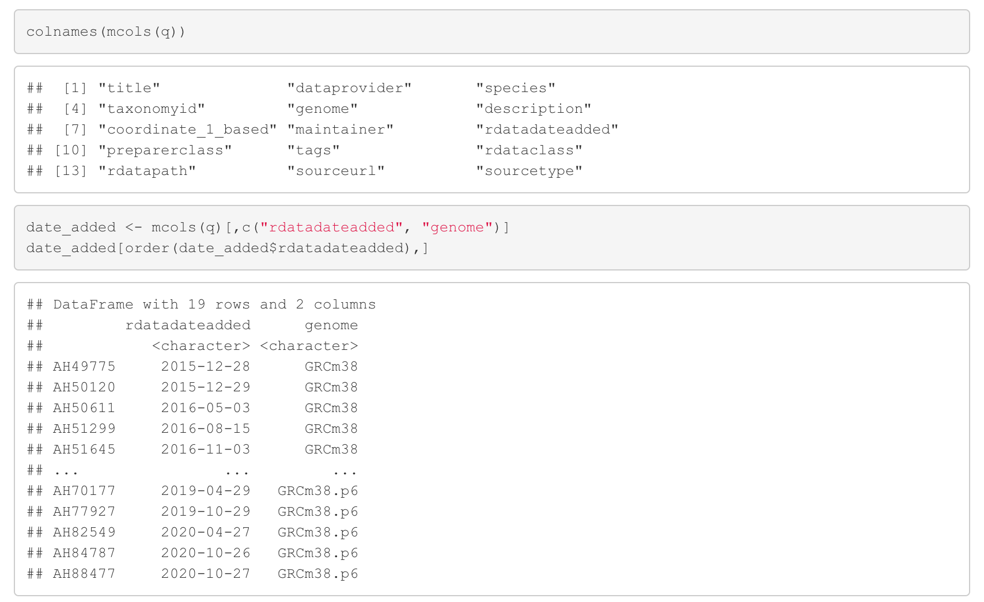
Debriefing on the assignments
Exercise 2
If several annotation/sequences are obtained for query one can look at the metadata with:

Slide 6
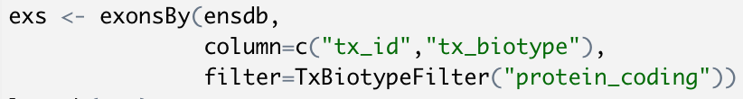
Debriefing on the assignments
Exercise 2
We can get the exons per transcript in the following way:

Slide 7
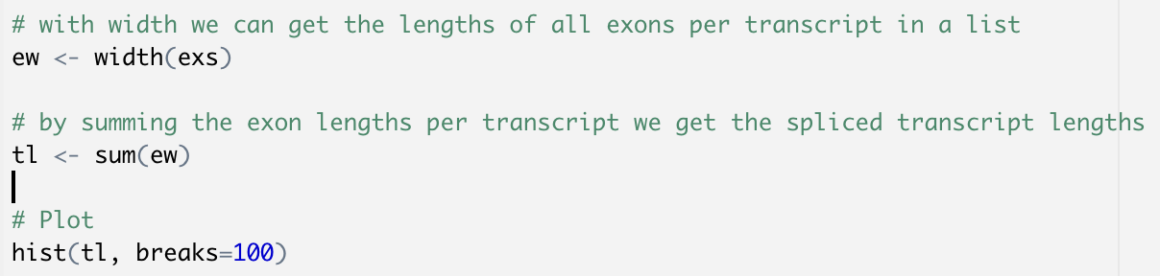
Debriefing on the assignments
Exercise 2
Calculating the number of exons per transcripts
Calculating the lengths of (spliced transcripts) using width()

Slide 8
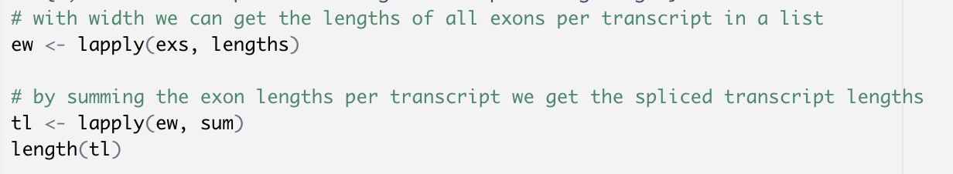
Debriefing on the assignments
Exercise 2
Alternatively: Calculating the lengths of (spliced transcripts) using lengths()

Slide 9

Next Generation Sequencing (NGS)
Shotgun sequencing:
Large DNA molecule
fragmentation
sequencing

Slide 10

Next Generation Sequencing (NGS)
RNA sequencing:
RNA molecules
cDNA
fragmentation
sequencing & alignment

Slide 11


Next Generation Sequencing:
one technology to rule them all
Genomics
& meta-genomics
Epigenomics
& chromatin
conformation
Transcriptomic, translatomics, epi-transcriptomics
A lot of convergence in terms of analysis tools and techniques
~80% of sequencing
market share

Slide 12
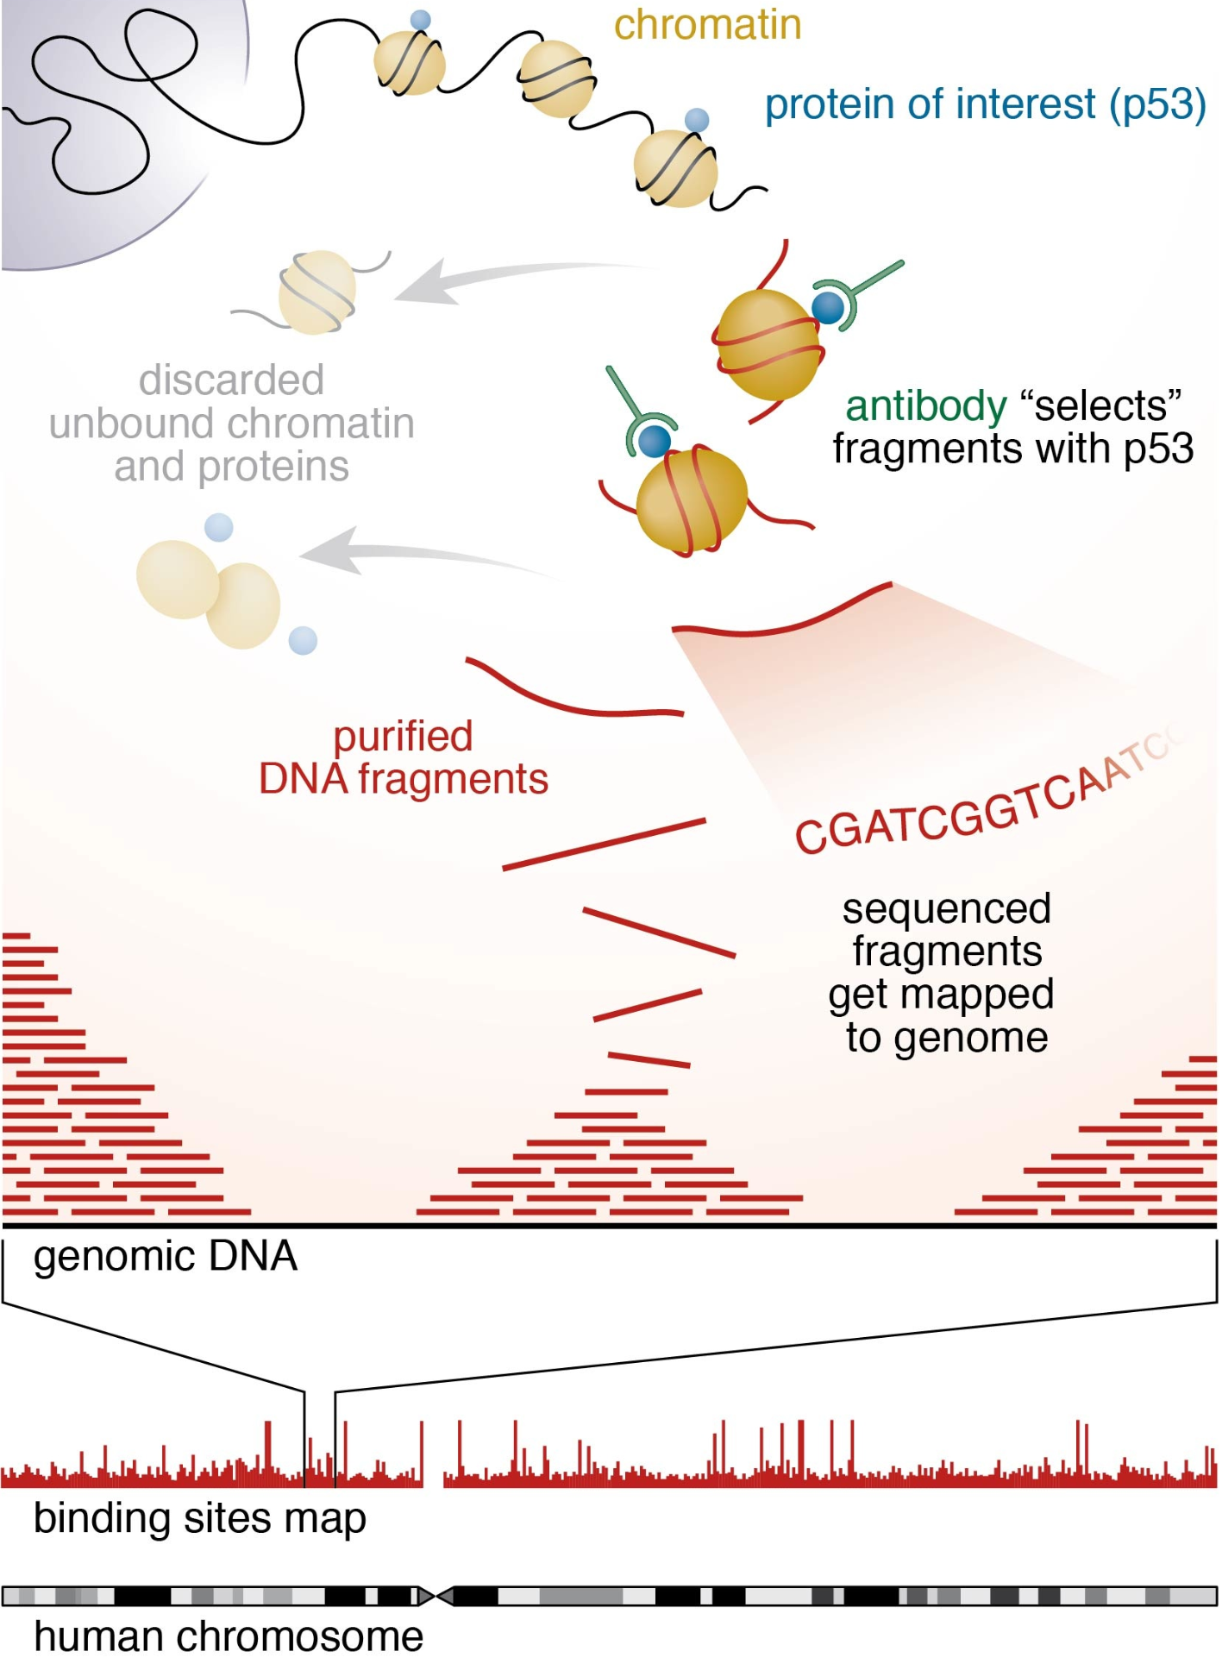
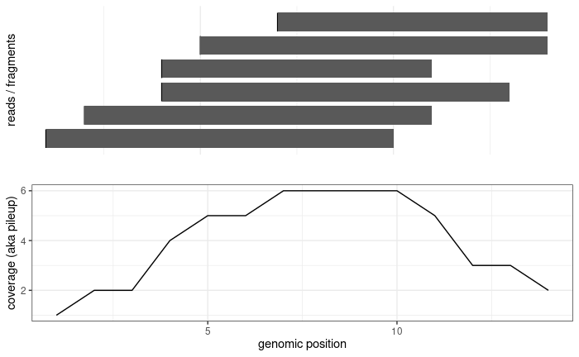
read
fragment
adapter
adapter
Single-end
sequencing:
read
fragment
Paired-end
sequencing:
read1
read2
fragment

Slide 13
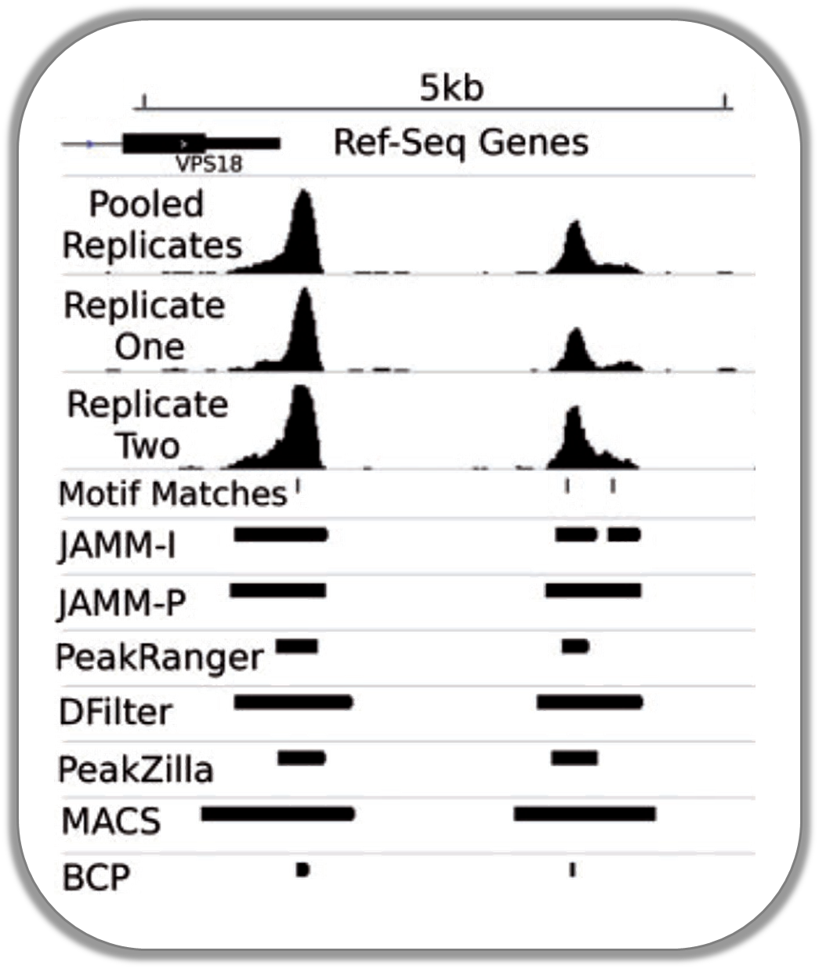
Peak calling
coverage
?
?
TF binding site
Enrichment over input?
input
(Ibrahim et al., NAR 2014)

Slide 14
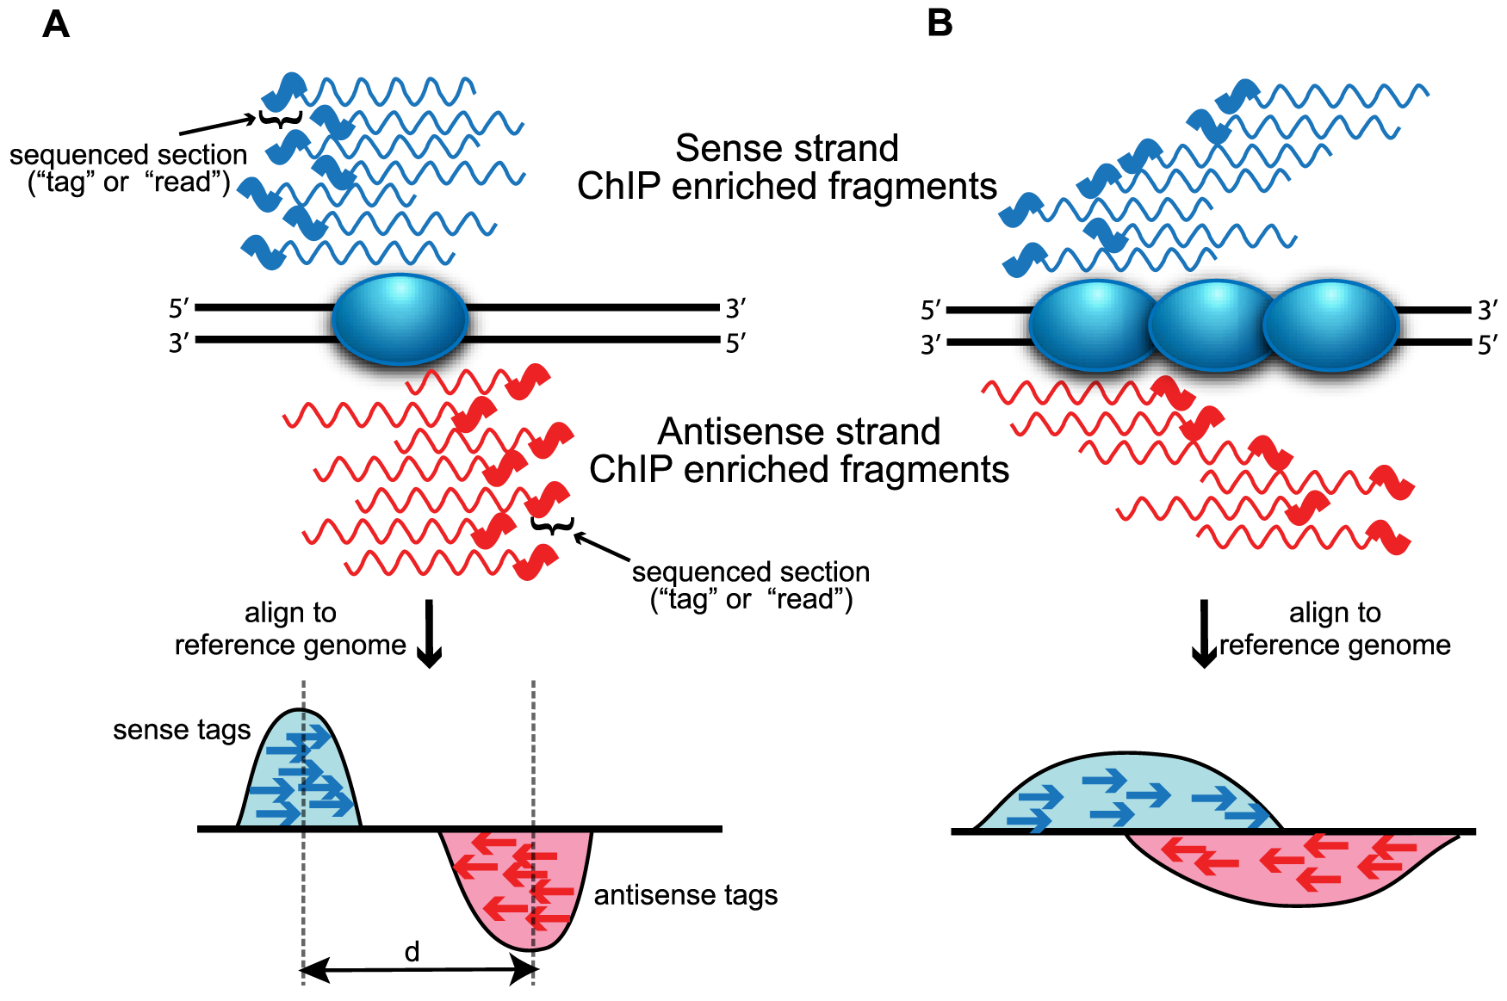
(Wilbanks et al., PLoS One 2010)

Slide 15
Overview of a primary analysis pipeline (ChIP-seq and the likes)
MACS2-3
genomic regions
*.bed, *.bb
*.bigbed
(and others)
genome sequence
*.fa / *.fasta
genome indices
indexing
peak calling
aligned reads
*.sam
*.bam
featureCounts
chromVAR
raw reads
*.fastq(.gz)
(QC &
trimming)
alignment
quantification
coverage
tracks
*.wig
*.bw
*.bigwig
computecoverage
fastqc/
trimmomatic/Rfastp
bowtie2
/Rsubread
(QC,
mark duplicates)
bamCoverage
(deepTools)

Slide 16
Alternative toolsets for (DNA) primary analysis
The most standard one:
fastqc
trimmomatic
bowtie2
picard
deeptools
Pure R-based
rfastp QuasR
Rsubread
Downstream analysis (R)
epiwraps
ChIPseeker
etc…

Slide 17
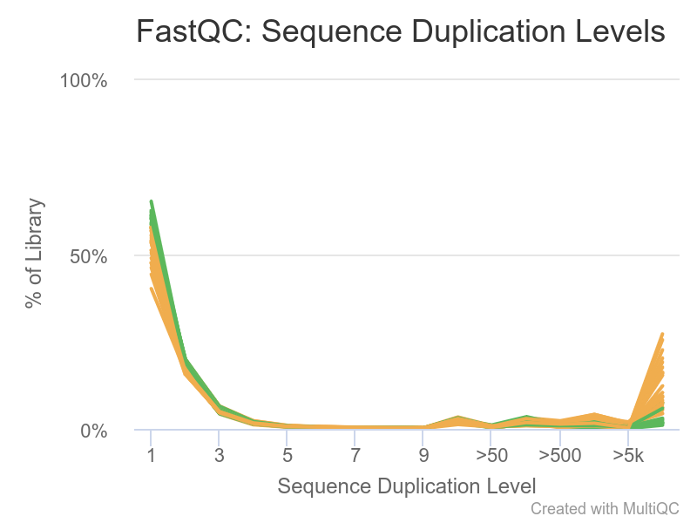
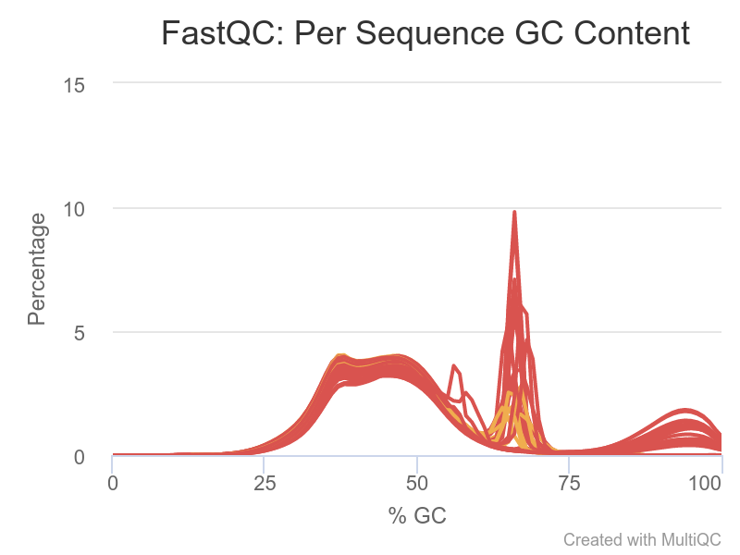
Example (rather extreme) QC problems
There are some sequences that are present thousands of times
Most reads have a more or less normal distribution centered a bit below 50% (genome-dependent)
A high % of reads has a very specific GC content
A certain % of the reads has an extremely high GC content

Slide 18
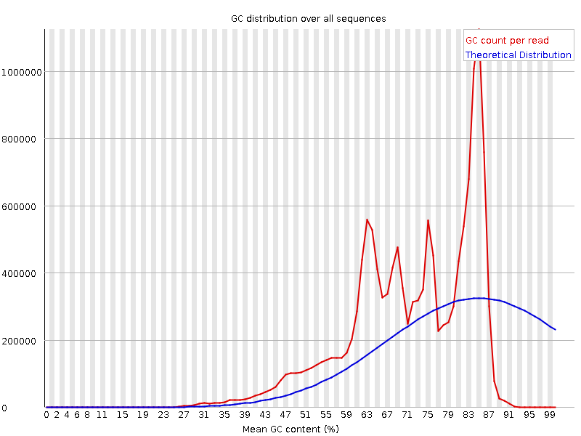
Example (rather
extreme)
QC problems:
Bias from
overamplification

Slide 19

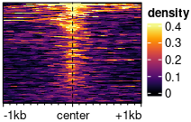
Visualizations available in epiwraps
Signal across one genomic region: plotSignalTracks
Signal across several genomic regions: signal2Matrix → plotEnrichedHeatmaps
coverage
← genomic coordinates →
(Based on the Gviz R package)
(Mainly based on the EnrichedHeatmap R package, itself based on ComplexHeatmap)

Slide 20
Assignment
Download the following Drosophila ChIP-seq for the protein CTCF:
IP: https://www.encodeproject.org/files/ENCFF127RRR/@@download/ENCFF127RRR.fastq.gz
(no input control for the purpose of this exercise)
Process it from the raw data, obtaining:
bam file
peaks
Report:
how many reads (and what percentage) were mapped
how many peaks were found
Plot the signal around one of the peaks
Please make sure that you name your final file assignment.html !!

