Slide 1

Bioinformatic approaches to regulatory genomics and epigenomics
376-​1347-00L | week 04
Pierre-Luc Germain

Slide 2
Plan for today
Debriefing on the assignment
Recap of last week
Manipulating and visualizing peaks
Coverage track generation
ENCODE & functional elements
Finding data from the literature

Slide 3

Debriefing on the assignments
Handing in the exercises etc.:
Handing in the exercises: Please name the exercises files just assignment.html
From now on points will be deduced if the file is not correctly named
When re-using code from the practicals, you should update the filenames :
=> however what we downloaded for this exercise is a CTCF dataset
Can easily lead to mistakes if you have several files on disk.

Slide 4
Overview of a primary analysis pipeline (ChIP-seq and the likes)
MACS2/3 MACSr
genomic regions
*.bed, *.bb
*.bigbed
(and others)
genome sequence
*.fa / *.fasta
genome indices
indexing
peak calling
aligned reads
*.sam
*.bam
featureCounts
chromVAR
raw reads
*.fastq(.gz)
(QC &
trimming)
alignment
quantification
coverage
tracks
*.wig
*.bw
*.bigwig
computecoverage
fastqc/
trimmomatic/Rfastp
bowtie2
/Rsubread
(QC,
mark duplicates)
bamCoverage
(deepTools),
epiwraps

Slide 5
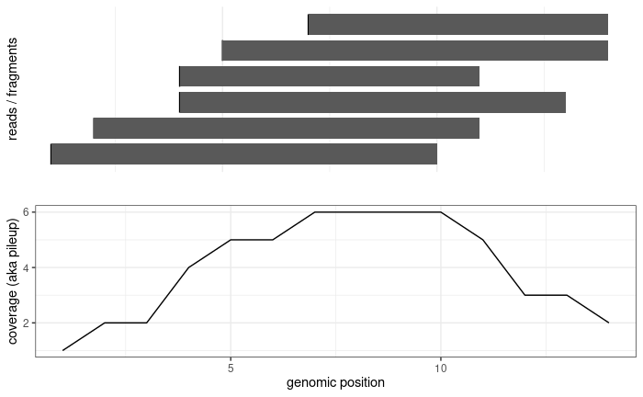
Recap of fragment summarization
read1
read2
fragment

Slide 6

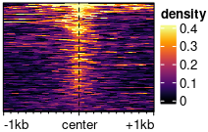
Visualizations available in epiwraps
Signal across one genomic region: plotSignalTracks
Input: bam/bigwig/bed/GRanges
Signal across several genomic regions: signal2Matrix → plotEnrichedHeatmaps
coverage
← genomic coordinates →
(Based on the Gviz R package)
(Mainly based on the EnrichedHeatmap R package, itself based on ComplexHeatmap)

Slide 7
Read extension in coverage track generation
read1
fragment
read1
fragment
read1
fragment
Coverage without
read extension
Coverage with
read extension

Slide 8
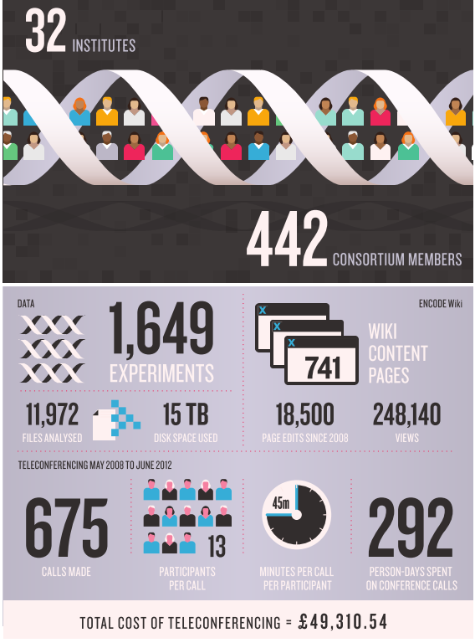
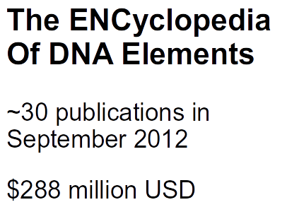
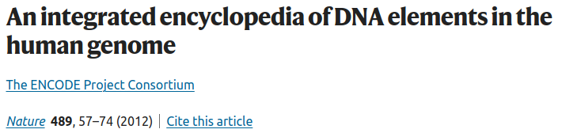
… then an ENCODE2, 3, now working towards the 5…

Slide 9
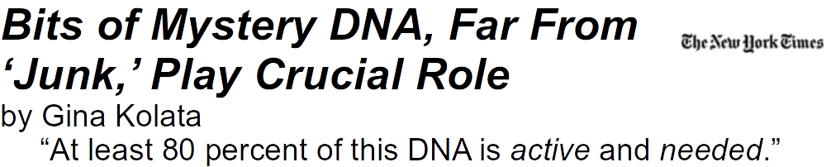

The evolutionary arguments for junk:
1% protein-coding
~4 to 10% evolutionarily conserved
>50% transposable elements
Onions have a 5 times bigger genome
The very angry response:
Graur et al., GBE 2013
(For more on the topic, see Germain, Ratti and Boem 2014; Ratti and Germain 2022)

Slide 10
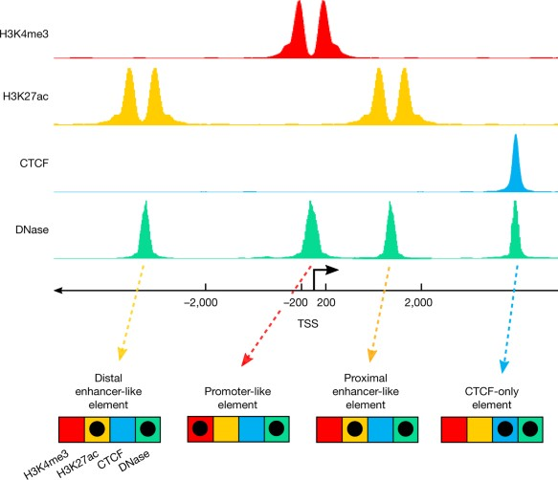
A signature-based encyclopedia of DNA elements
segmentation
enh
prom
enh
ENCODE’s “signature strategy”:
Different types of functional genetic elements are associated with different chemical signatures
We can identify functional elements by identifying these signatures genome-wide

Slide 11


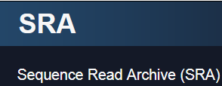

Generic repositories for NGS data
https://www.ebi.ac.uk/biostudies/arrayexpress
https://www.ncbi.nlm.nih.gov/geo/
https://www.ebi.ac.uk/ena/
https://www.ncbi.nlm.nih.gov/sra
International Nucleotide Sequence Database Collaboration

Slide 12



Quality-controlled and uniformly processed human and mouse NGS datasets
www.roadmapepigenomics.org
www.encodeproject.org
(hematopoietic system)

Slide 13
Assignment
Find and download from ENCODE the peaks (i.e. bed-like format) for the following histone modifications in mouse embryonic stem cells (mESC) from ENCODE:
p300, H3K4me3, H3K4me1, H3K27ac, and H3K27me3
(when there are replicates, we recommend using the bed file denoted as “conservative IDR thresholded peaks”)
Of the p300 peaks, what proportion overlap each of the marks?
Don’t forget to upload your assignment as “assignment.html” !

