Slide 1

Poverty Data Mining w/ A Random Decision Forest
Justin, Rauf, Hassan, AJ, Tim

Slide 2
Goal
Discover which factors are most impactful and lead to poverty
Find hidden trends in poverty data
Show natural or bias clustering within specific demographics
Show possible routes of alleviating poverty

Slide 3
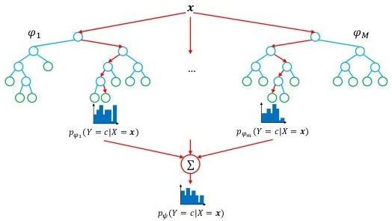
Random Forests for Invariant Ensemble
Forest of randomly bagged (disjoint) decision trees for invariant ensemble
Analysis of decision trees for structure of data
Decision tree is built greedily using iterative Gini index for maximizing co-variance
Data mining without a black box

Slide 4
Initial Exploratory Data Analysis

Slide 5
Feature Importance For Decision Tree Pruning

Slide 6
Pitch: Iterative Tuning to Reduce Poverty

