Slide 1
Poverty Data Mining w/ A Random Decision Forest
Identifying the Problem is the First Step
www.cu-poverty.ml

Slide 2
Goal
Discover which factors are most impactful and lead to poverty
Find hidden trends in poverty data
Show natural or bias clustering within specific demographics
Show possible routes of alleviating poverty

Slide 3
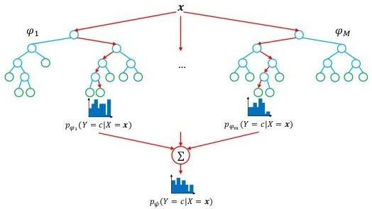
Random Forests for Invariant Ensemble
Forest of randomly bagged (disjoint) decision trees for invariant ensemble
Analysis of decision trees for structure of data
Decision tree is built greedily using iterative Gini index for minimizing co-variance
Data mining without a black box

Slide 4
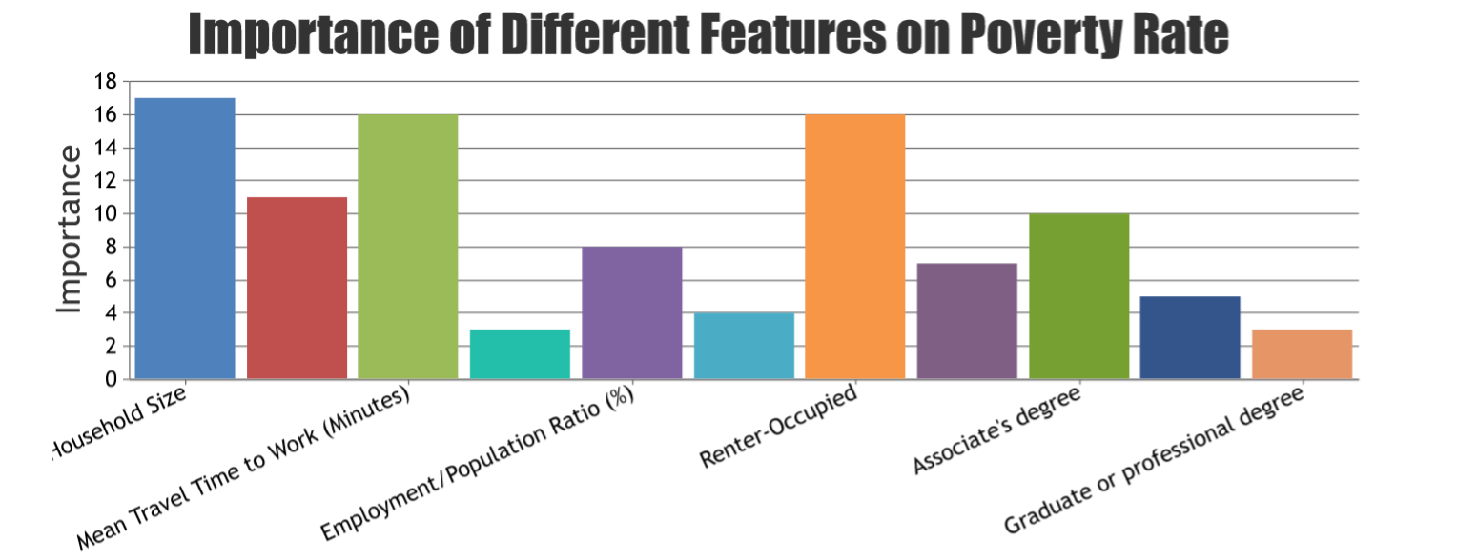
Feature Importance For Decision Tree Pruning
After training our decision trees, we were able to find the feature importance of various demographic factors

Slide 5
Pitch: Iterative Tuning to Reduce Poverty
Developed a website to dynamically input demographic data to find factors affecting poverty rate www.cu-poverty.ml
Iterative tuning process of money allocation by local services
Government or non-profits can use our service to target specific factors

