Slide 1

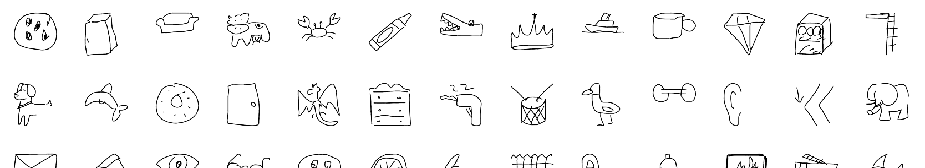

GANdraw
http://GANdraw.online/

Slide 2
COMPUTERS ARE PRETTY DUMB
They only do what humans tell them to do.
What if they could draw like humans?

Slide 3
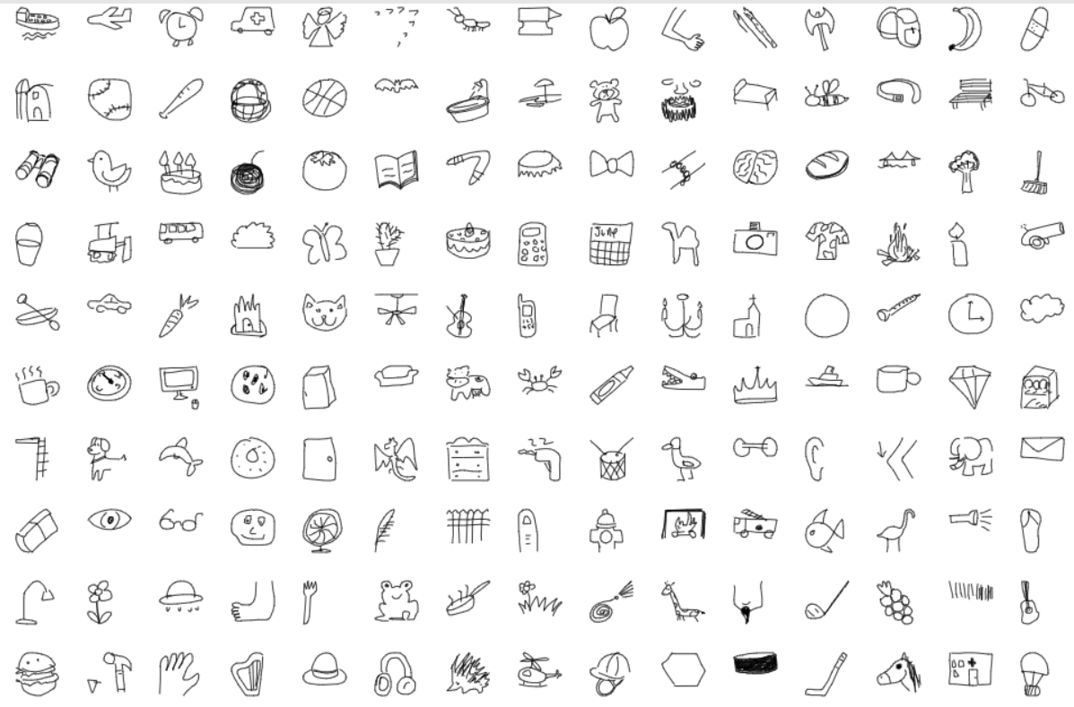
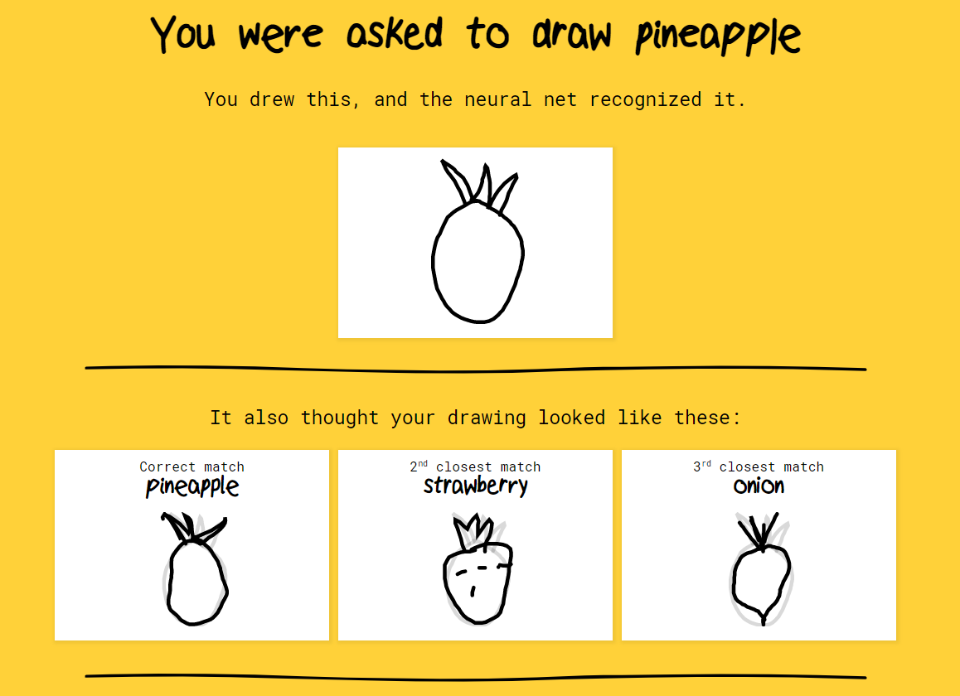
GOOGLE QUICKDRAW
https://quickdraw.withgoogle.com/

Slide 4

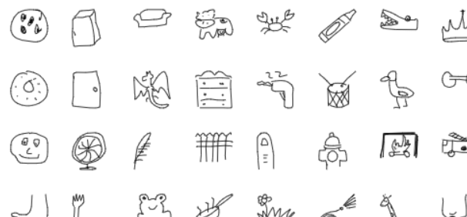
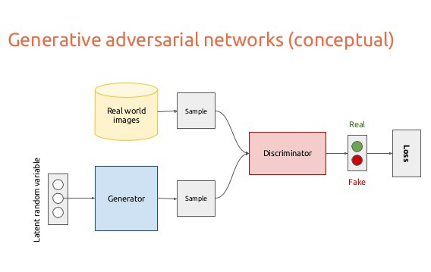
GENERATIVE ADVERSARIAL NETWORK (GAN)
Two networks competing against each other
One creates fake images, the other guesses which images are fake

Slide 5
GOAL
Train a GAN to create computer-generated doodles
Create a website to allow others to easily interact with our model
See similarities in user-generated images (from dataset)

Slide 6



WHAT WE USED
We built our project with a mix of:
Python, for the coding.
Tensorflow, for the deep learning.
Google Cloud Compute Engine, for the training of the models.
HTML/CSS/PHP/JavaScript, for the website.

Slide 7
CHALLENGES WE RAN INTO
GANs are notoriously difficult to train.
Mode collapse leading to limited range of results
Computationally expensive
Take a really long time
Tensorflow 2.0 learning curve

Slide 8
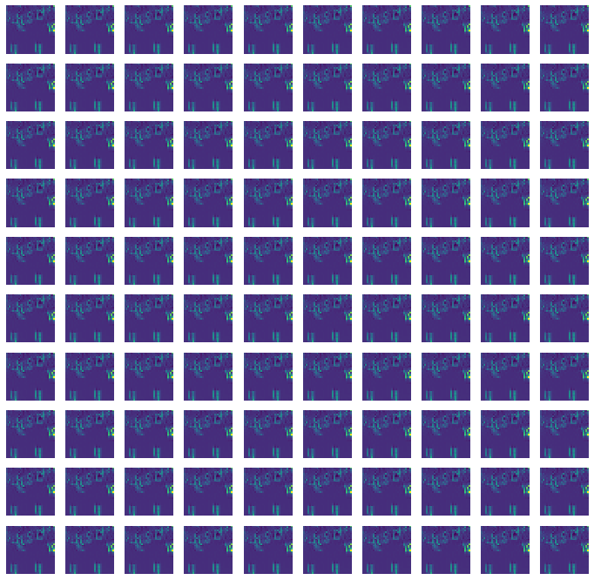
RESULTS
Alarm Clock
Latent Space

Slide 9
FUTURE STEPS
Implement animations and colors into our outputs
Incorporate more words into model:
We were limited by time and computational resources
Increase total accuracy

