Slide 1
The role of NPM1 and FLT3 in Acute Myeloid Leukemia

Slide 2
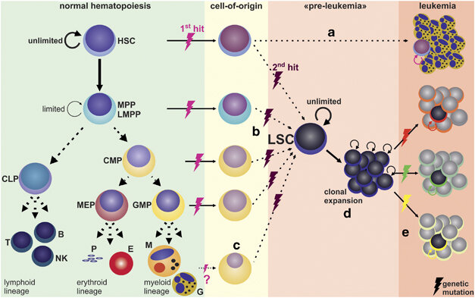
Acute Myeloid Leukemia
Riether et al., Cell Death and Differentiation (2014)

Slide 3
NPM1 and FLT3

Slide 4
Database Analysis Methods

Slide 5
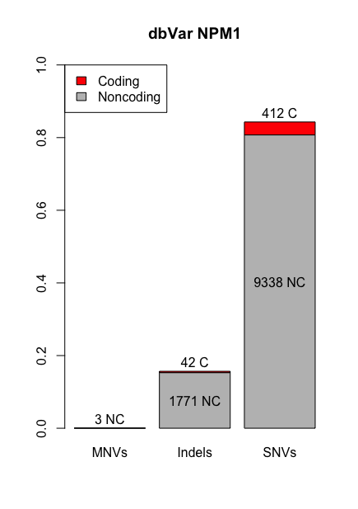
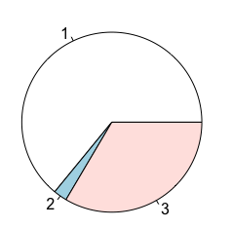
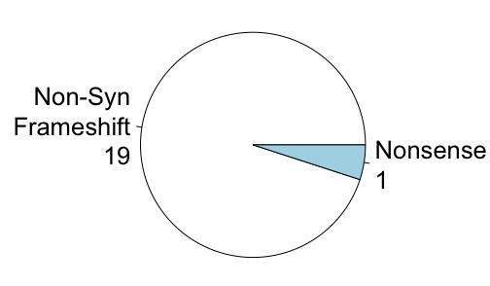
NPM1 dbSNP Mutation Breakdown
Missense 264
Nonsense 10
Synonymous 138

Slide 6
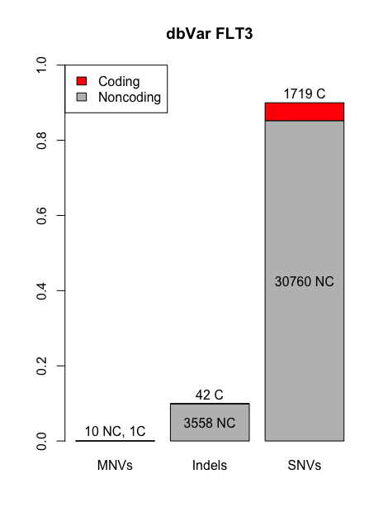
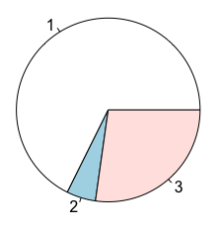
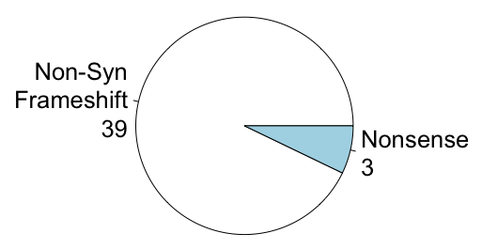
FLT3 dbSNP Mutation Breakdown
Missense 1163
Synonymous 468
Nonsense 88

Slide 7
NPM1 ClinVar Pathogenic Mutations
Start Pos | Reference | Alternate | Classification | Variant Type
171410542 | T | TCATG,TCCTG,TTCAG,TTCTG | LP | INDEL, NSF
171410539 | C | CTCTG | P | INDEL, NSF
171410540 | T | TCTGC | P | INDEL, NSF
171410541 | C | CTGCA,CTGCG | P | INDEL, NSF
171410543 | GGCAGTGGAGG | GTTTAAGGATTCGTC | P | INDEL, NSF
171410548 | TGGAGGAA | TCCCTGGCTAGG | P | INDEL, NSF
171410553 | GA | G | P | INDEL, NSF
171410565 | A | G | P | SNV, SYN
LP = Likely Pathogenic, P = Pathogenic; NSF = Non-Synonymous Frameshift, SYN = Synonymous

Slide 8
FLT3 ClinVar Pathogenic Mutations
Start Pos | Reference | Alternate | Classification | Variant Type
28018483 | T | A,C | LP | SNV, NSM
28018484 | A | G,T | LP | SNV, NSM
28018485 | G | A,C,T | LP | SNV, NSM, SYN
28018487 | T | A,C,G | LP | SNV, NSM
28018492 | T | A,C,G | LP | SNV, NSM
28018497 | CATG | C | LP | INDEL
28018501 | A | C,G,T | LP | SNV, NSM
28018502 | T | A,C,G | LP | SNV, NSM
28018504 | TC | AA | LP | MNV, NSM
28027222 | A | C,T | LP | SNV, NSM
28027236 | T | A,C | LP | SNV, NSM
28028203 | G | A,C,T | LP | SNV, NSM
28028205 | T | C | LP | SNV, NSM
28028244 | T | G | LP | SNV, NSM
28028279 | T | A,C,G | LP | SNV, NSM
28033974 | C | A,G,T | LP | SNV, NSM
Start Pos | Reference | Alternate | Classification | Variant Type
28034139 | A | C,G,T | LP | SNV, NSM
28034144 | A | C,G,T | LP | SNV, NSM
28034147 | T | A,C | LP | SNV, NSM
28034148 | A | C,G,T | LP | SNV, NSM
28034183 | A | C,G | LP | SNV, NSM
28034204 | T | A,C | LP | SNV, NSM
28034205 | A | G,T | LP | SNV, NSM
28018502 | TATC | T | LP/P | INDEL
28018487 | T | TGGATCC | P | INDEL
28018500 | G | A,C,T | P | SNV, NSM, SYN
28018503 | A | C,T | P | SNV, NSM
28034125 | T | TTCATATTCTCTGAAATCAACG | P | INDEL
28034139 | AATC | A | P | INDEL
LP = Likely Pathogenic, P = Pathogenic;
NSM = Missense, SYN = Synonymous

Slide 9
Single Cell Cohort

Slide 10
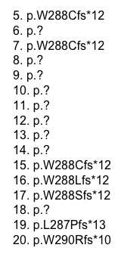
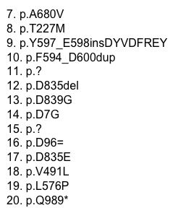
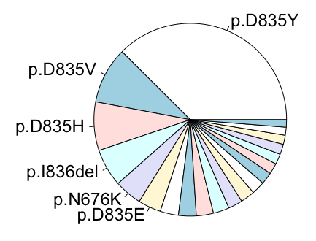
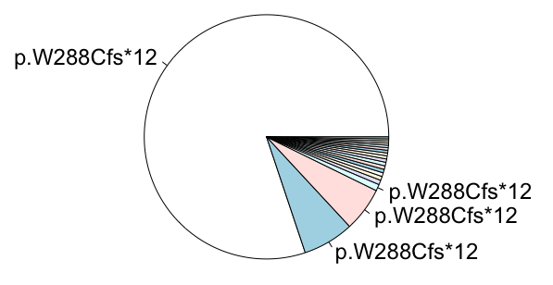
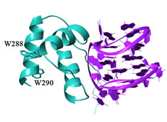
COSMIC exploration of clinical mutations
NPM1
FLT3
Adapted from fffff
Adapted from fffff

Slide 11
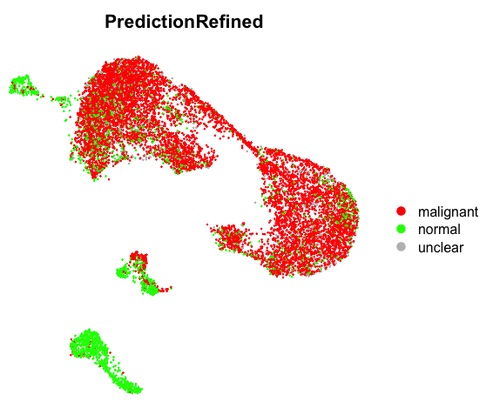
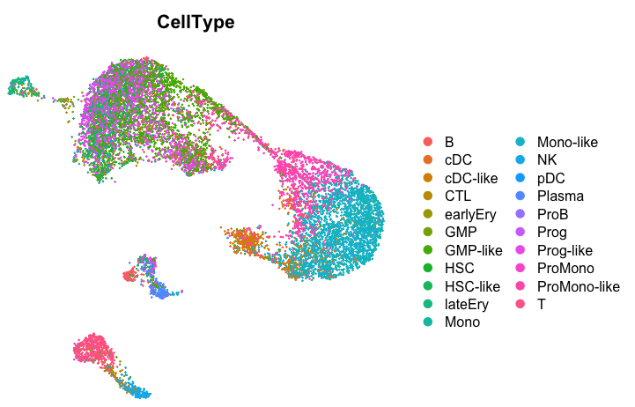
Single-cell analysis of 17 AML Patients
UMAP2
UMAP1

Slide 12
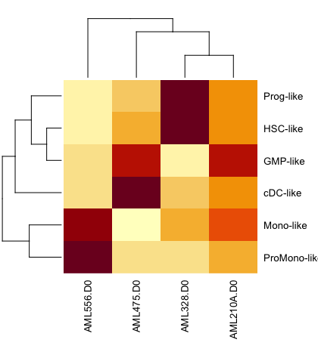
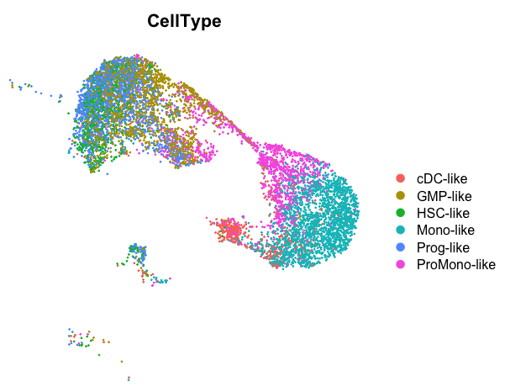
UMAP2
UMAP1

Slide 13
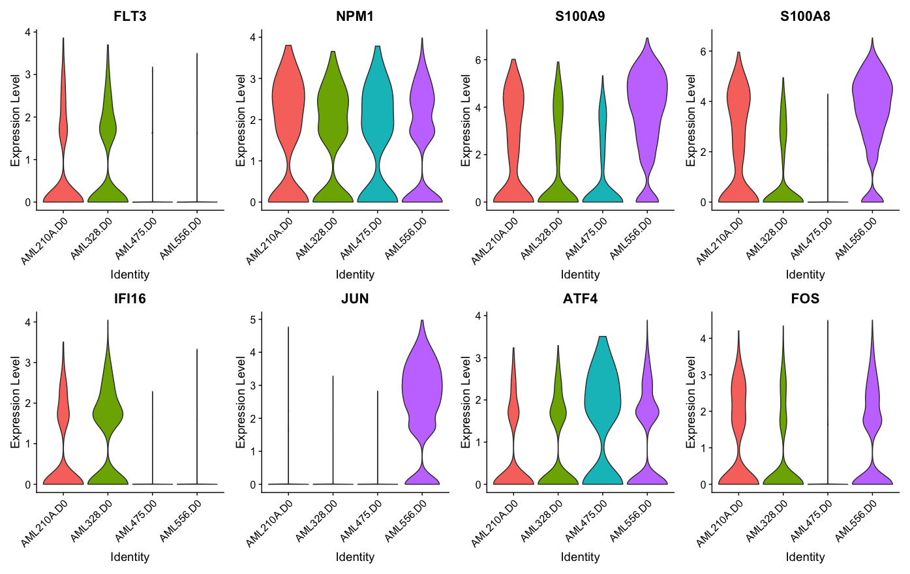
Differential Gene Expression Reveals

Slide 14
Conclusions

