Slide 1
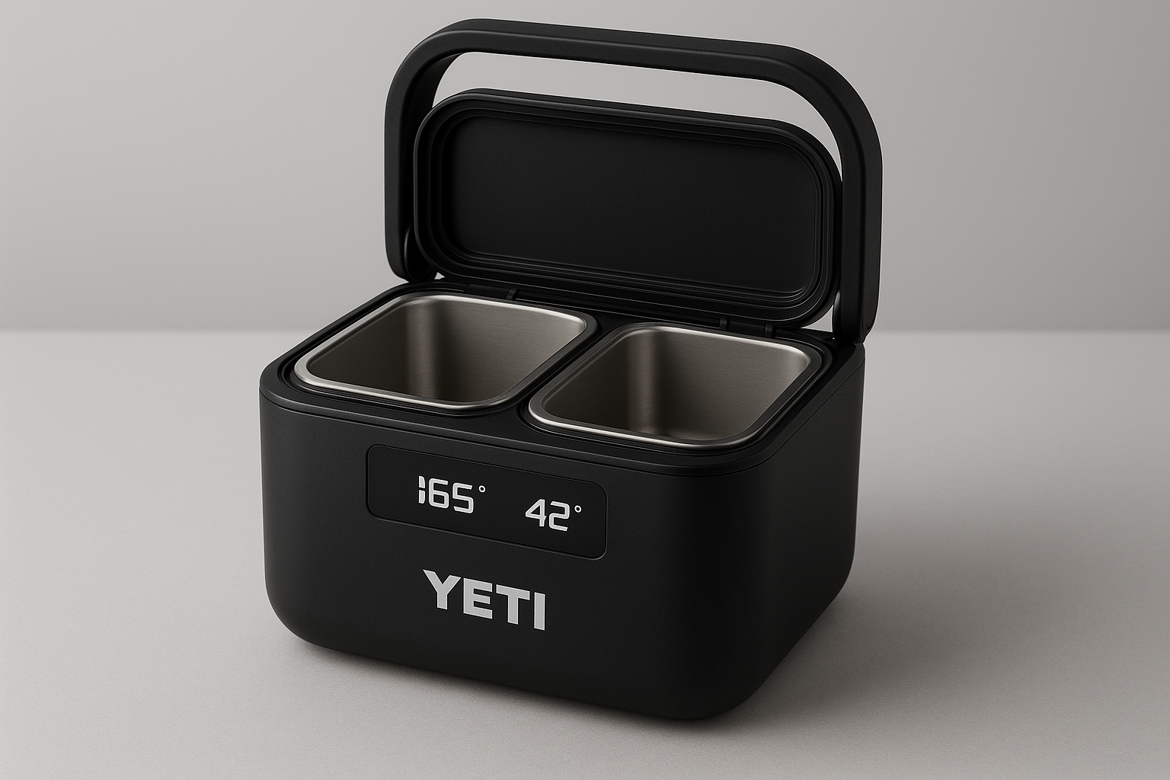
YETI TempBox
Group 1: Isabella Lomelo, Timothy Bang, Ving Dang, Naithan Desruisseaux, Isabelle Lyu, Daniel Paley, Amelia Youssef, Areeb Mahmood, Tyler Emken, Thomas Martin, Olivia Pirog, Florina Gola, Devin Goldstein

Slide 2
The Smart Temperature-Controlled Lunchbox
Product Concept:
Innovative upgrade to traditional insulated lunchboxes
Uses active thermoelectric technology to keep food hot or cold all day.
Controlled through a manual touch screen or a Bluetooth-connected app for temperature settings and alerts
Key Features:
Heating & Cooling System: maintains precise temperatures (35°F–160°F)
Dual-Zone Design: keeps hot and cold foods in separate compartments
Smart Connectivity: app control, battery monitor, and ready-to-eat notifications
Eco-Friendly Materials: recycled stainless steel and optional solar charging lid
Rugged & Leak-Proof: built tough for work, school, or outdoor use

Slide 3
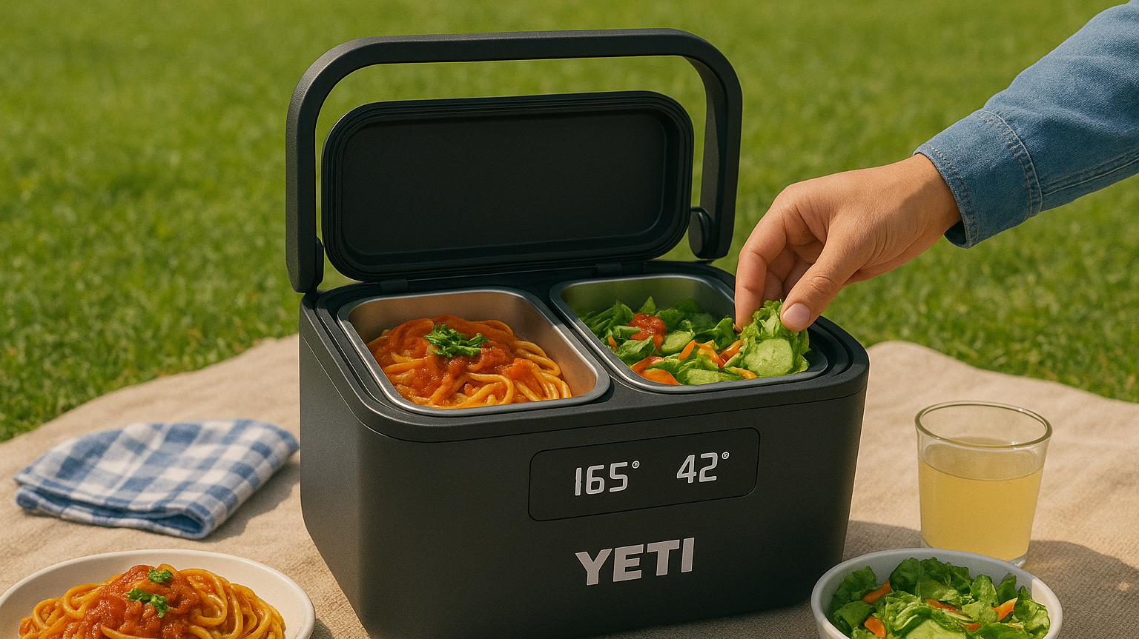
Why TempBox?
Traditional lunchboxes only slow temperature change, but the TempBox actively maintains ideal temperatures, going beyond just insulation.
Improvement on Existing Product: Smart, dual-temperature upgrade to classic lunchboxes.
Smart Technology Integration: Bluetooth app + precision temperature sensors.
Sustainability Focus: Eco materials, reusable battery, optional solar charging.

Slide 4
Market Research
  Target Consumers:
    Students and workers that bring lunch to work, and want to keep food cold/warm all day
    Outdoor users who want durable products to keep food lasting
  Market Needs:
    Durability, temperature control, high-quality, convenience, style
  Potential Competitors:
    Stanley, Hydro Flask, Igloo, Thermos
  Market Trends:
    The market for reusable and insulated products, such as cups + containers, is continuously growing
    Customers are looking for sustainable products that last
  Consumer Demographics: 54% Male, 46% Female
    Largest age group: 25-34 years old, but YETI is popular across all age groups
    Income/Class: Middle/Upper class
    Lifestyle: Consumers are active + outdoorsy, valuing premium-quality products, they can count on
  Buying Behavior
    Brand loyalty + Emotional connection, Positive brand image, Product innovation, Quality over price

Slide 5
SWOT Analysis
Strengths:
  Strong brand reputation for quality and durability
  Unique temperature-control technology that sets it apart from competitors
  Loyal customer base that values premium, long-lasting products
Weaknesses:
  High price point may limit appeal to budget-conscious buyers
  Added tech components could affect portability or ease of use
  Limited experience in producing smart or tech-based products
Opportunities:
  Growing demand for sustainable and reusable food storage solutions
  Expanding market for tech-integrated lifestyle products
  Potential for collaborations with influencers and outdoor or food-focused brands
Threats:
  Competition from established brands like Stanley and Hydro Flask
  Risk of cheaper alternatives entering the market with similar features
  Possible consumer hesitation toward paying more for a “smart” lunch box without proven reliability

Slide 6

Segmentation & Targeting
Target Segments:
Demographic:
Age: 10-55 years old
Occupations: Office employees, construction workers, students, nurses, and most other in-person workers
Income: Middle-High income people
Psychographic:
1. Value convenience, low cost of homemade food, during busy workdays
2. Environmentally conscious and prefer reusable products
3. Interested in health and meal prep
Behavioral:
Frequently eat lunch away from home (job sites, offices, campuses)
Seek temperature-controlled meals without relying on microwaves or refrigerators
Want the option to have cold or hot food
People who are too busy to go out for lunch

Slide 7
Positioning
Why YETI TempBox?
Distinctive: Only lunchbox with dual-zone heating and cooling technology
Superior: One product does the job of both a heater and cooler
Convenient: Keeps meals fresh and ready anytime, anywhere
Smart Design: Durable, portable
Positioning Strategy
More for More
Competitive Advantage: Dual zone heat/cool
Positioning Statement
For students and adults aged 10–55 who want fresh, perfectly tempered meals on the go, the YETI TempBox is a dual-compartment lunchbox that keeps one meal hot and another cold all day. Unlike ordinary lunchboxes, it delivers freshness, flexibility, and convenience through advanced temperature control technology, ideal for health-focused and budget-minded lifestyles.

Slide 8
Product Features: Smart technology – temperature-controlled lunch box with dual zones (can be either hot or cold) Built in temperature sensors Rechargeable cooling/warming system Design: Stainless steel accents, durable outer shell, easy clean interior Branding: Premium YETI branding emphasizing performance and sustainability Packaging Eco-friendly packaging made form recycled materials Represents YETI’s sustainability commitment | Price Strategy: Premium pricing — aligns with YETI’s established brand image and target market’s willingness to pay for quality and innovation. Justification: High-quality materials, advanced insulation technology, and smart features justify a higher price point. Optional Tiers: Offer multiple models and sizes (Standard, Smart, and Pro editions) to reach a wider audience without diluting brand prestige.
Place Distribution channels: YETI’s official website and flagship stores Outside retailers (REI, Target, etc.) Logistics: Leverage YETI’s pre-existing supply chains Delivery and instore pickup options | Promotion Advertising: Campaign across social media (Instagram, YouTube, TikTok) Public Relations: Partner with sustainability influencers, outdoor adventurers, and food bloggers to promote innovation and eco-focus. Sales Promotions: Limited-time launch discounts, bundle offers with YETI drinkware, and loyalty rewards for returning customers. Digital Marketing: Targeted ads on Google and social media platforms focusing on convenience, performance, and sustainability. Email marketing to YETI subscribers highlighting new product benefits and exclusive early access.

Slide 9
Digital Marketing Strategy
Social Media Strategy:
Platforms: Instagram, TikTok, YouTube
#YETITempBox #FreshnessFlex #MicrowaveDropout
Strategy: Showcase “before and after” lunch transformations and lifestyle reels of Yeti users
Content Marketing:
Blog posts on meal freshness, tech innovation, and sustainable eating.
Email Marketing:
Announce pre-orders, exclusive offers, loyalty rewards for existing YETI subscribers.
SEO Keywords: “smart lunch box,” “heated YETI,” “temperature-controlled YETI,” “portable food tech.”
Influencer Collabs: Outdoor enthusiasts, tech reviewers, and food prep influencers.

Slide 10
Implementation Plan
Phase 1: Ignite the Concept (Jan – Mar 2026) Objective: Finalize product design and build early buzz. Lead Teams: Product Development, Creative Marketing Team, Influencer Relations.
Phase 2: Build the Hype (Apr – Jun 2026) Objective: Create anticipation and capture pre-orders. Lead Teams: PR Team, E-commerce Team, Sales Partnerships
Phase 3: Grand Launch (Jul – Sept 2026) Objective: Official product launch and nationwide rollout. Lead Teams: PR Team, Event Marketing, Social Media, Retail Merchandising.
Phase 4: Sustain & Scale (Oct – Dec 2026) Objective: Retain momentum and gather feedback. Lead Teams: Customer Insights, Product Design, International Sales.
Phase 5: Innovate Forward (Jan 2027+) Objective: Plan future product line and continuous improvement. Lead Teams: Research and Development and User Experience Team

Slide 11
Budget
Product Development: App development, quality testing, thermoelectric technology integration, and prototype design = $120,000
Manufacturing Setup: Solar lid development, eco-material sourcing, and tooling = $80,000
Packaging Design: YETI environmental branding and recycled packaging = $20,000
Marketing Campaigns: Social media ads (TikTok Instagram, YouTube) influencer partnerships , and PR events = $70,000
Sales Promotions: Setup of loyalty programs, YETI package promotions, and launch discounts = $25,000
Distributions & Logistics: Shipping, warehousing, and retailing collaborations = $30,000
Contingency Reserve (10%): Covers unforeseen costs or changes in prices = $34,500
Total estimated launch budget: $379,500

Slide 12
Evaluation and Metrics
Purpose: To measure the success and effectiveness of the YETI Smart Lunch Box's marketing plan as well as reception to the product.
Sales & Revenue: Revenue-per-unit, revenue-per-customer
Website & E-Commerce: Daily traffic, conversion rates, and pre-order signups, email open and click-through rates
ROI & Channel Impact: Calculate ROMI of marketing efforts to find the most effective marketing plans
Social Media Engagement: Likes, shares, and hashtags on social media, Viewer-engagement ratios (views-likes, views-followers, etc.), link in bio clicks
Customer Satisfaction: Track repeat purchases, expansive feedback through satisfaction surveys, loyalty program usage rates

