Slide 1
Data
Transformation and Enrichment with OpenRefine: Part 1
Ryan Mendenhall
Columbia University Libraries
Oct. 3, 2018
Notes:
Thank you for attending today’s workshop! My name is Ryan Mendenhall, metadata librarian here at CUL

Slide 2

Plan for today
Background on OpenRefine and data transformation
Create a project in OpenRefine
Use faceting, clustering, and editing tools to visualize and transform “messy” data
Notes:
In today’s workshop, we’ll go over background on OpenRefine and data transformation, create a project in OpenRefine, and use faceting, clustering, and editing tools to visualize and transform “messy” data

Slide 3

But first. . . Introductions
Who has some experience with OpenRefine?
What do we mean by data clean-up?
Notes:
But first, let’s get to know each other a bit better.
Who has some experience with OpenRefine? What sorts of tasks have you used it for?
What do we mean by data “clean-up?”

Slide 4

What is OpenRefine?
History: Freebase Gridworks → GoogleRefine → OpenRefine
Most recent version 3.0 (we will use v. 2.8)
Runs in the browser at http://127.0.0.1:3333
GREL: Google Refine Expression Language
Formats: delimited text (CSV, TSV), Excel, XML, JSON, RDF, web services / APIs / endpoints
Documentation: GitHub, Website, email list, books (see resource list)
Image by Google Inc. [BSD (http://opensource.org/licenses/bsd-license.php)], via Wikimedia Commons
Notes:
Backing up, I want to briefly outline a bit about what OpenRefine actually is.
As we’ll see today, OpenRefine is a powerful tool; although it looks like a familiar spreadsheet tool, it’s much more than that.
An open source project originally developed in 2010 first by Metaweb Technologies and subsequently by Google, in 2012 Google stepped away from the project and it became OpenRefine. We are currently on version 2.8
There is an active developer community supporting the product, and it features various plugins, reconciliation services (which we’ll cover in part 2), and can support more complicated scripting.
When you open OpenRefine, the application starts up and opens a Graphical User Interface in your browser at the local address http://127.0.0.1:3333
Many of OpenRefine’s processes make use of GREL, or General Refine Expression Language, which we’ll get into later on in the workshop.
OpenRefine can handle a variety of file formats: delimited text (CSV, TSV), Excel, XML, JSON, RDF, web services / APIs / endpoints
There is quite a lot of documentation for OpenRefine, some of which we’ll point to at the end of today’s session in a resources section.

Slide 5
Why use OpenRefine?
Easily identify common errors in datasets
Basic visualization of datasets (faceting and clustering)
Built-in algorithms assist with identifying patterns
Easily transform large datasets for more consistent output
Match your data with external datasets (covered in part 2)
Import external data into your dataset (covered in part 2)
→Linked Data / Semantic Web
Notes:
So why use OpenRefine?
First I’ll put that to all of you. What sorts of projects do you think OpenRefine is suited to? What do you hope to use it for?
CLICK
It helps surface common errors, and provides basic visualization in the form of facets and clustering.
It has built-in algorithms that assist you with identifying patterns
You can batch transform large datasets for consistency
You can match your data with external sources, and also import some data from those sources into your data
These last two points are part of a process commonly called reconciliation. This reconciliation process can be crucial to creating linked data; many of you may be familiar with linked (open) data and semantic web technology, or at least have heard something about them or about specific linked data projects [like the Florentine Drawings project, LinkedJazz, or others]. We'll cover reconciliation and linked data in more detail in the second part of the workshop next week"

Slide 6
Scope of exercises
Our data is adapted from an import spreadsheet created for RBML’s Hubert H. Harrison Papers to upload content into CUL’s Digital Library Collections (DLC)
Import data and creating your first project
Basic features for exploring and editing data: faceting and clustering
Advanced clean-up using some lite GREL and regular expressions
Exporting your project
What else would you like to learn today?
Notes:
Now I’ll outline what we’ll tackle for the rest of the session.
The dataset we’ll be working with today comes from the RBML’s Hubert H. Harrison Papers https://findingaids.library.columbia.edu/ead/nnc-rb/ldpd_6134799/, but has been slightly modified for this session.
In a series of exercises, we’ll cover importing this data and creating a project, exploring and editing data with faceting and clustering, advanced clean-up using GREL and Regex, and finally exporting your project.
As a reminder, next week we’ll be covering data reconciliation and enrichment.
Is there anything else you would like to learn today?

Slide 7
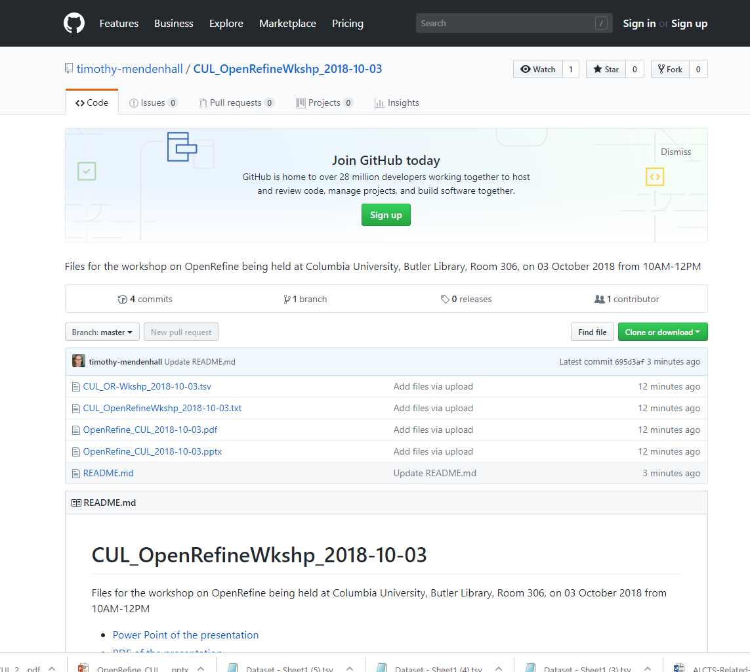
Today’s Workspace
Please download the workshop files from here:
https://bit.ly/2y6LVrx
Then right-click: Winzip → Extract to here
Notes:
Please download the workshop files from this GitHub page. I have backups on a thumb-drive if you are experiencing any problems. The files consist of our dataset and a “cheat sheet” that we’ll use for some of the more complex exercises
https://bit.ly/2y6LVrx
[Full URL]
https://github.com/timothy-mendenhall/CUL_OpenRefineWkshp_2018-10-03

Slide 8
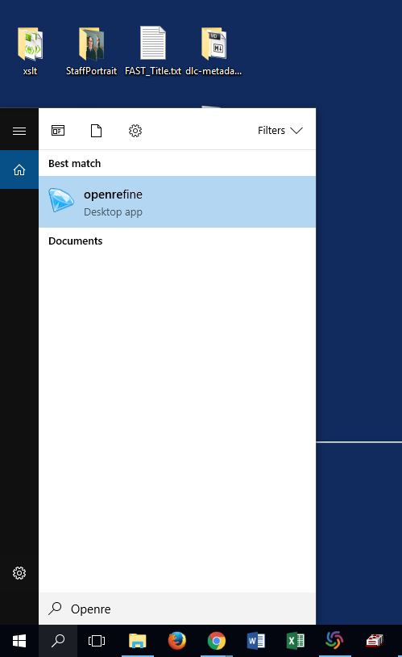
Import data and create project
Start the OpenRefine program
If the browser window doesn’t open: http://127.0.0.1:3333
Import the dataset file CUL_OR-Wkshp_2018-10-03.tsv
Why might we work with a “flat” data format like .tsv (delimited text)?
Notes:
Now we will begin by creating our first project. Double click the OpenRefine diamond in your applications folder. If a browser window does not open, type in http://127.0.0.1:3333 or http://localhost:3333. I have numerous projects I’ve already created, but you probably don’t. Click on “Create Project “on the left, and select the dataset file you downloaded. Click next.
Now you’ll see a preview screen. Don’t worry; it only shows 100 rows, but they are all there! As you see on the left, OpenRefine has automatically figured out that our file is a tab-separated file. Under Parse data as, you can see a comprehensive list of the other file types OpenRefine is able to open.
Click on the character encoding box, which opens a list of options. I have been bedeviled by character encoding issues in the past, so we can’t emphasize enough how important this is. UTF-8 is usually a safe bet.
Another option to be mindful of is the “Quotation marks are used to enclose cells containing column separators”--this will often cause errors in reading your data if your data includes any quotation marks. I usually uncheck this item. If you ever create a project, but it has fewer rows than your source data, it’s possible that OpenRefine misinterpreted a quotation mark.
On the right, a box is checked for parse next 1 lines as headers. You can configure this if you have, for example, two rows of headers.
Below, make sure that “Parse cell text into numbers, dates, …” is unchecked. This is an example of the software trying to be helpful, but it can wreak havoc on data like accession numbers.
If you’d like, you can change the name of the project, which has automatically been populated with the filename. I usually leave the filename as the project name, but it is up to you. Now you’re ready to click create project!
After creating the project, do you notice any inconsistent or messy data that we could clean up?
What seems familiar from GoogleSheets (or Excel), what is unfamiliar?
(5 minute break)

Slide 9
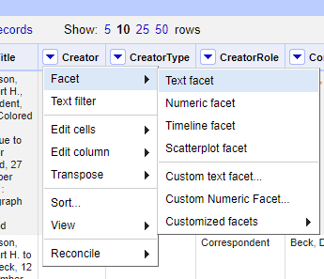
Visualizing and editing: faceting
Faceting = OpenRefine’s built-in feature to assist with:
Grouping data
Sorting data
Batch-editing data
What happens with faceting?
An sidebar opens with information on cells with identical values (value, cell count)
Much like a traditional spreadsheet sort, but more actionable
Notes:
Moving into the exercises, we are going to start big rather than small. We will focus first on some of OpenRefine’s tools to help sift through a larger dataset--faceting and clustering.
Faceting and clustering, separately or in combination, can simplify the process of cleaning up a messy dataset by helping us group, sort, and identify patterns in our data. The faceting and clustering interfaces provide easy mechanisms for us to make batch edits based on these groupings and patterns. After making some of these more sweeping batch edits, it can often be easier to focus on more granular or advanced editing tasks.
Let’s first look at faceting -- MOVE TO LIVE DEMO
Facet Creator column
When facet opens:
Out of 139 records we see immediately that we only have 32 unique values
Name, highlight, number, edit, include/exclude features
Sort by name versus sort by count
Show include, exclude, and invert
RETURN to SLIDE

Slide 10
Visualizing and editing: faceting
Types of facets
Our focus today: text facet
Custom facets using GREL and regular expressions (more on those later)
Other useful facets: word facet, duplicates facet, blank facet, error facet
Notes:
In our demo, we focused on using the Text facet to quickly identify patterns in the Artist column.
Depending on your data, though, there may be other facets that you may want to consider.
RETURN TO DEMO
show facet menu on Title column
use word facet on Title column
duplicate facet on Identifier column then add a text facet to remediate
facet by blank on Language

Slide 11
Exercise 1
Explore the facets function; try out at least the text facet, and one of the customized facets; explore the sort options in the facet box that appears at left; try some of the other features of the facet box (invert, reset, include, exclude)
Facets can also be cumulative--try faceting for all works by Creator “Harrison, Hubert H.” written in French
Notes:
NB: in the actual dataset, all materials are in English

Slide 12
Visualizing and editing: faceting as filtering
Keep in mind the power of faceting as we progress through the advanced exercises later--Faceting can be a powerful way reconcile or to apply batch changes to subsets of your data, rather than the entire dataset
Notes:
BEWARE: As you change data, facets update; always be cognizant when making changes of which facets are open/active,
how many rows/records you are working with at a given time (always check at upper left)
This feature of facets is most confusing when working with the facets relating to reconciliation tasks, covered in the second part of this workshop.

Slide 13
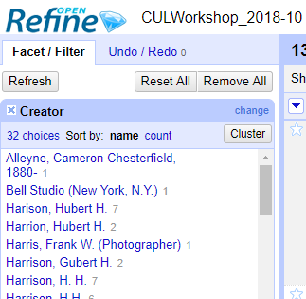
Visualizing and editing: Clustering
Clustering: takes faceting a step further by applying algorithms to your cell values to suggest matches
Unlike faceting, can help identify near matches and errors, e.g. “Harrison” will be clustered with “Herrison,” “1877” with “1878” and “1879”
Matching algorithms are grouped by method; we won’t go into the details here
Visualizations can help target your editing efforts
Human review is a key component of the clustering process
Notes:
One of OpenRefine’s most powerful feature is clustering, which uses algorithms based on NATURAL LANGUAGE PROCESSING
to help you identify near-matches in your dataset. Near matches could be variant forms of a name, like Rome versus Roma, or simply typos like Romr
LIVE DEMO
Let’s look at the OriginPlace column. N.B. This is randomized data I took from publication statements in unrelated bibliographic records, which I put into the dataset for the sake of illustration--the Frick Photoarchive data was standardized to the point that it would not have been suitable to demonstrate clustering.
Let’s first facet this column and sort by count--we already see that many of the most frequently occurring values are variants on “New York, N.Y.”
While we could go and manually change each of these variants, clustering can simplify this process. On your facet panel, click Cluster
Show different keying/distance functions (usually have better success with metaphone; cologne is like metaphone but tailored to German-language data)
Note that there is more info on these keying/distance functions via a link on the cluster screen--we don’t have time to discuss these in detail
On metaphone, show some of the graphs and how to use them to target types of clusters
Edit the NY, NY cluster, then merge and re-cluster
Note that clustering won’t catch everything--show Nueva York, NYC variants lower down, and then close and view the facet--it has updated automatically
Note that clustering can be a good springboard--cluster first, then edit from facets for smaller corrections

Slide 14
Exercise 2
Using the OriginPlace, play around with some of the faceting and clustering features. Try out different algorithms for clustering.
What kinds of matches and clusters are you getting? Which matching algorithms work better?

Slide 15
Exercise 3
Using the OriginPlace column, begin making batch edits using the faceting and clustering features
Notes:
wrap-up around 10:45

Slide 16
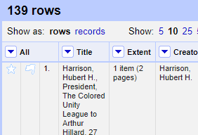
The All column
At left, the All column hides some useful features:
DELETING via starring and flagging
Edit rows→ Star/Flag rows THEN Edit rows→ Remove all matching rows
Stars or flags can also be used to make facets
REORDERING COLUMNS
Edit columns→ Re-order/remove columns
This can be easier than the “Move left” and “Move right” options available on other columns, especially in large datasets
Notes:
We’ve seen how to make subsets of our data using cascading facets, and how to perform batch-editing using faceting and clustering.
You may be wondering how to do some basic housecleaning--maybe you need to delete a portion of your dataset,
or you just need to reorder the columns to help you work with the data.
DEMO
Some basic features are available in the Edit cells and Edit columns menus, which we’ll cover in more detail during the rest of the presentation.
For example, you can move columns left or right, rename a column, blank out a column, or delete a column via Edit columns
The All column, however, is the primary way you can delete rows, by making temporary groupings
facet by blank on Creator--we want to get rid of all rows that have no Creator information
All--Star rows
All--Remove all matching rows
SHow that it’s easy to click undo
All-Reorder columns

Slide 17
Exercise 4
Try using the All column to remove all rows with materials of a specific Form, like correspondence, photographs, or ephemera--how could we do this most efficiently?
Try moving around the columns to make your work a bit easier
Notes:
Finish around 10:55

Slide 18
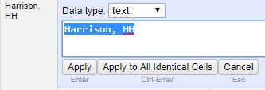
Editing cells
Counterintuitively, let’s now move into more granular changes. . .
Click in any cell--what options are available to change the cell content?
Notes:
Go straight to demo
Edit cells
Note data type options (let’s not get bogged down, though)
Option to apply change just to one cell, or to all matching cells in column

Slide 19
Exercise 5
Clean up some of the cells in the Type column--for example, click in the top cell, click “Edit,” and change the upper-case T to lower-case: “Text” → “text”. Click “apply to all identical cells”
Notes:
While attendees are doing this exercise, ask about the pros and cons of doing this sort of edit
manually versus faceting and clustering.

Slide 20
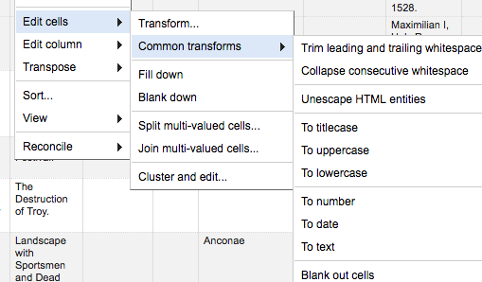
Editing cells
Common editing tasks:
Edit cells → Common transforms
Explore some of these tasks. . . why are these built-in to OpenRefine?
Notes:
Briefly show other “common transforms”
DEMO : Type column
Trim
Collapse
Lowercase
Blank out
As well as Edit cells
Fill down (takes first value spreads to all consecutive rows/records)
Blank down (doesn’t really work in 2.8)
Wrap-up 11:05

Slide 21

Editing cells
Regular expressions
Regular expressions (regexes): a syntax for complex find-and-replace
Examples:
\.$ matches all periods at the end of a line
\d{3}\-\d{4} matches all telephone numbers in format ###-#### e.g. 555-5456
GREL Syntax: value.replace(/{regex}/, "{replacement}")
Documentation on basic regexes in OpenRefine
Stephen Cole Kleene, inventor of resexes
Notes:
Image credit: Stephen Cole Kleene by Konrad Jacobs, Erlangen, Copyright is MFO - Mathematisches Forschungsinstitut Oberwolfach,http://owpdb.mfo.de/detail?photo_id=2122, CC BY-SA 2.0 de, https://commons.wikimedia.org/w/index.php?curid=12342617
In the last exercise, we made some basic batch changes to the Type column
Although the Faceting, Clustering, and Apply to all cells features can help us make this type of edit
more quickly than we could in a typical spreadsheet application, with a large dataset
making these kinds of repetitive changes can quickly get unwieldy.
OpenRefine has robust support for regular expressions, a commonly deployed programming shorthand
to match patterns (Wikipedia: “define a search pattern”), often used with find-and-replace and validation operations.
Has anyone here used regular expressions?
Regular expressions are used
not just in computer programming or in OpenRefine, but are supported by many applications--
even GoogleSheets lets you use regular expressions in find-and-replace operations.
Let’s look at some examples--don’t worry if you don’t understand the syntax, we will give you
sample regular expressions that you can use in the upcoming exercises. In the dropbox folder with
the presentation materials, there is a text file with the sample regular expressions. Feel free to open this file
now, and copy-and-paste in the regular expressions as needed. If you already have some experience
with regular expressions, or are feeling like experimenting, feel free to try out your own regular expressions as
we proceed. A link to a quick reference is available here on the slide, and also in the resources page at the end
of the presentation
Some basic regexes are here on the slide--we have a regex to match all periods at the end of a line, and another
one to match all telephone numbers in a standardized format
In OpenRefine, for finding and replacing we need to embed regexes into a basic GREL statement, given as
the third bullet point
DEMO
Genre column: Edit cells → Transform cells
value.replace(/ \(.+/,"")
Note that you have options: GREL vs Python etc ; error store original, store error, store blank etc. -- since this workshop if focusing entirely on OpenRefine and targeted to all levels of experience, we are not going to explore the using Python/Jython with OpenRefine

Slide 22
Exercise 6
You notice that all of the values in the Contributor column have a period at the end--this period should be removed from all the cells.
Using Edit cells → Transform -- can you deploy a regular expression (regex) to remove all periods at the end of the Contributor column? (Hint on previous slide)

Slide 23
Exercise 6
Using Edit cells → Transform -- can you deploy a regular expression (regex) to remove all periods at the end of a column?
ANSWER: value.replace(/\.$/, "")
Notes:
Answer is also in the .txt file for copying-and-pasting in

Slide 24
Named groups in regexes
Named groups: a way to refer to patterns in your data and use it in replace statements
Example: you need to normalize a date column: all data was entered MM/DD/YYYY, but you need it in the ISO standard format of YYYY-MM-DD
10/27/1925 → 1925-10-27
Find: (\d{2})/(\d{2})/(\d{4})
Replace: $3-$1-$2

Slide 25
Exercise 7
Using the Edit Cells→ Transform dialogue, clean up the Date1Code column. Convert the date to the standardized YYYY-MM-DD format
Where else might we use named groups to clean our data?
Notes:
ANSWER : value.replace(/(\d{2})\/(\d{2})\/(\d{4})/, "$3-$1-$2")
also in .txt file
NOTE: GREL formatting requires some extra string-escaping in order to prevent errors in the GREL parser--that’s why in the regex, backslashes precede the forward slashes

Slide 26
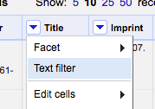
Custom filters and facets
Now that we’ve used some GREL and regular expressions, you have the basic tools to build your own text filters and custom facets
Facet→ Custom text facet OR Custom numeric facet
Text filter
Notes:
DEMO
Show Facet --> Custom text facet
Show Text filter
^[a-zA-Z]+$ -- everything with a single-word subject
Don’t go into detail, though
Wrap-up 11:20

Slide 27
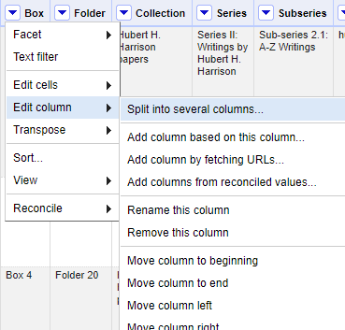
Splitting and joining
Columns and cells can be split or joined based on:
Delimiters (such as , ; |)
Fixed lengths (split or join at the nth position)
GREL and regexes
While splitting columns based on a delimiter is pretty self-explanatory, splitting and joining cells, and joining columns is a bit trickier. . . Let’s start with splitting columns. . .
Notes:
Looking at some of our data, particularly in the Subject column, we may note that we have multiple values in many of the cells;
In other cases, like the Medium column, we may actually have mixed data--Medium and Support in this case.
Depending on your project, either of these cases (multiple values or mixed data) may present a challenge, and you may
need to separate your data elements. Conversely, you may need to join data spread across columns or cells.
Why would you have to split or join data?
Other splitting columns use cases: parsing out birth date and death date, units from quantities, etc.
Fortunately, OpenRefine offers many options to split and join data. Let’s look at a few in the coming exercises. . .
DEMO:
Use SubjectType column
Edit Column → Split into several columns
Discuss some of the options in the menu; note that you can use regular expressions
Split on ;
Look at the resulting columns

Slide 28
Exercise 8
Edit column→ Split into several columns
What data might we want to split into multiple columns or cells/rows?
See if you can split BoxFolder into two columns (“Box” “Folder”) based on the delimiter “, “

Slide 29
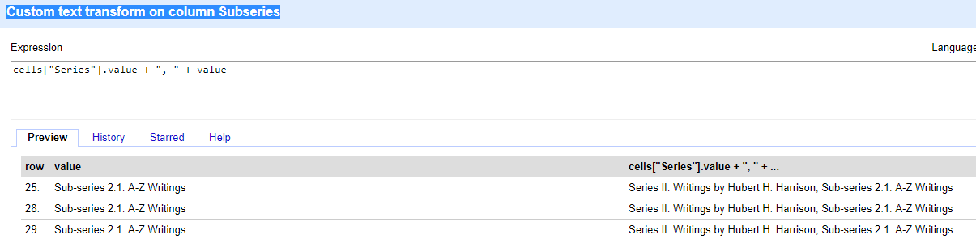
Joining column data
Joining column data:
Edit Cells→ Transform
Insert the column name and delimiter (like a space or semicolon) into this GREL script: cells[“COLUMN_NAME”].value + “DELIMITER” + value
GREL will generate an error if your columns are not well-named, e.g. if the column name has a space or non-alphanumeric character
Notes:
DEMO
For our upload project, we’ve decided that the information on the archival series and on the archival subseries don’t need to be in separate data fields, so we’ll join the series and subseries columns using GREL
Subseries column
Edit cells → Transform
cells["Series"].value + ", " + value
Could also do this via
Edit column → Add column based on this column
cells["Series"].value + ", " + cells[“Subseries”].value
Note that if you are using OpenRefine in the Record View mode (see below), you’ll need a different GREL script, with the caveat that your column name can’t contain spaces and special characters:
row.record.cells.Series.value[0] + ", " + value

Slide 30
Exercise 9
Join some column data!
What are some cases where you might want to join data from various columns?
Notes:
Using Edit cells → Transform in the destination column:
Example: joining Location and Collection
On Collection, click Cells → Transform
cells["Location"].value + "; " + value
See preceding slide’s speaker notes for additional ways of combining column data. How could we build on this methodology to join several columns to build a correctly formatted “Preferred citation” for each item? See the finding aid for the collection for details on the format of a preferred citation.

Slide 31
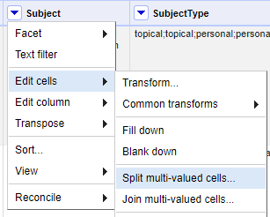
Splitting cells: Rows
vs. Records
Look at the Subjects column--there are multiple values in many of the cells
Why might we want to look at each value separately?
Splitting cell values brings into relief a powerful feature of OpenRefine: viewing data as Rows versus viewing data as Records
Notes:
Arguably a more common use case, we may often need to split multi-valued cells.
Multivalued cells may commonly occur if you’re working with data exported from a database,
such as a library catalog, a digital asset management system, or platforms like Omeka.
Why might we want to look at each value separately?
Briefly, this can help us with faceting and clustering (and also reconciliation, to be covered next week)
OpenRefine is not able to analyze each value in a multivalued cell separately unless you split the cell.
Let’s look at how this works.
DEMO
Subject column
Do a text facet and cluster -- what a mess!
Edit cells → Split multivalued cells
Split on semicolon
What looks different? What may be problematic about splitting the cells [data may get separated from its record]
Change to record view -- what looks different now?
Facet and cluster again
Edit cells → Join multivalued cells

Slide 32
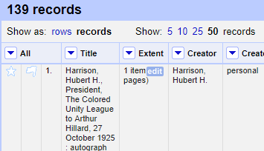
Exercise 10
Using the Subject column, click Edit cells→ Split multivalued cells. Split the cells on the delimiter ;
After splitting the cell data, toggle between the “Show as” options at the top left of your spreadsheet: Show as rows, Show as records. How are these views different?
In record view, do some cleanup with faceting and clustering
Then, click Edit cells→ Join multivalued cells. Use a semicolon as a delimiter, as before

Slide 33
Splitting cells
What are some advantages and disadvantages to using the “Split/Join multivalued cells” functions for editing (and reconciling) our data?
Notes:
Wrap-up: 11:40

Slide 34
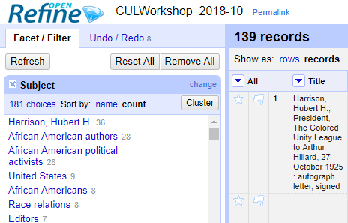
Undo/Redo ...and reusing your work!
On the top left, there is an undo/redo panel (you may have missed it!)
Essentially, this functions like “Version history” in a Google Sheet or “Track Changes” in Microsoft
If you make some disastrous batch edits or some scripts go awry, you can always back-up and recover
Just click on the point in the editing history that you’d like to revert to, and return to editing!
Notes:
AP to end

Slide 35
Undo/Redo ...and reusing your work!
Extract/Apply
Click on the Extract button: a snippet of JSON code appears
This code can be copied as a kind of batch script that you can re-apply to other datasets (via the Apply button)
Note that you can also select and de-select steps to include in this code
How might you use this powerful functionality?

Slide 36
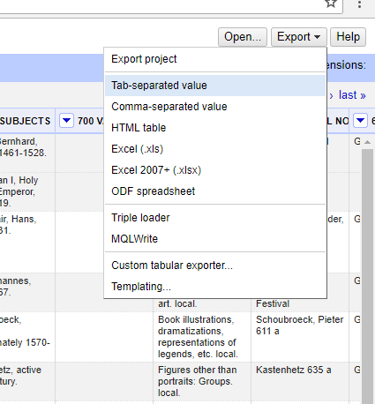
Exporting your data
To get your data out of OpenRefine:
Click Export (at the top right of screen)
Pick a data format
The file will appear in your default downloads folder
Exporting a project
Export → Export project
This exports both your data and the entire editing history since you loaded it into OpenRefine
Can be opened by another instance of OpenRefine
Notes:
RM
OpenRefine saves your project automatically, so….
Unless you uninstall the program, or install a new version (or something awful happens to your hard drive). . .
No need to worry--your data will still be there when you reopen OpenRefine!
RETURN TO DEMO
Show data export options
Explain project export (data plus editing history) -- why might you want the project, why might you just want the data?

Slide 37
Resources
http://openrefine.org/
Homepage has basic tutorials, Documentation has links to mailing lists, wikis, and Downloads has links to the GitHub page
Verborgh, Ruben and De Wilde, Max. Using OpenRefine. Birmingham : Packt Publishing, 2013. 9781-78328-908-0
A good introduction and reference to using OpenRefine; although based on an older version, most editing features are the same
Especially useful:
Chapter 1 Recipe 3
Chapter 2 Recipe 2
Chapter 3 Recipe 3
van Hooland, Seth and Verborgh, Ruben. Linked data for libraries, archives and museums : how to clean, link and publish your metadata. London : Facet Publishing, 2014. 9781856049641
A more in-depth exploration of the linked data world, with many examples of how to use OpenRefine
Karen Hwang’s post for METRO about using OpenRefine
Notes:
Here are some resources. . .

Slide 38
Resources ctd.
Rawson, Katie and Muñoz, Trevor. “Against cleaning” at Curating Menus, referenced 15 May 2018, http://curatingmenus.org/articles/against-cleaning/
An exploration of what we’re talking about when we talk about “data cleaning”
Regular expressions and GREL
“General Refine Expression Language” at OpenRefine Wiki, referenced 10 May 2018, https://github.com/OpenRefine/OpenRefine/wiki/General-Refine-Expression-Language
The primary reference source for GREL. Fairly user-friendly, richly illustrated with examples
“Understanding regular expressions” at OpenRefine Wiki, referenced 10 May 2018 https://github.com/OpenRefine/OpenRefine/wiki/Understanding-Regular-Expressions
A good introduction to using regular expressions in GREL scripts in OpenRefine
https://www.regular-expressions.info/
Despite the wonky look, this is an excellent reference for all things Regular Expressions
https://regex101.com/
Another option for testing your regex
Notes:
Wrap-up: 5:50

Slide 39
Questions?
I hope to see you back here next week for
Part 2: reconciliation and enrichment!
Ryan Mendenhall
trm2151@columbia.edu
Notes:
QA 5:50-6PM

