Slide 1
Layout Widgets in Flutter and State Management
Experiment 2(b): Row, Column, Stack Experiment 5(b): setState() and Provider
UI DESIGN FLUTTER | CSE / IT Laboratory

Slide 2
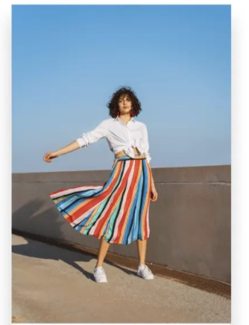
Image widget
To display any kind of image. The image can be of different types: - Asset Image (stored on computer)
- Network image (can be accessed via link)
Etc..
Image.asset() in flutter code
or Image.network() in flutter code

Slide 3
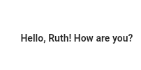
Text widget
A text widget helps to display text on mobile screen
Text(“Hello, Ruth! How are you?”)

Slide 4
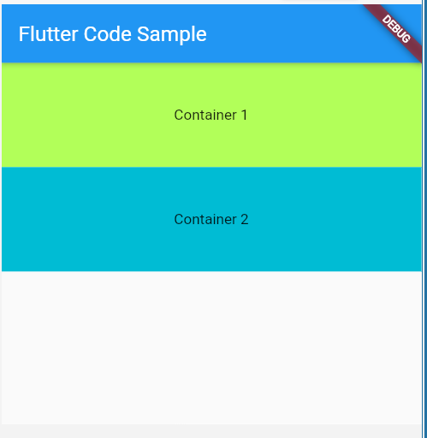
Container widget
Container(
child: Text(“Container 1”)
),
Container(
child: Text(“Container 2”)
),

Slide 5
Experiment 2(b) – Layout Widgets
Implement different layout structures using Row, Column and Stack
Flutter layouts are built by arranging widgets inside parent widgets.
Row arranges children horizontally.
Column arranges children vertically.
Stack places children on top of one another.
These widgets can be combined to create complete user interfaces.
UI DESIGN FLUTTER

Slide 6
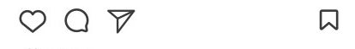
Row widget
Row(
children:
[
Icon(),
Icon(),
Icon(),
Spacer(),
Icon(),
]
),
A row widget is like a widget in X-Plane. (X Axis)
A row can have multiple children widgets

Slide 7
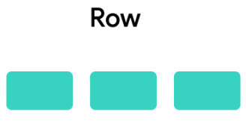
Row Widget
Row places its child widgets from left to right.
Useful for menus, icon + text combinations, buttons, and horizontal sections.
Important properties:
children – list of widgets arranged horizontally
mainAxisAlignment – controls horizontal distribution
crossAxisAlignment – controls vertical alignment
UI DESIGN FLUTTER

Slide 8
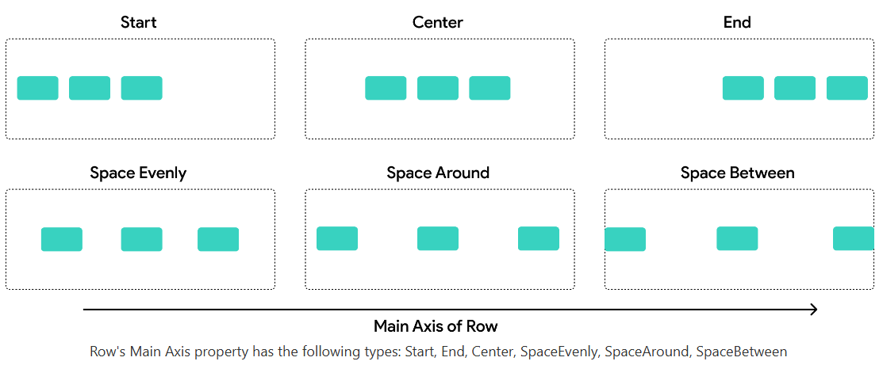
The main axis is the primary direction, child widgets are laid out in a Row or Column.

Slide 9
mainAxisAlignment Options
Value | Behavior
start | Children align to the left
center | Center horizontally
end | Align to right
spaceBetween | Space distributed between children
spaceAround | Equal space around children
spaceEvenly | All spacing equal

Slide 10
crossAxisAlignment Options
Value | Behavior
start | Align top
center | Center vertically
end | Align bottom
stretch | Children expand vertically (if possible)

Slide 11
Main Axis vs Cross Axis
Main Axis → Vertical
Controls how children are aligned top-to-bottom.
Cross Axis → Horizontal
Controls how children are aligned left-to-right.

Slide 12
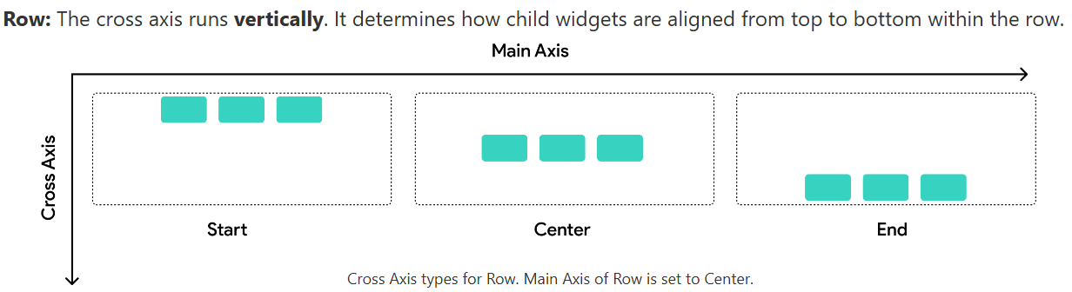

Slide 13
Row – Example
Row( mainAxisAlignment: MainAxisAlignment.spaceEvenly, children: [ Icon(Icons.home), Text('Home'), Icon(Icons.settings), ], )
UI DESIGN FLUTTER

Slide 14
import 'package:flutter/material.dart';
void main() {
runApp(const MyApp());
}
class MyApp extends StatelessWidget {
const MyApp({super.key});
@override
Widget build(BuildContext context) {
return MaterialApp(
debugShowCheckedModeBanner: false,
home: Scaffold(
appBar: AppBar(
title: const Text('Row Widget'),
),

Slide 15
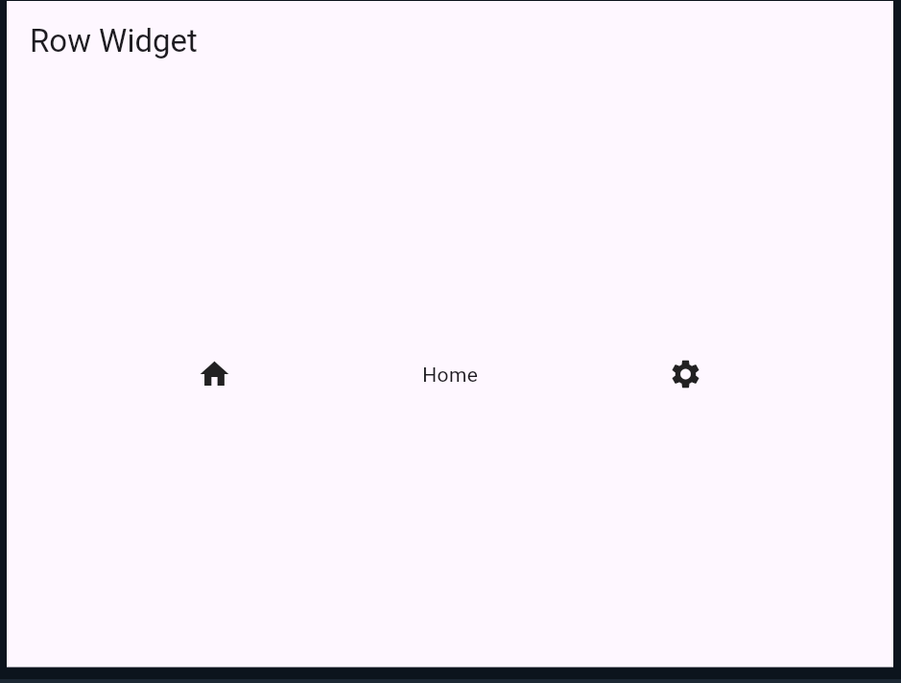
body: Center(
child: Row(
mainAxisAlignment: MainAxisAlignment.spaceEvenly,
children: const [
Icon(Icons.home),
Text('Home'),
Icon(Icons.settings),
],
),
),
),
);
}
}

Slide 16
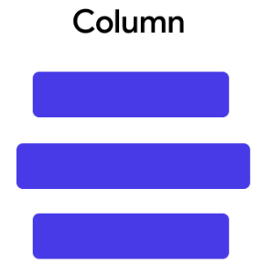
Column Widget
Column places its child widgets from top to bottom.
Useful for forms, login pages, profile screens, and vertical menus.
Important properties:
children – list of widgets arranged vertically
mainAxisAlignment – controls vertical distribution
crossAxisAlignment – controls horizontal alignment
UI DESIGN FLUTTER

Slide 17
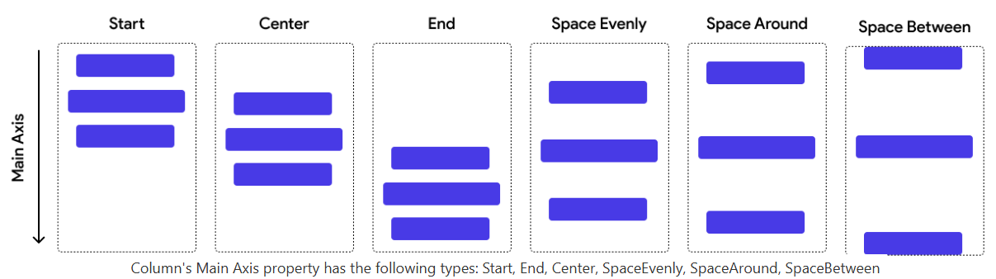

Slide 18
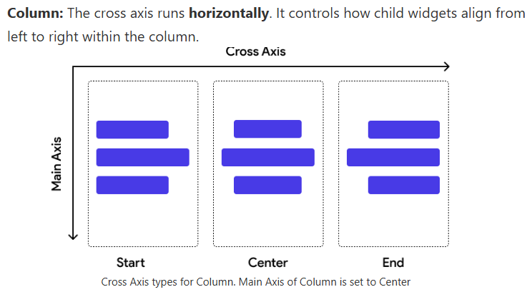

Slide 19
Column – Example
Column( mainAxisAlignment: MainAxisAlignment.center, crossAxisAlignment: CrossAxisAlignment.center, children: [ Text('Welcome to MGIT'), Text('UI Design Flutter'), ElevatedButton( onPressed: () {}, child: Text('Start'), ), ], )
UI DESIGN FLUTTER

Slide 20
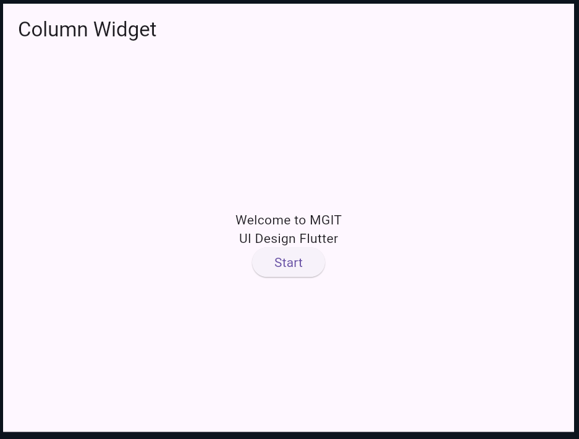
import 'package:flutter/material.dart';
void main() {
runApp(const MyApp());
}
class MyApp extends StatelessWidget {
const MyApp({super.key});
@override
Widget build(BuildContext context) {
return MaterialApp(
debugShowCheckedModeBanner: false,
home: Scaffold(
appBar: AppBar(
title: const Text('Column Widget'),
),

Slide 21
body: Center(
child: Column(
mainAxisAlignment: MainAxisAlignment.center,
crossAxisAlignment: CrossAxisAlignment.center,
children: [
const Text('Welcome to MGIT'),
const Text('UI Design Flutter'),
ElevatedButton(
onPressed: () {
print('Start button clicked');
},
child: const Text('Start'),
),
],
),
),
),
);
}
}

Slide 22
MainAxisAlignment and CrossAxisAlignment
mainAxisAlignment controls alignment along the widget's main direction.
For Row: main axis = horizontal.
For Column: main axis = vertical.
crossAxisAlignment controls alignment perpendicular to the main axis.
Common values: start, center, end, spaceBetween, spaceAround, spaceEvenly.
UI DESIGN FLUTTER

Slide 23
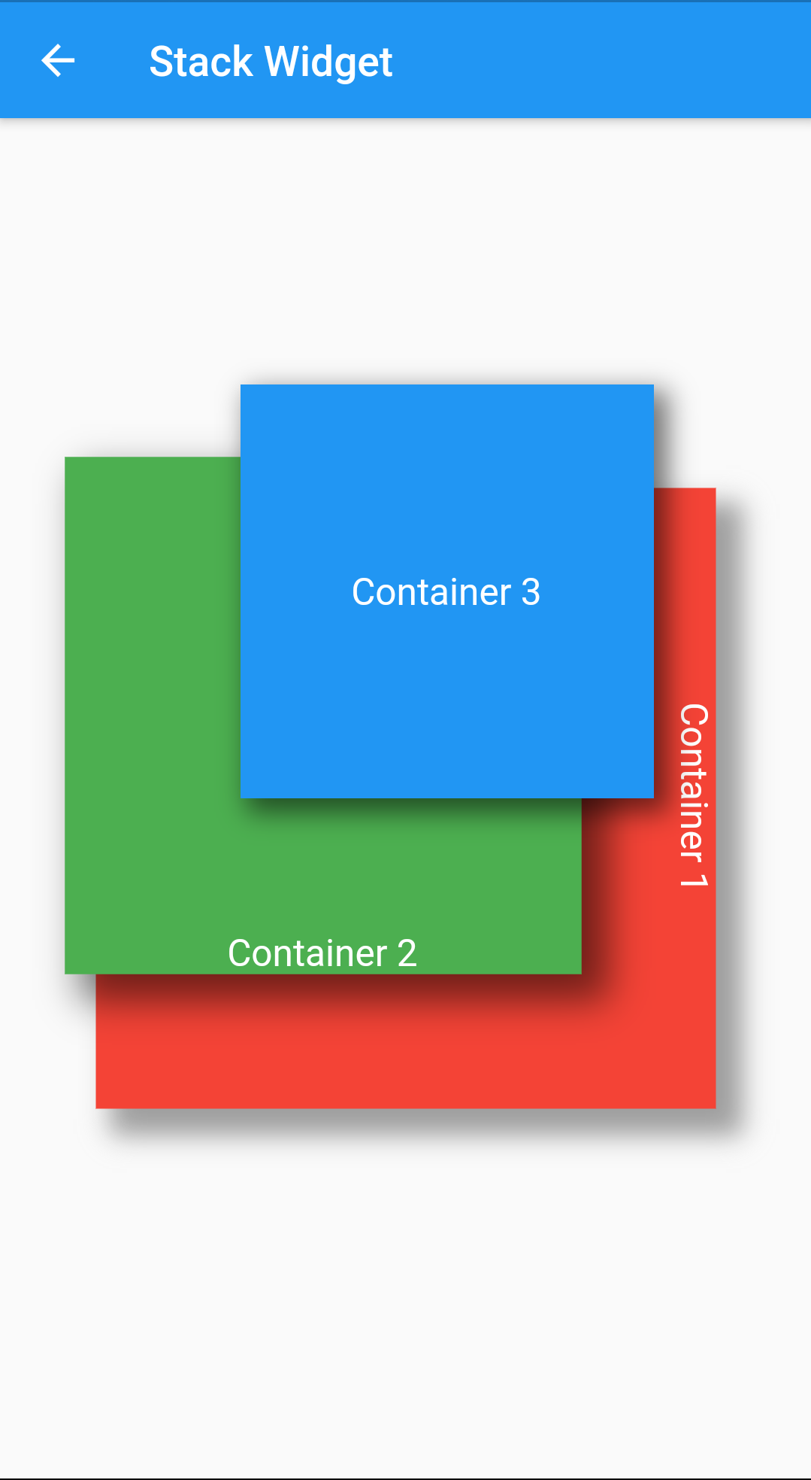
Stack Widget
Stack places widgets one above another.
The first child is at the back; later children appear above it.
Useful for image overlays, badges, profile pictures and floating labels.
Positioned can be used to control the location of a child inside a Stack.
UI DESIGN FLUTTER

Slide 24
Stack – Example
Stack( children: [ Image.network('image_url'), Positioned( bottom: 10, left: 10, child: Text( 'MGIT', style: TextStyle(color: Colors.white), ), ), ], )
UI DESIGN FLUTTER

Slide 25
import 'package:flutter/material.dart';
void main() {
runApp(const MyApp());
}
class MyApp extends StatelessWidget {
const MyApp({super.key});
@override
Widget build(BuildContext context) {
return MaterialApp(
home: Scaffold(
appBar: AppBar(
title: const Text('Stack Widget'),
),
body: Center(
child: Stack(
children: [
Image.network(
'https://picsum.photos/300/200',
width: 300,
height: 200,
fit: BoxFit.cover,
),
const Positioned(
bottom: 10,
left: 10,
child: Text(
'MGIT',
style: TextStyle(
color: Colors.white,
fontSize: 24,
fontWeight: FontWeight.bold,
),
),
),
],
),
),
),
);
}
}

Slide 26
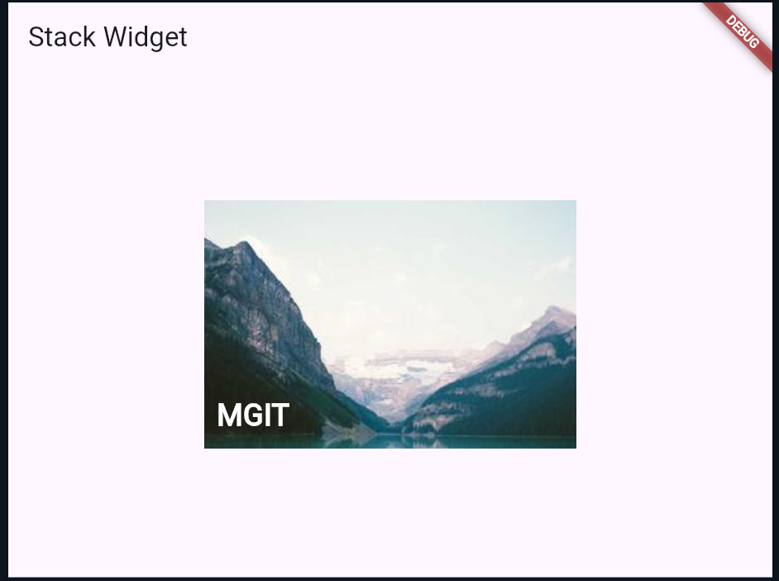

Slide 27
Combined Layout – Row + Column + Stack
Real applications normally combine multiple layout widgets.
Example structure:
Column – main vertical structure
Row – horizontal group of actions
Stack – image with text/icon overlay
Practice: design a simple student profile screen using all three.
UI DESIGN FLUTTER

Slide 28
import 'package:flutter/material.dart';
void main() {
runApp(const MyApp());
}
class MyApp extends StatelessWidget {
const MyApp({super.key});
@override
Widget build(BuildContext context) {
return MaterialApp(
home: Scaffold(
appBar: AppBar(
title: const Text('Combined Layout'),
),
body: Column(
children: [
// Stack: Text over Image
Stack(
children: [
Image.network(
'https://picsum.photos/400/200',
width: double.infinity,
height: 200,
fit: BoxFit.cover,
),
const Positioned(
bottom: 10,
left: 10,
child: Text(
'MGIT',
style: TextStyle(
color: Colors.white,
fontSize: 24,
fontWeight: FontWeight.bold,
),
),
),
],
),
const SizedBox(height: 20),

Slide 29
// Column: Text arranged vertically
const Column(
children: [
Text(
'Welcome to MGIT',
style: TextStyle(
fontSize: 22,
fontWeight: FontWeight.bold,
),
),
Text('UI Design using Flutter'),
],
),
const SizedBox(height: 20),
// Row: Widgets arranged horizontally
Row(
mainAxisAlignment: MainAxisAlignment.spaceEvenly,
children: [
const Icon(Icons.home),
const Icon(Icons.school),
ElevatedButton(
onPressed: () {},
child: const Text('Start'),
),
],
),
],
),
),
);
}
}

Slide 30
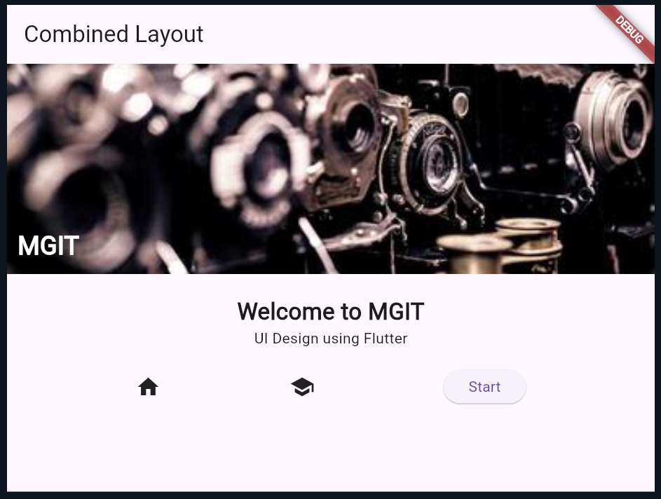

Slide 31
Experiment 2(b) – Lab Exercise
Create a student profile UI.
Use Column for the main screen.
Use Stack for profile image + status/edit icon.
Use Row for name, department and action buttons.
Apply alignment properties and spacing.
Run the application and verify the layout on the emulator.
UI DESIGN FLUTTER

Slide 32
Experiment 5(b) – State Management
Implement state management using setState and Provider
State is data that can change while an application is running.
Examples: counter value, selected item, login status, form values.
When state changes, the UI may need to be rebuilt.
Flutter provides setState() for local state and Provider for shared/application state.
UI DESIGN FLUTTER

Slide 33
setState()
setState() is used inside a StatefulWidget's State class.
It tells Flutter that the state has changed and the affected UI should rebuild.
The state-changing code is placed inside setState(() { ... }).
Best suited for simple, local state.
UI DESIGN FLUTTER

Slide 34
Counter using setState()
class CounterPage extends StatefulWidget { const CounterPage({super.key}); @override State<CounterPage> createState() => _CounterPageState(); } class _CounterPageState extends State<CounterPage> { int count = 0;
@override Widget build(BuildContext context) { return Scaffold( body: Center( child: Column( mainAxisAlignment: MainAxisAlignment.center, children: [ Text('Count: $count'), ElevatedButton( onPressed: () { setState(() { count++; }); }, child: Text('Increment'), ), ], ), ), ); } }
UI DESIGN FLUTTER

Slide 35
import 'package:flutter/material.dart';
void main() {
runApp(const MyApp());
}
class MyApp extends StatelessWidget {
const MyApp({super.key});
@override
Widget build(BuildContext context) {
return MaterialApp(
debugShowCheckedModeBanner: false,
home: const CounterPage(),
);
}
}
class CounterPage extends StatefulWidget {
const CounterPage({super.key});
@override
State<CounterPage> createState() => _CounterPageState();
}
class _CounterPageState extends State<CounterPage> {
int count = 0;
@override
Widget build(BuildContext context) {
return Scaffold(
appBar: AppBar(
title: const Text('Counter App'),
),

Slide 36
const SizedBox(height: 20),
ElevatedButton(
onPressed: () {
setState(() {
count++;
});
},
child: const Text('Increment'),
),
],
),
),
);
}
}
body: Center(
child: Column(
mainAxisAlignment: MainAxisAlignment.center,
children: [
Text(
'Count: $count',
style: const TextStyle(
fontSize: 30,
fontWeight: FontWeight.bold,
),
),

Slide 37
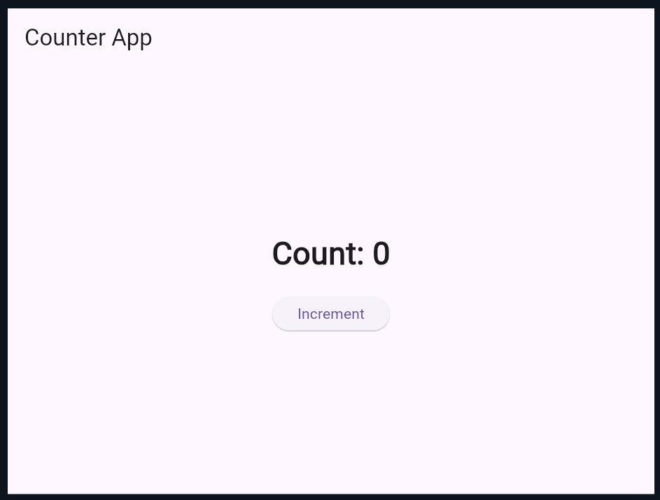

Slide 38
How setState() Works
1. User performs an action.
2. Event handler changes the state.
3. setState() notifies Flutter that the state changed.
4. Flutter rebuilds the relevant widget.
5. Updated value appears on the screen.
Flow: User Action → State Change → setState() → Rebuild UI
UI DESIGN FLUTTER

Slide 39
Why Provider?
setState() is convenient for small, local state.
As applications grow, state may be needed by multiple widgets.
Provider helps expose shared state to widgets without passing values through many widget constructors.
Provider commonly works with ChangeNotifier and notifyListeners().
UI DESIGN FLUTTER

Slide 40
Provider – Main Concepts
ChangeNotifier – class that holds changeable application state.
notifyListeners() – informs listening widgets that state changed.
ChangeNotifierProvider – makes the state available to descendant widgets.
Consumer – rebuilds a widget when the provided state changes.
Provider.of<T>(context) – accesses the provided object.
UI DESIGN FLUTTER

Slide 41
Provider – Counter Model
import 'package:flutter/material.dart'; class CounterModel extends ChangeNotifier { int count = 0; void increment() { count++; notifyListeners(); } }
UI DESIGN FLUTTER

Slide 42
Provider – Supplying the State
ChangeNotifierProvider( create: (_) => CounterModel(), child: MyApp(), ) class MyApp extends StatelessWidget { @override Widget build(BuildContext context) { return MaterialApp( home: CounterPage(), ); } }
UI DESIGN FLUTTER

Slide 43
Provider – Reading the State
Consumer<CounterModel>( builder: (context, counter, child) { return Column( children: [ Text('Count: ${counter.count}'), ElevatedButton( onPressed: counter.increment, child: Text('Increment'), ), ], ); }, )
UI DESIGN FLUTTER

Slide 44
setState() vs Provider
setState(): simple and local state management.
Provider: useful when state is shared by multiple widgets.
setState(): state normally belongs to one StatefulWidget.
Provider: separates state/model logic from UI and allows dependent widgets to listen.
Choose the simplest approach that fits the application.
UI DESIGN FLUTTER

Slide 45
Experiment 5(b) – Lab Exercise
Part A: Create a counter application using StatefulWidget and setState().
Part B: Create the same counter application using Provider.
Use ChangeNotifier to store the counter value.
Call notifyListeners() after changing the value.
Use Consumer to display the updated value.
Compare the two implementations.
UI DESIGN FLUTTER

Slide 46
Learning Outcomes
Understand Row, Column and Stack layout structures.
Use mainAxisAlignment and crossAxisAlignment appropriately.
Combine multiple layout widgets to build a UI.
Understand state and why state management is required.
Implement local state using setState().
Implement shared state using Provider and ChangeNotifier.
UI DESIGN FLUTTER

Slide 47
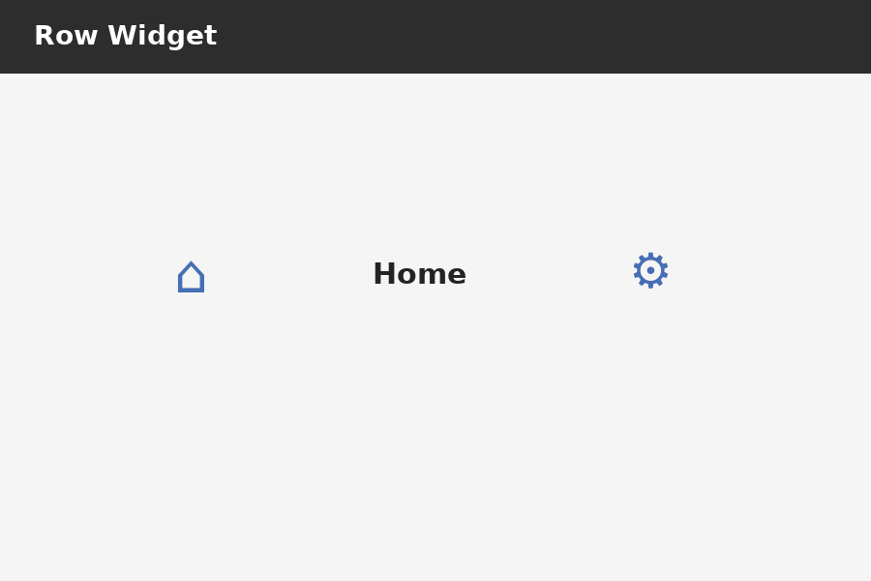
Output – Row Widget
Expected output: children arranged horizontally.

Slide 48
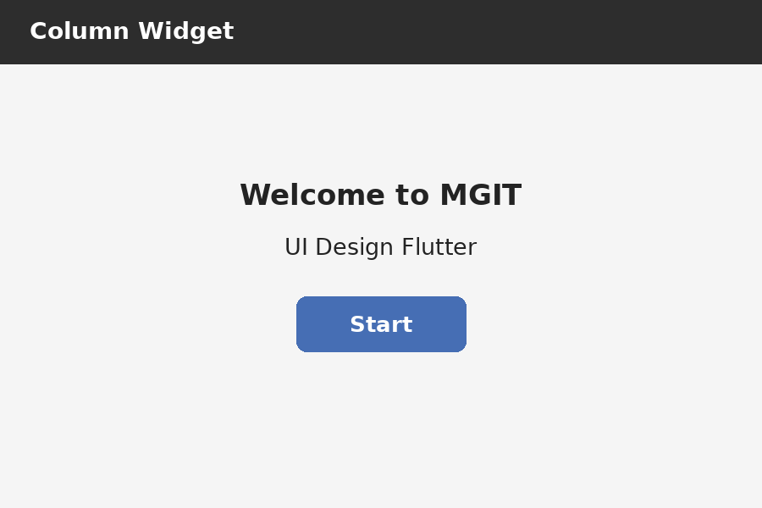
Output – Column Widget
Expected output: children arranged vertically.

Slide 49
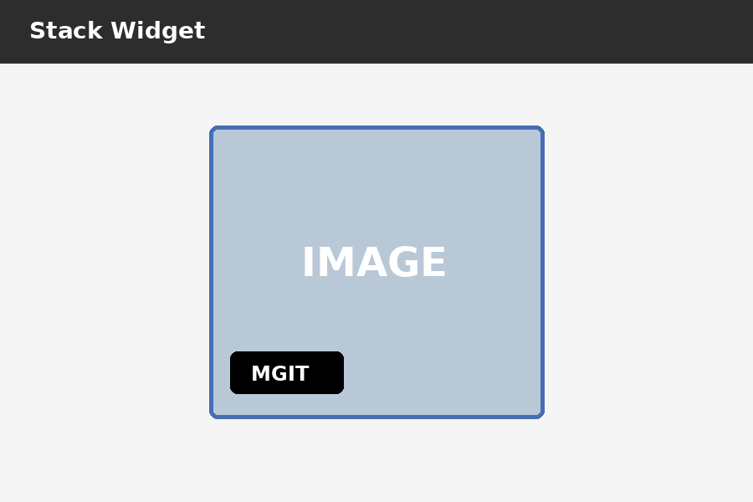
Output – Stack Widget
Expected output: text is displayed over the image.

Slide 50
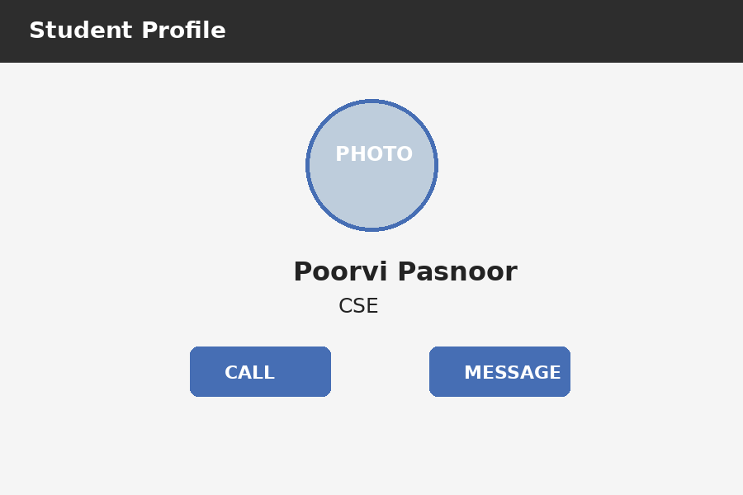
Output – Combined Row + Column + Stack
Expected output: a simple student profile UI using all three layouts.

Slide 51
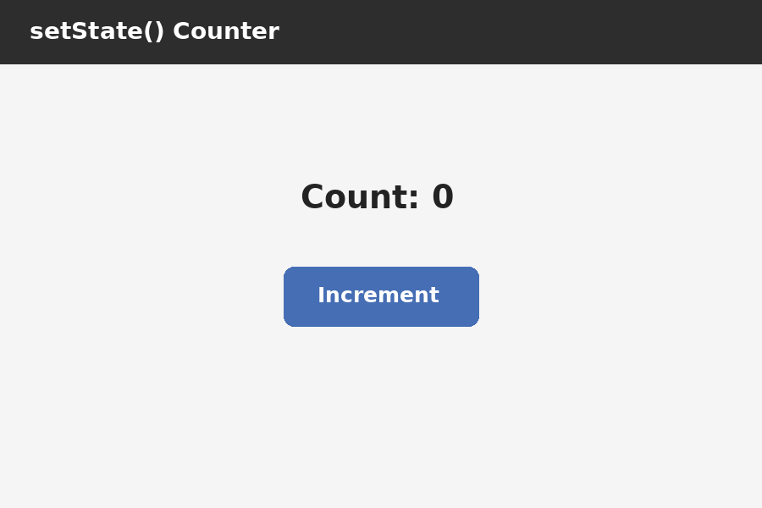
Output – setState() Counter (Initial)
Initial output: Count = 0.

Slide 52
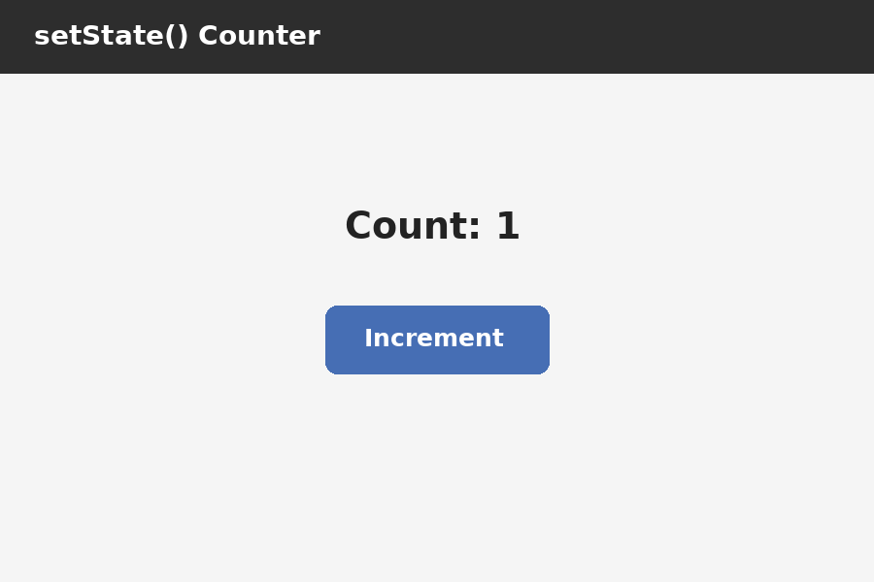
Output – setState() Counter (After Click)
After pressing Increment: Count changes to 1 and the UI rebuilds.

Slide 53
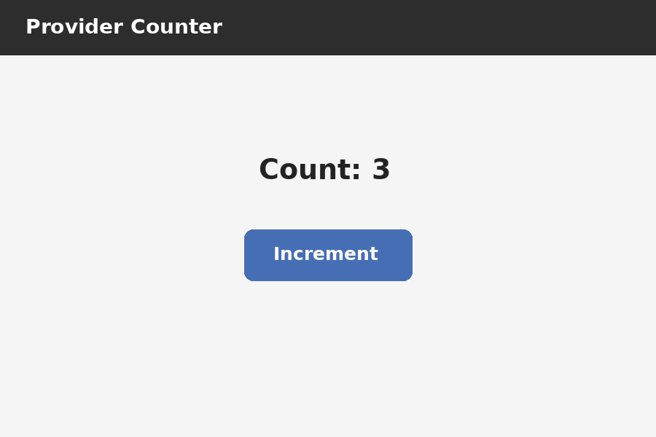
Output – Provider Counter
Expected output: Provider-managed counter showing the updated value.

Slide 54
Step-by-Step Instructions
Step 1: Add your image to project folderInside your Flutter project directory:
Navigate to:
your_project_name/assets/images/
If assets or images folders do not exist, create them.
your_project/
└── assets/
└── images/
└── bg.jpg ← (your background image here)

Slide 55
Step 2: Update pubspec.yaml file
Open pubspec.yaml and add this under flutter: section:
flutter:
assets:
- assets/images/bg.jpg
Make sure:
Indentation is correct (use 2 spaces).
The file is saved after editing.
Get dependencies – clicl-its update pub file
flutter:
assets:
- assets/images/bg.jpg

