Slide 1
Widgets
Dr. V. Subba Ramaiah
Asst. Prof., Dep. Of CSE
MGIT, Hyd.

Slide 2
What is a widget?
A Widget is a description of part of the user interface.
Everything in Flutter is a widget.
Primary component of any flutter application.
Acts as a UI for the user to interact with the application.
building block of the user interface (UI)
Think of widgets like Lego pieces — each one does a small job, and you combine them to build your full app.

Slide 3
Purpose of a Widget
Widgets are used to:
Build the UI layout.
Manage the state (data that changes on screen).
Handle user interactions (like button taps).
Apply styling and themes.
In short: a widget tells Flutter what to draw and how to behave.

Slide 4
Why we need Widgets
Without widgets, you’d have to write raw layout code (like Android XML or iOS Storyboards). Flutter widgets make UI development:
Declarative (you describe what you want, Flutter handles how).
Faster (hot reload).
Consistent (same look across Android, iOS, Web).

Slide 5
Types of Widgets
Flutter widgets are mainly divided into two types:
Type | Description | When to use
Stateless Widget | UI does not change over time | For static content
Stateful Widget | UI changes when data or user input changes | For dynamic or interactive screens

Slide 6
Stateful and Stateless Widgets
A widget is either stateful or stateless. If a widget can change—when a user interacts with it, for example—it's stateful.
A stateless widget never changes. Icon , IconButton , and Text are examples of stateless widgets.
Flutter Widgets
│
┌───────────┴───────────┐
↓ ↓
StatelessWidget StatefulWidget
│ │
Fixed UI Dynamic UI

Slide 7
Examples
Stateless widgets are text, icons, icon buttons, and raised buttons.
A stateful widget is dynamic: for example, it can change its appearance in response to events triggered by user interactions or when it receives data. Checkbox , Radio , Slider , InkWell , Form , and TextField are examples of stateful widgets.

Slide 8
Feature | StatelessWidget | StatefulWidget
State | No mutable state | Has mutable state
UI changes | Generally based on inputs | Can change during runtime
setState() | No | Yes
Example | Text, Icon, static UI | Counter, Checkbox
Complexity | Simple | More complex
State object | Not separate | Separate State object
Stateless = UI doesn't manage changing state
Stateful = UI manages changing state

Slide 9
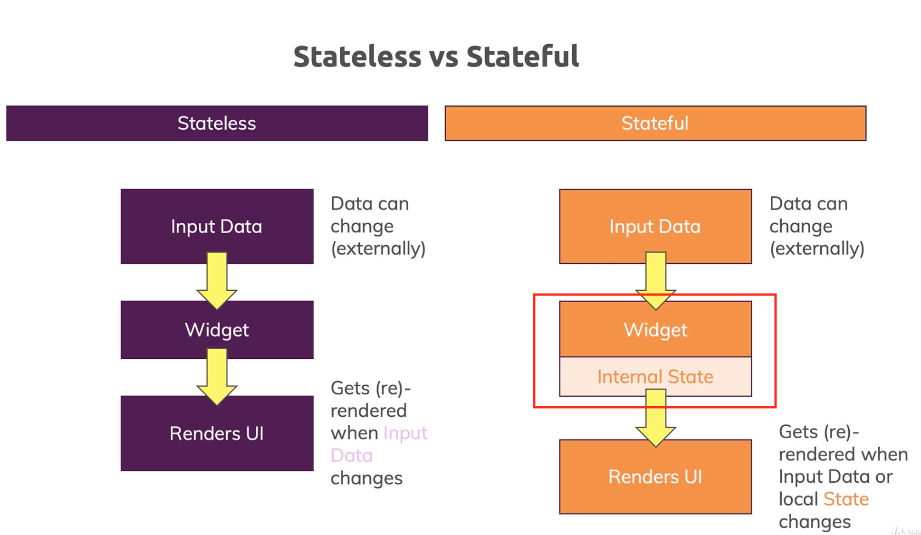

Slide 10
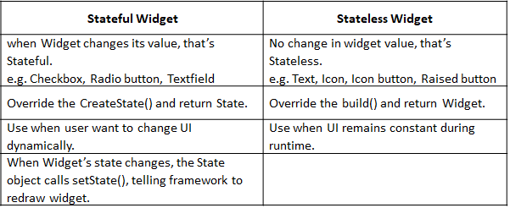

Slide 11
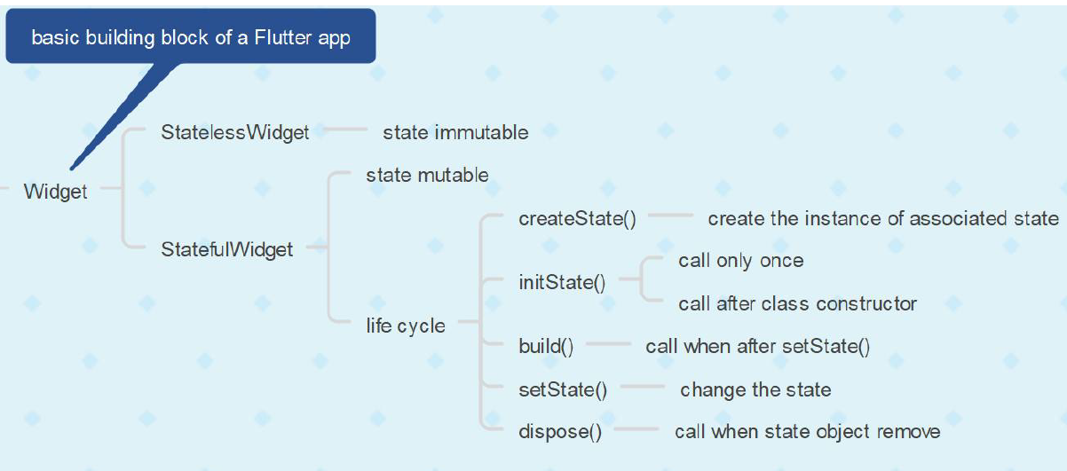

Slide 12
Basic Structure of a Flutter Application
import 'package:flutter/material.dart';
void main() {
runApp(MyApp());
}
runApp() takes the root widget and displays it on the screen

Slide 13
packages
import 'package:flutter/material.dart';
Purpose: Loads the Flutter Material Design library, which contains widgets like MaterialApp, Scaffold, AppBar, Text, etc.
MaterialApp → provides theme and overall app structure.
Scaffold → gives you a full page layout.
AppBar → shows the top bar with title.
Text → displays your content.

Slide 14
MaterialApp
Use / Purpose
Main root widget for Material Design apps.
Sets up themes, routes, navigation, and title bar.
Provides the base structure and styling (colors, fonts, transitions) following Google’s Material Design system.
Why we need
Without MaterialApp, widgets like Scaffold, AppBar, and TextTheme won’t have access to Material styling.
Gives your app a consistent look and feel across platforms.

Slide 15
MaterialApp - Key Properties
Property | Description
home | The default screen widget of your app.
title | App title (used by Android/iOS task manager).
theme | Defines colors, fonts, and styles.
routes | Named routes (for navigation).
debugShowCheckedModeBanner | Hides debug banner.

Slide 16
import 'package:flutter/material.dart'; void main(){ runApp(MaterialApp( home:Text(“MGIT"), )); }

Slide 17
Entry point
void main()
{
runApp(MyApp());
}
main() is the starting point of every Dart/Flutter program.
runApp() tells Flutter which widget to display first.
MyApp() is a custom widget (your app), defined below.

Slide 18
Scaffold
Use / Purpose
Provides a basic visual layout structure for your screen (page).
Gives a ready-made framework that includes:
App bar
Body
Floating action button
Drawer (side menu)
Bottom navigation bar
Why we need
Without Scaffold, you’d have to manually handle screen layout and safe areas.
Handles system UI features automatically (like status bar padding, background color, etc.).

Slide 19
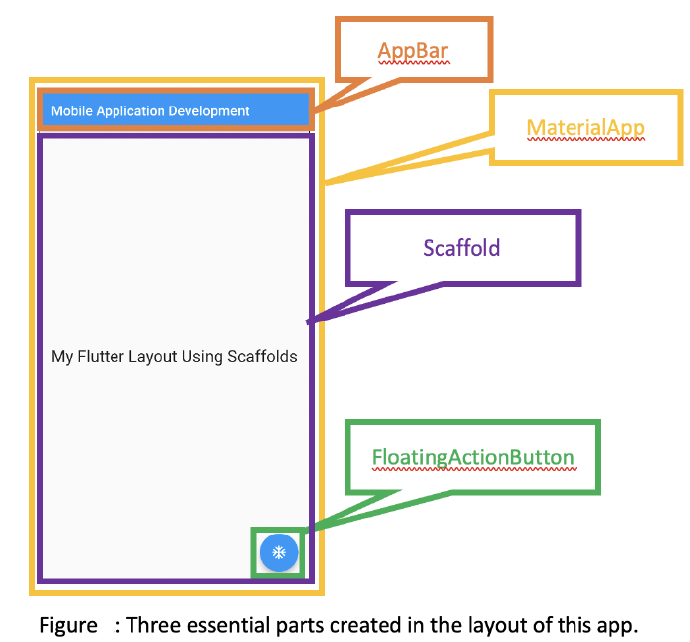

Slide 20
Scaffold – Key Properties Property | Purpose
appBar | Adds a top bar (title, icons, actions. etc.)
body | Main screen content of the screen
backgroundColor | Set the background color of the screen
floatingActionButton | Shows a circular button usually used for main action
drawer | Adds a left-side sliding menu
bottomNavigationBar | Adds a bottom bar for navigation
persistentFooterButtons | Adds buttons at the bottom that stay fixed
resizeToAvoidBottomInset | Handles screen resize when keyboard appears

Slide 21
Example
Scaffold(
appBar: AppBar(title: Text('Home')),
body: Center(child: Text('Welcome!')),
floatingActionButton: FloatingActionButton(
onPressed: () {},
child: Icon(Icons.add),
),
)

Slide 22
AppBar
Use / Purpose
The top bar (header) of your app screen.
Used to show title, actions (like search, menu, settings), and navigation icons (back button, drawer icon).
Why we need
Gives a consistent and beautiful top header across all screens.
Provides built-in animation and system integration.

Slide 23
AppBar – Key Properties
Property | Description
title | Widget (usually Text) displayed in the center/left.
backgroundColor | Color of the AppBar.
actions | List of icons or widgets on the right.
leading | Widget on the left (e.g. back button).
centerTitle | Center the title (true/false).

Slide 24
Example
AppBar(
title: Text(‘MGIT'),
backgroundColor: Colors.blueAccent,
actions: [
IconButton(onPressed: () {}, icon: Icon(Icons.search)),
],
)

Slide 25
Text
Use / Purpose
Displays a string of text on the screen.
One of the simplest but most-used widgets in Flutter.
Why we need
Every label, title, or message on your screen uses a Text widget.
Highly customizable for style, font, color, and alignment.

Slide 26
Text – Key Properties
Property | Description
data | The text string to display.
style | Font size, color, weight, etc.
textAlign | Alignment (left, right, center).
maxLines | Limit number of visible lines.
overflow | Handle overflow text (ellipsis, clip).

Slide 27
Example
Text(
'Welcome to MGIT',
style: TextStyle(
fontSize: 22,
fontWeight: FontWeight.bold,
color: Colors.blue,
),
textAlign: TextAlign.center,
)

Slide 28
import 'package:flutter/material.dart'; StatelessWidget
void main(){
runApp(const MyApp());}
class MyApp extends StatelessWidget {
const MyApp({super.key});
@override
Widget build(BuildContext context) {
return const MaterialApp(
home: Scaffold(
body: Center(
child: Text(
'Welcome to MGIT',
style: TextStyle(fontSize: 24, color: Colors.purple),
),
),
),
);
}
}
Doesn’t change once built. Example: labels, icons, static pages.
Output: A simple screen showing “Welcome to MGIT”.
UI stays same always — no data change.

Slide 29
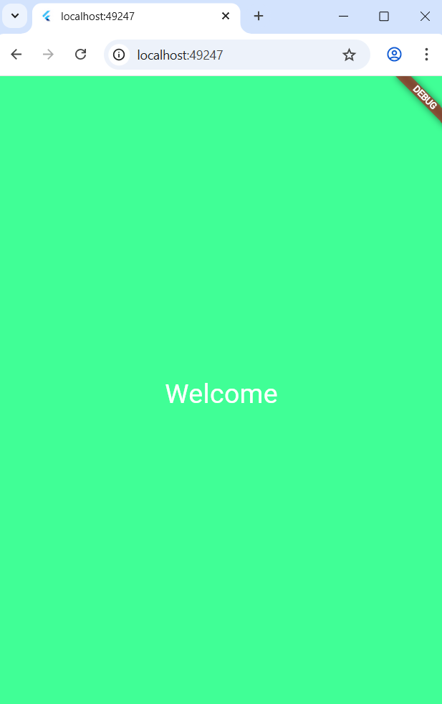
🎨 1️⃣ Using Scaffold.backgroundColor
import 'package:flutter/material.dart';
void main() => runApp(const MyApp());
class MyApp extends StatelessWidget {
const MyApp({super.key});
@override
Widget build(BuildContext context) {
return const MaterialApp(
home: Scaffold(
backgroundColor: Colors.lightBlueAccent, // 👈 sets background color
body: Center(
child: Text(
'Welcome',
style: TextStyle(fontSize: 30, color: Colors.white),
),
),
),
); }}

Slide 30
import 'package:flutter/material.dart'; void main() { runApp(MyApp()); } class MyApp extends StatefulWidget { const MyApp({super.key}); @override State<MyApp> createState() =>MyAppState(); }

Slide 31
class _MyAppState extends State<MyApp> { @override Widget build(BuildContext context) { return MaterialApp( home: Scaffold( appBar: AppBar( title: Text('Image'), ), body: Center( child: Container( height: 200, width: 300, child: Image.network('img_src'), ), ), )); } }

