Slide 1
MGIT CSE DEPARTMENT
Result Analysis System
From Excel to Cloud Database — Architecture & Deployment
1,090
35,582
3-Tier
Students
Result Rows
Architecture
Node.js
MySQL
React
Railway
Render
Vercel

Slide 2
The Raw Data
Excel dataset — one row per student per subject
HT_NO
COURSE_CODE
COURSE_NAME
CIE
SEE
TOTAL
GRADE
POINTS
CREDITS
24261A0501
MA101BS
Matrices & Calculus
23
29
52
B
6
4
24261A0501
CS101ES
Prog. for Problem Solv.
28
35
63
A
8
3
24261A0502
MA101BS
Matrices & Calculus
19
18
37
C
5
4
24261A0503
CS151ES
PPS Lab
38
—
38
B
6
2
◈ ~300 students × ~10 subjects = ~3,000 rows per semester
◈ SEE marks can be NULL (lab subjects have no external exam)
◈ TOTAL is pre-computed in Excel — not always CIE + SEE
◈ Subjects with 0 credits are excluded from GPA calculation
◈ Semester number is NOT in the file — passed as CLI argument at import

Slide 3
Excel → MySQL: The Import Script
backend/scripts/import.js — run once per semester file
1
2
3
4
5
Read Excel
Infer Meta
Hash Password
Insert Student
Upsert Result
▶
▶
▶
▶
xlsx library reads the file
into a JS array of objects
Branch, year & section
derived from HT number
Default password hashed
with bcrypt (10 rounds)
Creates student row if
HT_NO not already present
ON DUPLICATE KEY UPDATE
— safe to re-run
$ node scripts/import.js ../data/CSE_SEM3.xlsx 3 ← semester number passed as argument
Why ON DUPLICATE KEY UPDATE? The unique key on (ht_no, semester, course_code) prevents duplicate rows. If you re-run the import for the same file, it updates existing records instead of failing — making the script safely idempotent.

Slide 4
Database Schema
Four tables — each with a clear single responsibility
students
results
faculty
admins
ht_no VARCHAR(20) PK
id INT AUTO_INCREMENT PK
id INT AUTO_INCREMENT PK
id INT AUTO_INCREMENT PK
password_hash VARCHAR(255)
ht_no VARCHAR(20) FK
username VARCHAR(50) UNIQUE
username VARCHAR(50) UNIQUE
branch VARCHAR(20)
semester TINYINT
password_hash VARCHAR(255)
password_hash VARCHAR(255)
year TINYINT
course_code VARCHAR(20)
name VARCHAR(100)
Full dept access
section VARCHAR(10)
cie_marks / see_marks / total
course_code VARCHAR(20)
grade_letter / grade_points
1 row per student
Scopes faculty to one subject
credits INT
1 row per student-subject-semester
Relationship: students ──< results (one-to-many via ht_no foreign key) | UNIQUE KEY on (ht_no, semester, course_code) prevents duplicates

Slide 5
Section Assignment
How 1,090 students were mapped to CSE-1 through CSE-5
24
261
A
05
XX
Batch Year
College Code
Lateral?
Branch (CSE)
Roll ← Section key
CSE-1
01 – 64
~255 students
CSE-2
65 – 99, A0 – C8
~251 students
CSE-3
C9 – K3
~256 students
CSE-4
K4 – R7
~128 students
CSE-5
R8 – Z1
~126 students
UPDATE students SET section = CASE WHEN RIGHT(ht_no,2) BETWEEN '01' AND '64' THEN 'CSE-1' WHEN RIGHT(ht_no,2) BETWEEN '65' AND '99' OR BETWEEN 'A0' AND 'C8' THEN 'CSE-2' ... WHERE ht_no LIKE '%261A05%';

Slide 6
Deployment Architecture
Three cloud services — each handling one tier of the application
Vercel
Render
Railway
FRONTEND
BACKEND
DATABASE
Hosts the React app as
static files on a global CDN.
Auto-deploys on every git push
to the dev branch.
Runs the Node.js / Express
server permanently.
Handles auth, GPA logic,
PDF generation & API routes.
Managed MySQL instance.
Holds all 35,582 result rows.
Connected via public TCP
with credentials in .env.
HTTPS →
MySQL →
result-analysis-three.vercel.app
result-analysis-backend.onrender.com
ballast.proxy.rlwy.net:54145
Browser → Vercel (React) → Render (Express API) → Railway (MySQL)

Slide 7
CI/CD — Git Push to Live
Every push to the dev branch automatically updates both Vercel and Render
1
2
3
4
5
Developer
Pushes Code
GitHub
dev branch
Vercel
Detects Push
Render
Detects Push
Railway
Always Live
→
→
→
→
git push origin dev
Source of truth
npm run build
→ dist/ on CDN
npm install
→ node app.js
No redeploy needed
DB is persistent
Git Branch Strategy
main Stable, production-ready. No direct pushes.
dev Integration branch. Vercel + Render deploy from here.
feature/xxx Branch off dev for each feature → PR back into dev.

Slide 8
What We Built
◈ Excel dataset (3,000+ rows/semester) imported into MySQL via Node.js script
◈ 4 tables — students, results, faculty, admins — with foreign keys and unique constraints
◈ 1,090 students auto-assigned to CSE-1 through CSE-5 based on HT roll number ranges
◈ Express API with JWT auth, role-based access, GPA calculation, PDF marksheets
◈ React frontend deployed on Vercel — student, faculty, admin dashboards
◈ MySQL hosted on Railway, backend on Render — fully live at a public URL

Slide 9
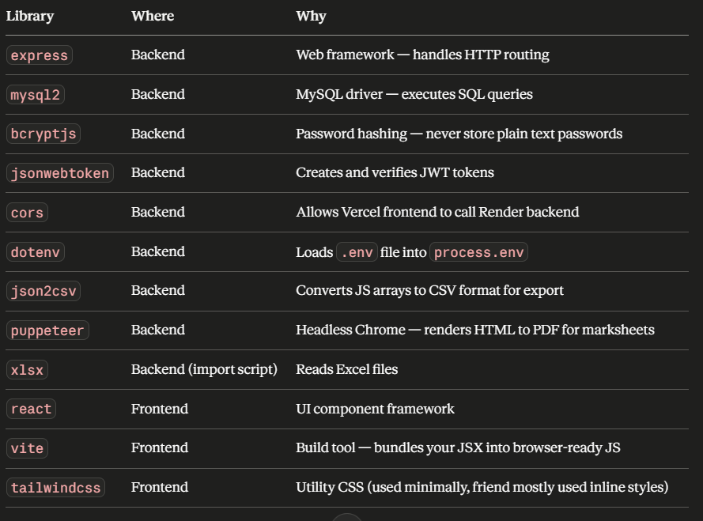

Slide 10
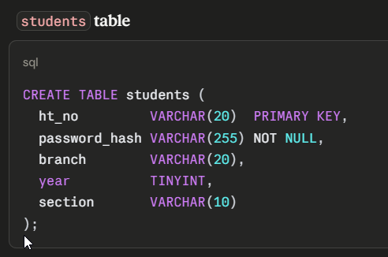

Slide 11
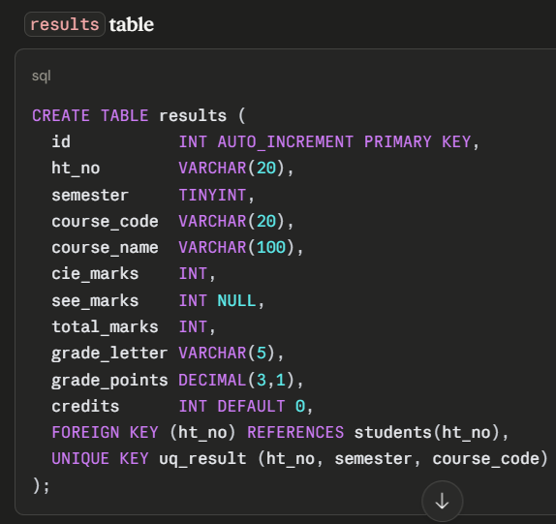

Slide 12
