Slide 1

openSUSE Leap 16
A Case Study
Timothy Saxena (24261A05R4)
V Harshini (24261A05R5)
Vanam Sai Mani Akshat (24261A05R6)

Slide 2
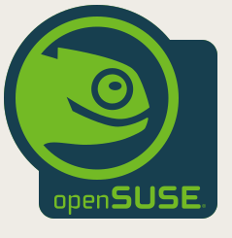
The Name, Pronunciation & Mascot
Pronounced: "open-SOO-zuh" — rhymes with open source
SUSE is a German acronym: Software und System-Entwicklung (Software & Systems Development)
Founded in Nuremberg, Germany — the name honours Konrad Zuse, inventor of the first programmable computer
"open"SUSE — "open" added in 2005 when development was opened to the public community
Mascot: Geeko the Chameleon — symbolises adaptability across any environment

Slide 3


What is openSUSE Leap?
A free, open-source Linux distribution
Built for stability, reliability, and professional use
Two flavours under openSUSE:
Leap — stable, fixed releases, You leap from v15 → v16
Tumbleweed — rolling release, always latest
Based on SUSE Linux Enterprise (SLE) — the OS large corporations pay for
Current release: Leap 16 — released October 1, 2025
Enterprise-grade Linux, available to everyone for free.
Think of it like:
Fortune 500 companies pay thousands for SUSE Linux Enterprise. Leap gives you the same codebase — for free.

Slide 4


Why Was It Made? The Problem It Solved
Problem 1 — SUSE Was Closed (pre-2005)
SUSE Linux was a paid product only. Community developers could not contribute.
Problem 2 — openSUSE Existed but Was Unstable (2005–2015)
When development opened, the community version chased the latest software. Exciting, but too unreliable for serious or professional use.
The Solution — Leap (2015):
Sync openSUSE directly with SUSE Linux Enterprise source code.
Same stability. Same security. Zero cost.

Slide 5
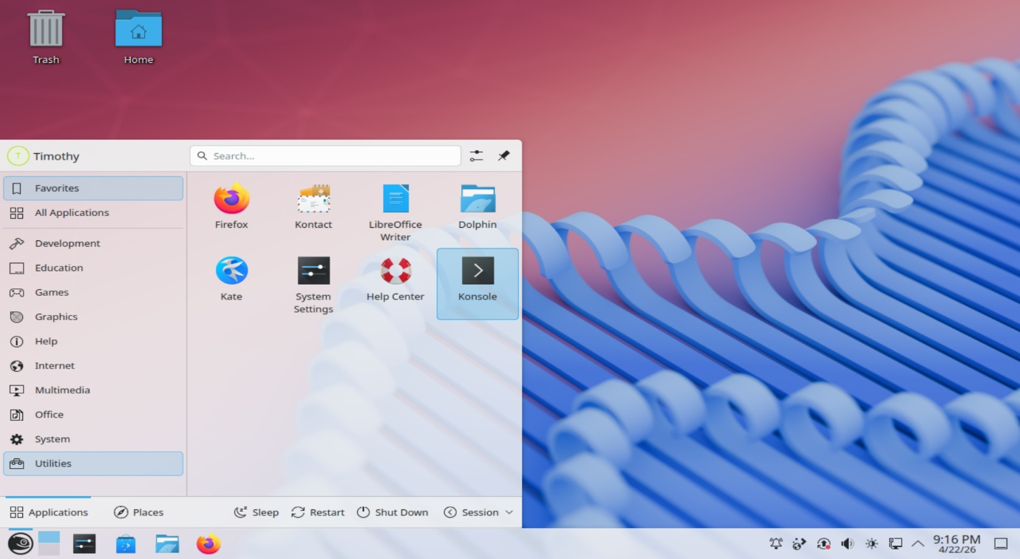
Key Functionality 1 – User Interface
User Interface based on KDE Plasma
It gives you the taskbar, file manaopenSUSE Leap 16 offers KDE Plasma 6.4 as the main desktop choice
ger, settings app, window decorations, start menu — all of it.

Slide 6
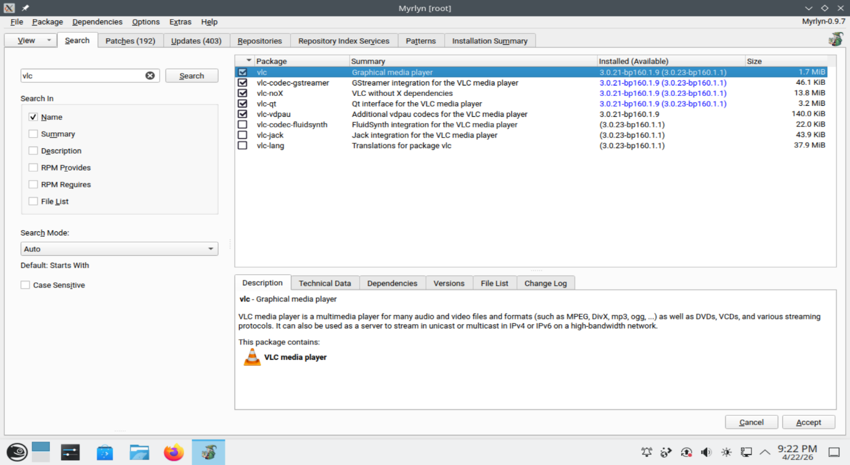
Key Functionality 2 — Installing & Managing Software
Myrlyn (App Installer)
Open Myrlyn from the app launcher
Search for any application by name
Click Install → done.
Clean, fast, focused

Slide 7
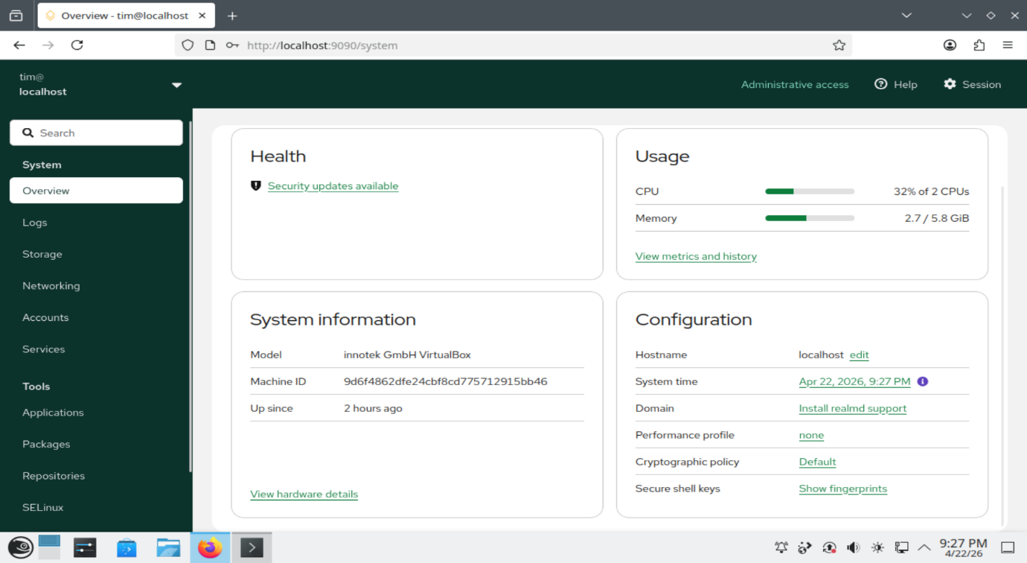
Key Functionality 3 – Memory Management
Handled entirely by the Linux kernel
Virtual memory —
each running program gets its own
protected memory space
Swap partition acts as overflow
when RAM is full
Cockpit shows real-time RAM usage
watch memory being allocated live as
you open apps

Slide 8
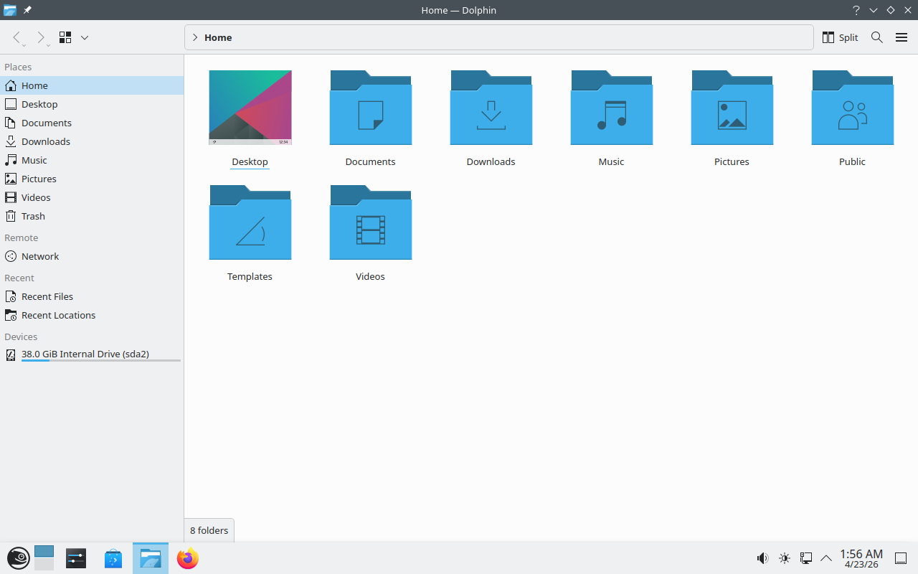
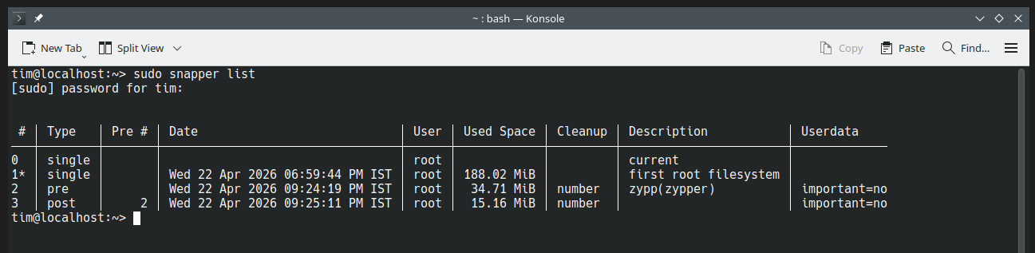
Key Functionality 4 – Files, Storage Management
File System — Btrfs ("Better FS")
Default filesystem in Leap 16
Superpower: automatic snapshots
— saved before every update
Btrfs = Ctrl+Z for your entire OS
Dolphin is the default file manager
— tabbed, powerful, clean

Slide 9
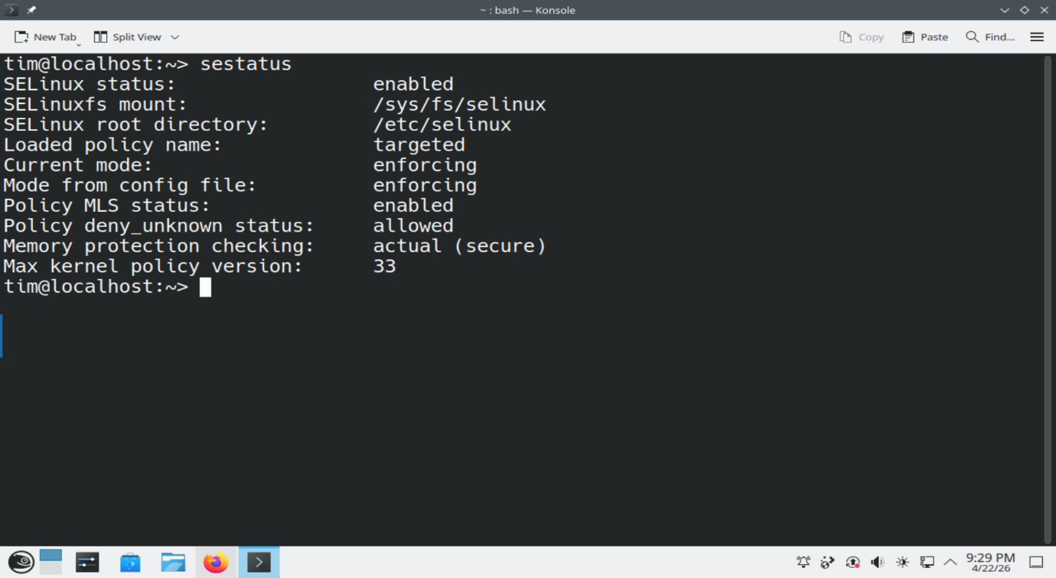
Key Functionality 5 — Devices, I/O & Security
Device Management
Handled by udev — the Linux device manager
Plug in a USB drive: udev detects it instantly, mounts it automatically
Printers managed via CUPS (Common Unix Printing System)
I/O System
All I/O flows through the Linux kernel's I/O subsystem
Kernel treats devices, files, and network connections
as file descriptors — one unified interface
Security — SELinux
SELinux (Security-Enhanced Linux) enforced by default
Originally developed by the US National Security Agency (NSA)
Even if a program is hacked, SELinux contains the damage

Slide 10
What openSUSE Leap Does Well — and What It Doesn't
Strengths
Weaknesses
Rock-solid stability
Rarely breaks — thoroughly tested before every release
Enterprise-grade security
SELinux enforced by default — same as US DoD systems
Btrfs snapshots
Roll back your entire OS like pressing Ctrl+Z
Long support lifecycle
Leap 16 supported until 2031 — 6 years!
Cockpit web dashboard
Manage your entire OS through a browser
Steeper learning curve
Not as beginner-friendly as Ubuntu or Mint
Smaller community
Fewer online tutorials compared to Ubuntu
Not great for gaming
SELinux causes friction; 32-bit disabled by default
Slower software updates
Intentional, but newer app versions arrive late
Large download size
Heavier ISO compared to minimal distros

Slide 11
History: Who Built It & When
1992
Four German students found S.u.S.E. in Nuremberg
1994
S.u.S.E. Linux 1.0 released — one of the oldest Linux distros still alive today
1996
Adopted RPM packaging & launched YaST
2004
Novell acquires SUSE for $210 million
2005
openSUSE community project launched —
development opened to the public for first time
2015
Split into Leap (stable) and Tumbleweed (rolling)
2019
SUSE becomes independent again after EQT Partners buyout
Oct 2025
Leap 16 released

