Slide 1
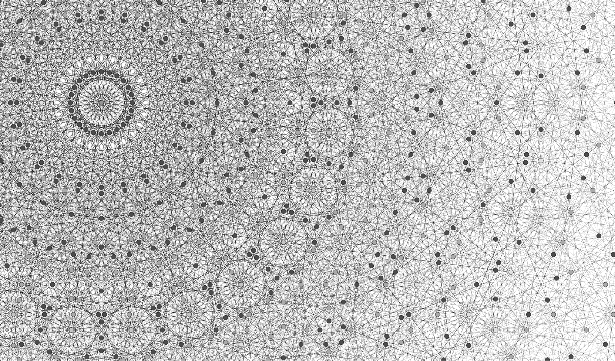
code-mercury
task-based distributed computing for C#/.NET

Slide 2
task-based distributed computing
what is it?
tasked-based computing
distributed computing

Slide 3
task-based computing
Task Parallel Library (TPL)
Task<T>
Reactive Extensions (Rx)
IObservable<T>
modeling asynchronous computation as a stream of Ts pushed back at the caller
(can consider Task<T> as IObservable<T> that returns at most one item)

Slide 4
distributed computing
multiple computers communicating via a network, interacting with each other to achieve a common goal
resilience to individual computer failings

Slide 5
abstractions
sync
async
Func<T>
pull one output
IEnumerable<T>
pull many outputs
Task<T>
one output pushed back
IObservable<T>
many outputs pushed back

Slide 6
abstractions . async
Task<T>
one output pushed back
IObservable<T>
many outputs pushed back
how do we make these distributed?

Slide 7
code-mercury . network
how machines interact

Slide 8
zmq node
envelope
sender
recipient
message
transmits messages between interconnected ZMQ ROUTER sockets
abstracts async messaging between directly connected sockets using reactive extensions
(note: a zmq node is really a combination ZmqObserver and ZmqObservable in code)
010110110010
network
software
ZMQ NODE
TCP
010110110010
IObserver< >
ROUTER
IObservable< >

Slide 9
zmq node
other zmq nodes
network
software
other software
components
ZMQ NODE
A
ROUTER
ZMQ NODE
B
010110110010
ROUTER
ZMQ NODE
ROUTER
C

Slide 10
mercury node
envelope
sender (zmq)
recipient (zmq)
message (envelope)
sender (mercury)
recipient (mercury)
message
transmits messages between mercury nodes
abstracts async messaging between indirectly connected sockets using reactive extensions
010110110010
backend
frontend
MERCURY NODE
IObservable< >
ISubject< >
IObserver< >

Slide 11
zmq node
other zmq nodes
network
software
backend
frontend
other software
components
ZMQ NODE
A
ROUTER
ZMQ NODE
MERCURY NODE
B
010110110010
ROUTER
ZMQ NODE
ROUTER
C

Slide 12
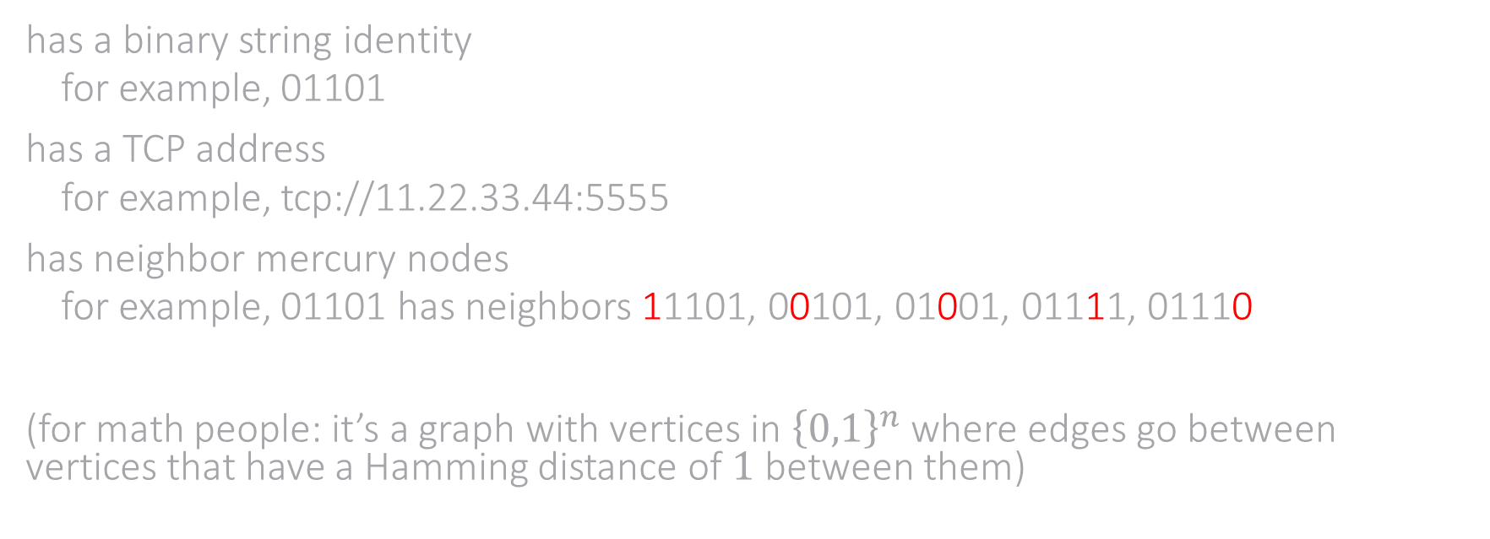
mercury node
has a binary string identity
for example, 01101
has a TCP address
for example, tcp://11.22.33.44:5555
has neighbor mercury nodes
for example, 01101 has neighbors 11101, 00101, 01001, 01111, 01110
(for math people: it’s a graph with vertices in ${\left\{0,1\right\}}^{n}$ where edges go between vertices that have a Hamming distance of $1$ between them)

Slide 13
mercury node
envelope (zmq)
sender (zmq)
recipient (zmq)
message (envelope, mercury)
sender (mercury)
recipient (mercury)
message
an envelope is received from the frontend
it is sent to a neighbor mercury node closer to the mercury node recipient
010110110010
sender 011
recipient 111
backend
frontend
MERCURY NODE
011
recipient 110
sender 011
recipient 110

Slide 14
mercury node
envelope (zmq)
sender (zmq)
recipient (zmq)
message (envelope, mercury)
sender (mercury)
recipient (mercury)
message
an envelope is received from the backend and it is not addressed to this mercury node
it is sent to a neighbor mercury node closer to the mercury node recipient
010110110010
sender 111
recipient 110
backend
frontend
MERCURY NODE
111
sender 011
recipient 110

Slide 15
mercury node
envelope (zmq)
sender (zmq)
recipient (zmq)
message (envelope, mercury)
sender (mercury)
recipient (mercury)
message
an envelope is received from the backend and it is addressed to this mercury node
it is sent to the frontend
010110110010
backend
frontend
MERCURY NODE
110
sender 011
recipient 110

Slide 16
mercury graph
push envelope with recipient 011 into 100
zmq nodes pass data along path 100 → 110 → 010 → 011
receive envelope at 011
011
111
001
101
010
110
000
100

Slide 17
mercury graph
push envelope with recipient 011 into 100
zmq nodes pass data along path 100 → 110 → 010 → 011
receive envelope at 011
011
111
001
101
010
110
000
100

Slide 18
mercury graph
push envelope with recipient 011 into 100
zmq nodes pass data along path 100 → 110 → 010 → 011
receive envelope at 011
011
111
001
101
010
110
000
100

