Slide 1
code-mercury
task-based distributed computing for C#/.NET

Slide 2
abstractions
sync
async
Func<T>
pull one output
IEnumerable<T>
pull many outputs
Task<T>
one output pushed back
IObservable<T>
many outputs pushed back

Slide 3
abstractions . async
Task<T>
one output pushed back
IObservable<T>
many outputs pushed back
how do we make these distributed?

Slide 4
code-mercury . network
how messages are sent

Slide 5
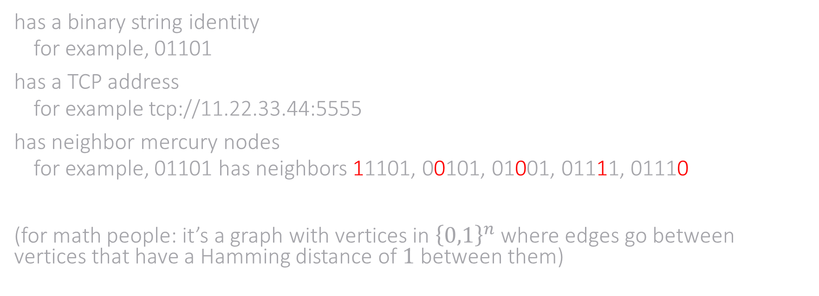
mercury node
has a binary string identity
for example, 01101
has a TCP address
for example tcp://11.22.33.44:5555
has neighbor mercury nodes
for example, 01101 has neighbors 11101, 00101, 01001, 01111, 01110
(for math people: it’s a graph with vertices in ${\left\{0,1\right\}}^{n}$ where edges go between vertices that have a Hamming distance of $1$ between them)

