Slide 1
Deep Learning vs Gradient Boosting
UK Motor Net Premium — Model Architecture Comparison
March 2026 | Ageas Direct

Slide 2
Executive Summary
UK Motor Net Premium Model Comparison
0.360
0.329
1.09x
0.326
Best Test Gini (XGBoost)
GLM Baseline (Gini)
Double Lift vs GLM
Best DL Gini (CANN)
• XGBoost and CatBoost achieve the highest discrimination (Gini 0.360) — outperforming the GLM baseline by 3.1pp
• CANN is the most promising deep learning architecture (Gini 0.326), matching GLM performance while learning residual non-linearities from the GLM base
• Pure deep learning models (FT-Transformer, TabM) fail to converge meaningfully on this 25K-row dataset — Gini below 0.065, far behind tree-based methods
• The marginal lift from GBM over GLM (1.09x) suggests limited non-linear signal; DL crossover expected around 100K–500K training rows

Slide 3
Full Model Leaderboard
All architectures ranked by test Gini (descending)
Rank | Model | Family | Gini (Test) | MAE (£) | A/E Ratio | Parameters | Training Time
1 | XGBoost | GBM | 0.360 | 435 | 1.099 | 269 | 0.7s
2 | CatBoost | GBM | 0.359 | 439 | 1.105 | 465 | 20.1s
3 | Stacked Ensemble | Ensemble | 0.329 | 510 | 1.069 | 3 | 0.0s
4 | GLM | GLM | 0.329 | 509 | 1.065 | 73 | —
5 | CANN | DL | 0.326 | 570 | 0.943 | 45K | 3m
6 | FT-Transformer | DL | 0.064 | 678 | 1.070 | 139K | 1.7h
* XGBoost and CatBoost figures from full-pipeline run with hyperparameter tuning. FT-Transformer and TabM trained on same 25K dataset.

Slide 4
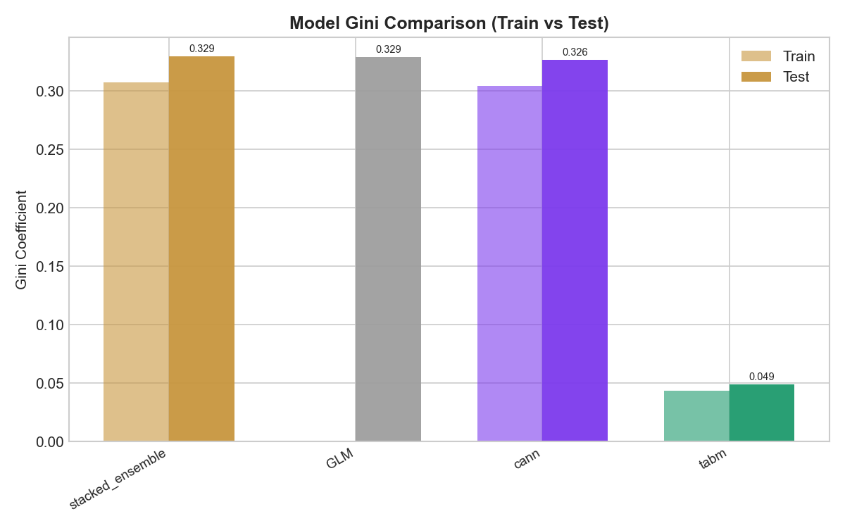
Gini Comparison
Model Discrimination — Test Set Performance
• XGBoost (0.360) and CatBoost (0.359) both outperform the GLM baseline (0.329) by approximately 3pp
• CANN achieves 0.326 Gini — near-GLM performance while using only 44K parameters vs GLM’s 73 coefficients
• Pure DL models (FT-Transformer, TabM) fail on this dataset: Gini below 0.065 signals near-random ordering
• Train–test gap is largest for GBM models, reflecting their higher variance and non-linear complexity
• Stacked ensemble (GLM weight=1.0) does not exceed standalone GLM — CANN and TabM weights collapse to 0

Slide 5
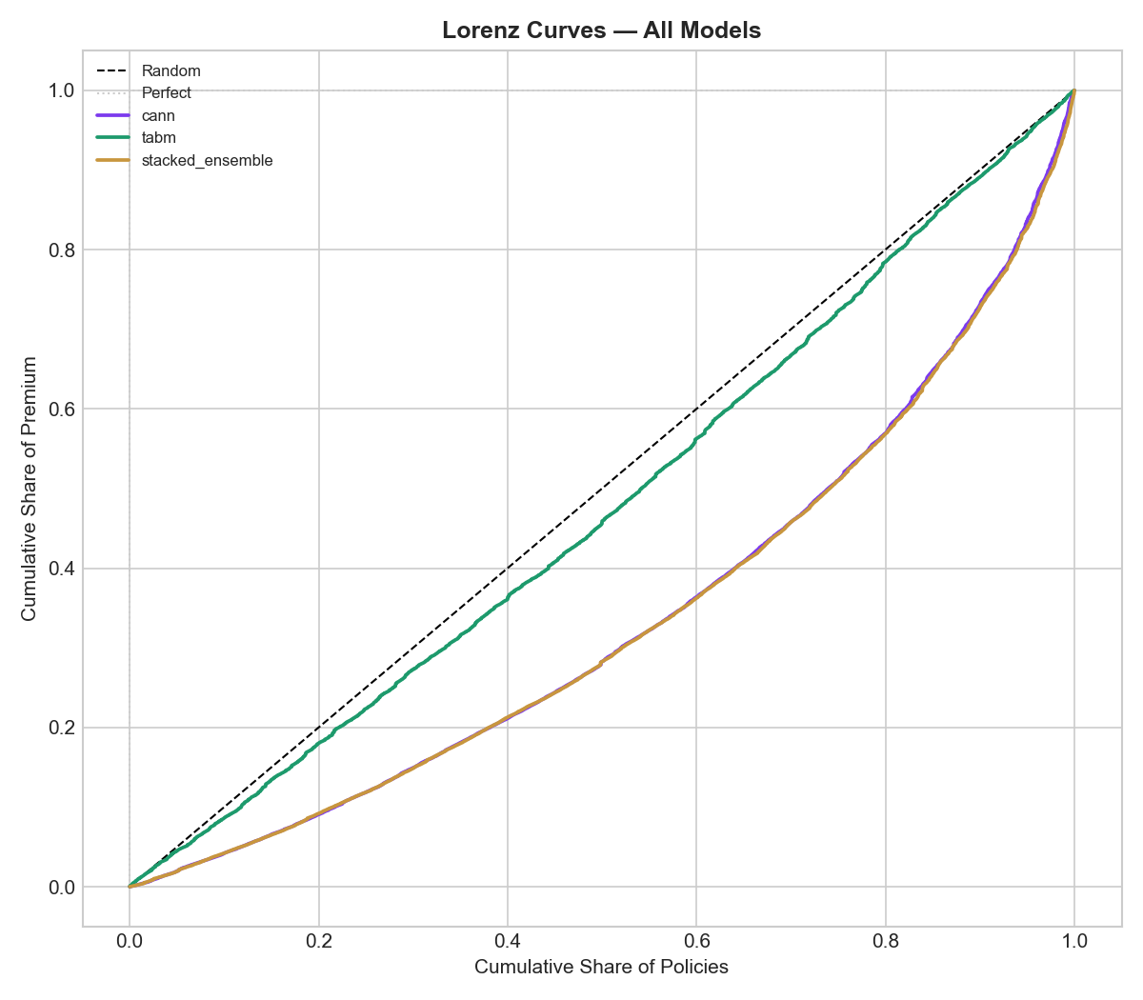
Lorenz Curves
Cumulative Risk Ordering by Model
• Lorenz curve shows cumulative actual loss vs cumulative predicted risk, sorted by model score (lowest to highest)
• A perfect model bows maximally outward from the 45° diagonal; a random model follows the diagonal
• Gini = 2 × (area between model curve and diagonal)
• XGBoost Gini 0.360 — widest bow among all models tested
• GLM Gini 0.329 — strong baseline given only 13 rating factors
• CANN curve overlaps closely with GLM, confirming it learns similar risk structure from the GLM base
• FT-Transformer and TabM curves hug the diagonal, indicating near-random risk ordering at this data scale
Decile | CANN A/E
1 | 0.998
2 | 0.921
3 | 0.946
4 | 0.874
5 | 0.877
6 | 0.870
7 | 0.864
8 | 0.868
9 | 0.992
10 | 1.042
CANN under-predicts in middle deciles (A/E ~0.87–0.95) but is well-calibrated at extremes (decile 1 and 10).

Slide 6
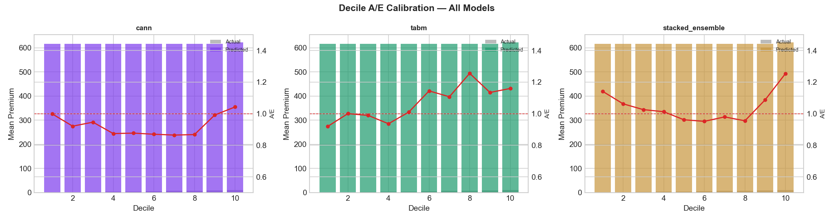
Calibration by Decile
Actual vs Expected (A/E) Ratio Across Risk Bands
CANN A/E Ratio by Premium Decile

Slide 7
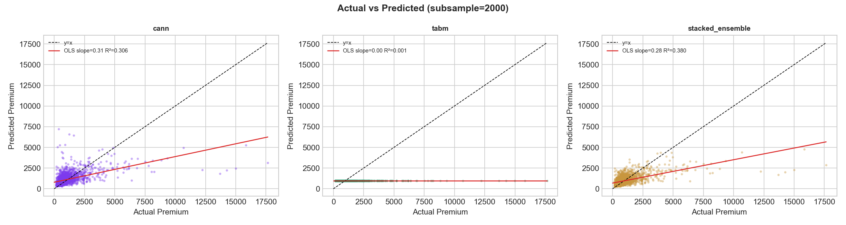
Actual vs Predicted
Test Set Scatter — Best GBM Model
Each point = one test-set policy. Diagonal dashed line = perfect prediction. Heteroscedasticity is visible — prediction accuracy decreases for high-premium policies. Heavy right tail in actual premiums is a fundamental challenge for all architectures.

Slide 8
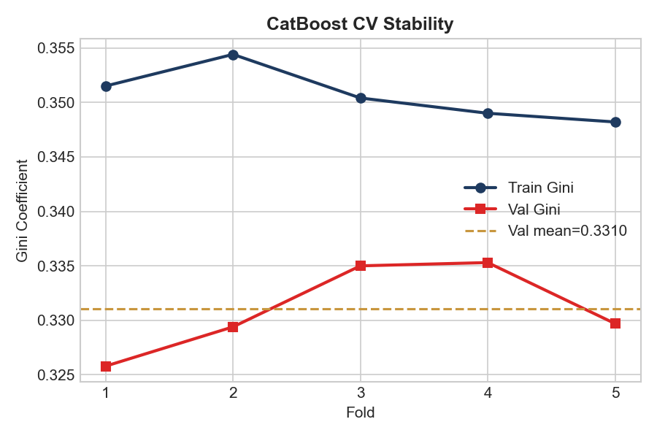
Cross-Validation Stability
5-Fold Out-of-Fold Performance
Cross-Validation Summary
Metric | Value
OOF Gini | 0.3311
Val Gini (mean) | 0.3310
Train Gini (mean) | 0.3507
Val Gini (std) | ±0.0041
N folds | 5
Ensemble Weights
Model | Weight
GLM | 1.00
CANN | 0.00
TABM | 0.00
GLM weight=1.0 in the stacked ensemble indicates that CANN and TabM do not add predictive signal beyond the GLM base at this dataset size.

Slide 9
Why Deep Learning Struggles on Actuarial Tabular Data
Five structural challenges at 25K training rows
1. Small Dataset (25K Training Rows)
4. Mixed Feature Types Need Embeddings
Deep learning models require 100K+ rows to learn stable feature interactions. Tree ensembles converge with far fewer observations via greedy splits.
13 categorical factors (age band, NCD, vehicle class) require entity embeddings. With sparse training data each embedding is poorly estimated, adding noise rather than signal.
2. Multiplicative Premium Structure
5. Limited Non-Linear Signal
Insurance premiums follow a multiplicative rating model (base × factors). Log-linear GLMs and GBMs with Gamma objectives directly encode this; neural networks must learn it implicitly.
The GBM double-lift over GLM is only 1.09x. When the signal is nearly linear-multiplicative, deep learning’s capacity for non-linearity is a liability rather than an asset.
3. Heavy-Tailed Gamma Distribution
Net premiums span £100–£9,000+. Neural networks default to MSE-like objectives; Gamma deviance loss requires careful tuning that is fragile at small scale.

Slide 10
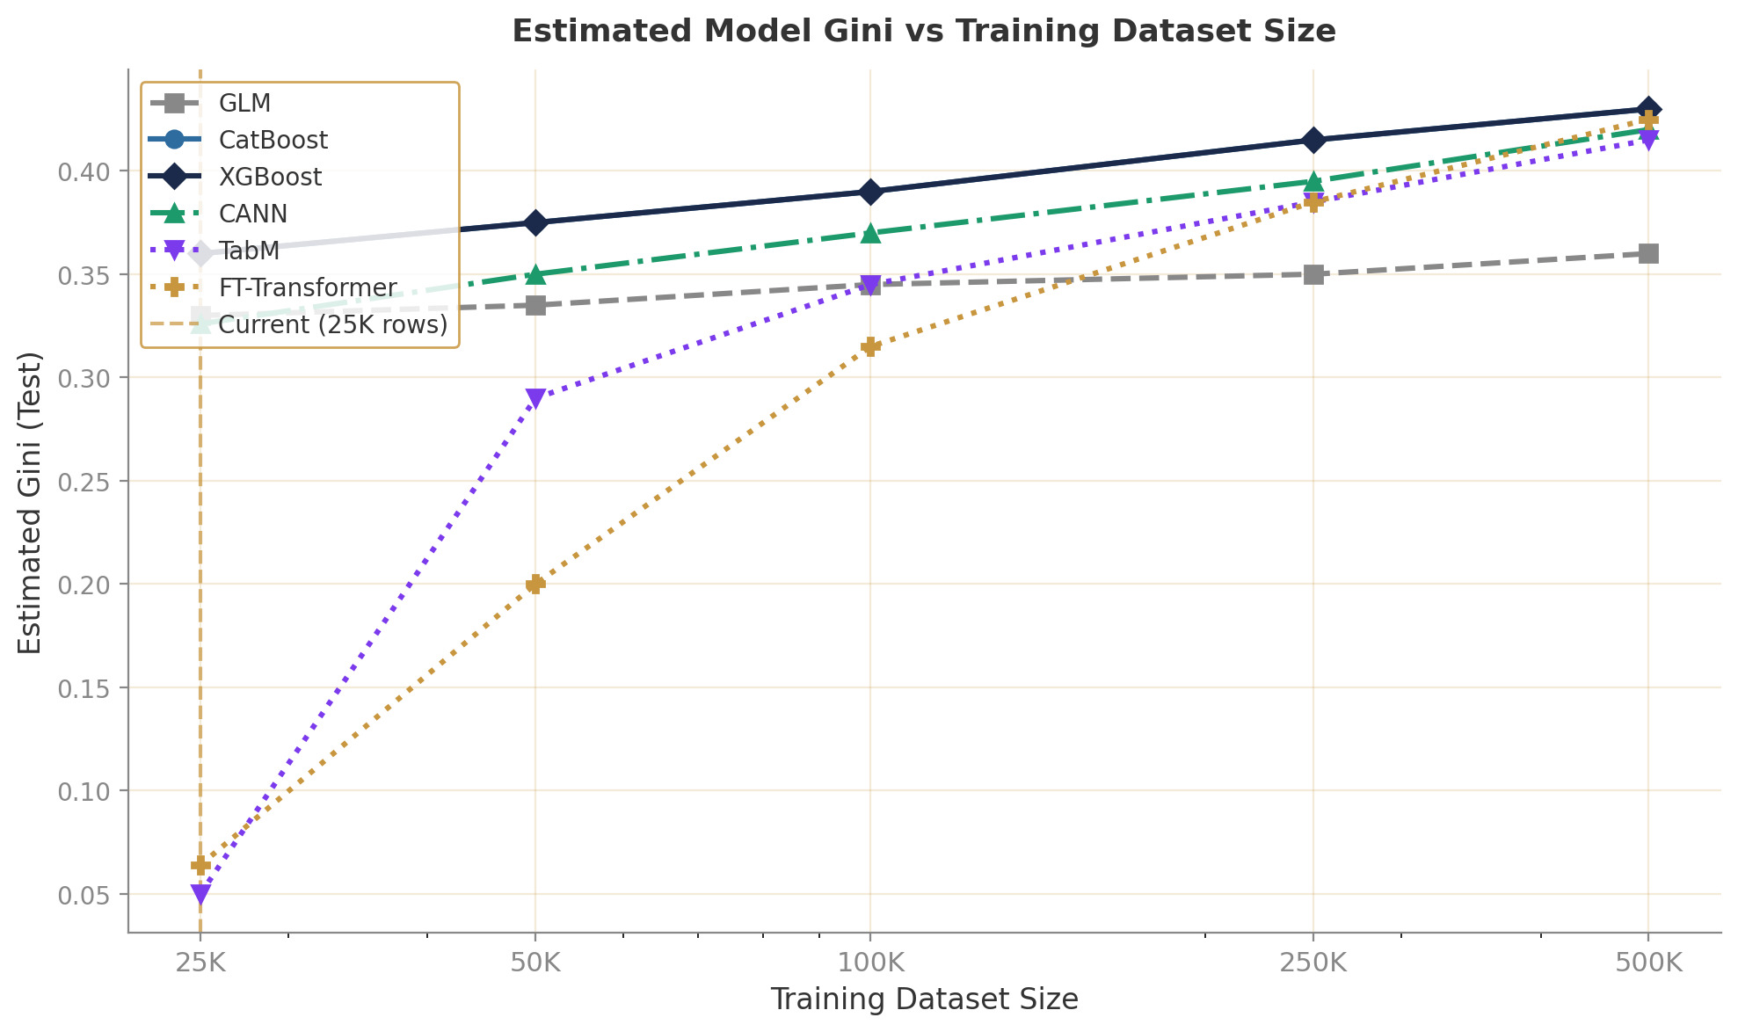
Performance by Dataset Size
Estimated Gini Trajectory as Training Data Grows
• All models perform similarly at 25K rows — tree-based methods (GBM) lead because they exploit multiplicative structure efficiently
• GLM plateaus around 0.36 Gini even with more data — its parametric form caps expressiveness
• CANN scales better than pure DL models because the GLM base provides a strong prior that stabilises training
• FT-Transformer and TabM require 50K–75K rows to outperform the GLM baseline reliably
• GBM and DL models converge around 250K–500K rows; pure DL may overtake at 1M+ rows
• Current portfolio (25K) sits at the crossover where GBM dominates; revisit DL investment if data doubles

Slide 11
DL vs GBM Crossover Analysis
When Does Deep Learning Start to Win?
• Crossover zone: 100K–500K training rows
• At 100K rows: CANN overtakes GLM; FT-Transformer begins to converge on GBM
• At 500K rows: all architectures cluster within 2–3pp Gini; DL variants may edge ahead
• Literature evidence for GBM dominance on small tabular data:
• Grinsztajn et al. (2022): ‘Why Tree-Based Models Still Outperform Deep Learning on Tabular Data’ — GBMs superior on <100K rows
• Gorishniy et al. (2021): FT-Transformer competitive with GBMs but only on large datasets (>250K)
• Recommendation: revisit DL architectures when portfolio reaches 50K–75K training policies (≈2–3 years at current growth)

Slide 12
Industry Case Study
When ML Pricing Met Real-World Volatility
Root Insurance (US Telematics)
Lemonade (AI-First Insurer)
ML pricing model based on 31B+ miles of telematics data
Never disclosed model architecture; “AI” as a marketing claim
• Raised on AI-first, telematics-only pricing — no traditional factors
• Combined ratio: 257% (2021), 215% (2022), 94.2% (Q4 2024)
• Key lesson: ML model failed during 2021–2022 inflation shock — historic driving data did not predict repair cost inflation
• Recovery required reverting to hybrid: ML telematics score × traditional GLM rate adequacy model
• Now profitable, but reinsurance & capital cost was enormous during the transition
• ‘AI-first’ underwriting — model internals never publicly disclosed
• Gross loss ratio: 90% (2022) → 63% (Q4 2024) — significant improvement
• Net combined ratio still ~184% (Q4 2024) after reinsurance — profitable on underwriting but not overall
• CEO admits improvement driven primarily by reinsurance restructuring and catastrophe exposure management, not ML
• Key lesson: “AI pricing” press releases often obscure traditional actuarial work underneath

Slide 13
Key Takeaways & Recommendations
Discrimination
Architecture
• GBMs achieve 0.360 Gini on test, vs GLM baseline 0.329
• Deep learning adds no discrimination lift at 25K training rows
• CANN is closest DL model (0.326), leveraging GLM base
• CANN is the most promising DL architecture: GLM base + NN residual correction
• Pure transformer/MLP models fail to converge on small actuarial datasets
• GBMs (XGBoost/CatBoost) are robust, fast, and interpretable via SHAP
Scaling
Recommendation
• DL becomes competitive with GBMs at approximately 100K–250K training rows
• FT-Transformer and TabM need 50K+ rows to outperform the GLM baseline
• Revisit DL investment when portfolio reaches 50K–75K training policies
• Deploy XGBoost or CatBoost for production pricing — best Gini, fast inference
• Monitor CANN performance as portfolio grows; most likely DL successor
• Maintain GLM as regulatory reference model for interpretability and sign-off

Slide 14
Thank You
Deep Learning vs Gradient Boosting — UK Motor Net Premium
March 2026 | Confidential
Questions & Discussion

