Slide 1
Unstructured Data Opportunities
Novel Data Sources for Insurance Pricing Innovation
March 2026 | Strategic Analysis

Slide 2
Traditional Data Has Reached Diminishing Returns
0.360
0.329
+0.0 pts
Current Best Gini
GLM Baseline
Marginal DL Lift
• Structured rating factors (age, NCD, vehicle group, postcode) are fully exploited by GLMs and GBMs
• Deep learning adds no incremental lift at current data sizes (25K policies)
• The next frontier is not better models — it is better data
• Unstructured and alternative data sources remain largely untapped in UK motor pricing

Slide 3
Three Tiers of Opportunity
TIER 1 — Build Tomorrow
DVSA MOT API | Open Banking | Claims NLP
Proven signal, clear regulatory path
TIER 2 — Build This Year
Dashcam Video Scoring | Street View Address Scoring
Strong signal, higher execution complexity
TIER 3 — Position for 2027-28
Sleep / Circadian Data | EV Charging Data
Emerging signal, early mover advantage

Slide 4
Tier 1: Verified Mileage & Vehicle Condition
• Free, public UK Government API — queryable by registration plate
• Verified odometer readings at each MOT test (replaces self-declared mileage)
• Vehicle maintenance behaviour score from advisory / failure history
• Mechanical condition risk flags (brakes, tyres, suspension)
Tier 1 — Low Risk
2-5 Gini pts
Expected Lift
Low
Effort
Very Low
Regulatory Risk

Slide 5
Tier 1: Transaction-Derived Behavioural Signals
• PSD2 consent-based query at point of quote
• Fuel spend — verified mileage (cross-validates self-declared)
• Gambling frequency / volume — risk-taking propensity
• Financial stress signals — correlated with claim fraud and at-fault risk
• Late-night transaction patterns — nocturnal activity proxy
• 90% of lenders now consider alternative data critical (Nova Credit 2024)
Tier 1 — Medium Risk
1-3 Gini pts
Expected Lift
Medium-High
Effort
Medium
Regulatory Risk

Slide 6
Tier 1: Claims Intelligence Feedback Loop
• BERT models predict frequency and severity from adjuster notes (CAS Variance 2023)
• No consent or data acquisition needed — insurer's own claims data
• Extract: injury severity keywords, fraud patterns, liability attribution
• Feedback loop: each claims cycle improves the pricing model
• Compounding data advantage over competitors
Tier 1 — Low Risk
2-4 Gini pts
Expected Lift
Medium
Effort
Low
Regulatory Risk

Slide 7
Tier 2: Computer Vision Behavioural Risk
• Beyond GPS telematics: distraction events, following distance, hazard anticipation
• MIT research: risk-behaviour extraction from dashcam proven
• MDPI 2024: 80% recall on pre-accident anticipation from video
• 30-day video sampling windows, not continuous surveillance
• Existing video_to_text pipeline is architecturally transferable
Tier 2 — Medium Risk
3-5 Gini pts
Expected Lift
High
Effort
Medium
Regulatory Risk

Slide 8
Tier 2: Address-Level Visual Intelligence
• Google Street View + Mapillary — address-level features
• Road surface quality, parking type, street lighting, traffic calming
• Replaces sector-level PCD scores with property-level resolution
• Real estate AVMs prove incremental lift over postcode (PLOS One 2025)
• Updated more frequently than geodemographic surveys
Tier 2 — Medium Risk
1-2 Gini pts
Expected Lift
Medium
Effort
Medium-High
Regulatory Risk

Slide 9
Tier 3: Position for 2027-2028
Sleep & Circadian Data
EV Charging Data
• Stanford SleepFM (2026): 100+ conditions from sleep data
• 54.5% of Americans use wearables
• Fatigue is a direct causal accident factor
• Regulatory: High — health data = special category under GDPR
• kWh consumed — direct mileage verification
• Charging location patterns reveal regular routes
• 30%+ of UK new registrations are EV
• Regulatory: Low — commercial data agreement

Slide 10
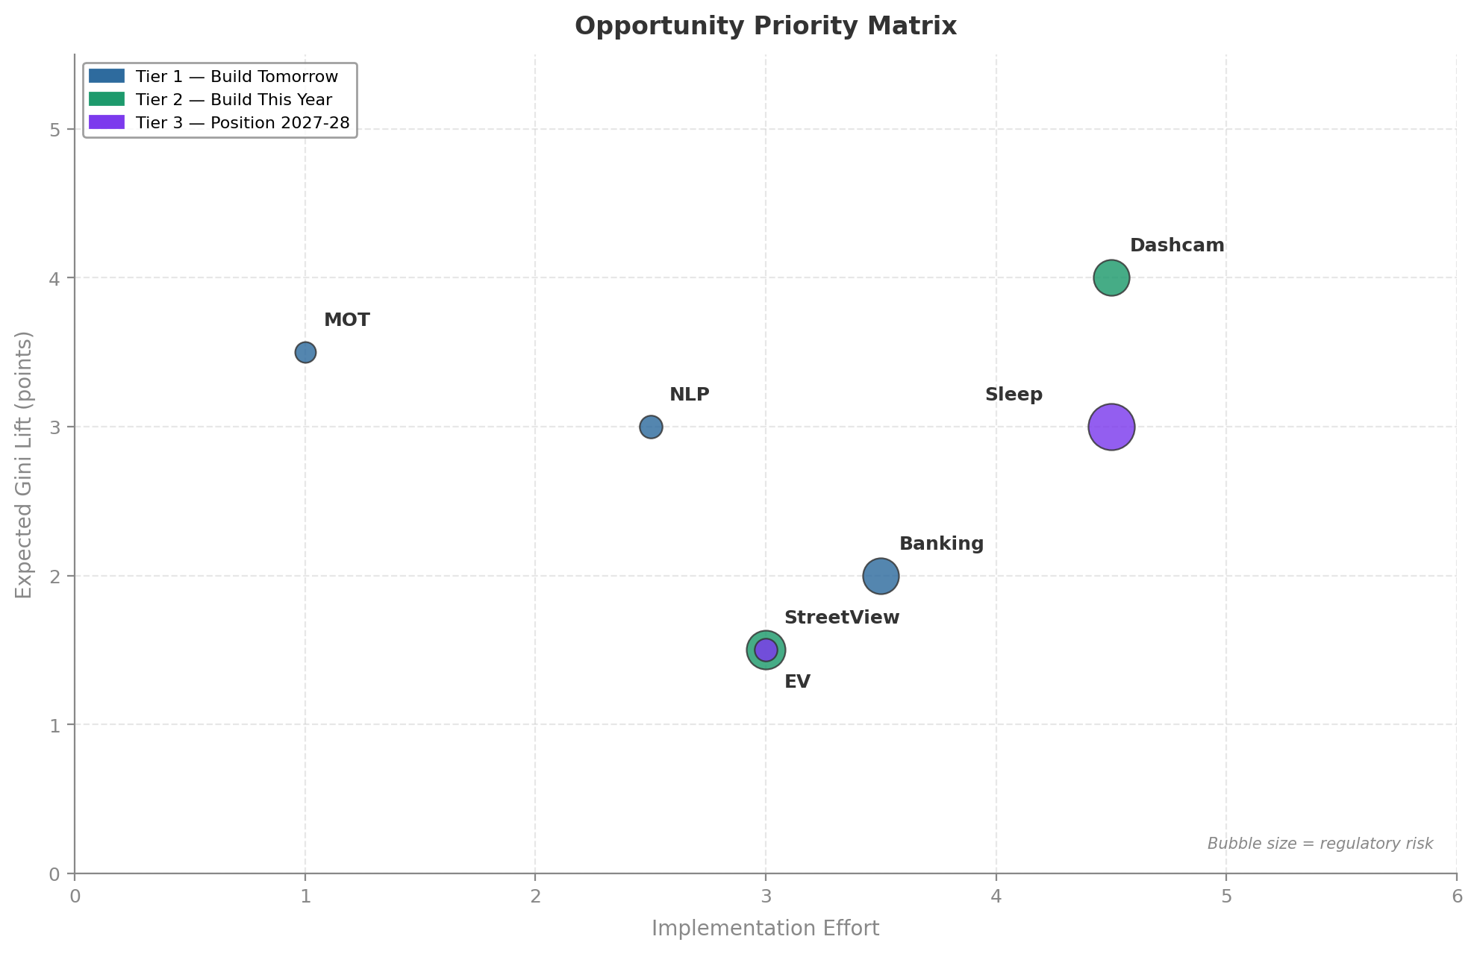
Opportunity Priority Matrix
Top 3 Priorities
1. DVSA MOT API
Highest lift-to-effort ratio. Free government data, no consent required.
2. Claims NLP
Own data asset. No acquisition cost. Compounds with each renewal cycle.
3. Open Banking
Strong behavioural signal. PSD2 infrastructure now mature in UK.

Slide 11
The Billion-Pound Business: Data Enrichment Middleware
Single API call at point of quote — 50 features from novel sources
Data Flywheel
Compliance as a Service
Integration Stickiness
More quotes — more signal — better models — more customers
Proxy discrimination testing, DPIA, FCA Consumer Duty evidence
Once embedded in quote workflow, switching costs are high
• Go-to-market: DVSA MOT API alone is compelling enough for first 5 insurers

Slide 12
UK Regulatory Framework
Regulation | Scope | Key Requirement | Risk Level
UK GDPR / ICO | Personal data profiling | DPIA for automated pricing | Medium
FCA Consumer Duty | Fair value by segment | Novel data cannot concentrate costs on vulnerable customers | High
Equality Act 2010 | Protected characteristics | No proxy discrimination via data features | High
FCA GIPP (PS21/5) | Renewal pricing | Limits loyalty penalty exploitation | Low
Social Media | De facto prohibited | Disparate impact + consent barriers | Very High

Slide 13
Emerging Players & Market Signals
Company | Stage | Data Type | Relevance
ZestyAI | Growth ($62M) | Satellite property risk | Live with Lemonade
Tractable | Unicorn ($185M) | CV on damage photos | Claims triage — pre-loss
Shift Technology | Growth | Claims NLP + networks | Fraud from narratives
Cytora | Growth | LLM on submissions | Commercial underwriting
Arity (Allstate) | Operating | Driving behaviour data | Mobility data marketplace
Credolab | Growth | Smartphone psychometrics | Pre-launch UK / EU
• Otonomo & Wejo (connected vehicle data) collapsed 2023-24 — pure data marketplace model failed

Slide 14
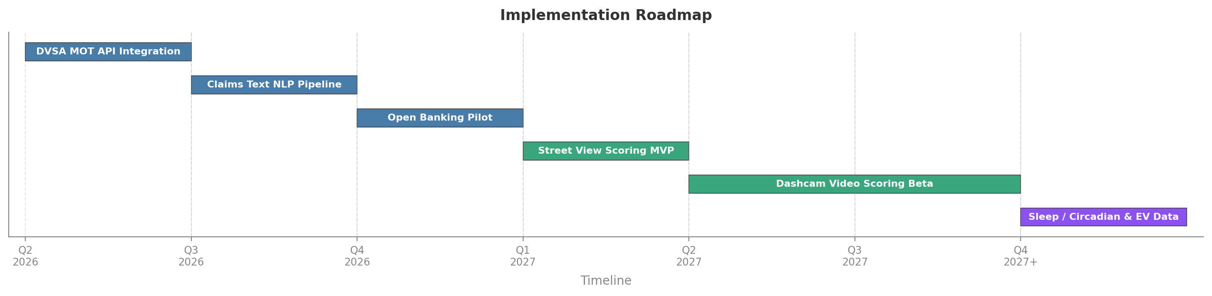
Implementation Roadmap
Key Milestones
Q2 2026
DVSA MOT API live — validated mileage in pricing
Q1 2027
Street View feature store built & A/B tested
Q3 2026
NLP claims scoring in production pipeline
Q3 2027
Dashcam beta — 500 vehicle trial cohort
Q4 2026
Open banking pilot — 5,000 consented quotes
2028
Next-gen biometric / EV data decision point

Slide 15
The Next Frontier Is Better Data, Not Better Models
March 2026 | Strategic Analysis | Internal Use Only

