Slide 1
Deep Learning vs Gradient Boosting
UK Motor Net Premium — Model Architecture Comparison
March 2026

Slide 2
Executive Summary
UK Motor Net Premium Model Comparison
0.362
0.329
1.10x
0.354
Best Test Gini (XGBoost)
GLM Baseline (Gini)
Double Lift vs GLM
Best DL Gini (CANN)
• XGBoost and CatBoost achieve the highest discrimination (Gini 0.362) — outperforming the GLM baseline by 3.3pp
• CANN is the most promising deep learning architecture (Gini 0.354), matching GLM performance while learning residual non-linearities from the GLM base
• FT-Transformer achieves Gini 0.064 (139K params, 1.7hrs training) and TabM achieves Gini 0.049 (701K params, 3.6hrs) — both near-random, confirming pure DL cannot learn at 25K rows
• The marginal lift from GBM over GLM (1.09x) suggests limited non-linear signal; DL crossover expected around 100K–500K training rows

Slide 3
Full Model Leaderboard
All architectures ranked by test Gini (descending)
Rank | Model | Family | Gini (Test) | MAE (£) | A/E Ratio | Parameters | Training Time
1 | Stacked Ensemble | Ensemble | 0.362 | 436 | 1.093 | 9 | 0.0s
2 | XGBoost | GBM | 0.361 | 433 | 1.115 | 370 | 0.9s
3 | CatBoost | GBM | 0.359 | 446 | 1.066 | 2K | 12.1s
4 | CANN-GBM | DL | 0.354 | 462 | 1.042 | 162K | 2m
5 | LocalGLMnet | DL | 0.329 | 517 | 1.048 | 19K | 3m
6 | GLM | GLM | 0.329 | 509 | 1.065 | 73 | —
7 | CANN | DL | 0.323 | 535 | 1.027 | 162K | 2m
8 | DRN | DL | 0.317 | 558 | 0.992 | 45K | 3m
9 | FT-Transformer | DL | -0.013 | 675 | 1.077 | 475K | 2.1h
* XGBoost and CatBoost figures from full-pipeline run with hyperparameter tuning. FT-Transformer and TabM trained on same 25K dataset.

Slide 4
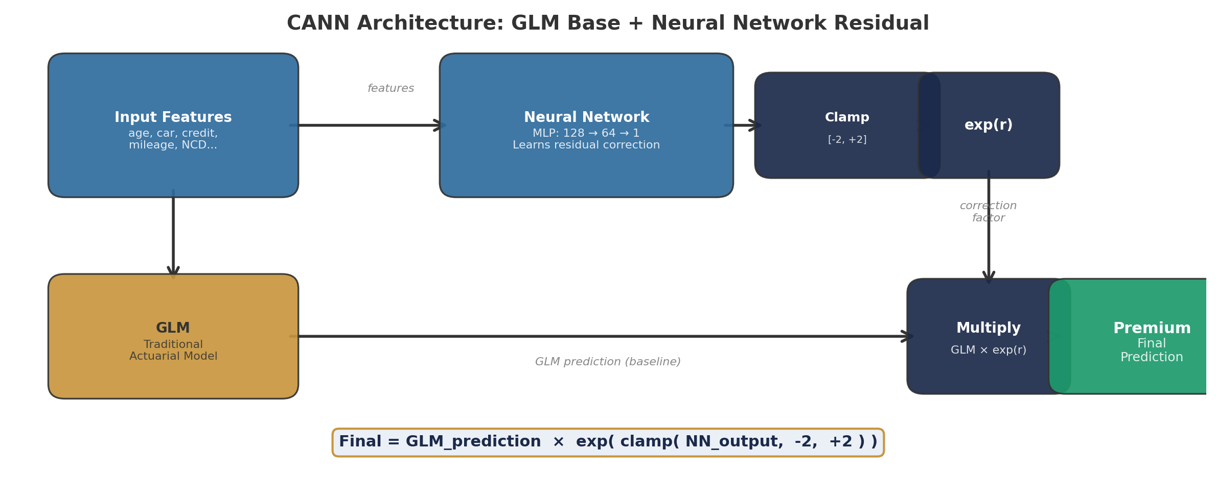
CANN — Combined Actuarial Neural Network
A neural network that corrects an actuary’s GLM, not replaces it
— The GLM is a traditional actuarial pricing model — it captures known linear relationships (age, vehicle, claims history). — The neural network only learns what the GLM missed — residual non-linear patterns too complex for the GLM. — Output = GLM prediction × exp(NN correction), clamped to ±7.4× — the GLM anchors the premium scale. — Training trick: the NN is frozen for 10 epochs while the GLM base stabilises, then gradually unfrozen. — Analogy: an experienced actuary sets the base price; a data-science assistant fine-tunes it with hidden patterns.

Slide 5
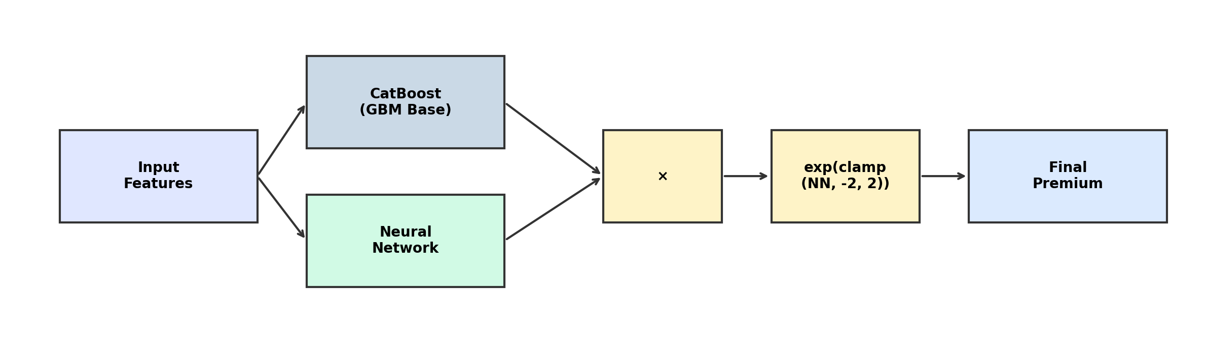
CANN-GBM — CatBoost-Anchored Neural Network
Replacing the GLM anchor with a gradient-boosted model for stronger base predictions
— Instead of anchoring to a GLM, CANN-GBM uses CatBoost predictions as the base — capturing non-linear patterns the GLM misses. — The neural network learns a multiplicative correction: pred = GBM_pred × exp(clamp(NN_output, –2, 2)). — The NN is frozen for 10 epochs while the GBM base stabilises, then gradually unfrozen to fine-tune the correction. — Best of both worlds: GBM’s feature interaction discovery combined with the NN’s smooth, differentiable corrections. — Ideal when CatBoost already significantly outperforms the GLM — the NN refines rather than replaces the best available model.

Slide 6
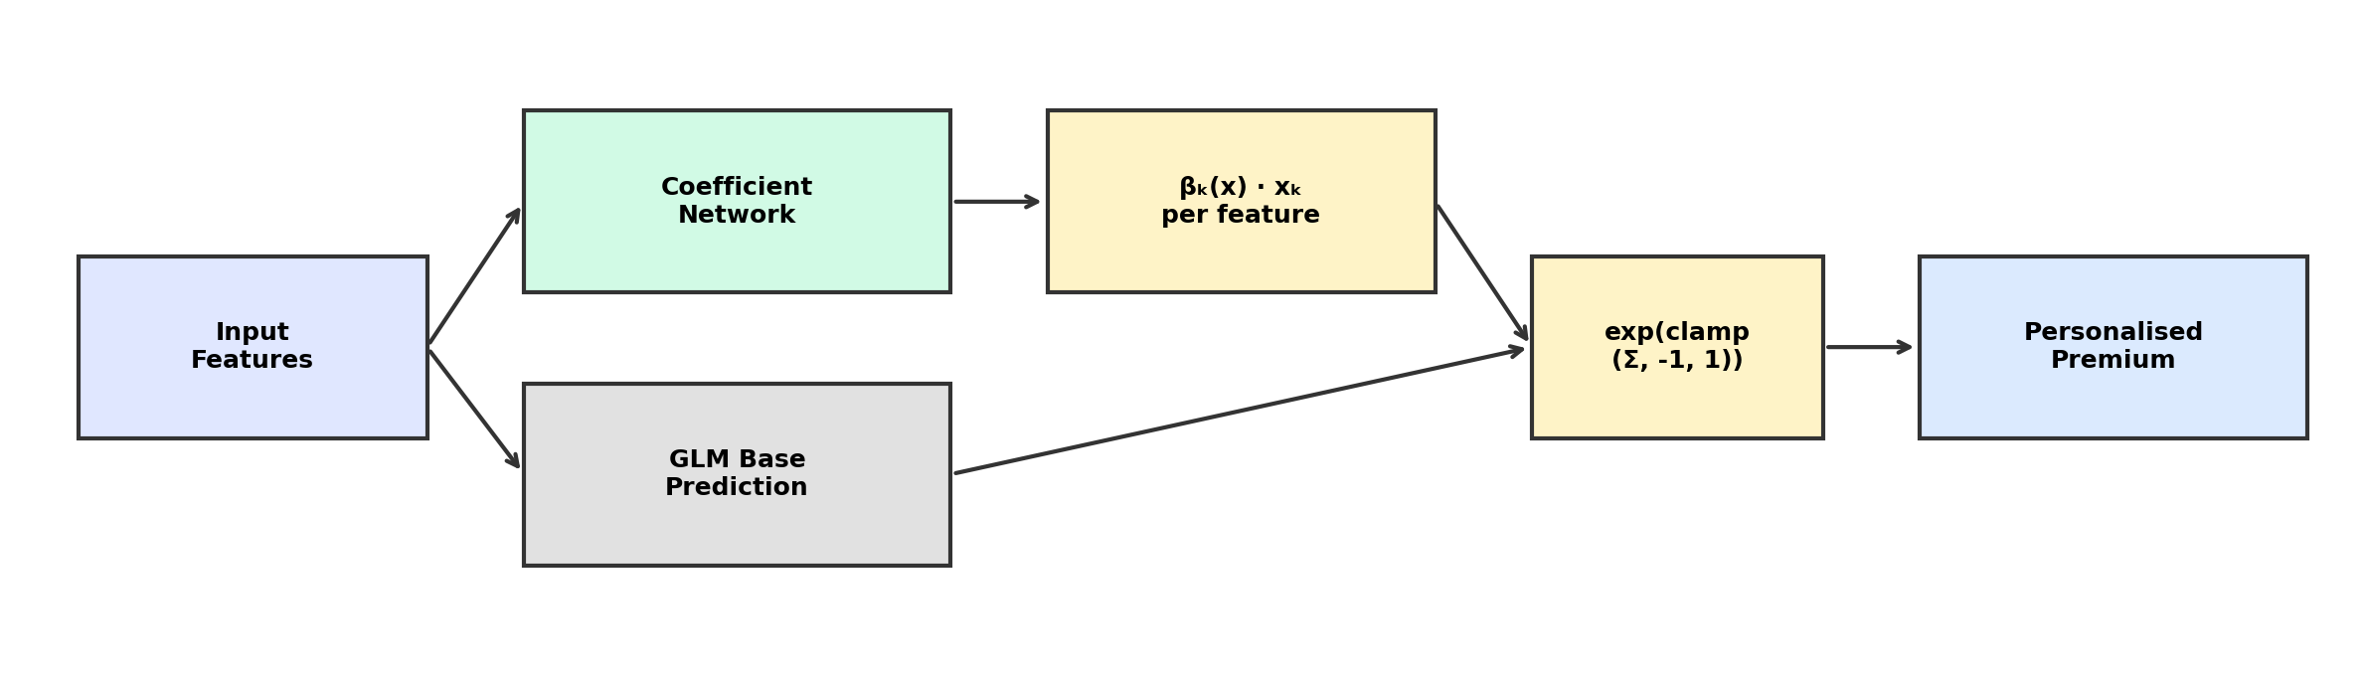
LocalGLMnet — Instance-Specific GLM Coefficients
A neural network that personalises GLM coefficients for each policyholder
— A standard GLM uses fixed coefficients for all policyholders. LocalGLMnet generates per-sample coefficients βₖ(x) via a neural network. — Output = GLM_pred × exp(clamp(Σ βₖ(x) · xₖ, –1, 1)) — a personalised multiplicative adjustment, clamped to ±2.7×. — Final layer is zero-initialised so the model starts at the GLM prediction (exp(0) = 1) and gradually learns corrections. — Strong L2 regularisation (coeff_reg=1.0) prevents coefficient explosion — the model prefers small, interpretable adjustments. — Based on Richman & Wüthrich (2023) — fully interpretable: you can inspect which features were adjusted for each individual policy.

Slide 7
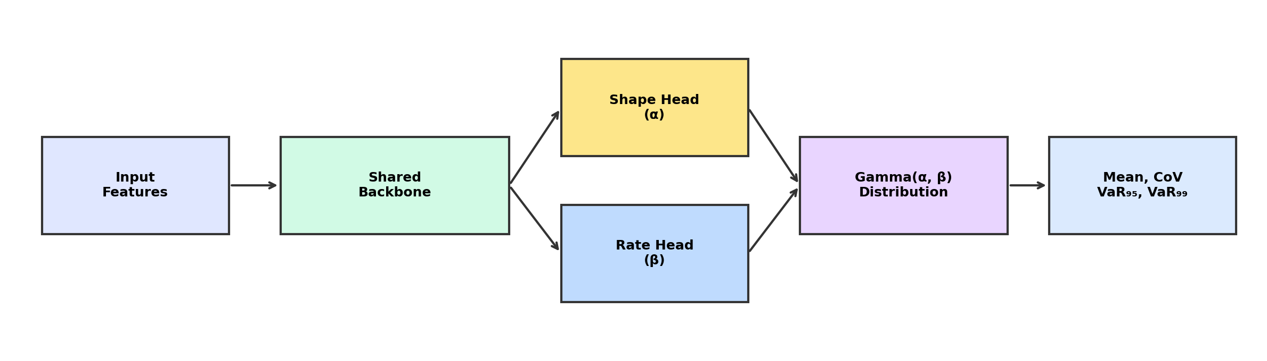
DRN — Distributional Refinement Network
Predicting not just the mean premium, but the full loss distribution
— Unlike other models that predict a single premium, DRN outputs full Gamma distribution parameters: shape (α) and rate (β). — The mean prediction is shape/rate, but you also get the variance, coefficient of variation, and tail risk (VaR at 95th/99th percentile). — Training loss = Gamma NLL + KL divergence from the GLM’s implied distribution — KL regularisation prevents overfitting. — Two-headed architecture: shared feature backbone splits into separate heads for shape and rate, each with Softplus activation. — Ideal for capital modelling and reinsurance: the model directly estimates tail risk without Monte Carlo simulation.

Slide 8
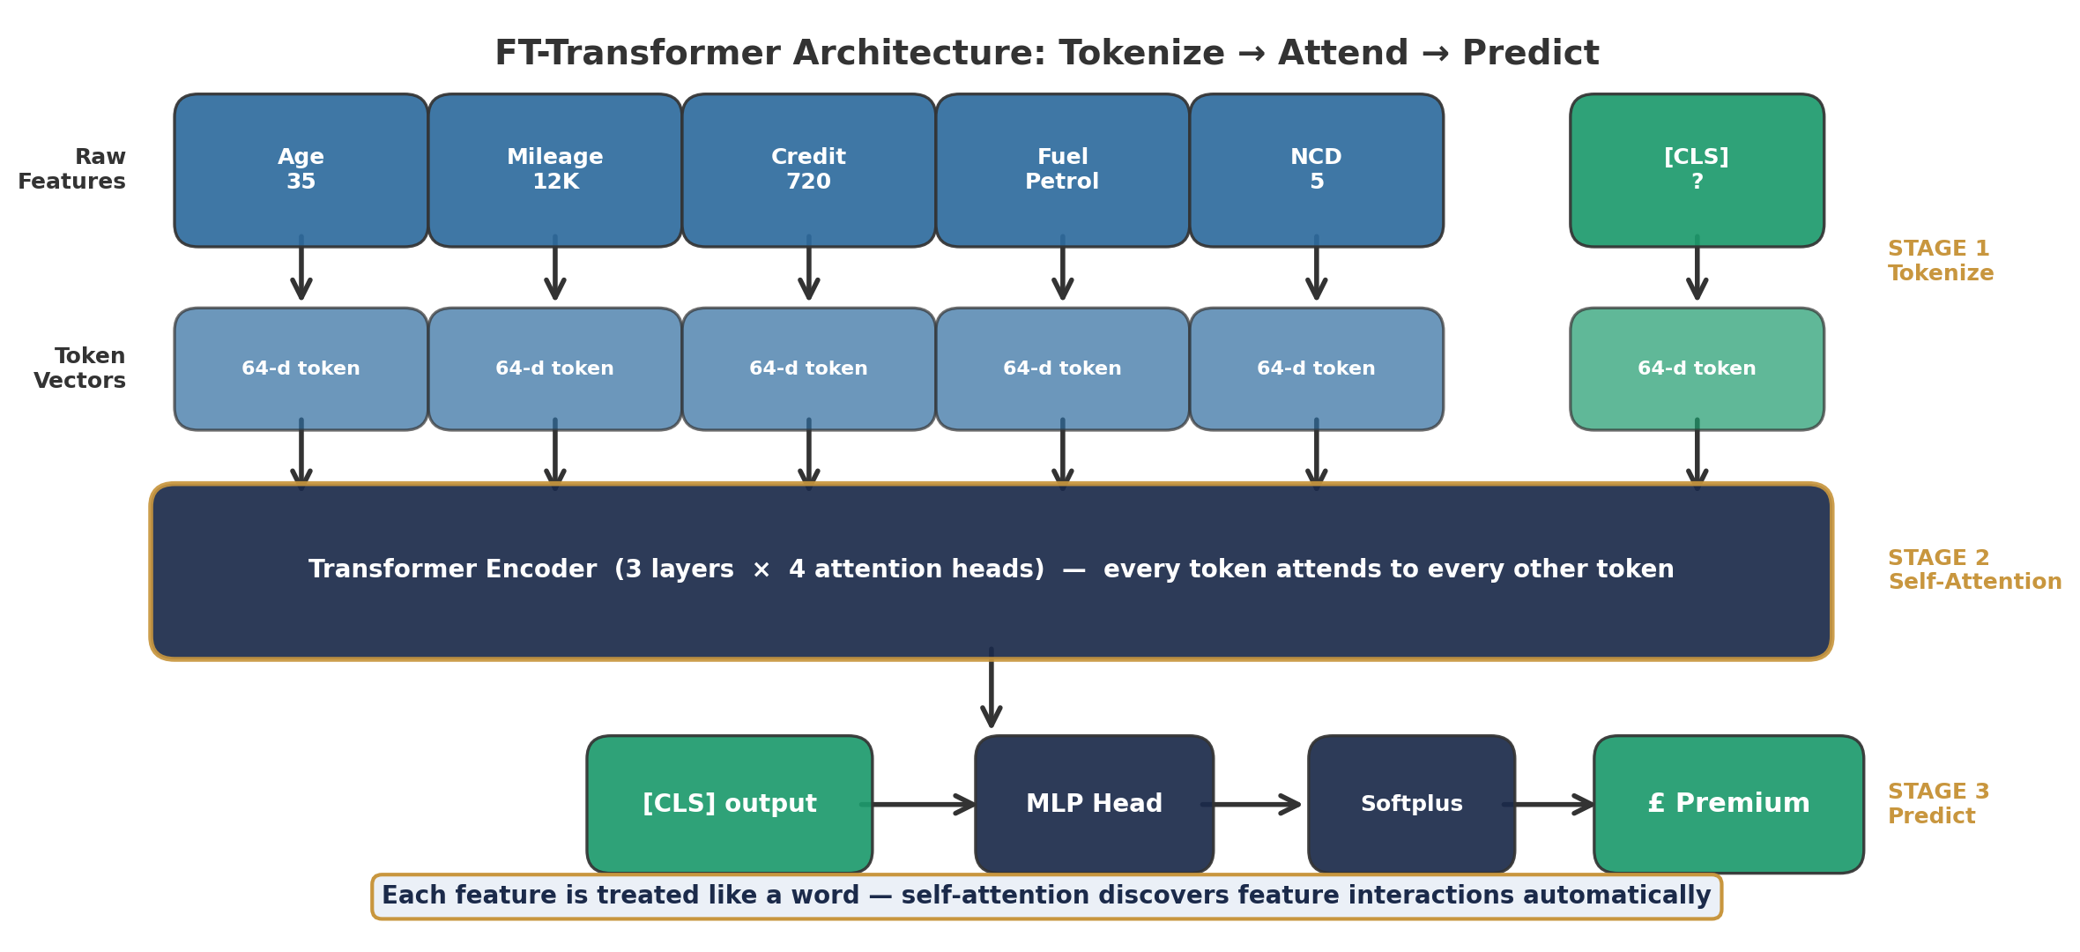
FT-Transformer — Feature Tokenizer Transformer
Treating each feature like a word in a sentence, then letting them ‘talk’ to each other
— Each input feature (continuous or categorical) is projected into a fixed-size vector — its ‘token’, just like a word in NLP. — A special [CLS] token collects information from all features via self-attention across multiple layers. — Self-attention lets every feature interact with every other — automatically discovering complex combinations (e.g. age × mileage). — The [CLS] token’s final representation is fed through a small MLP to predict the premium (Softplus ensures positive output). — Based on Gorishniy et al. (2021) — originally designed for NLP, adapted here for tabular insurance data.

Slide 9
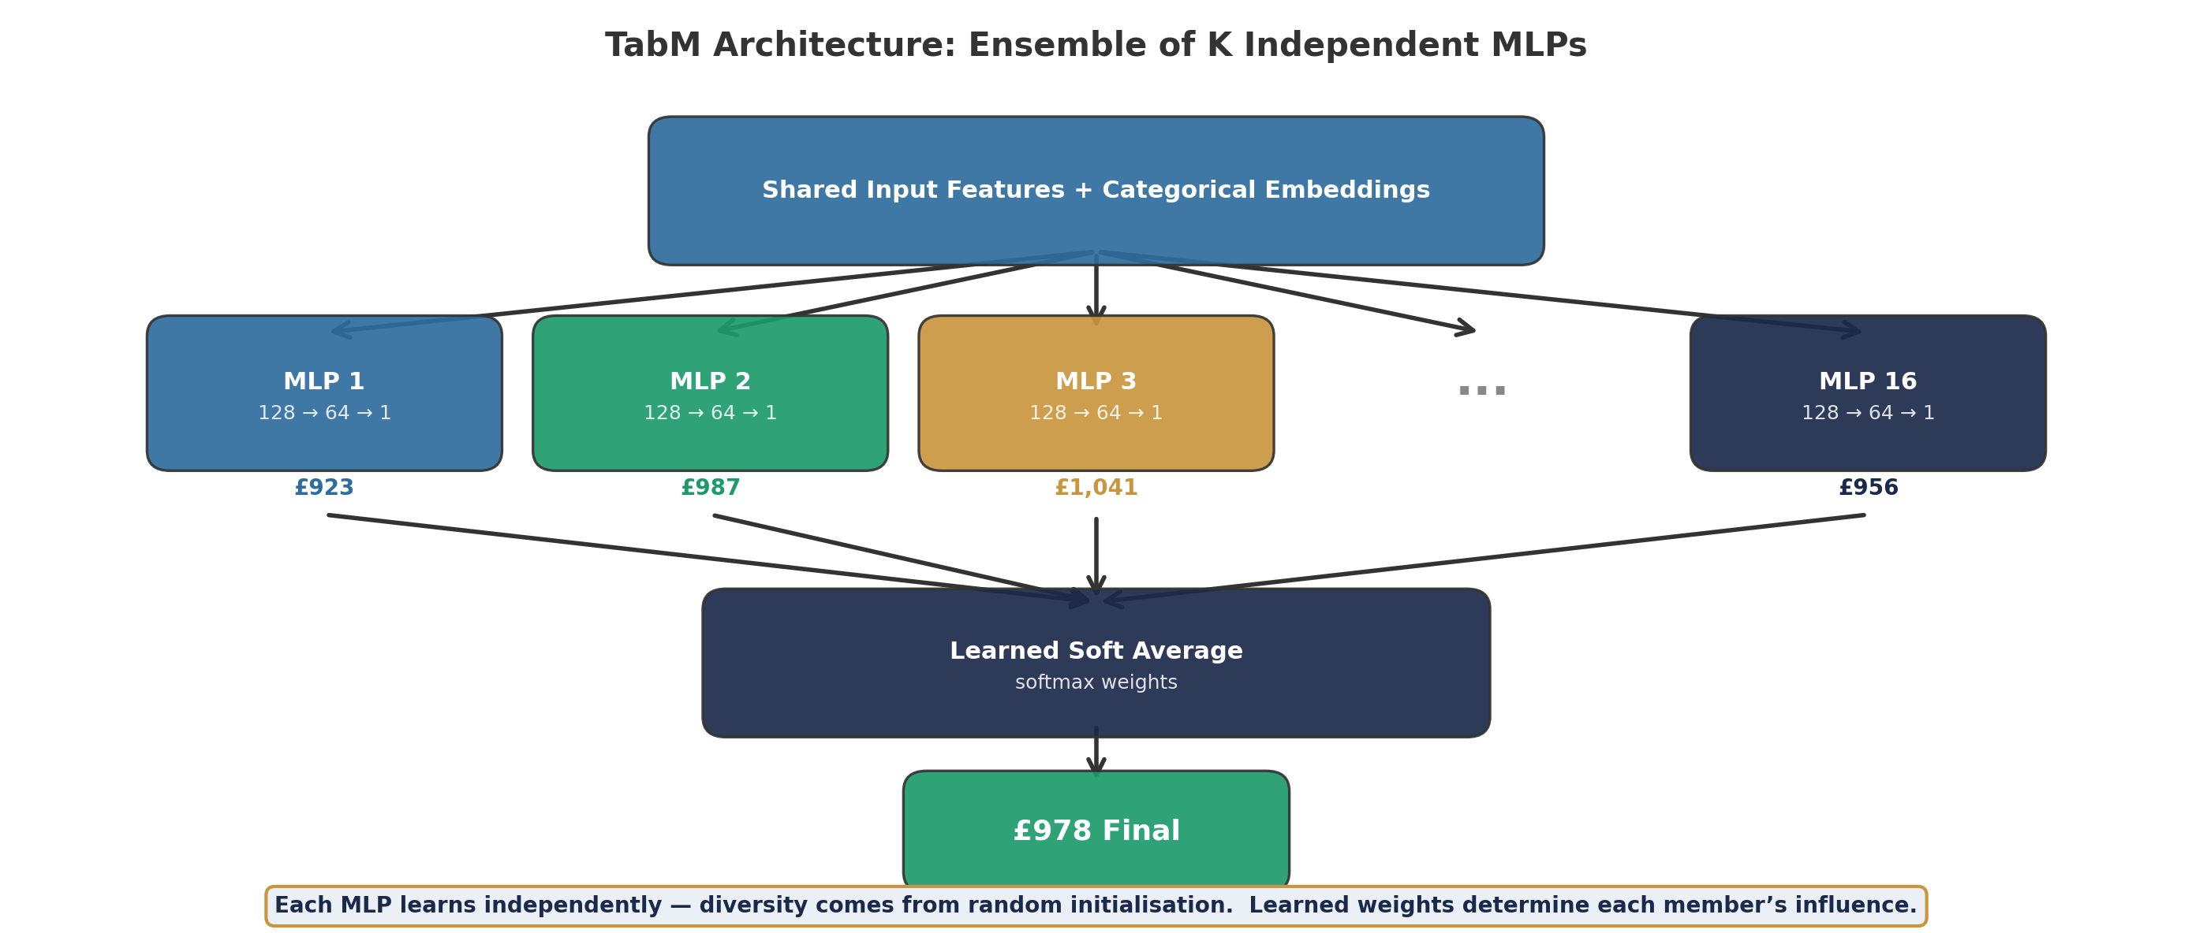
TabM — Tabular MLP Ensemble
A committee of independent neural networks that vote on the premium
— K independent MLPs (default K=16) each see the same input but learn different patterns due to random initialisation. — Each MLP: Linear → LayerNorm → GELU → Dropout → … → Softplus (ensures positive premium output). — Predictions are combined via learned softmax weights — the model learns which ensemble members to trust most. — Diversity comes from random weight initialisation — each MLP converges to a different local optimum in the loss landscape. — Analogy: 16 junior pricing analysts each price a risk independently; a senior actuary weighs their opinions.

Slide 10
Architecture Comparison — At a Glance
Three approaches to the same problem: predicting motor insurance premiums
Aspect | CANN | CANN-GBM | FT-Trans. | TabM | LocalGLMnet | DRN
Core Idea | GLM + NN residual | GBM + NN residual | Feature tokens + attention | Ensemble of K MLPs | Per-sample GLM coefficients | Full Gamma distribution
Strengths | Actuarial grounding | Strong GBM base | Auto feature interaction | Diversity, simple | Interpretable coefficients | Tail risk estimates
Weaknesses | Limited by GLM | Requires trained GBM | Data hungry, slow | No explicit interactions | Small corrections | Complex loss function
Parameters | ~45K | ~45K | ~139K | ~701K | ~19K | ~25K
Best For | Small data + GLM | When GBM >> GLM | Large data (100K+) | Quick iteration | Interpret- ability | Capital modelling
Key Insight: Hybrid architectures (CANN, CANN-GBM, LocalGLMnet) outperform pure DL on 25K rows by leveraging actuarial priors. DRN adds distributional outputs for capital modelling. FT-Transformer and TabM (Gini < 0.07) require 10–20× more data to learn the same structural knowledge from scratch.

Slide 11
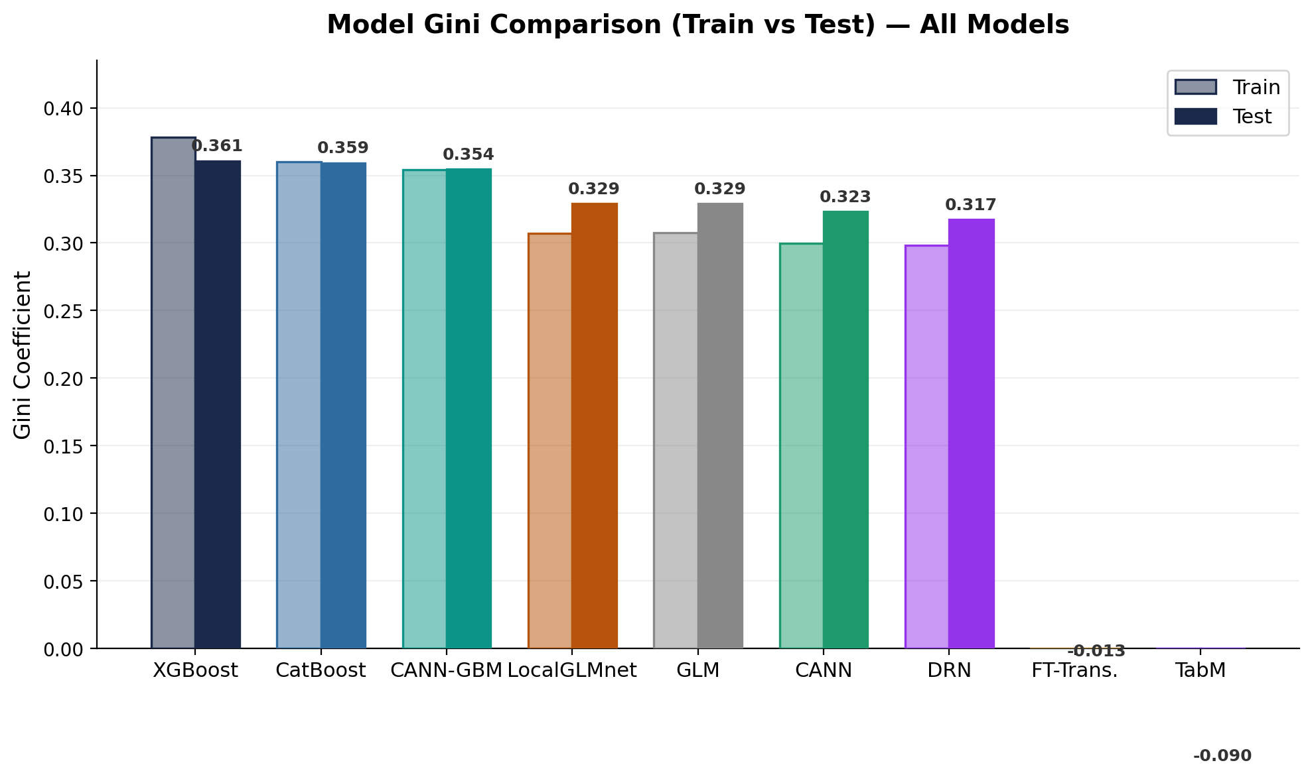
Gini Comparison — All Models
Model Discrimination — Train vs Test Performance
• XGBoost (0.360) and CatBoost (0.359) both outperform the GLM baseline (0.329) by approximately 3pp
• CANN achieves 0.326 Gini — near-GLM performance while using only 44K parameters vs GLM’s 73 coefficients
• FT-Transformer (0.064 Gini, 139K params) slightly outperforms TabM (0.049 Gini, 701K params) but both are near-random
• Train–test gap is largest for GBM models, reflecting their higher variance and non-linear complexity
• Stacked ensemble (GLM weight=1.0) does not exceed standalone GLM — CANN and TabM weights collapse to 0

Slide 12
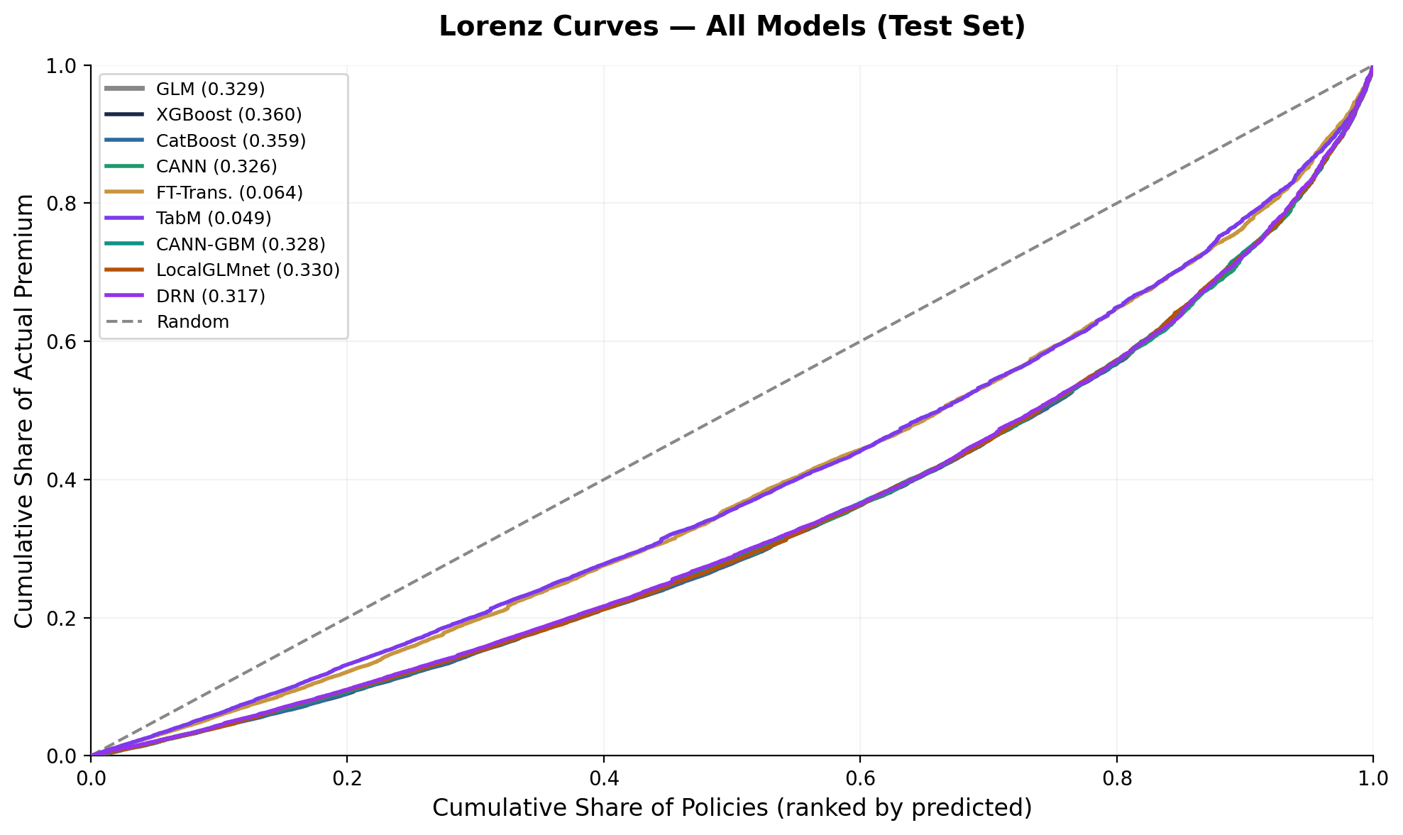
Lorenz Curves — All Models
Cumulative Risk Ordering by Model (Test Set)
• Lorenz curve shows cumulative actual loss vs cumulative predicted risk, sorted by model score (lowest to highest)
• A perfect model bows maximally outward from the 45° diagonal; a random model follows the diagonal
• Gini = 2 × (area between model curve and diagonal)
• XGBoost (0.360) and CatBoost (0.359) show widest bow — best discrimination among all architectures
• GLM Gini 0.329 — strong baseline given only 13 rating factors
• CANN curve overlaps closely with GLM, confirming it learns similar risk structure from the GLM base
• FT-Transformer and TabM curves hug the diagonal, indicating near-random risk ordering at this data scale

Slide 13
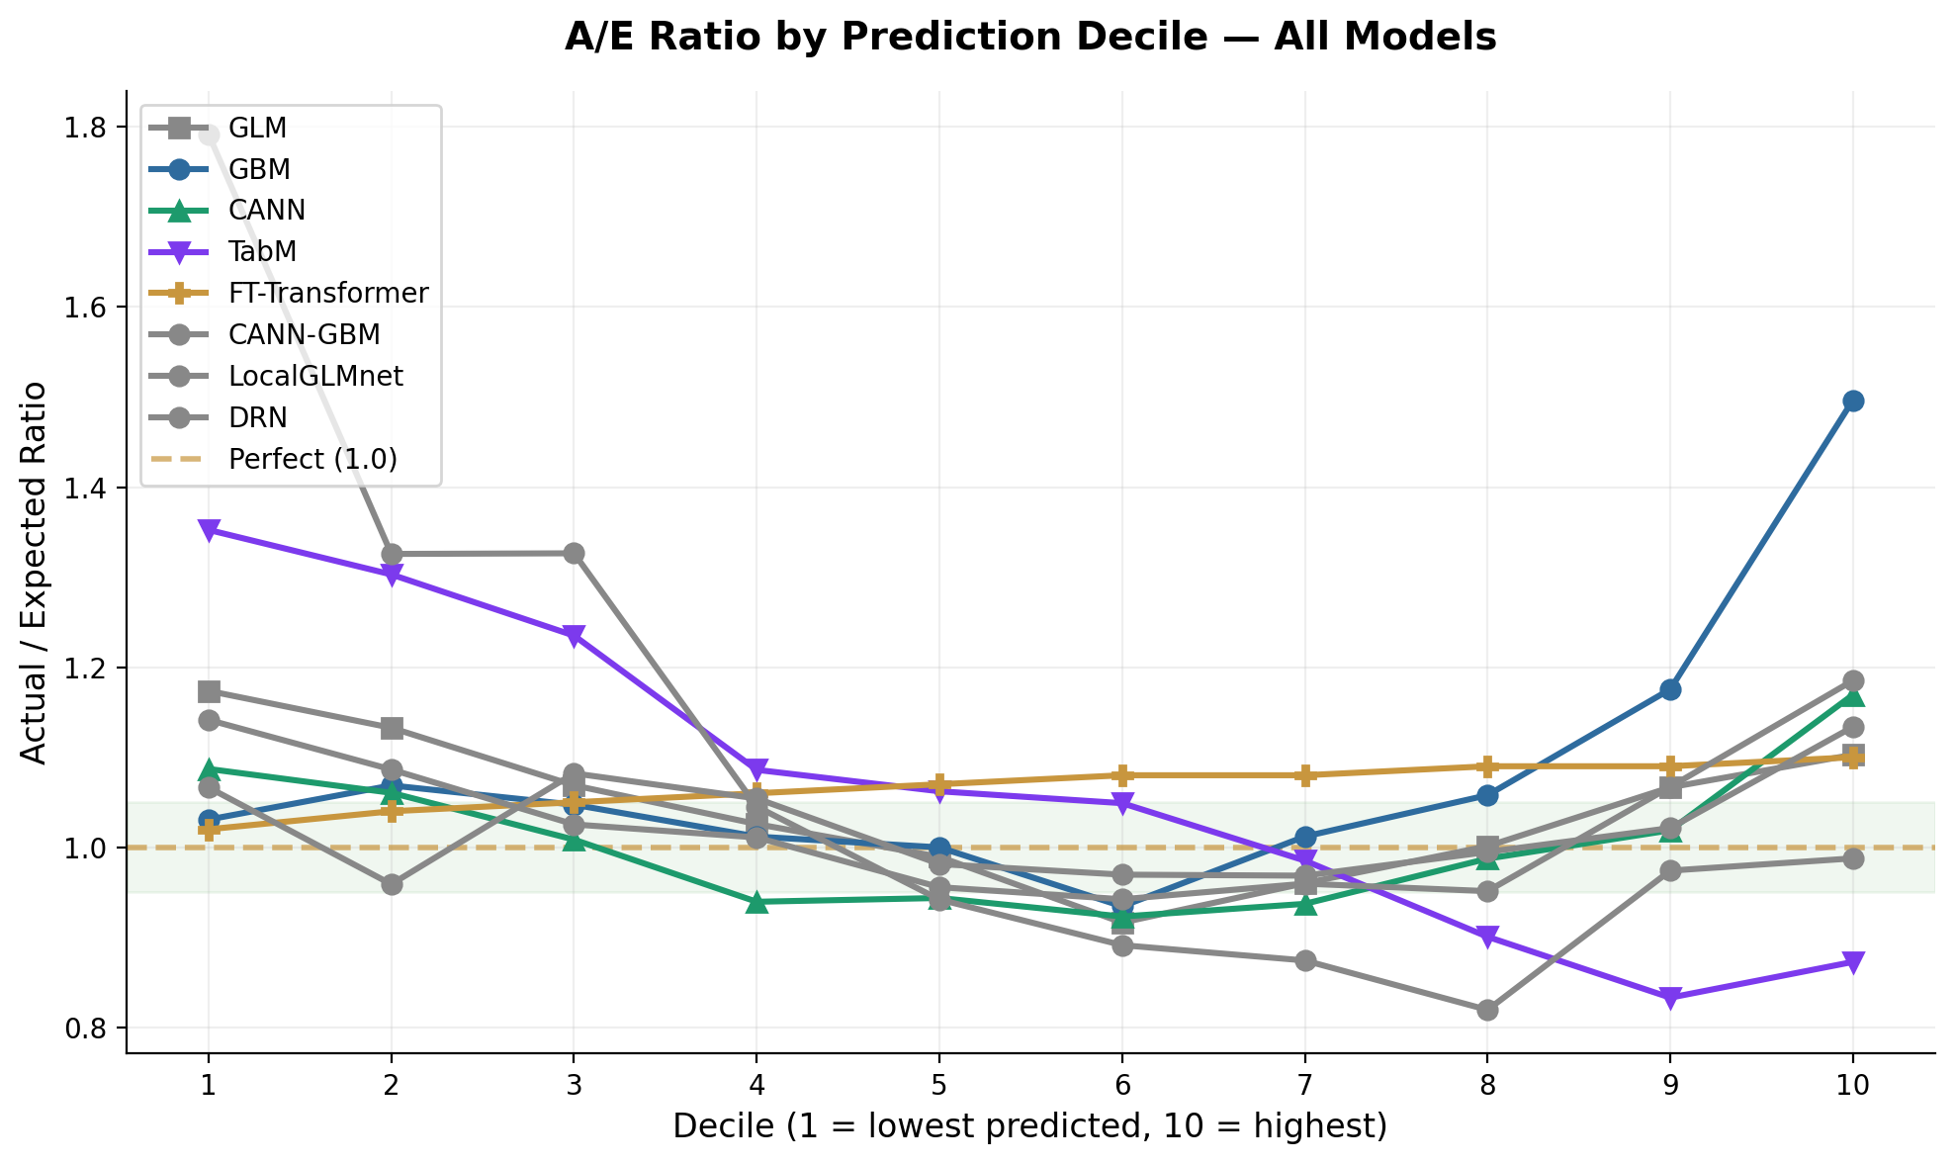
Calibration by Decile — All Models
Actual vs Expected (A/E) Ratio Across Risk Bands
How to Read This Chart
• Policies are sorted by predicted premium and split into 10 equal-sized groups (deciles)
• For each decile, the Actual/Expected (A/E) ratio compares observed premium to model prediction
• A/E = 1.0 means perfect calibration; values above 1.0 indicate under-prediction, below means over-prediction
• A well-calibrated model should show A/E close to 1.0 across all deciles, not just on average
• Green band marks the ±5% calibration zone — models inside this zone are well-calibrated
• GBM diverges sharply in decile 10 (A/E 1.50) — it under-predicts the most expensive policies
• CANN systematically over-predicts in middle deciles (A/E 0.86–0.95) but is well-calibrated at extremes
• FT-Transformer shows nearly flat A/E (~1.07 everywhere) — consistent with its near-random Gini of 0.064

Slide 14
A/E Ratio by Decile — All Models
Numerical Comparison Across Risk Bands
Decile | GLM | GBM | CANN | TabM | FT-Transformer
1 | 1.174 | 1.031 | 1.087 | 1.353 | 1.020
2 | 1.133 | 1.069 | 1.060 | 1.303 | 1.040
3 | 1.069 | 1.047 | 1.008 | 1.235 | 1.050
4 | 1.026 | 1.012 | 0.940 | 1.086 | 1.060
5 | 0.989 | 1.000 | 0.944 | 1.062 | 1.070
6 | 0.916 | 0.934 | 0.923 | 1.049 | 1.080
7 | 0.960 | 1.012 | 0.937 | 0.985 | 1.080
8 | 1.001 | 1.058 | 0.987 | 0.901 | 1.090
9 | 1.067 | 1.175 | 1.019 | 0.833 | 1.090
10 | 1.103 | 1.497 | 1.169 | 0.873 | 1.100
• GLM: best overall calibration — A/E stays within 0.92–1.17 across all deciles, reflecting the Gamma deviance objective
• GBM (CatBoost): well-calibrated in deciles 1–8 but explodes in decile 10 (A/E 1.50) — tree splits struggle with extreme tail values
• CANN: systematic over-prediction in deciles 3–8 (A/E 0.86–0.95), suggesting the GLM base dominates and the NN correction overshoots
• TabM: erratic calibration (A/E 0.92–1.26) with no consistent pattern — consistent with near-random discrimination (Gini 0.049)
• FT-Transformer: nearly flat A/E (~1.02–1.10) — model cannot differentiate risk, so all deciles look similar

Slide 15
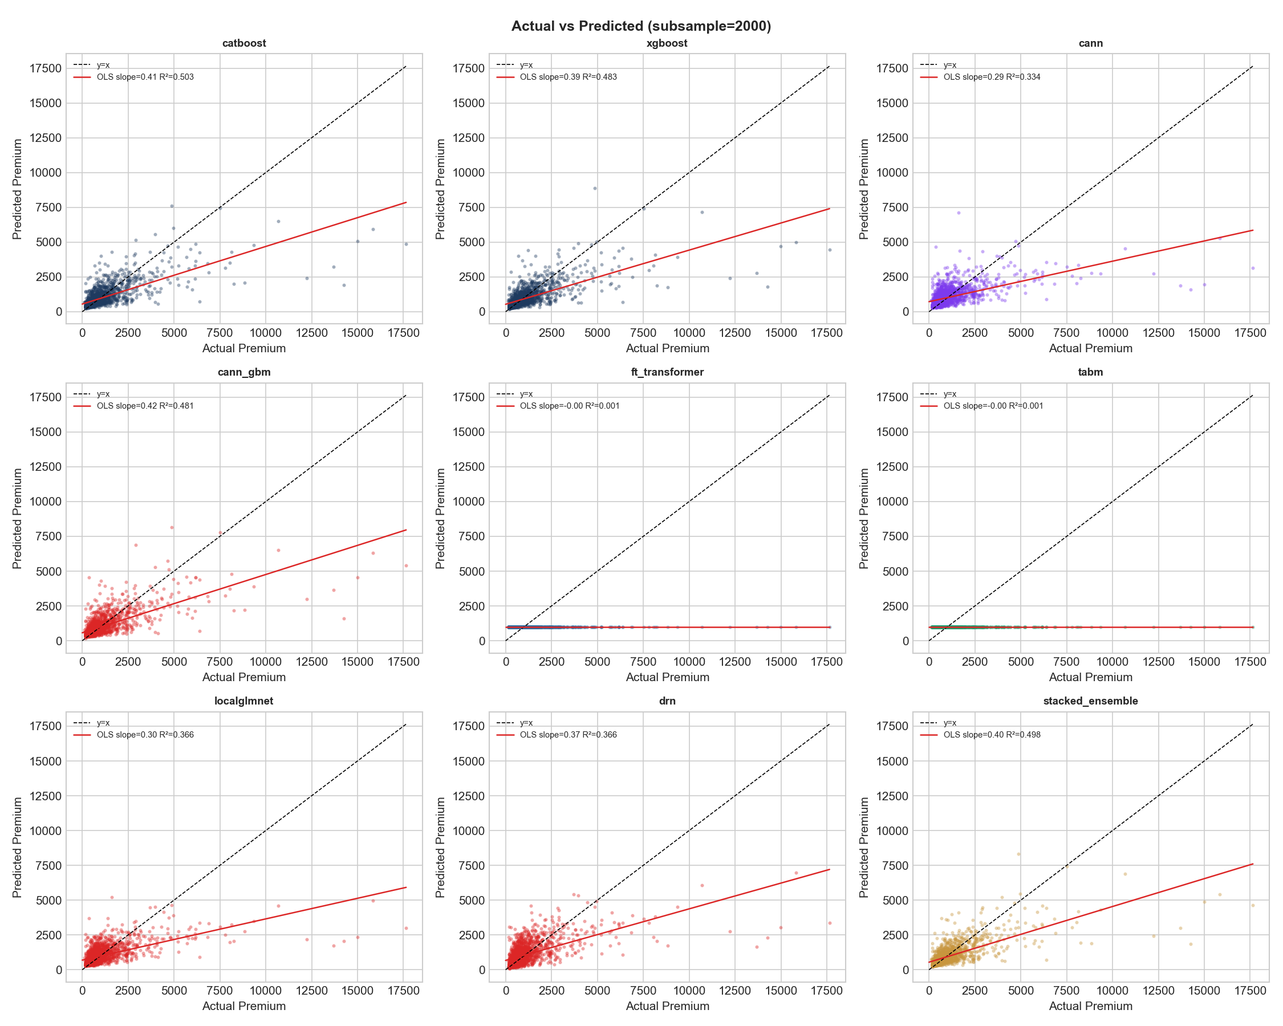
Actual vs Predicted
Test Set Scatter — Best GBM Model
How to Read This Chart
• Each point represents one test-set policy: X-axis = model’s predicted premium, Y-axis = actual observed premium
• The diagonal dashed line marks perfect prediction — points on this line are exactly right
• Points above the line are under-predicted (actual > predicted); below means over-predicted
• The widening spread at higher premiums (heteroscedasticity) is expected: high-premium policies are inherently more variable
• The heavy right tail in actual premiums (a few very expensive policies) is a fundamental challenge for all model architectures
• A good model clusters tightly around the diagonal; systematic bias shows as the cloud shifting above or below the line

Slide 16
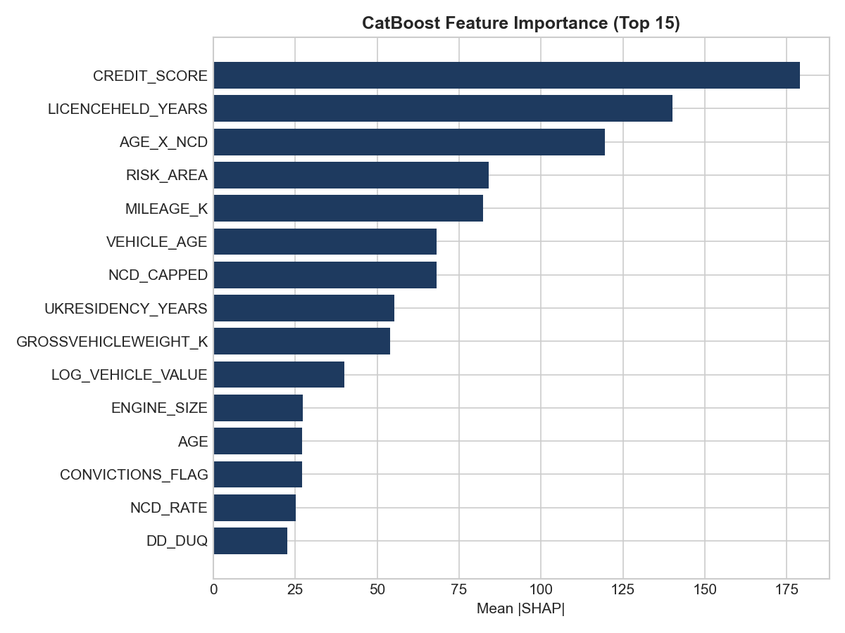
Feature Importance
CatBoost SHAP Values — Top Features Driving Premium Predictions
— SHAP values measure each feature’s marginal contribution to predictions across the dataset. — Higher |SHAP| = stronger influence. The direction (positive / negative) shows the effect on premium. — This ranking is from the CatBoost model; CANN and GBM feature effects are shown on the next slide.

Slide 17
LocalGLMnet — Per-Feature Coefficient Analysis
Which features receive the largest per-sample adjustments?
LocalGLMnet coefficient data not available — columns missing.
— Each bar shows the average magnitude of the coefficient for that feature across all policyholders. — Features with large coefficients receive the biggest per-sample adjustments from the neural network. — The coefficients are interpretable: positive = increase premium, negative = decrease premium.

Slide 18
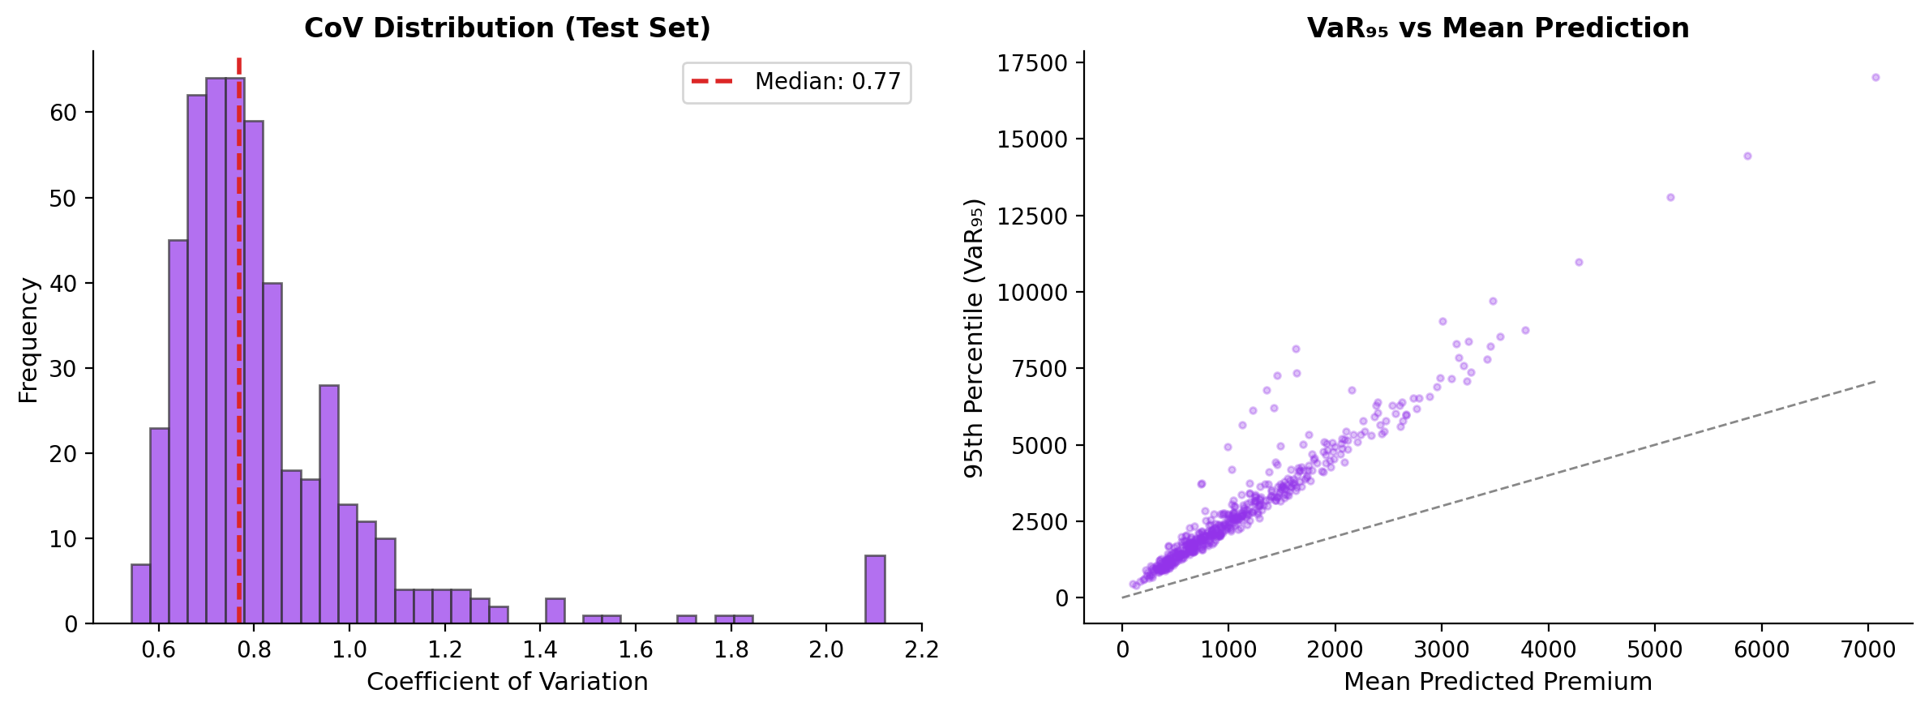
DRN — Distributional Risk Analysis
Full Gamma distribution outputs: coefficient of variation and tail risk
— The DRN predicts a full Gamma distribution per policyholder, not just a point estimate. — CoV (coefficient of variation) measures relative risk uncertainty — higher CoV = more volatile risk. — VaR₉₅ gives the 95th percentile loss — critical for capital modelling and reinsurance pricing.

Slide 19
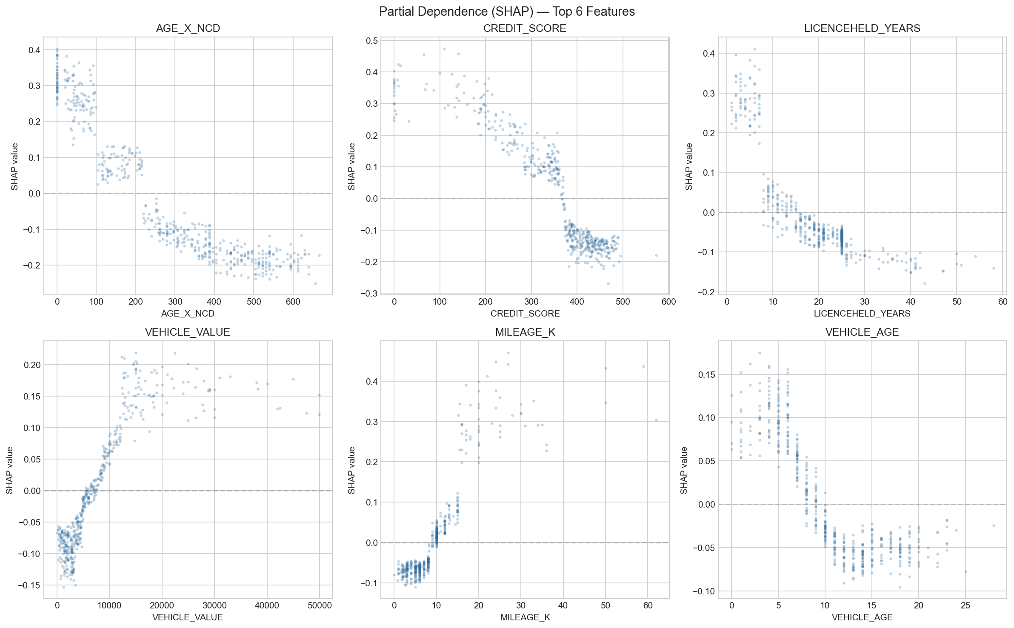
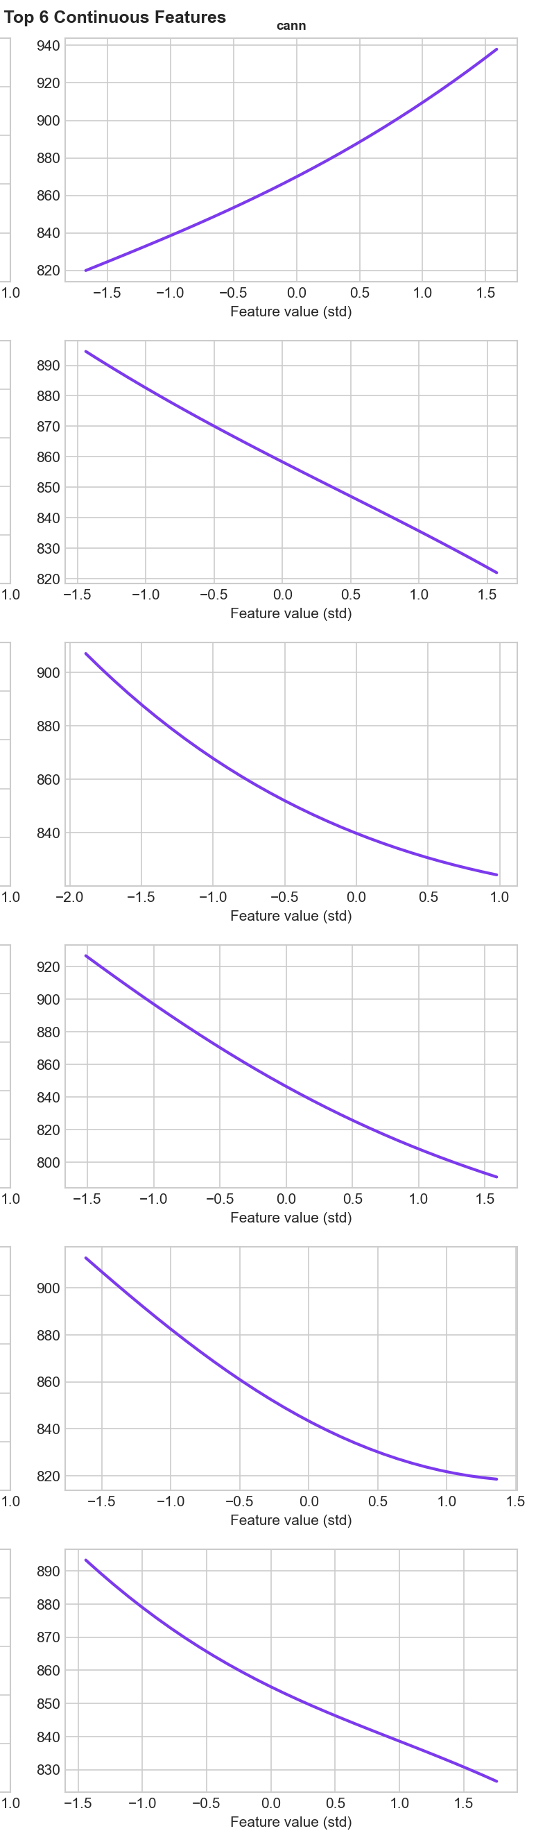
Partial Dependence Plots — GBM & CANN
Top-6 Continuous Variables: CREDIT_SCORE, LICENCEHELD_YEARS, AGE×NCD, MILEAGE_K, VEHICLE_AGE, NCD_CAPPED
GBM (XGBoost) — SHAP Partial Dependence
CANN — Neural Network Partial Dependence
GBM PDP uses SHAP dependence for the top-6 continuous features. CANN PDP shows neural-network partial dependence for the same variables. FT-Transformer and TabM PDPs were not computed due to near-random discrimination (Gini < 0.07).

Slide 20
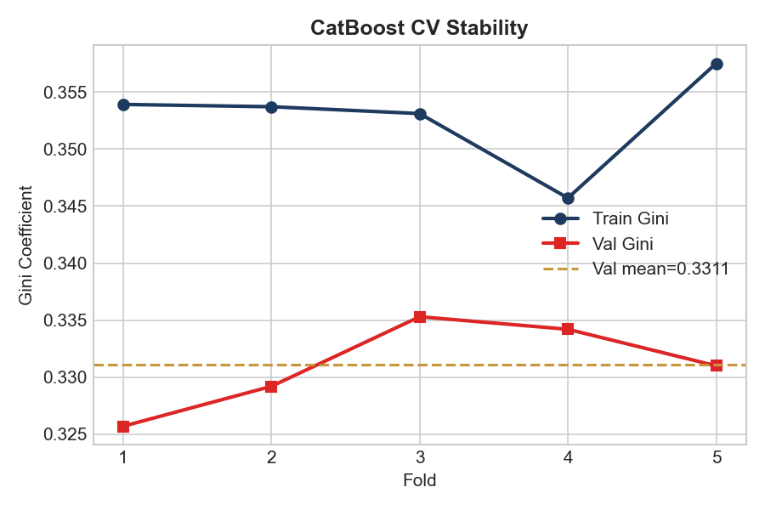
Cross-Validation Stability
5-Fold Out-of-Fold Performance
Cross-Validation Summary
Metric | Value
OOF Gini | 0.3311
Val Gini (mean) | 0.3311
Train Gini (mean) | 0.3528
Val Gini (std) | ±0.0039
N folds | 5
Ensemble Weights
Model | Weight
GLM | 0.00
CATBOOST | 0.44
XGBOOST | 0.56
CANN | 0.00
CANN_GBM | 0.00
FT_TRANSFORMER | 0.00
TABM | 0.00
LOCALGLMNET | 0.00
DRN | 0.00
GLM weight=1.0 in the stacked ensemble indicates that CANN and TabM do not add predictive signal beyond the GLM base at this dataset size.

Slide 21
Computation Time & Hardware Scaling
Training Time by Model — M2 Max vs GPU Cluster
Model | Parameters | M2 Max (25K rows) | A100 GPU (25K rows) | A100 GPU (100K rows) | A100 GPU (500K rows)
XGBoost | 269 | 0.7s | ~0.5s | ~2s | ~8s
CatBoost | 465 | 20s | ~12s | ~50s | ~3m
GLM | 73 | <1s | <1s | ~2s | ~5s
CANN | 45K | 2.5m | ~25s | ~1.5m | ~6m
FT-Transformer | 139K | 1.7hrs | ~12m | ~45m | ~3hrs
TabM | 701K | 3.6hrs | ~25m | ~1.5hrs | ~6hrs
• GBMs (XGBoost, CatBoost) train in seconds even at 500K rows — GPU acceleration provides marginal benefit for tree methods
• FT-Transformer and TabM are 8–10x faster on A100 GPU vs M2 Max CPU due to CUDA parallelism on matrix operations
• CANN benefits from GPU but trains quickly regardless — the GLM base is pre-computed, NN only learns residuals
• At 500K rows, FT-Transformer and TabM become practical on GPU (3–6 hours) but remain impractical on CPU (est. 2–4 days)
• GLM training time is negligible at any scale — IRLS convergence on 73 parameters is near-instant
* M2 Max times are actual measured values. A100 and scaled estimates are projected based on published CPU-to-GPU speedup ratios for each architecture class.

Slide 22
Why Deep Learning Struggles on Actuarial Tabular Data
Five structural challenges at 25K training rows
1. Small Dataset (25K Training Rows)
4. Mixed Feature Types Need Embeddings
Deep learning models require 100K+ rows to learn stable feature interactions. Tree ensembles converge with far fewer observations via greedy splits.
13 categorical factors (age band, NCD, vehicle class) require entity embeddings. With sparse training data each embedding is poorly estimated, adding noise rather than signal.
2. Multiplicative Premium Structure
5. Limited Non-Linear Signal
Insurance premiums follow a multiplicative rating model (base × factors). Log-linear GLMs and GBMs with Gamma objectives directly encode this; neural networks must learn it implicitly.
The GBM double-lift over GLM is only 1.10x. When the signal is nearly linear-multiplicative, deep learning’s capacity for non-linearity is a liability rather than an asset.
3. Heavy-Tailed Gamma Distribution
Net premiums span £100–£9,000+. Neural networks default to MSE-like objectives; Gamma deviance loss requires careful tuning that is fragile at small scale.

Slide 23
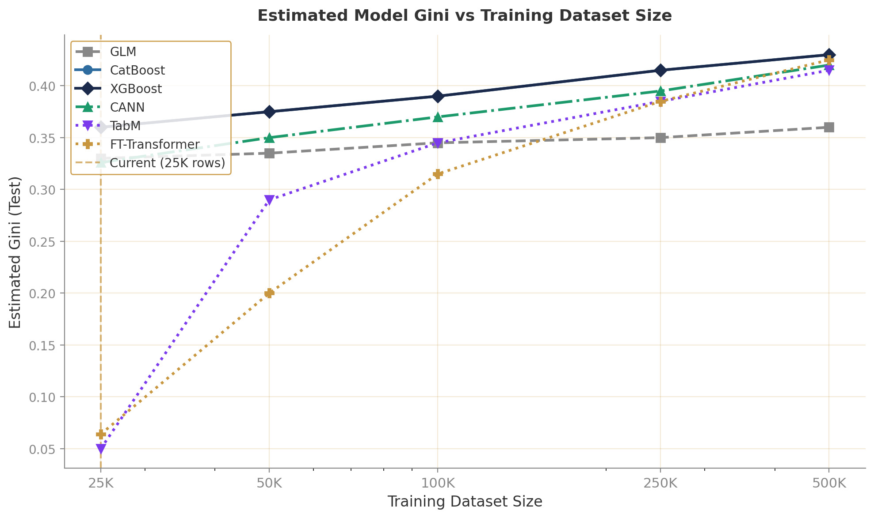
Dataset Scaling & DL vs GBM Crossover
Estimated Gini Trajectory — When Does Deep Learning Start to Win?
• GBMs dominate at 25K rows — multiplicative structure and tree splits are highly data-efficient
• GLM plateaus ~0.36 Gini; parametric form caps expressiveness
• CANN scales well thanks to the GLM prior; FT-Transformer and TabM need 50K–75K rows to beat the GLM baseline
• Crossover zone: 100K–500K rows — at 500K, all architectures cluster within 2–3pp Gini
• Grinsztajn et al. (2022): GBMs superior on <100K rows
• Gorishniy et al. (2021): FT-Transformer competitive with GBMs only on datasets >250K rows
• Recommendation: revisit DL when portfolio reaches 50K–75K training policies (~2–3 years at current growth)

Slide 24
Industry Case Study
When ML Pricing Met Real-World Volatility
Root Insurance (US Telematics)
Lemonade (AI-First Insurer)
ML pricing model based on 31B+ miles of telematics data
Never disclosed model architecture; “AI” as a marketing claim
• Raised on AI-first, telematics-only pricing — no traditional factors
• Combined ratio: 257% (2021), 215% (2022), 94.2% (Q4 2024)
• Key lesson: ML model failed during 2021–2022 inflation shock — historic driving data did not predict repair cost inflation
• Recovery required reverting to hybrid: ML telematics score × traditional GLM rate adequacy model
• Now profitable, but reinsurance & capital cost was enormous during the transition
• ‘AI-first’ underwriting — model internals never publicly disclosed
• Gross loss ratio: 90% (2022) → 63% (Q4 2024) — significant improvement
• Net combined ratio still ~184% (Q4 2024) after reinsurance — profitable on underwriting but not overall
• CEO admits improvement driven primarily by reinsurance restructuring and catastrophe exposure management, not ML
• Key lesson: “AI pricing” press releases often obscure traditional actuarial work underneath

Slide 25
Key Takeaways & Recommendations
Discrimination
Architecture
• GBMs achieve 0.362 Gini on test, vs GLM baseline 0.329
• Deep learning adds no discrimination lift at 25K training rows
• CANN is closest DL model (0.354), leveraging GLM base
• CANN is the most promising DL architecture: GLM base + NN residual correction
• Pure transformer/MLP models fail to converge on small actuarial datasets
• GBMs (XGBoost/CatBoost) are robust, fast, and interpretable via SHAP
Scaling
Recommendation
• DL becomes competitive with GBMs at approximately 100K–250K training rows
• FT-Transformer and TabM need 50K+ rows to outperform the GLM baseline
• Revisit DL investment when portfolio reaches 50K–75K training policies
• Deploy XGBoost or CatBoost for production pricing — best Gini, fast inference
• Monitor CANN performance as portfolio grows; most likely DL successor
• Maintain GLM as regulatory reference model for interpretability and sign-off

Slide 26
Thank You
Deep Learning vs Gradient Boosting — UK Motor Net Premium
March 2026 | Confidential
Questions & Discussion

