Slide 1
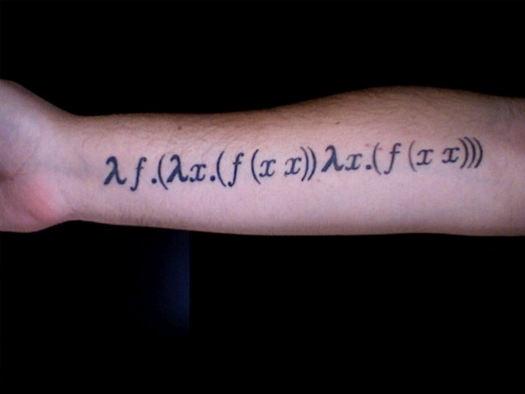
Lambdas and Closures
Lambdas and Closures
Lambdas and Closures
Lambdas and Closures
Lambdas and Closures
Lambdas and Closures
Lambdas and Closures
Lambdas and Closures
And how they Apply to LISP and Scheme
And how they Apply to LISP and Scheme
And how they Apply to LISP and Scheme
By: Timothy Lee
CS4850
And how they Apply to LISP and Scheme

Slide 2
What are these two types of Functions?
Lambdas
Closures
Also go by the name Anonymous Functions
Staples of functional programming languages
Nameless inline functions to be utilized by higher functions often as passed parameter or to be returned after constructing result
A way of using embedded functions to close over values and allow them to persist past the scope of a function
Allows for the creation of private values in functional languages that can be re-accessed when the function is re-executed

Slide 3

LAMBDAs
(define (add2Num n) (lambda (x) (+ x n)))
add2Num
Lksp Code
Generally implemented using closures
Useful for one time use functions, generally inside of other functions
Allows a function to be used as a parameter and even assigned and returned
Anonymous functions are not found to an identifier.
First implemented in LISP in 1958

Slide 4
CLOSUREs
With closures, defining a function inside of a function allows the inner function to access the non-local “upvalues” of the higher scoped function
First implemented in 1975 in Scheme and is very heavily associated with functional programming languages
Lamba-calculus
function startAt(x)
function incrementBy5(x)
return x + 5
return incrementBy

Slide 5
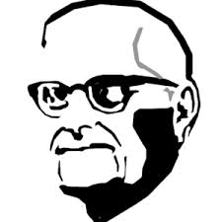
Lambda and Programming Languages
LISP
Scheme
name from “List Processing”
Lambda is a syntactic operation which creates nameless functions
(lambda (x) (* x x))
A lambda operation returns a function which can be passed a value
One of two main dialects of LISP
Lambda is a special form that generates nameless procedures
(lambda (x y) (* x y))
The environment of the lambda expression is remembered for future calls

Slide 6
Closures and Programming Languages
LISP
Scheme
“Let Over Lambda”
(let ((counter 0))
(lambda () (incf counter)))
“functions with a state”
http://letoverlambda.com/textmode.cl/guest/chap2.html
Scheme procedures remember storage locations that contain environments for past calls
Scheme procedures are closures
(define (mult x)
(lambda (y)
(* x y)))
(define multBy5 (mult 5))
http://stackoverflow.com/questions/36636/what-is-a-closure

Slide 7
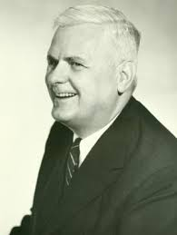
Lambda Calculus
Both Scheme and LISP follow a Lambda Calculus philosophy first spelled out by Alonzo Church
Important for functional programming languages that need to use functions within functions and functions that can take other functions as parameters, as well as return functions
Functions can serve as both input and output to other functions
Anonymous Functions and Closures are both inspired from this Lambda Calculus
Lambdas attempt to be efficient and nameless, confining themselves to their usefulness
Closures like to play lexical and scoping games in order to access upvalues and create a memory environment for subsequent calls

Slide 8

Sources
http://en.wikipedia.org/wiki/Anonymous_function
http://en.wikipedia.org/wiki/Closure_%28computer_programming%29
http://www.cs.berkeley.edu/~bh/ssch9/lambda.html
http://cs.calvin.edu/courses/cs/214/adams/labs/10/e-lisp/
http://en.wikipedia.org/wiki/Lisp_%28programming_language%29
http://www.cs.cmu.edu/Groups/AI/html/r4rs/r4rs_6.html
http://letoverlambda.com/textmode.cl/guest/chap2.html
http://c2.com/cgi/wiki?LexicalClosure
ftp://ftp.cs.utexas.edu/pub/garbage/cs345/schintro-v13/schintro_122.html
http://en.wikipedia.org/wiki/Lambda_calculus#Functions_that_operate_on_functions
http://stackoverflow.com/questions/36636/what-is-a-closure
http://stackoverflow.com/questions/220658/what-is-the-difference-between-a-closure-and-a-lambda

