Slide 1
Cambridge Charter School Internship Building a Turing Machine
Chad Spensky, Tim Greer, Jack Lepird, Stuart Baker
Feb 3 2015
Notes:
1
1

Slide 2
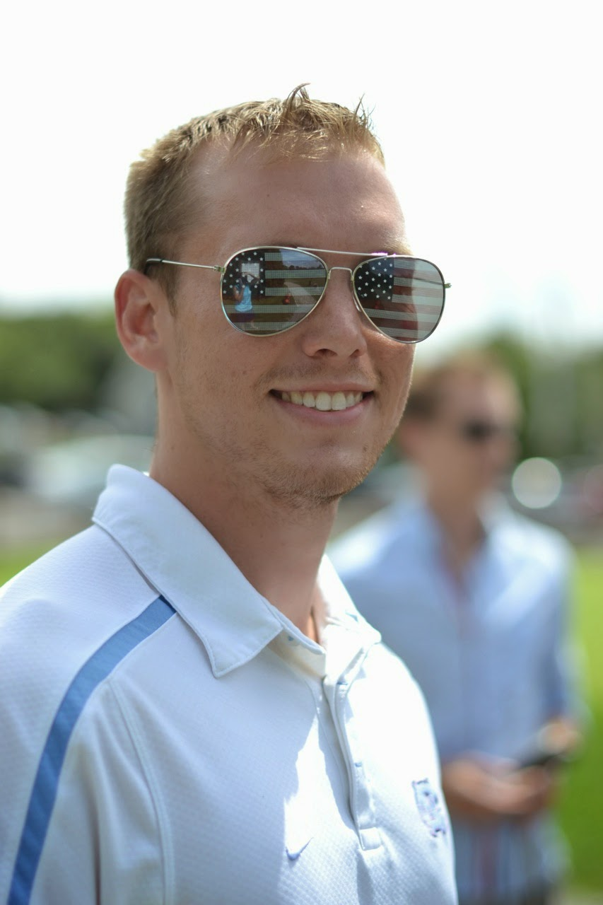
Who are we?
Chad Spensky
Area of Expertise: Computer Security
Education:
Bachelor’s Degree
Mathematics / Comp Sci. / Econ. @ PITT
Master’s Degree
Computer Security @ UNC-CH
Research Interests:
Authentication, Low-level Malware Analysis, Embedded Systems
Hobbies:
Snowboarding, Volleyball, Basketball, Inner Tube Water Polo, Traveling, Tinkering

Slide 3
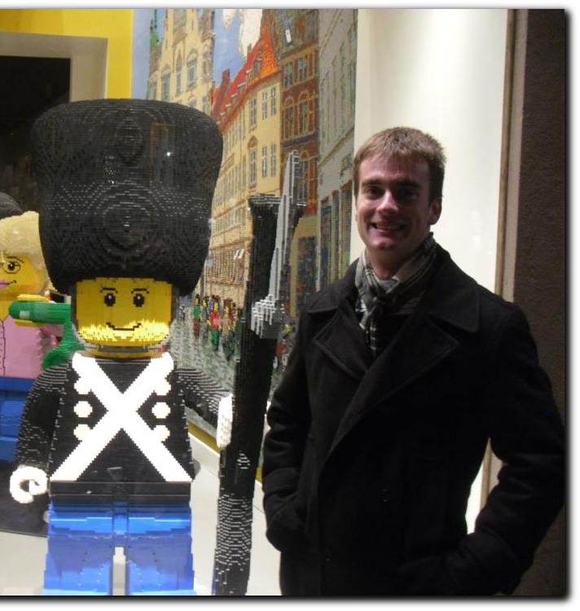
Who are we?
Jack Lepird
Areas of Expertise:
Machine Learning, Optimization, and Artificial Intelligence
Education:
Bachelor's Degree:
Mathematics / Operations Research / German, United States Air Force Academy
Master’s Degree (underway):
Operations Research, Massachusetts Institute of Technology
Research Interest:
Next-Generation Aircraft Collision Avoidance Systems
Hobbies:
Travel, SCUBA, Golf

Slide 4
Who are we?
Tim Greer

Slide 5
Who are we?
Stuart Baker

Slide 6
Who are you?
What are your favorite subjects?
What is your favorite food/color/animal?
What do you do for fun?
What do you hope to get out of this internship?

Slide 7
Why are we here?
To Build a Turing Machine!

Slide 8
Why are we here?
A WHAT?! Machine?

Slide 9
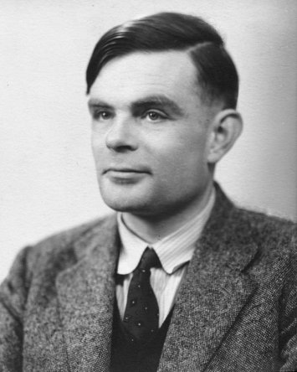
Alan Turing
One of the fathers of Computer Science
Cracked German “Enigma” code during WWII
Shorted war by “two to four years”
Solved “Entscheidungsproblem”
One of the “problems of the [20th] century”
Could run marathon in under 2hrs 30 min
5:45 minute miles
Basically, a huge stud

Slide 10
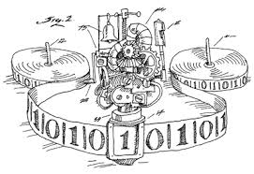
What is a Turing Machine?
A mental exercise
Consists of three parts:
Tape
Head
“Machine State”
Three operations:
Change symbol on tape
Move Tape
Change “state”

Slide 11
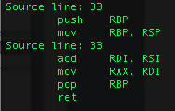
So, why do we care?
Anything computable can be run on a Turing Machine
Weird, right?
Weirder: In theory, the Turing machine is more powerful than your computer!
Studying a Turing machine can show us the limits of computing
Provides a useful model for a Central Processing Unit (CPU) in an electronic computer
In fact, CPU instructions (right) look very similar to Turing Machine instructions

Slide 12
Our semester goal
www.aturingmachine.com

