Slide 1
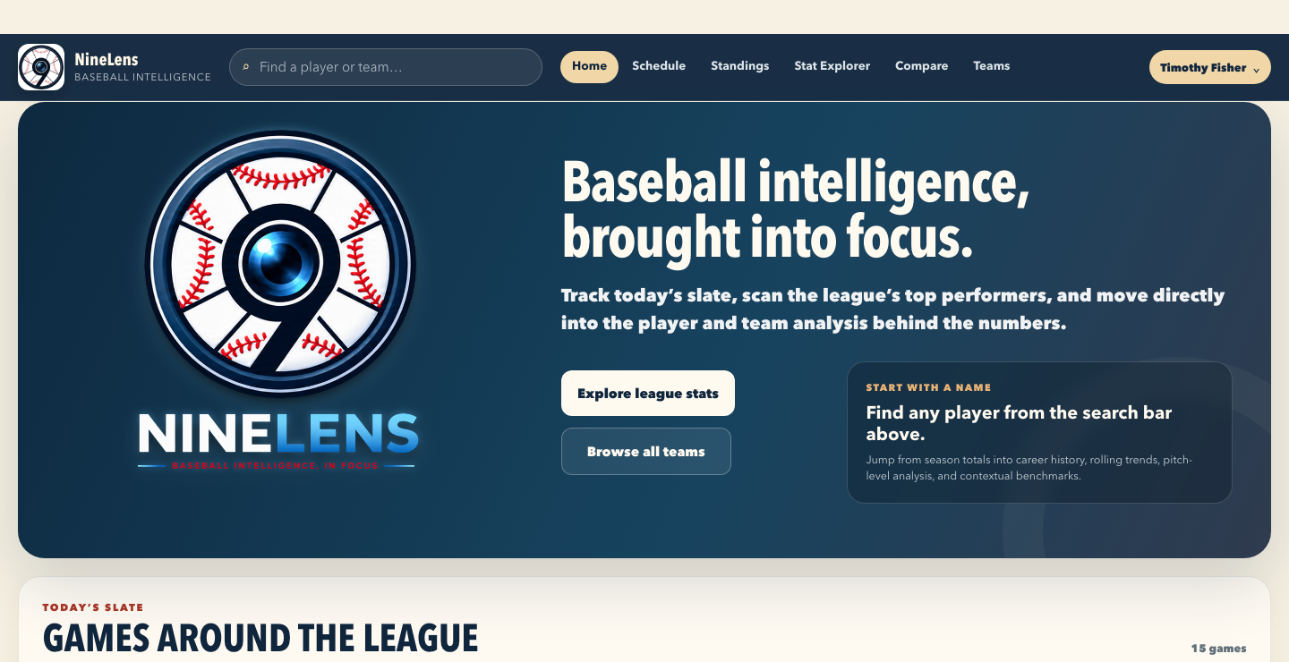
OPEN-SOURCE BASEBALL INTELLIGENCE
NineLens
Baseball intelligence
brought into focus.
A connected workspace for player evaluation, team analysis, game intelligence, and better baseball decisions.
Version 1.0.0
github.com/timothyf/ninelens

Slide 2
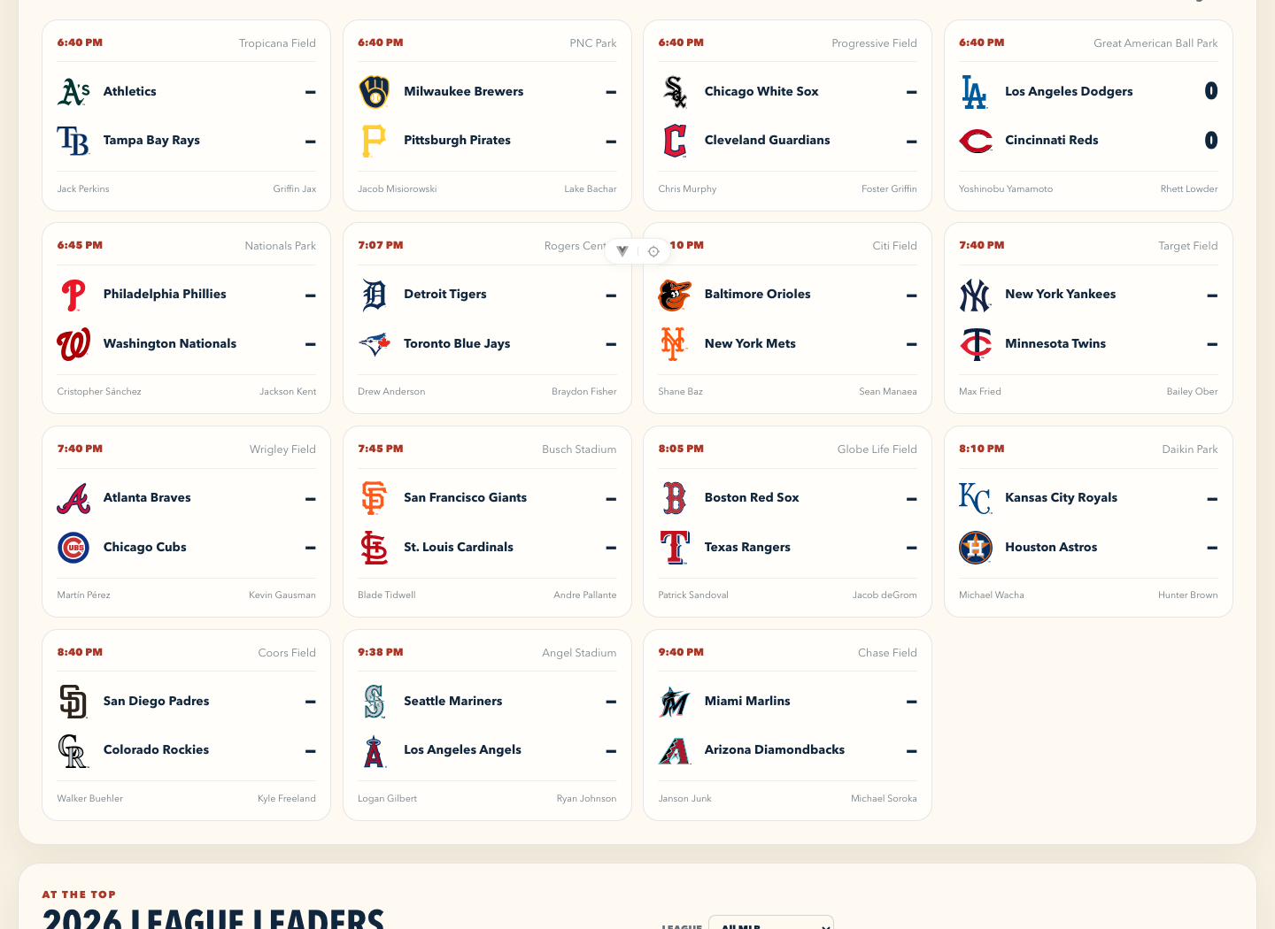
Baseball questions rarely live in one place.
Research starts with a question. The work is connecting the evidence that answers it.
THE PROBLEM
A player’s performance, a team’s needs, and the context of a game are connected. Most workflows make you assemble that connection manually.
NineLens brings the research path into one place: league context, player detail, game evidence, team performance, and staff workflow.
NINELENS • BASEBALL INTELLIGENCE
02

Slide 3
One workspace, four ways to move the work forward.
NineLens connects the information people use to research, evaluate, explain, and act.
Find the signal
Understand the context
Study the evidence
Carry the decision
Search players, teams, schedules, standings, and league leaders.
Compare performance with benchmarks, roles, splits, and recent form.
Move from a game summary into box scores, pitches, batted balls, and situations.
Save analyses, write notes, build watchlists, and evaluate acquisition fit.
NINELENS • BASEBALL INTELLIGENCE
03

Slide 4
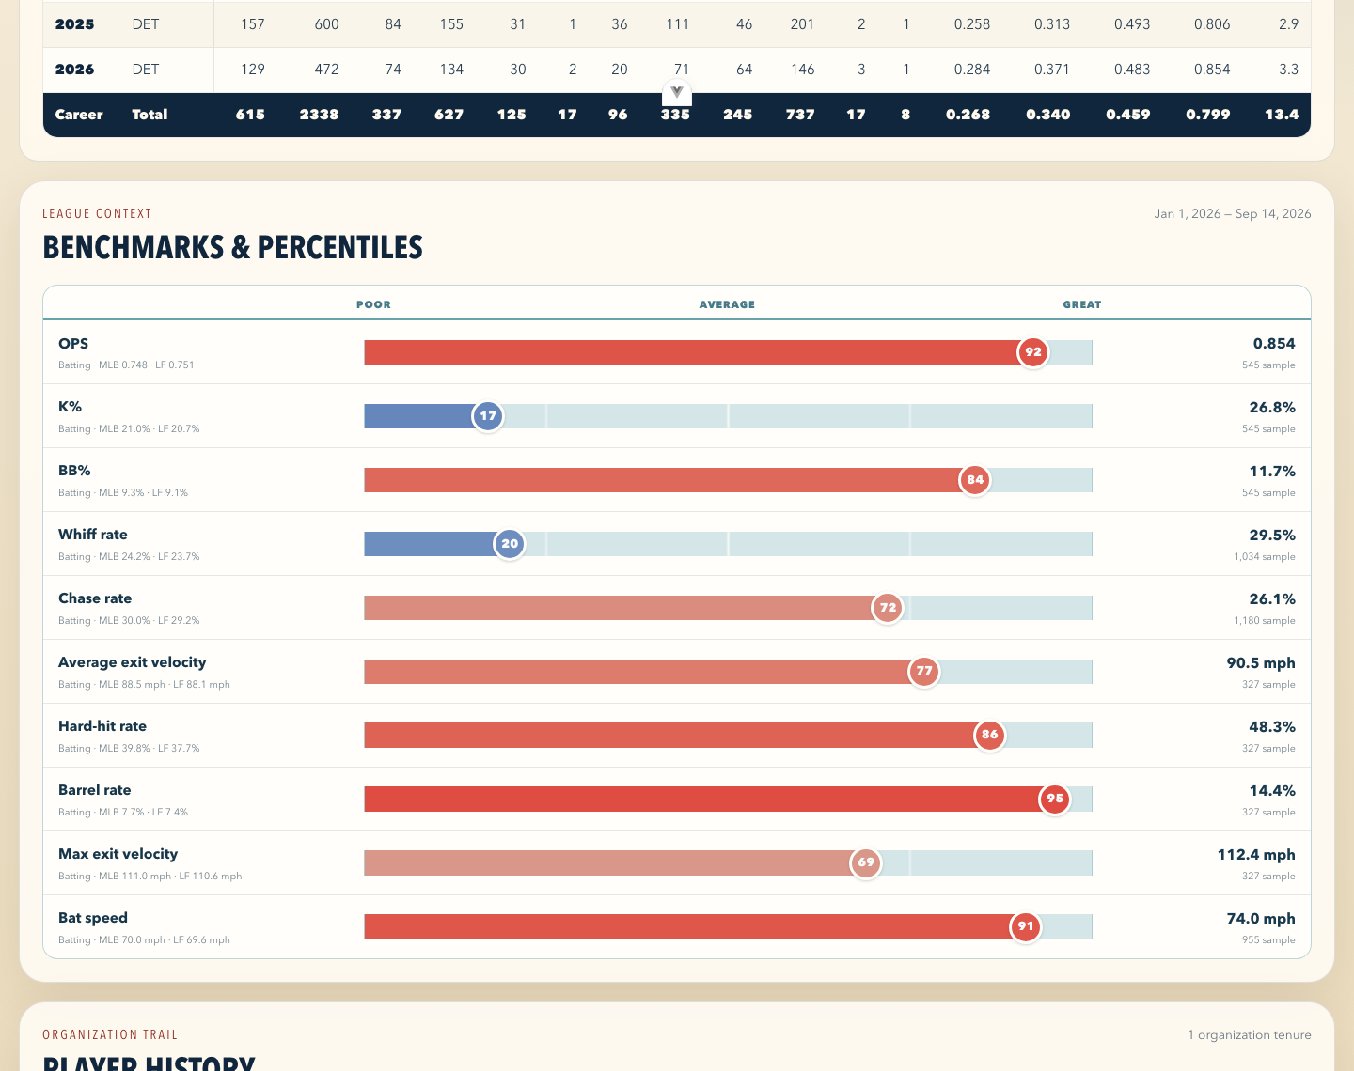
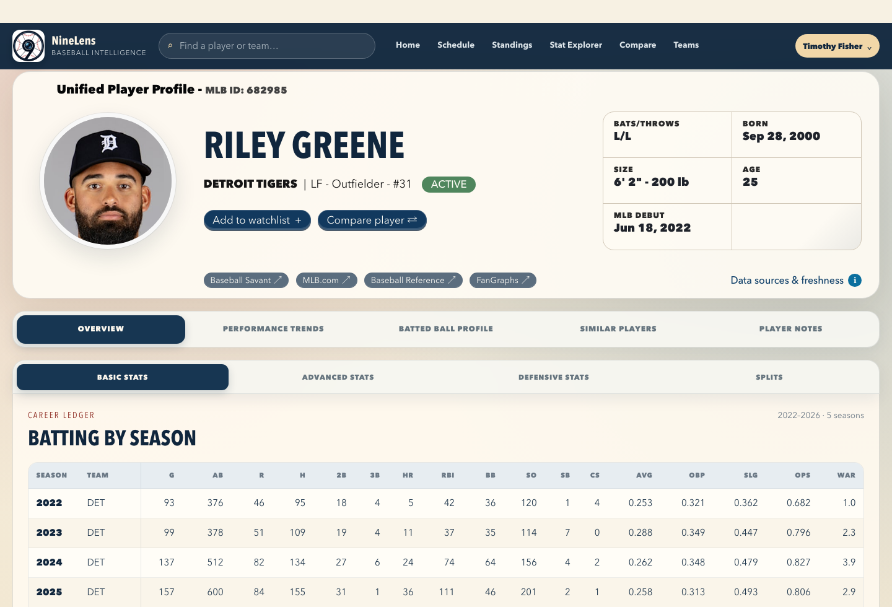
Player profiles turn a stat line into a point of view.
A unified profile connects biography, career production, benchmarks, trends, history, and notes.
EXAMPLE: RILEY GREENE
Career production on top. League context underneath. The same profile carries into trends, similar players, and staff notes.
NINELENS • BASEBALL INTELLIGENCE
04

Slide 5
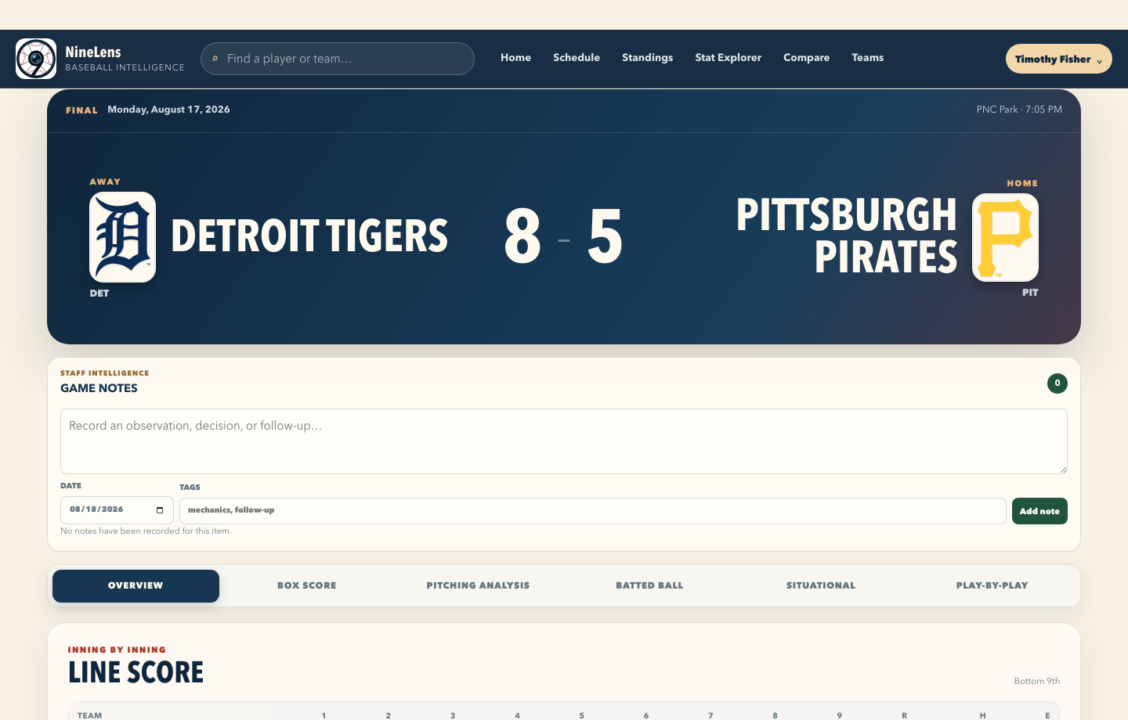
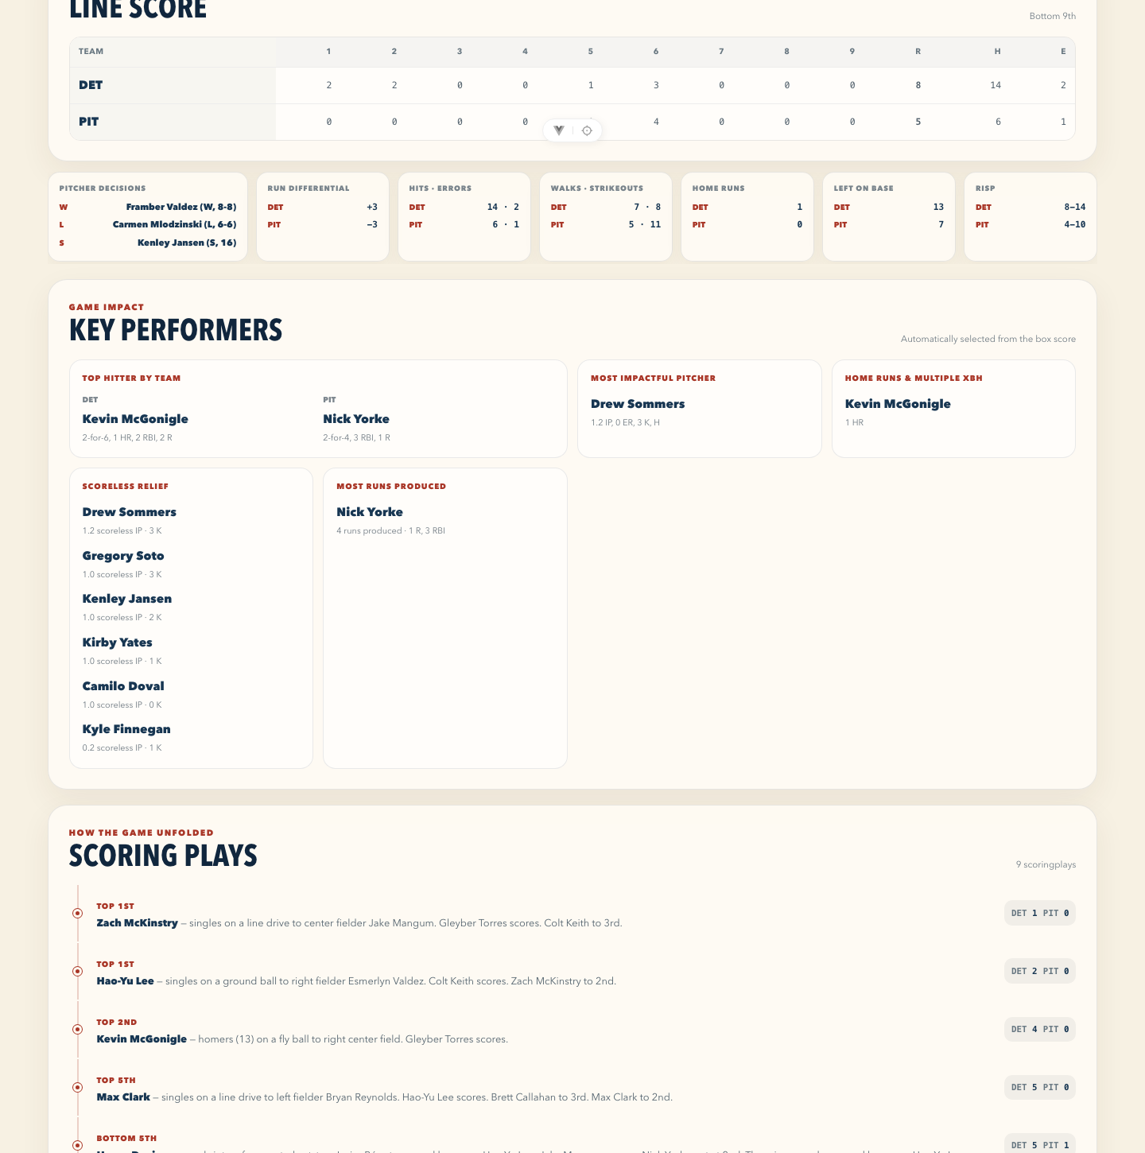
Game intelligence follows the game as it unfolded.
NineLens makes the path from final score to decision-relevant evidence easy to follow.
ONE GAME, SEVERAL LENSES
Overview, box score, pitching analysis, batted ball, situational results, and play-by-play live together on the Game Summary page.
NINELENS • BASEBALL INTELLIGENCE
05

Slide 6
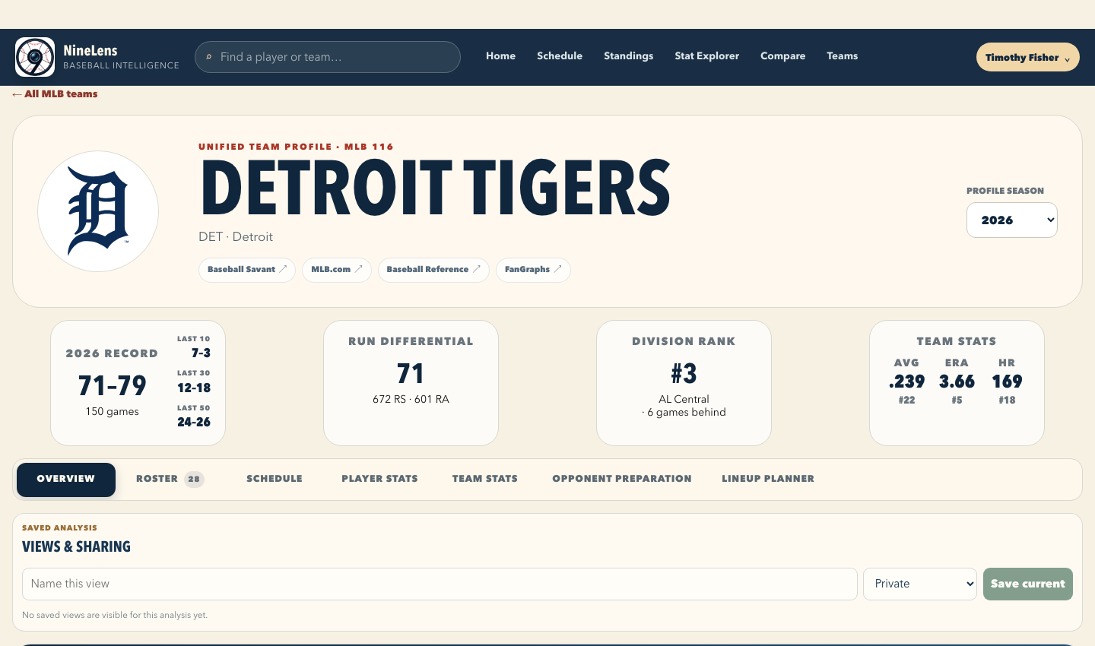
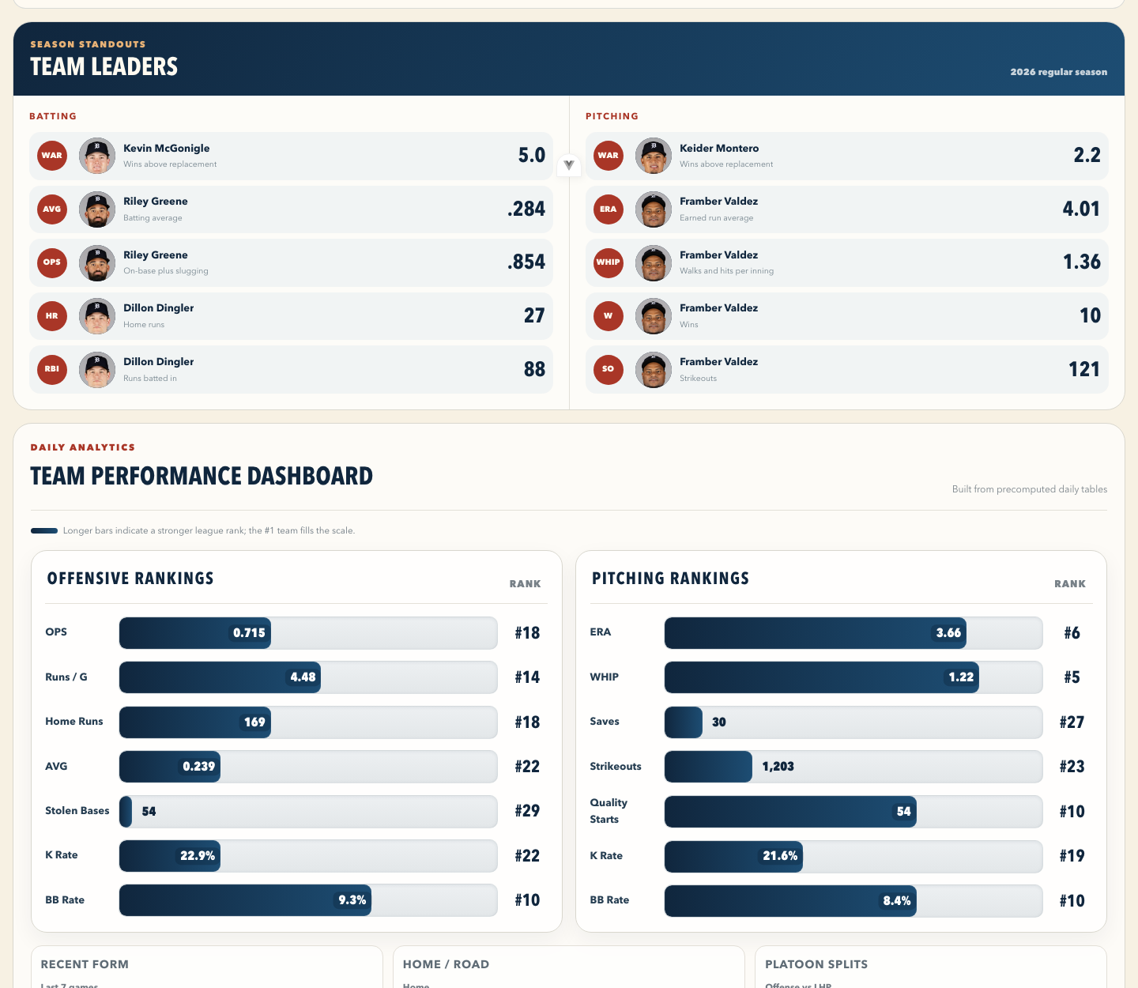
Team profiles connect performance to the next decision.
Team context combines production, rank, recent form, roster, schedule, and decision-support tools.
FROM DASHBOARD TO ACTION
Team Performance Dashboard shows where a club is strong, where it is vulnerable, and how those patterns change over time.
NINELENS • BASEBALL INTELLIGENCE
06

Slide 7
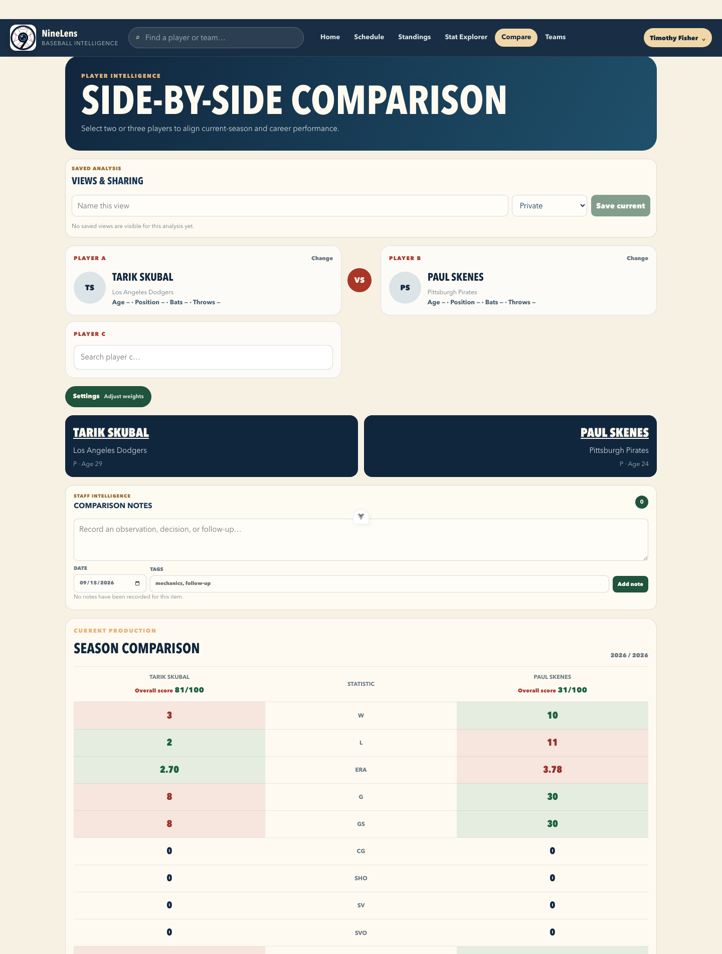
The work stays connected after the analysis.
NineLens is designed for the part of baseball work that happens after the first answer.
DECISION SUPPORT
Compare players side by side, adjust stat weights, save the view, and keep the reasoning with the analysis.
The same workflow extends to watchlists, organizational need profiles, acquisition candidates, lineup scenarios, opponent reports, notes, tags, and audit history.
Research
Evaluate
Explain
Revisit
NINELENS • BASEBALL INTELLIGENCE
07

Slide 8
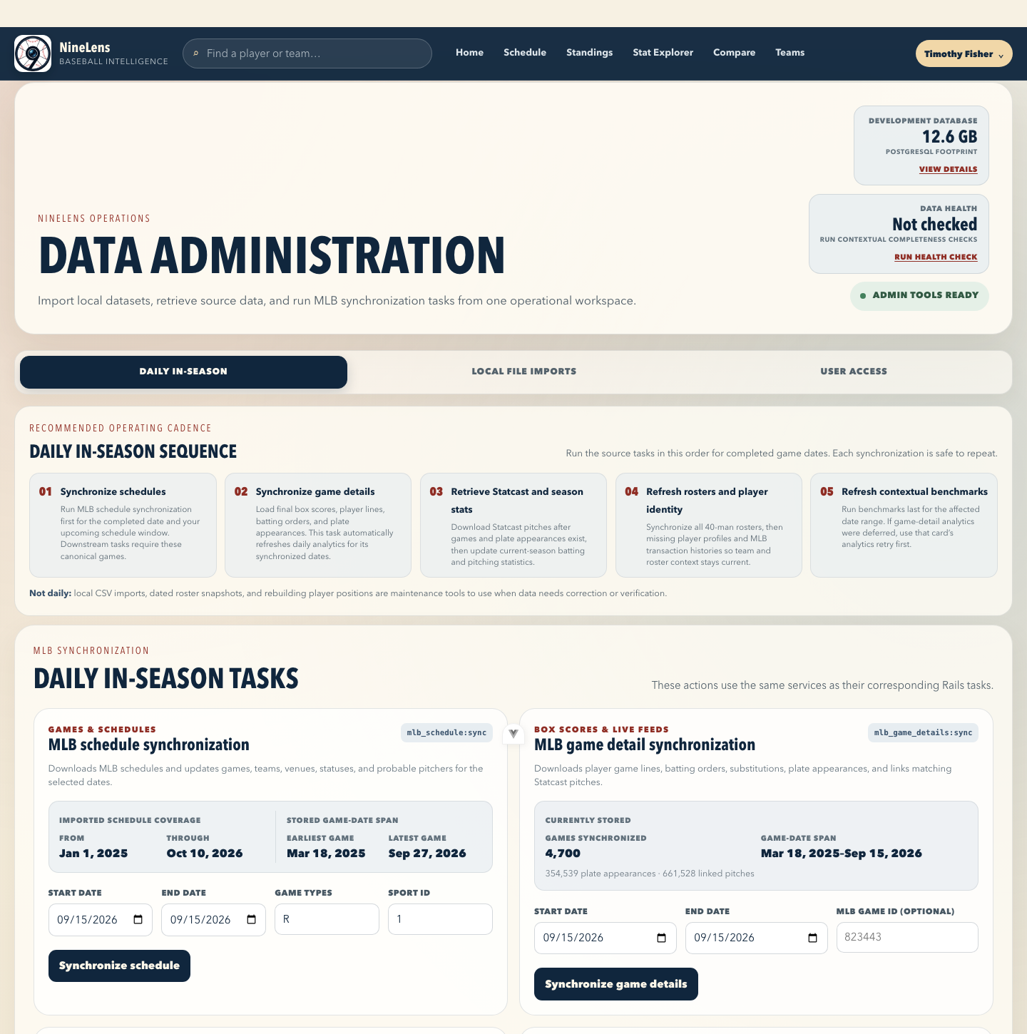
A data workflow built for repeatable research.
NineLens combines source data, calculated analytics, and a searchable interface in one system.
UNDER THE HOOD
Source data enters through repeatable, idempotent workflows.
01
MLB + Statcast
Schedules, games, rosters, profiles, season stats, and pitches.
02
PostgreSQL
Canonical records, historical relationships, and raw source responses.
03
Derived analytics
Daily summaries, benchmarks, percentiles, trends, and coverage checks.
04
Decision surface
Rails API, Vue application, saved views, notes, and staff workflows.
NINELENS • BASEBALL INTELLIGENCE
08

Slide 9
THE FIRST PUBLIC RELEASE
NineLens 1.0.0
A project built to make baseball research more connected, explainable, and useful in the context of real decisions.
Open source. Built from a baseball operations perspective. Ready for the next chapter.
Explore the repository
NineLens
https://github.com/timothyf/ninelens
BASEBALL INTELLIGENCE

