Slide 1


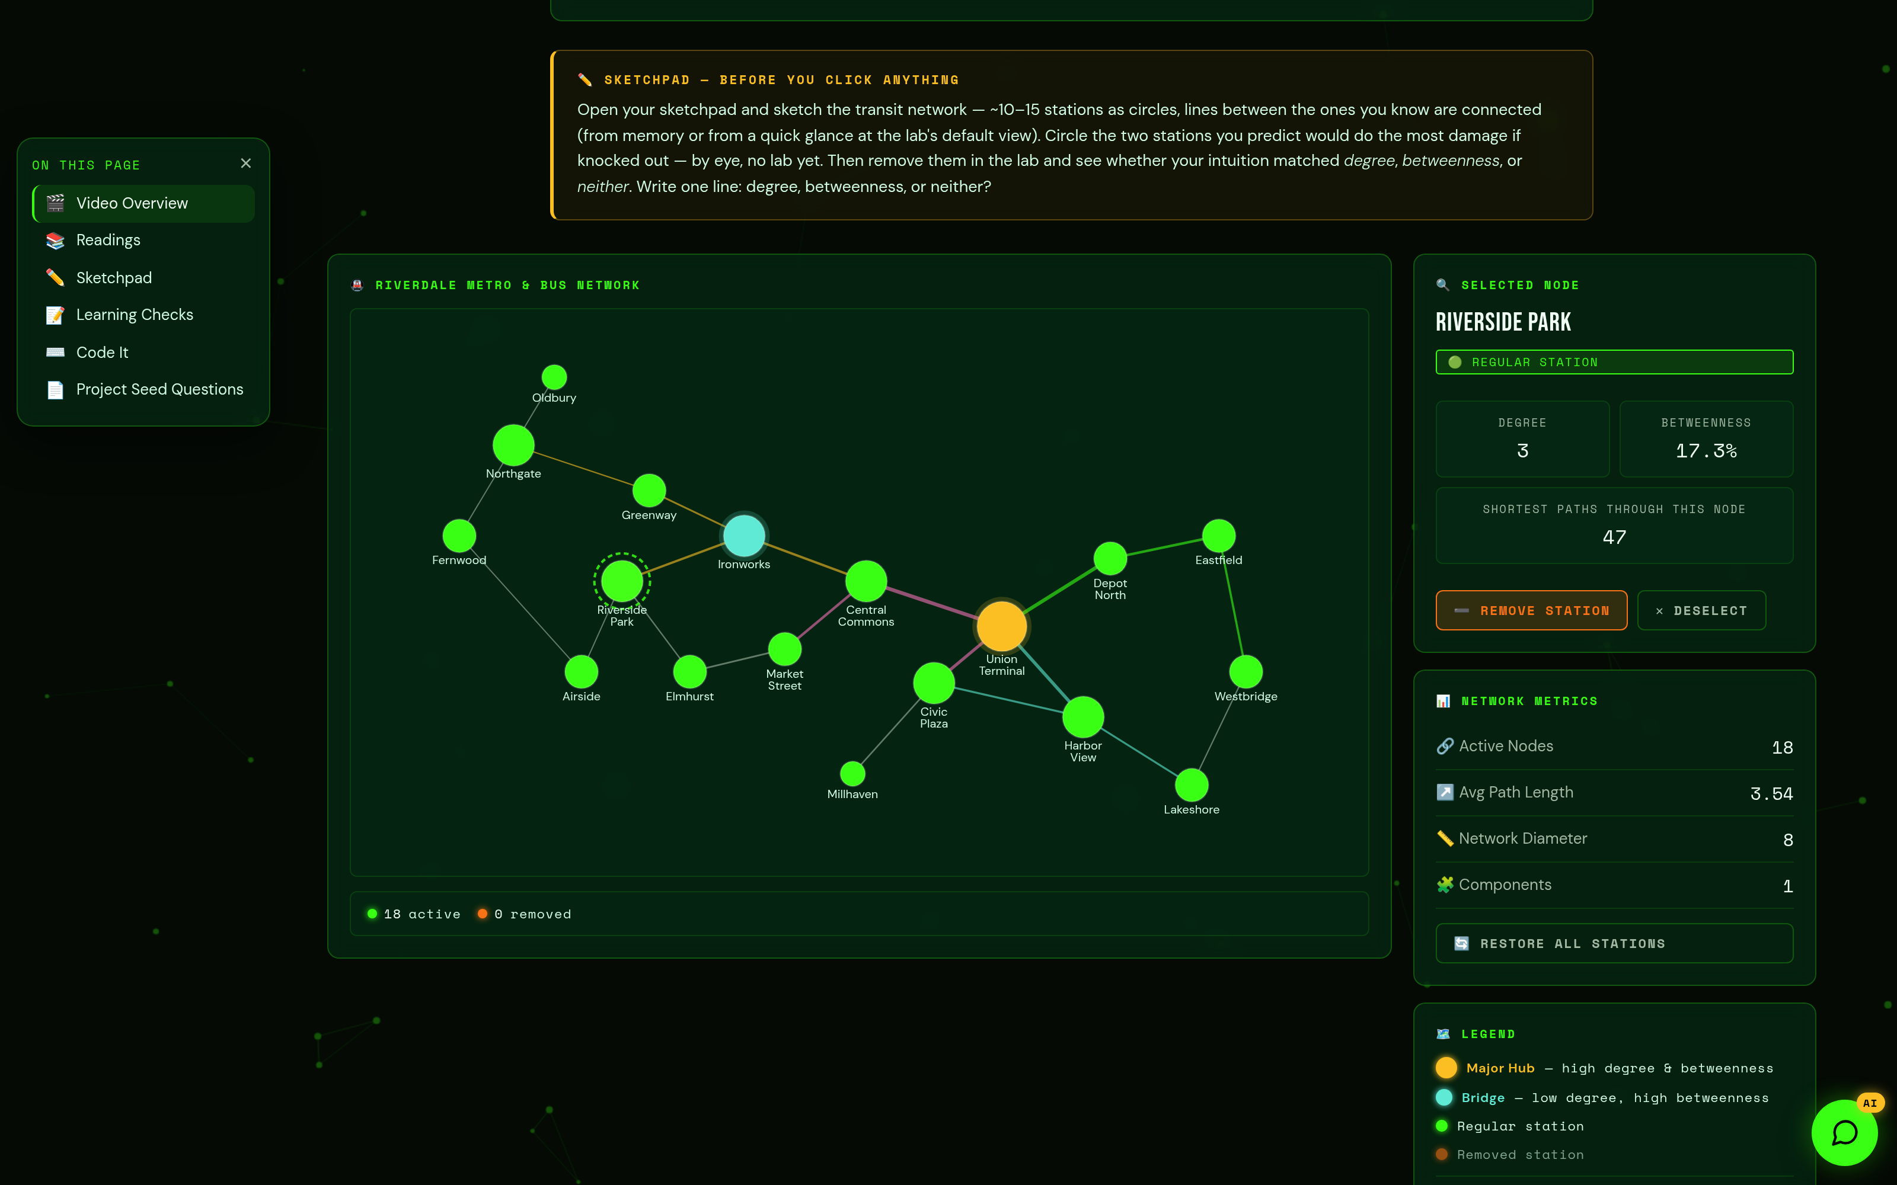
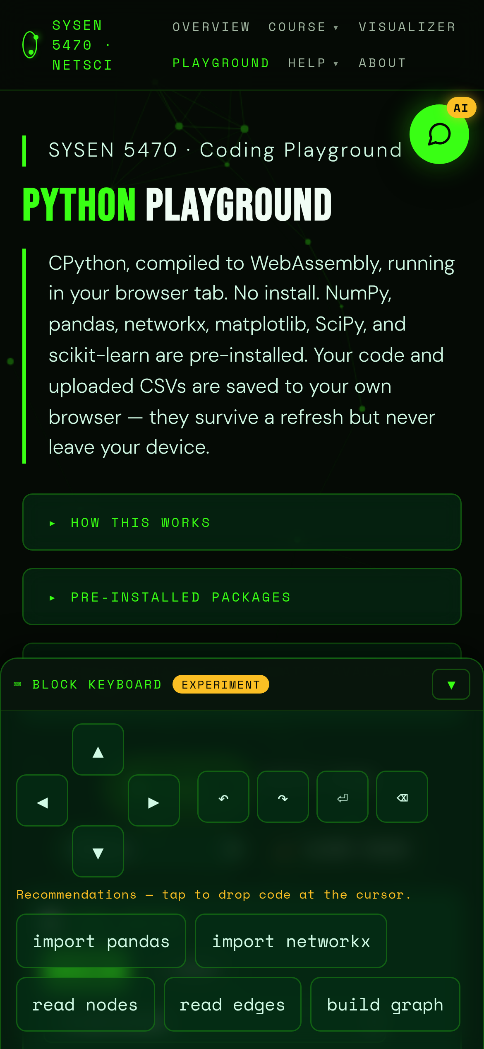
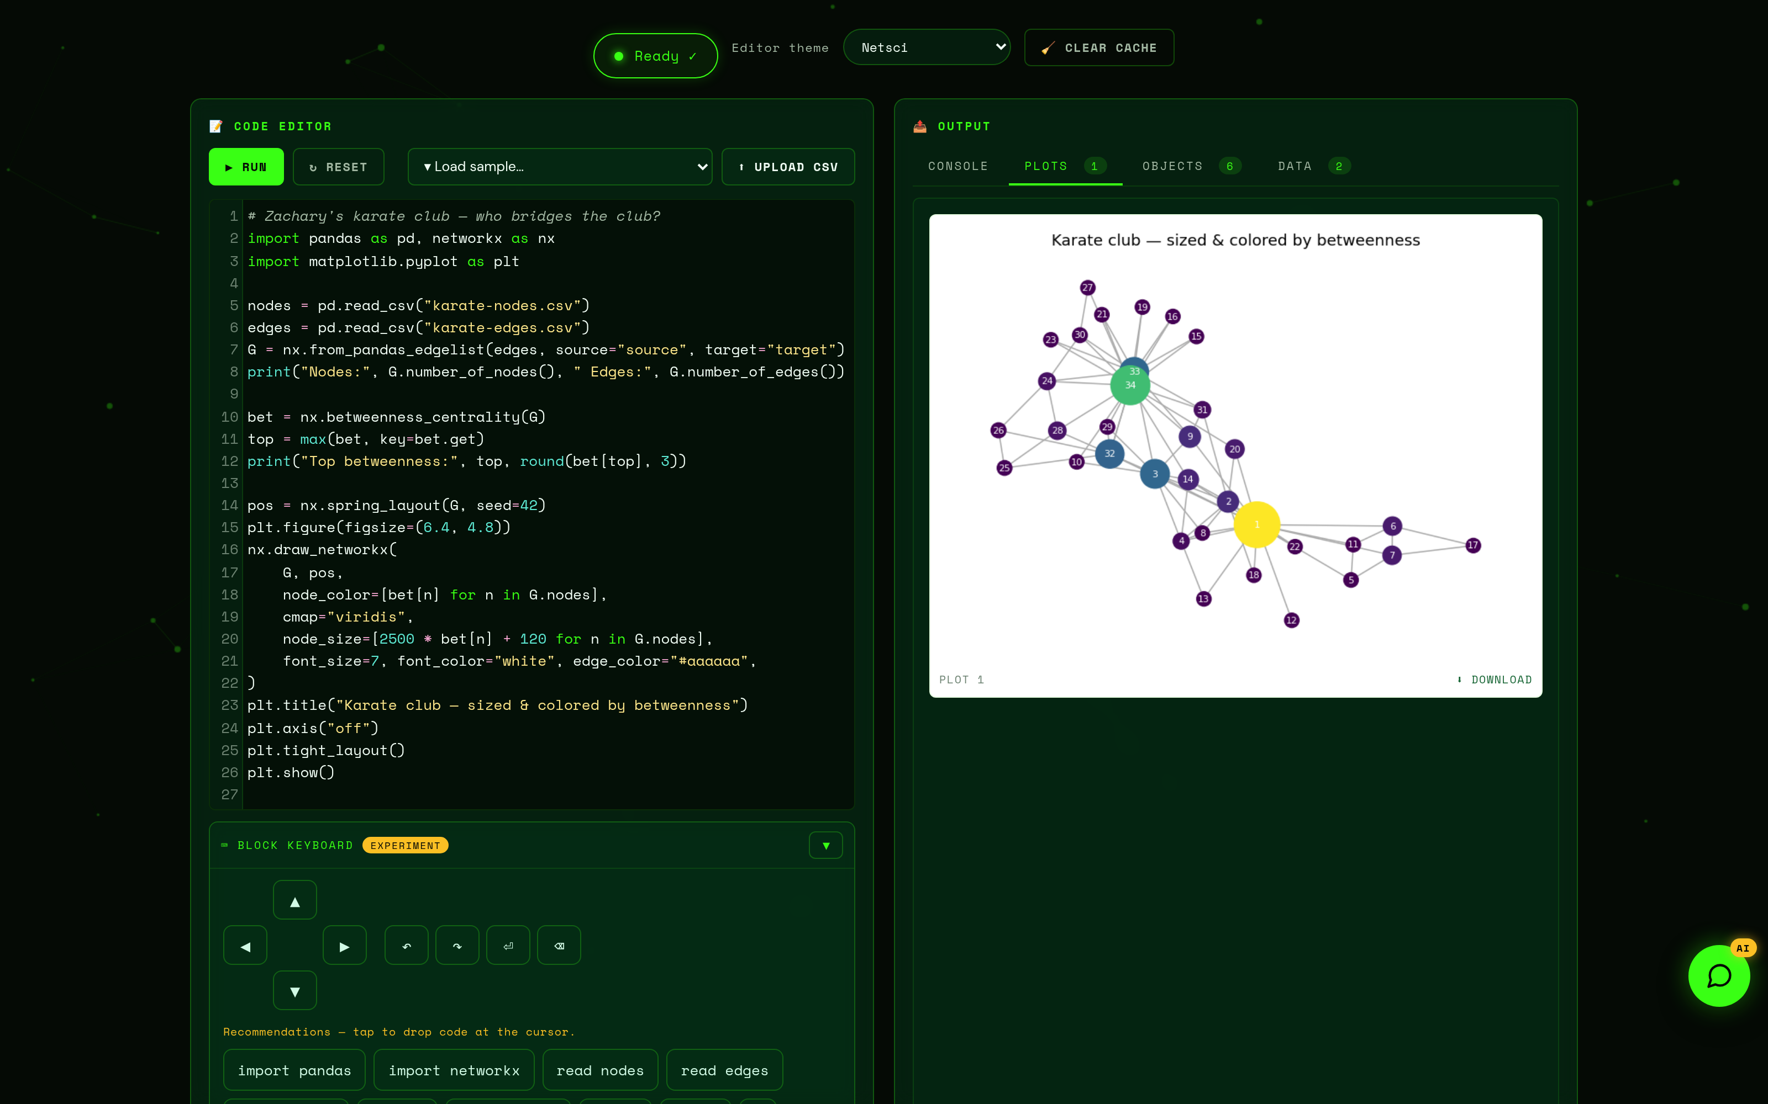
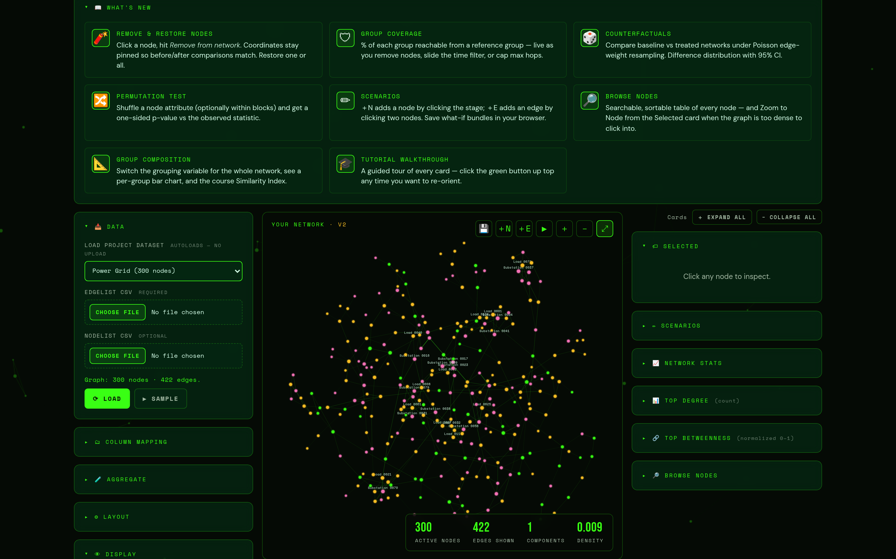


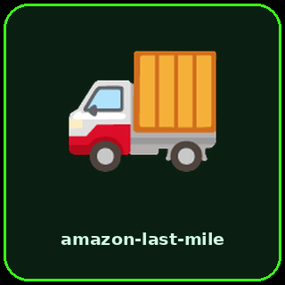
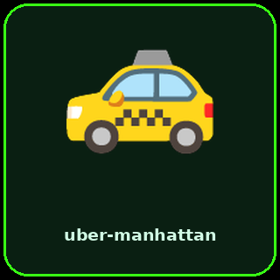



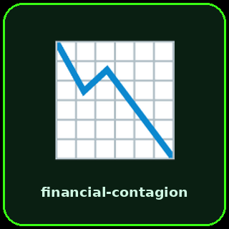
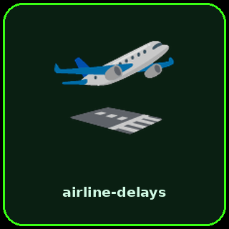
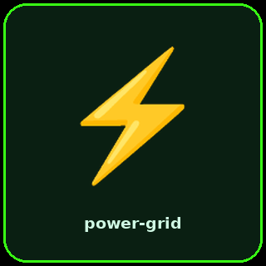



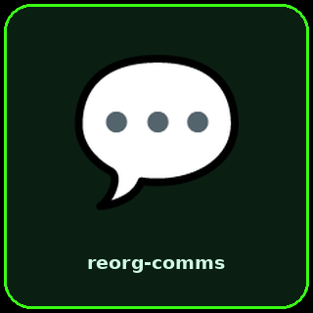
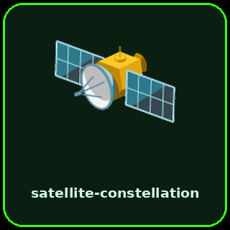
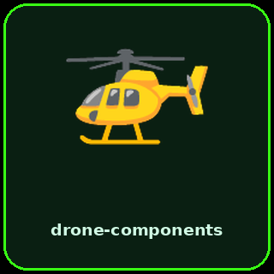
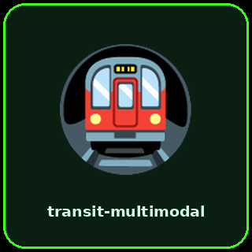

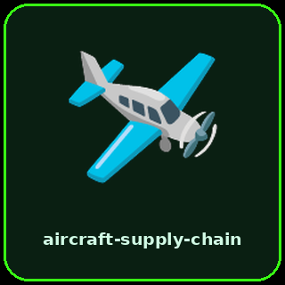
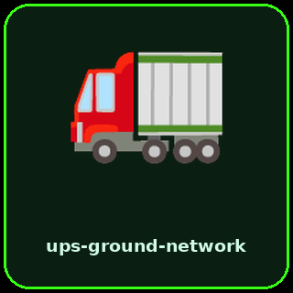
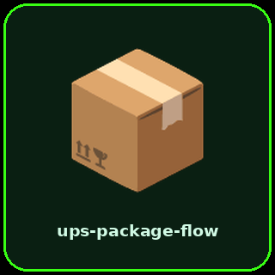


Production-Quality Interactive Course Labs, Built with AI
Tim Fraser, Ph.D.
Systems Engineering · Cornell University
tmf77@cornell.edu · timothyfraser.com/netsci
How AI coding agents let one instructor ship a fully interactive, zero-install course platform — SYSEN 5470: Network Science & Applications for Systems Engineering
11
interactive labs, live on the course site
21
planted-story project datasets
2
languages taught in lockstep (R + Python)
17
packages preloaded in the browser
$0
servers, accounts, or hosting
THE PROBLEM
THE LABS, LIVE — EVERY ONE A MANIPULABLE ARTIFACT, NOT A PDF
WHAT STUDENTS GET
Students learn networks by clicking, breaking, and rebuilding them — not by reading PDFs. But one production-quality interactive lab takes weeks of web engineering: simulation code, instant-feedback questions, mobile support. A full course needs dozens — plus datasets, codebooks, and teaching code in two languages. That is months of engineering no teaching schedule allows.
Real R & Python in the browser — zero install, no accounts, works on any device.
Labs that push back: remove a node, watch the metrics shift, get instant feedback.
Explore visually, then export a complete runnable script and keep going in code.
A Socratic AI study companion that asks questions back instead of giving answers.
THE AI WORKFLOW
Code on a phone. A tap-to-code block keyboard — D-pad cursor, undo/redo, and context-aware code chips — lets students write real code from the bus, the gym, or the back row.
The instructor directs and reviews; AI agents do the engineering.
1
Encode conventions once — Reusable agent "skills" capture teaching style, dataset standards, and the course glossary.
2
AI drafts each artifact — A lab page, a dataset generator, or a matched R + Python teaching script.
3
Verify automatically — Headless-browser tests; answer keys recomputed from the rendered page; R and Python outputs cross-checked to match.
Case-study lab “Why does betweenness matter?” — remove a transit station and watch path lengths, components, and criticality shift live. Learning checks are recomputed from the rendered network, so answers can never drift.
4
Instructor reviews — A pedagogy, tone, and accuracy pass on every artifact before it ships.
Ship free & static — GitHub Pages hosting; CI rebuilds the student repo and AI study companion automatically.
TRY IT RIGHT NOW
5
Built with agentic AI coding tools (Claude Code). Every artifact is verified; none is hand-coded.
In-browser R & Python playgrounds (WebAssembly): real code, real plots, on the student’s own device — no install, no login.
Network Visualizer: point-and-click failure cascades and counterfactuals — then export the runnable script that reproduces every click.
Course site
Network Visualizer
21 synthetic project datasets, generated by AI under a strict codebook standard — each hides a “planted story” that survives naive analysis, and ships with R + Python loaders.
This poster was built with the same AI workflow it describes.

