Slide 1
Genome Viewer
Red Team

Slide 2
Red Team Members
James Dailey
James Ord
Joseph Cooper
Catalin Pop
John Berlin
Tim Holmes
Abhishek Biswas (Mentor)

Slide 3
Genomes
What is a genome?
A set of genetic instructions
Studied via sequencing
All living thing have genomes

Slide 4
Bacteria Genomes
Bacterial pathogens spread disease
M. tuberculosis
Causes Tuberculosis
Infects two billion people worldwide
M. leprae causes leprosy
M. marinum
Damages aquaculture
Causes skin disease in humans
Understanding can lead to cures

Slide 5
Bacterial Genome Sequencing
Genome is shattered into fragments
Fragments reassembled in a circle
Repeated sections cause problems with reassembly

Slide 6
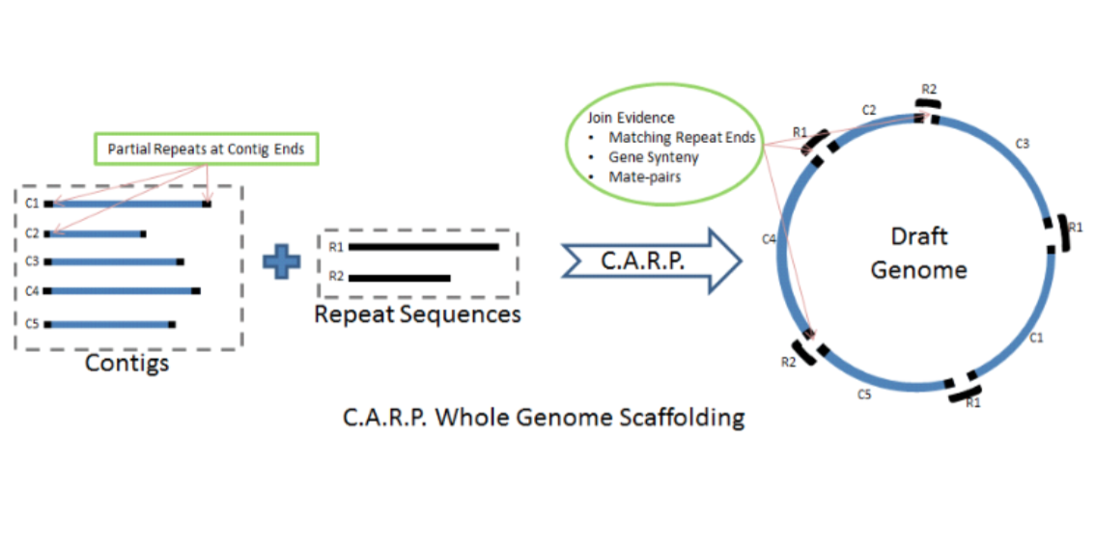
CARP (Correlative Algorithm for Repeat Placement)
Carp lacks a proper User Interface (UI)

Slide 7
Current Solutions Have Issues
Current Genome Viewers:
Do not display reasons behind fragment joins
Do not allow for fragment rearrangement
Standard viewers are not open source
Open source viewers are too specialized
Poor User Interface (UI)

Slide 8
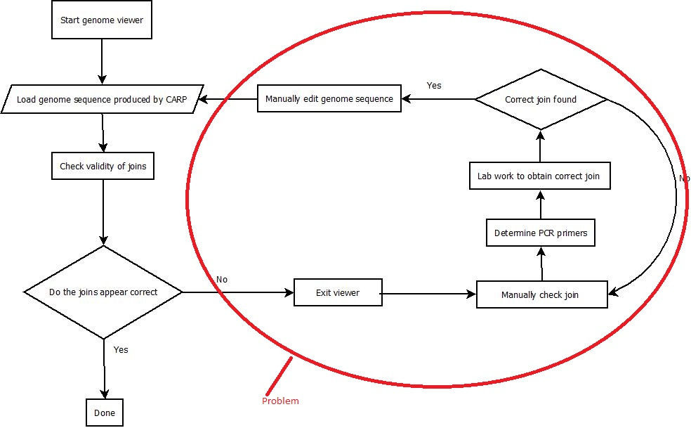
Current Process Flow

Slide 9
Ideal Solution
Ideal solution will:
Display a genome sequence in a circle
Show justifications used for sequence fragments
Have an intuitive interface
Be open source based
Export to GenBank format
National Institute of Health’s genetic sequence database

Slide 10
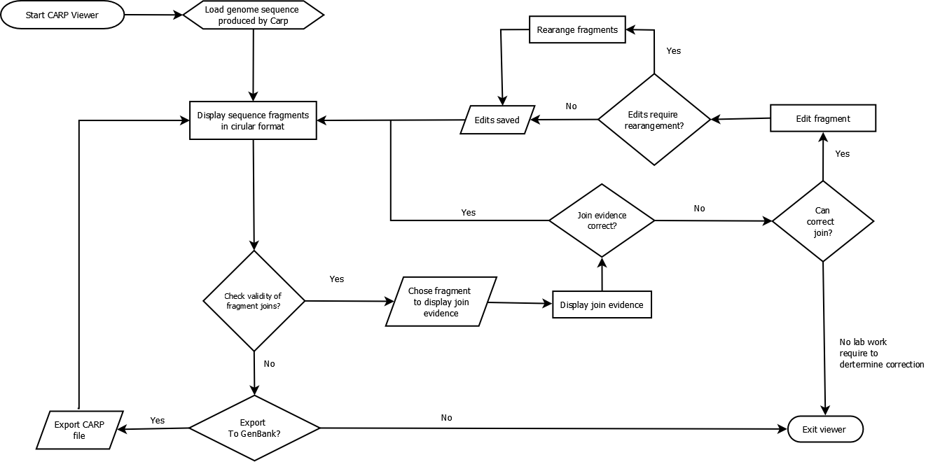
Solution Process Flow

Slide 11
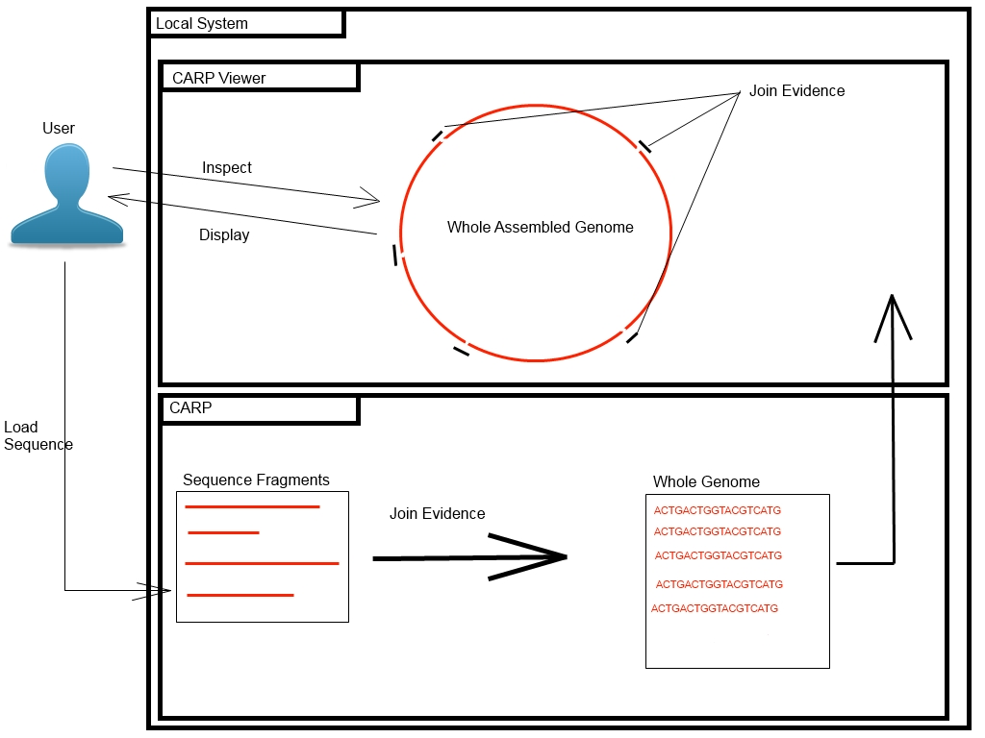
Functional Components

Slide 12
Development Process
Eclipse IDE
javaFX
GitLab
Agile Development Model
2 week sprints
100 man hours per sprint

Slide 13
The Solution Will
Provide genome sequencers with a User Interface
Display genome sequences in a circle
Display evidence used to make each fragment join

Slide 14
The User processes
User will be able to:
Check if join evidence is correct
Edit fragments and rearrange them
Zoom in and out of the genome sequence
Export file to GenBank

Slide 15
Out of Scope
Solution will not:
replace the entire genome sequencer only the UI
Be an application available for mobile usage
Calculate the repeat sequences
Justify the fragment joins

Slide 16
Who will this help?
Biologists who:
Need to sequence bacterial DNA
Use genome sequencers that lack a UI

Slide 17
How will this help?
Save time and money
More work stays “in house”
Open to future development
Auditability

Slide 18
Red Team Management
Website will be kept updated
Weekly meetings with our mentor and the entire team
Use github to create list of issues and assign them to individual members
Setting due dates and ensuring we meet those dates

Slide 19
References
http://www.healthpovertyaction.org/policy-and-resources/the-cycle-of-poverty-and-poor-health/tuberculosis/key-facts-tuberculosis/
http://www.geneious.com
http://wishart.biology.ualberta.ca/cgview/
http://www.ualberta.ca/~stothard/papers/bioinformatics_cgview.pdf
http://gcm.wfcc.info/speciesPage.jsp?strain_name=Mycobacterium%20shottsii
Additional resources available here:
http://www.cs.odu.edu/~410red/resources.html

