Slide 1

Chapter 10
Max-flow Min-cut
Divesh Aggarwal
School of Computing
Department of Computer Science

Slide 2
A classical application
In 1950s, a study regarding the rail network that linked the Soviet Union to its satellite countries in Eastern Europe was published.
The network was modeled as a graph with vertices, representing geographic regions, and edges, representing links between those regions in the rail network. Each edge weight, represents the rate at which material could be shipped from one region to the next.
They determined both the maximum amount of stuff that could be moved from Russia into Europe, and
The cheapest way to disrupt the network by blowing up train tracks, which was called the bottleneck

Slide 3
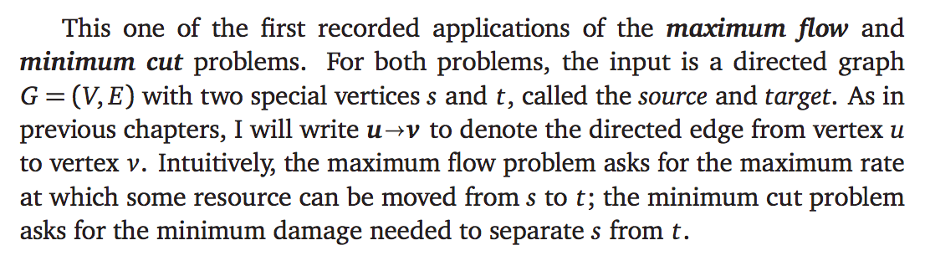
Min-cut and max-flow

Slide 4
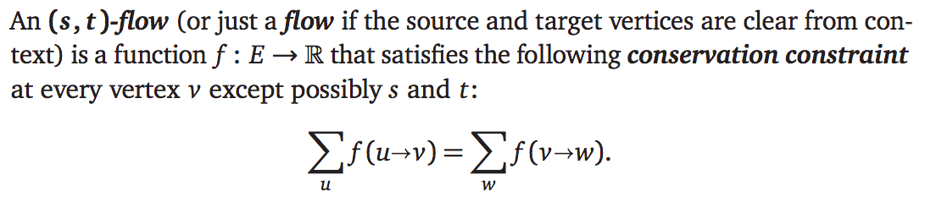
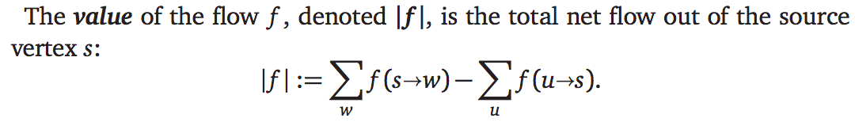
Flows

Slide 5
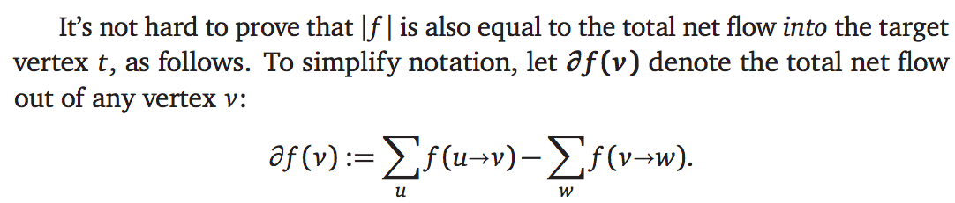

Flows

Slide 6
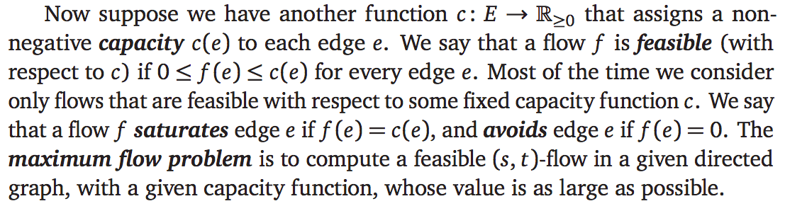
Maximum Flow Problem

Slide 7
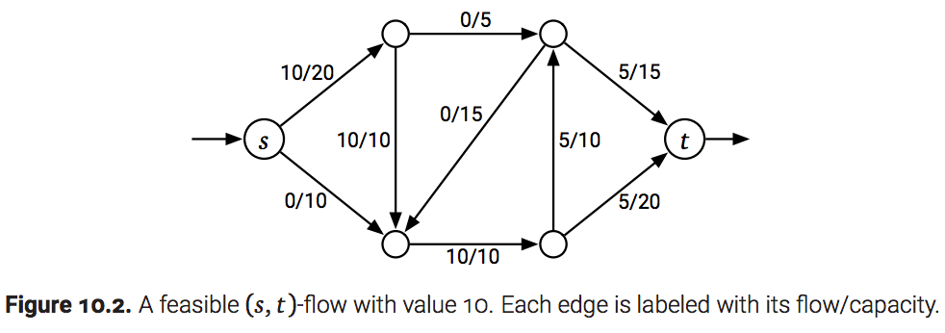
Maximum Flow Problem

Slide 8
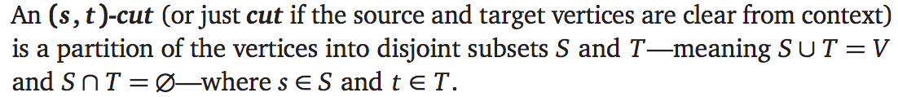
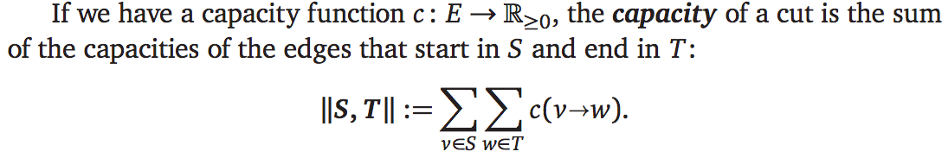
Minimum Cut

Slide 9
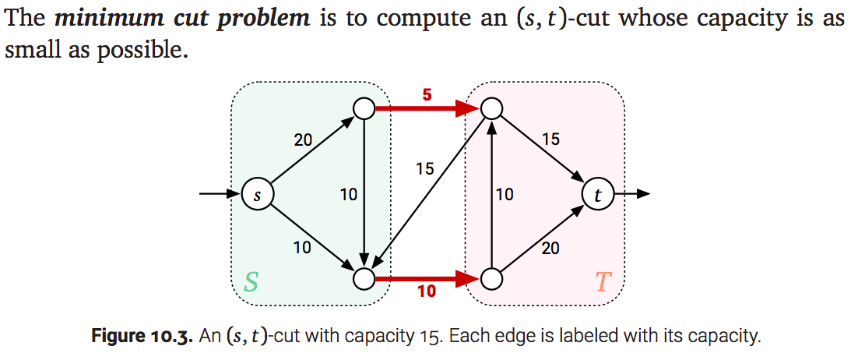
Minimum Cut
Intuitively, the minimum cut is the cheapest way to disrupt all flow from s to t

Slide 10
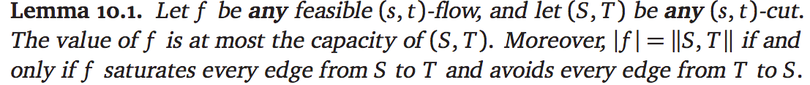
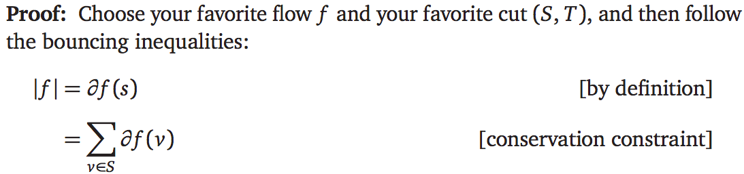
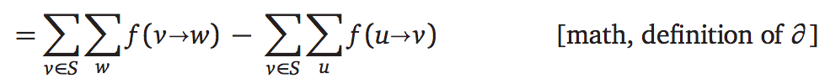

Relation between flows and cuts

Slide 11
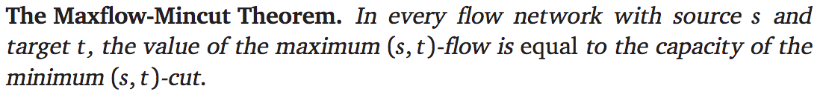
Relation between flows and cuts

Slide 12

Proof of the maxflow-mincut theorem
Intuitively, the residual capacity of an edge indicates how much more flow can be pushed through that edge.

Slide 13
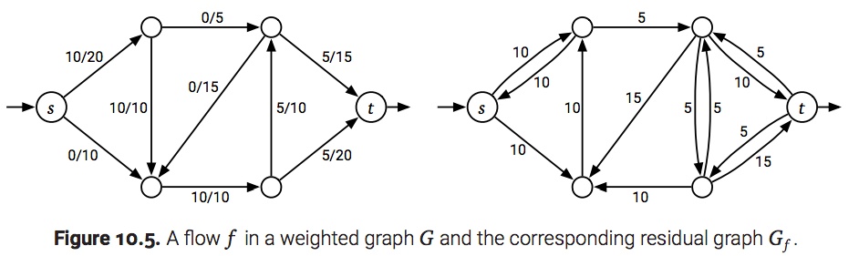
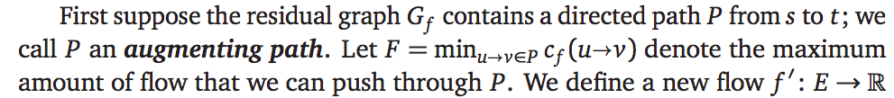
Proof of the maxflow-mincut theorem

Slide 14
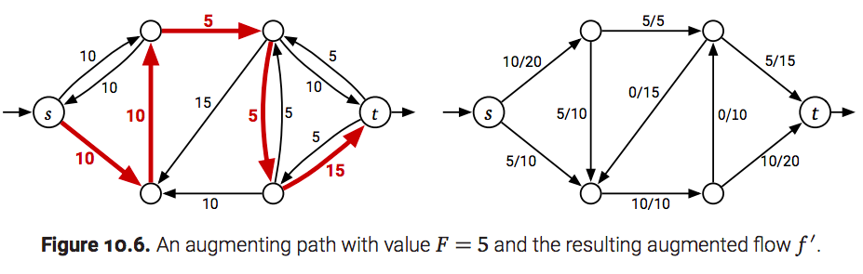
Can send an additional F amount of flow

Slide 15
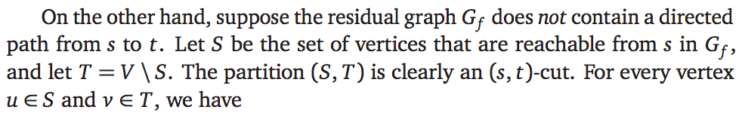
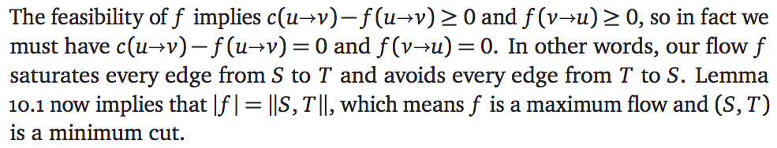
Completing the proof

Slide 16
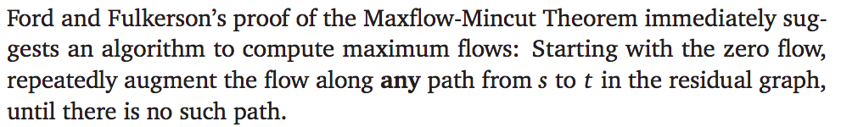
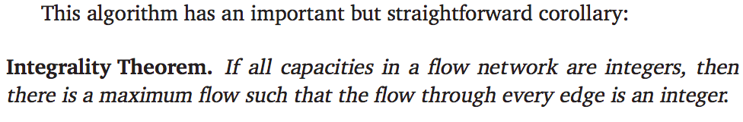
Max-flow algorithm

Slide 17
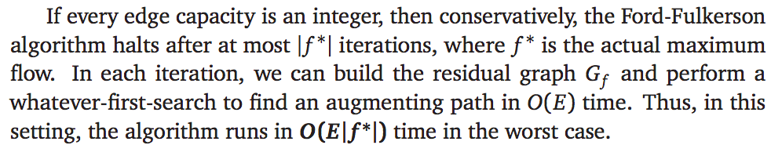
Analysis

Slide 18
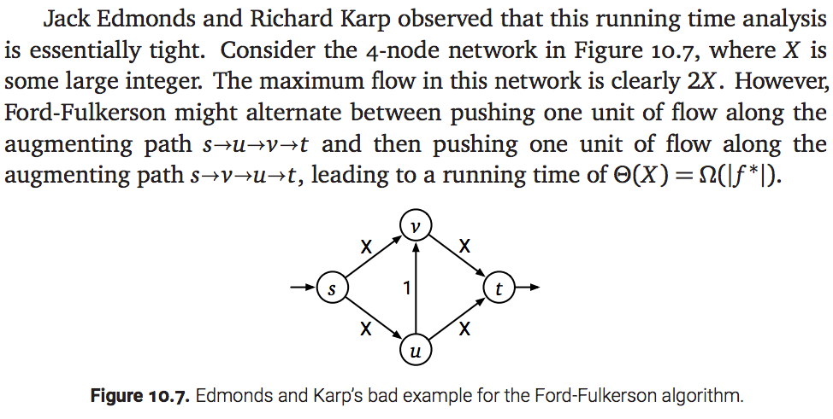
Analysis is tight

Slide 19
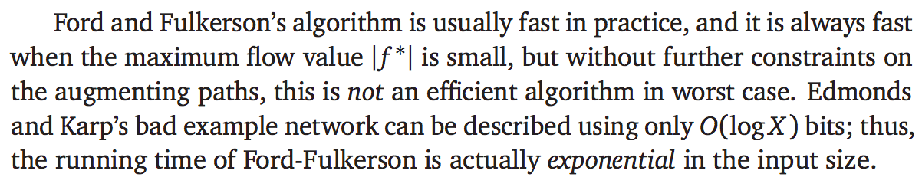
Analysis is tight

Slide 20
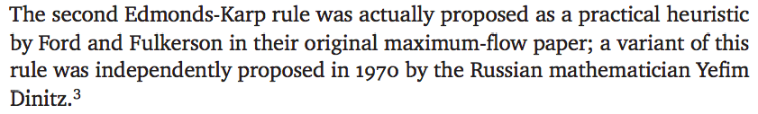

Edmonds’ and Karp’s algorithm

Slide 21
Edmonds’ and Karp’s algorithm
Note that the above doesn’t care about edge weights (as long as it is non-zero)

Slide 22
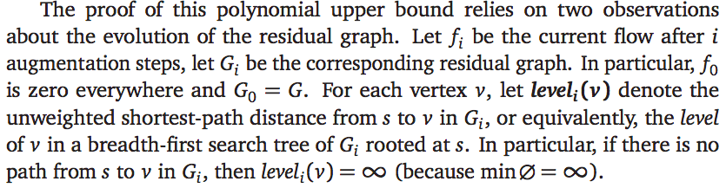
How does the residual graph evolve?

Slide 23

Proof of lemma
If we weren’t adding any edges, then the proof would be trivial. But, we add the edge (v,u) in the residual graph if the edge (u,v) is added to the flow
We prove the claim by induction on level_{i}(v) (and not on the integer i).
As an inductive hypothesis, assume for every vertex u such that
level_{i}(u) < level_{i}(v), that level_{i}(u) $≤$ level_{i-1}(u).

Slide 24
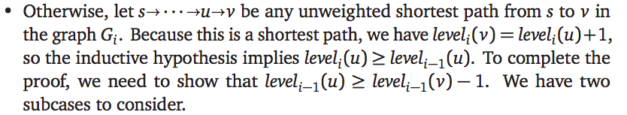
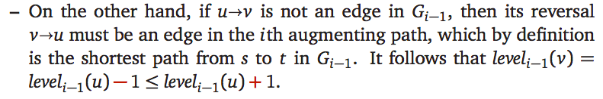
Proof of lemma

Slide 25
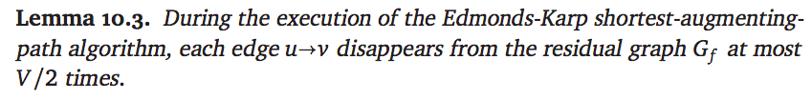
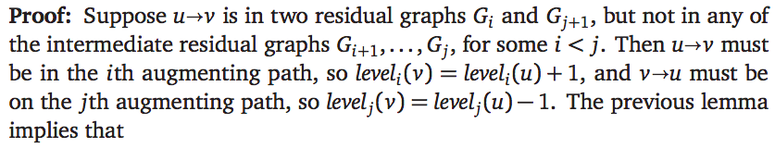
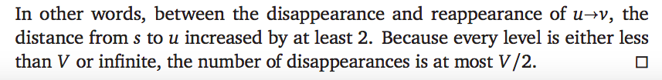
Edges cannot disappear/reappear too often

Slide 26
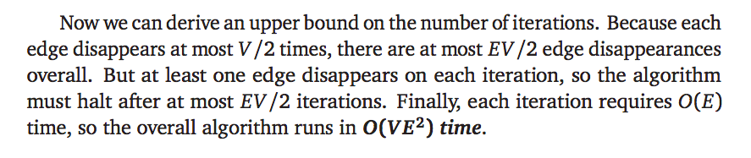
Analysis

Slide 27
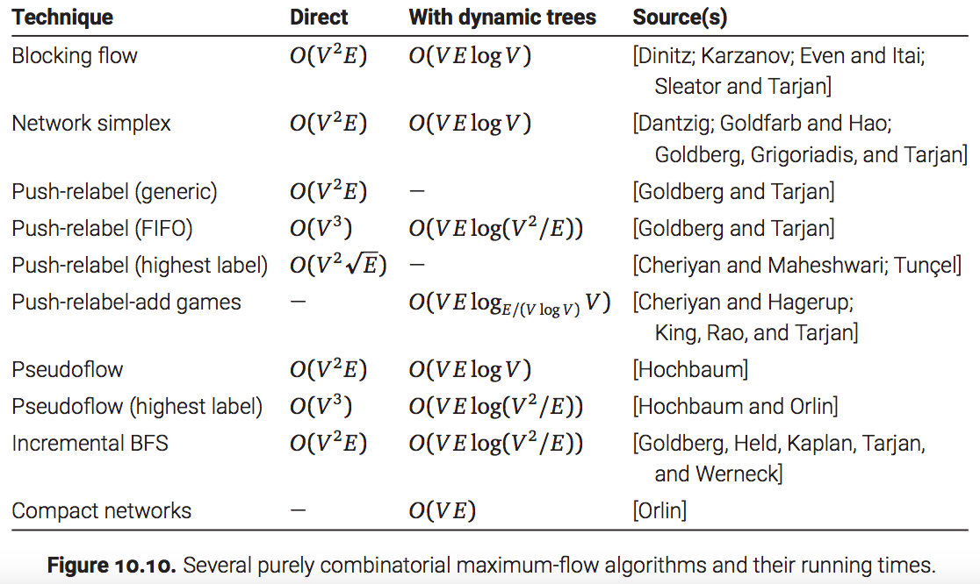
Progress on max-flow algorithms

Slide 28

Best known algorithm
The fastest known (purely combinatorial) maximum-flow algorithm, announced by James Orlin in 2012, runs in O(VE) time, exactly matching the worst-case complexity of a flow decomposition. The details of Orlin’s algorithm are far beyond the scope of this module.
Nevertheless, for the purpose of analyzing algorithms that use max flows, we will use the following:

Slide 29
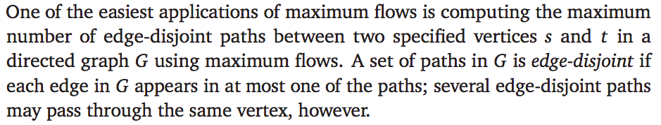
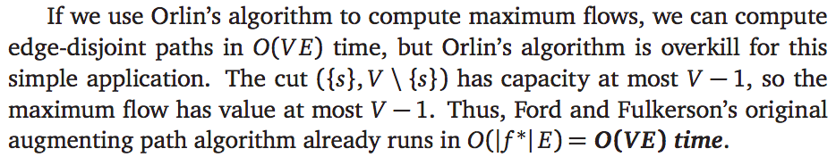
Edge disjoint paths
If we give each edge capacity 1, then max flow from s to t is the maximum number of edge disjoint paths from s to t.

Slide 30
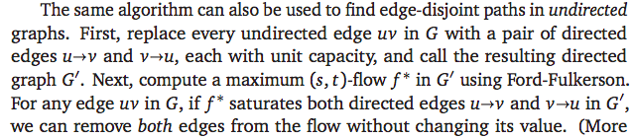
For undirected graphs

Slide 31
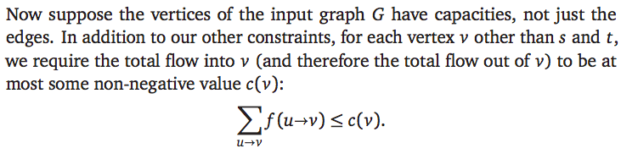
Vertex capacities

Slide 32
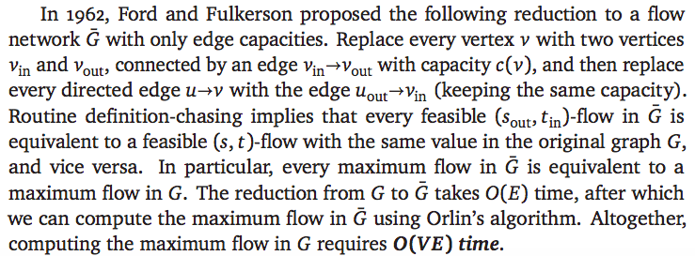
From vertex capacities to edge capacities

Slide 33

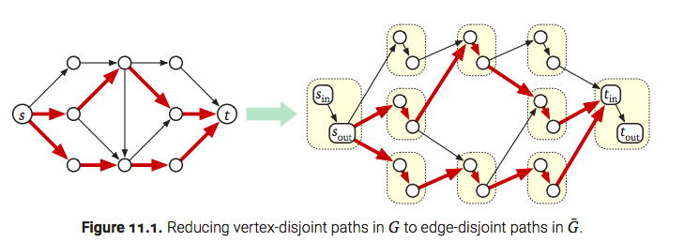
Vertex disjoint paths

