Slide 1

Chapter 7
Minimum Spanning Trees
Divesh Aggarwal
School of Computing
Department of Computer Science

Slide 2
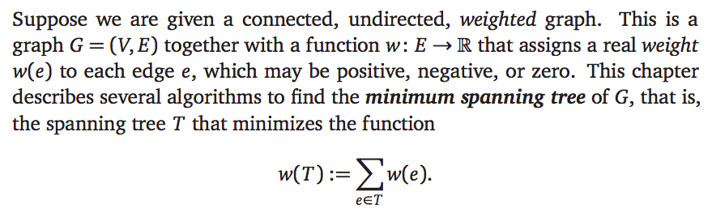
Minimum spanning tree

Slide 3
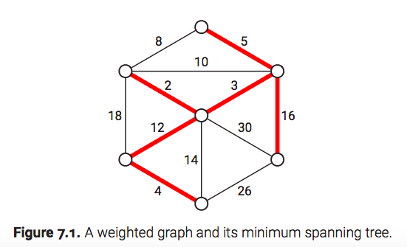
Minimum spanning tree

Slide 4
Minimum spanning tree
Let T, T’ be two distinct trees, and let e be the smallest weight edge that is in T but not T’, and e’ be the smallest weight edge in T’ but not in T. Assume wt(e) < wt(e’)
Consider G = T’ {e}. This graph contains one cycle C, containing the edge e. Removing any one edge from this cycle gives a spanning tree.
Let e’’ be the largest weight edge in C that is not in T. Then either weight(e’’) > weight(e), which contradicts the optimality of T’, or weight(e’’) < weight(e) which contradicts the minimality of e’.

Slide 5
Minimum spanning tree
Let T, T’ be two distinct trees, and let e be the smallest weight edge that is in T but not T’, and e’ be the smallest weight edge in T’ but not in T. Assume wt(e) < wt(e’)
Consider G = T’ {e}. This graph contains one cycle C, containing the edge e. Removing any one edge from this cycle gives a spanning tree.
Let e’’ be the largest weight edge in C that is not in T. Then either weight(e’’) > weight(e), which contradicts the optimality of T’, or weight(e’’) < weight(e) which contradicts the minimality of e’.

Slide 6
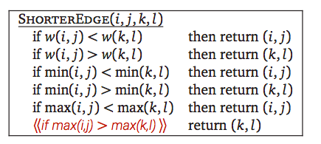
Distinct edge weights not necessary
If we already have an algorithm that assumes distinct edge weights, we can still run it on graphs where some edges have equal weights, as long as we have a consistent method for breaking ties. For example,
So, we will assume that the MST is unique by making the above assumption.

Slide 7
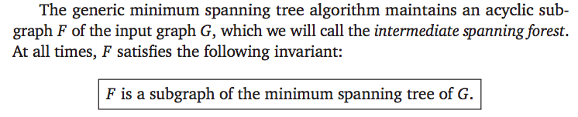
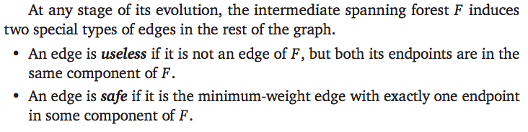
The generic MST Algorithm

Slide 8
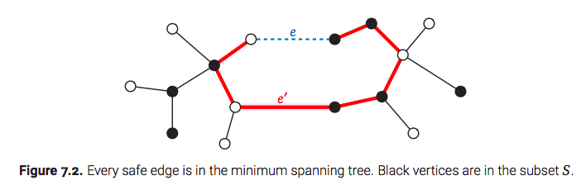
Safe edges must be included
Suppose there is an edge e =(u,v) that is a minimum weight edge with one endpoint in S, where S is a subset of the vertices. We claim that e must be in the MST. Suppose e is not in the MST T. Then, consider a path in T from u to v. Consider the edge e’ in T from a vertex in S to a vertex not in S. Then, replacing e’ by e gives a spanning tree with smaller weight.

Slide 9
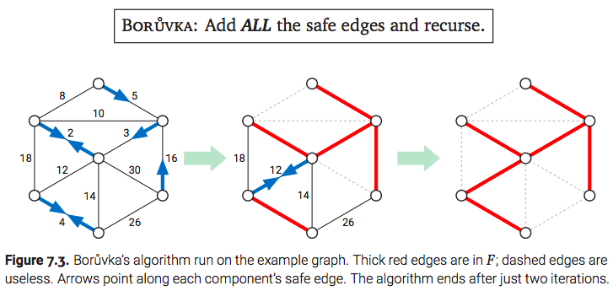
Boruvka’s algorithm
The oldest and arguably simplest minimum spanning tree algorithm was discovered by the Czech mathematician Otakar Boruvka in 1926.

Slide 10
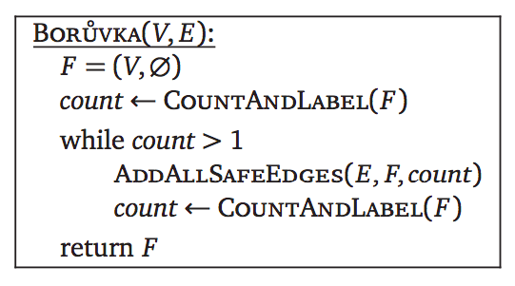
Boruvka’s algorithm

Slide 11
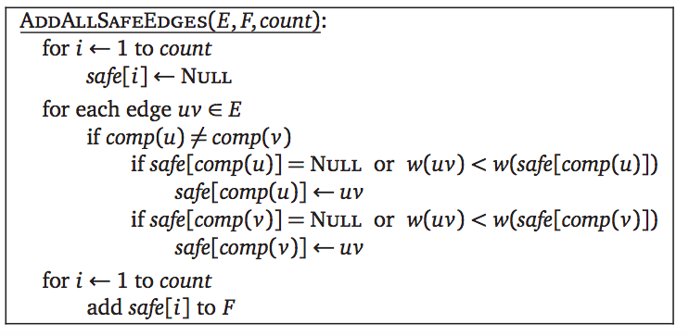
Boruvka’s algorithm

Slide 12
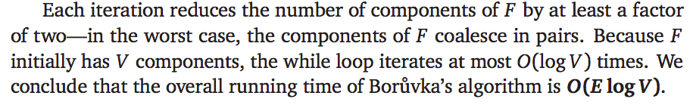
Complexity analysis and remarks
Boruvka’s algorithm runs much faster than O(E log V) in practice
Boruvka’s algorithm runs in O(E) for many graphs
This algorithm is much easier to parallelize
We will study other algorithms which are provably faster

Slide 13

Jarnik’s(Prim’s) algorithm

Slide 14
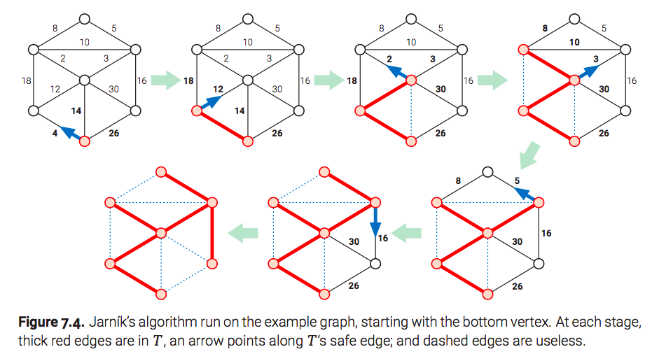
Jarnik’s(Prim’s) algorithm

Slide 15
Time complexity
To implement Jarník’s algorithm, we keep all the edges adjacent to T in a priority queue. When we pull the minimum-weight edge out of the priority queue, we first check whether both of its endpoints are in T. If not, we add the edge to T and then add the new neighboring edges to the priority queue. runs in O(E log E) = O(E log V) time

Slide 16
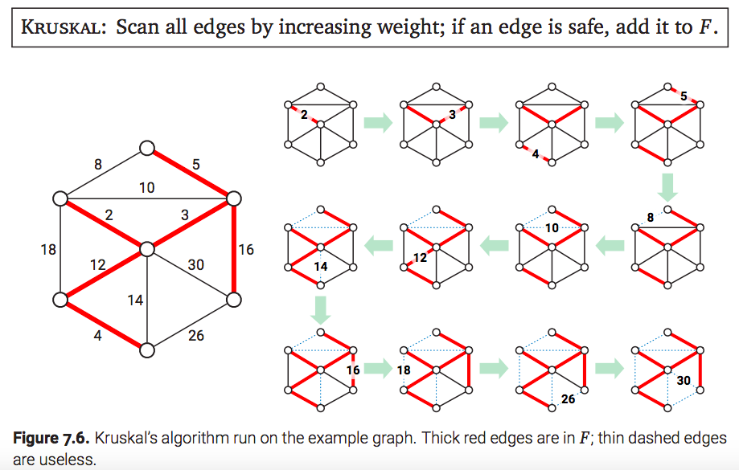
Kruskal’s algorithm

Slide 17
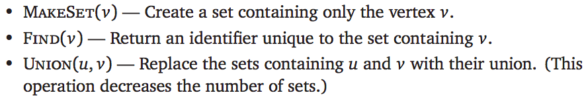
Kruskal’s algorithm
Kruskal’s algorithm makes use of the following functions:

Slide 18
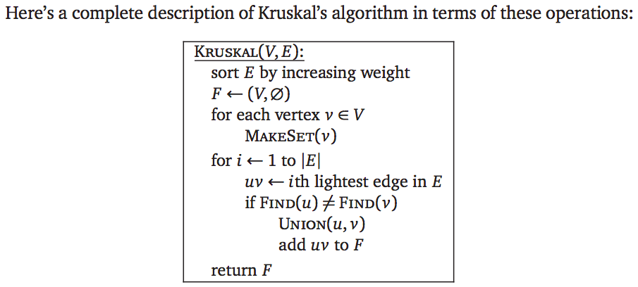
Kruskal’s algorithm

Slide 19
Complexity analysis
After the initial sort, the complexity is dominated by the total time taken for the UNION operation. When two components are joined by an edge, the smaller component inherits the label of the larger component; that is, we traverse the smaller component (via whatever-first search). This traversal requires O(1) time for each vertex in the smaller component. Each time the component label of a vertex changes, the component of F containing that vertex grows by at least a factor of 2; thus, each vertex label changes at most O(log V) times. It follows that the total time spent updating vertex labels is only O(V log V).

Slide 20
Chapter 7
Shortest Paths
Divesh Aggarwal
School of Computing
Department of Computer Science

Slide 21
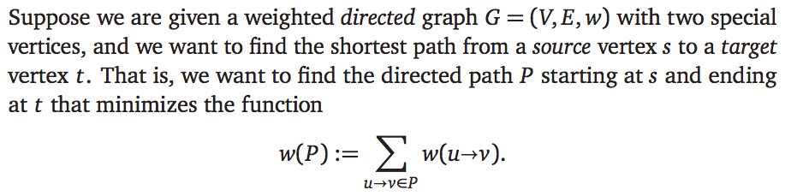
Shortest path in directed graphs

Slide 22
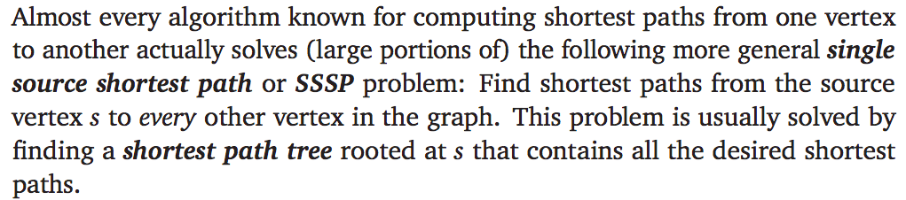
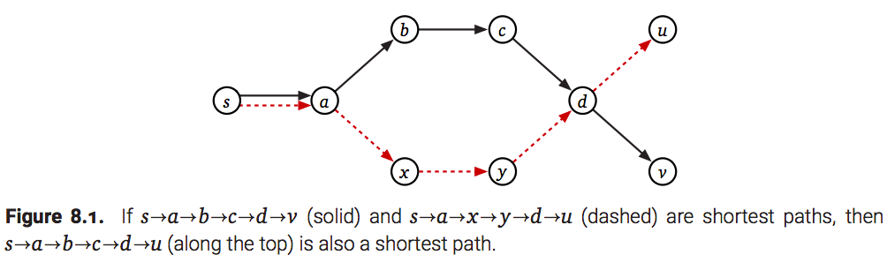
Shortest path in directed graphs

Slide 23
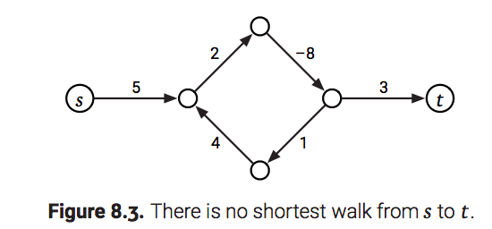
Negative cycles imply no shortest path

Slide 24
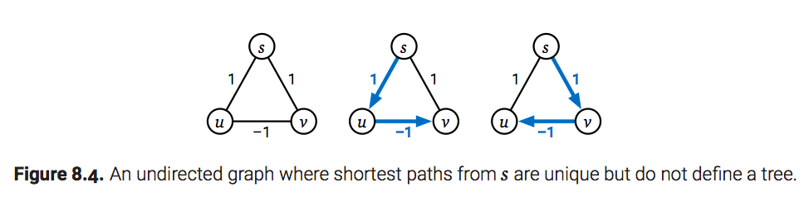
We will assume directed graphs
Undirected graphs with negative edge implies a negative cycle with two vertices
Subpaths of an undirected shortest path that contains a negative edge are not necessarily shortest paths; consequently, the set of all undirected shortest paths from a single source vertex may not define a tree, even if shortest paths are unique

Slide 25
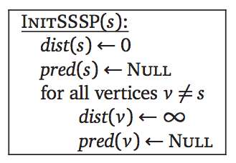
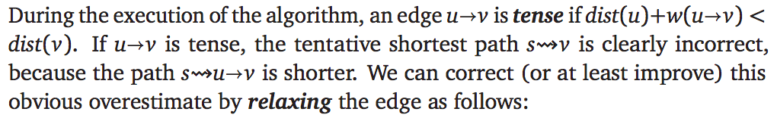
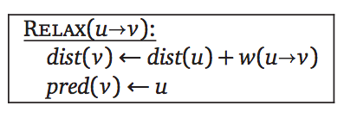
The generic SSSP algorithm

Slide 26
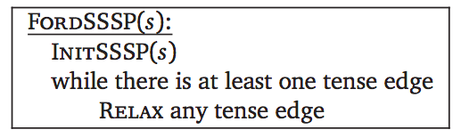
The generic SSSP algorithm

Slide 27
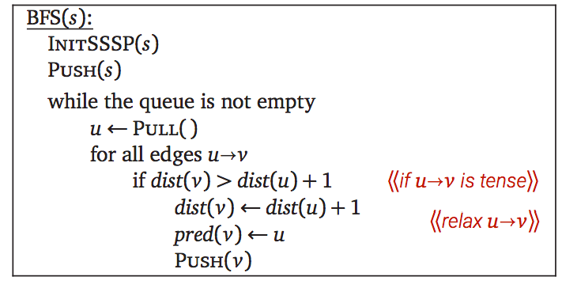
BFS for unweighted graphs

Slide 28
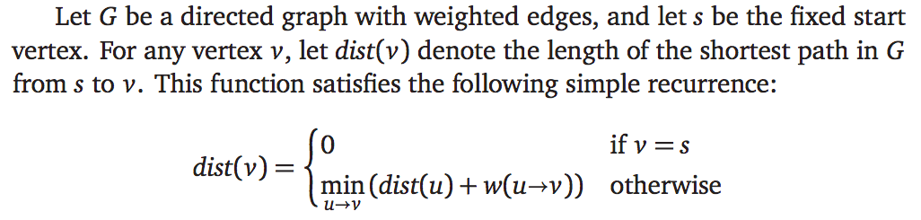
Directed Acyclic Graphs: DFS

Slide 29
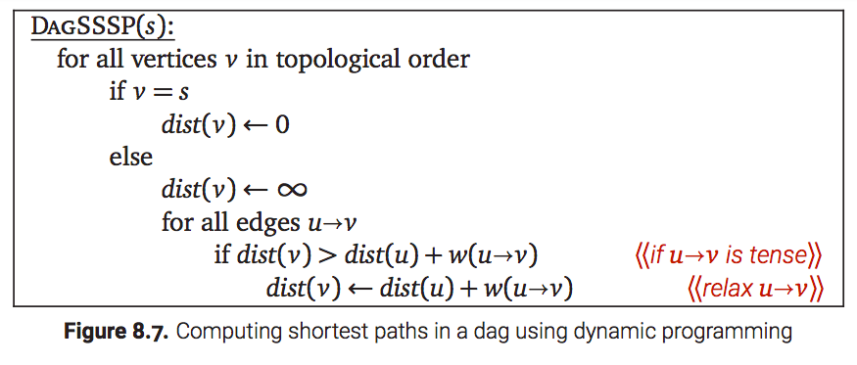
Directed Acyclic graphs: DFS

Slide 30
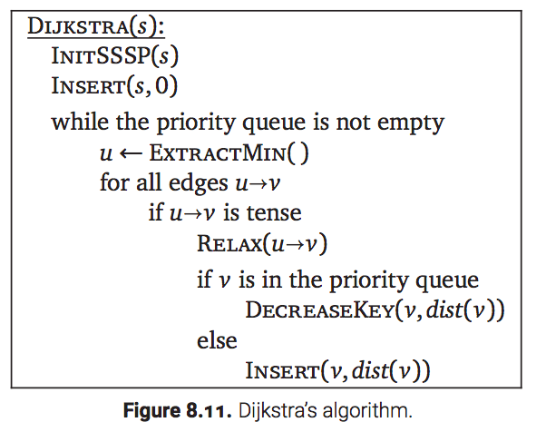
Dijkstra’s algorithm

Slide 31
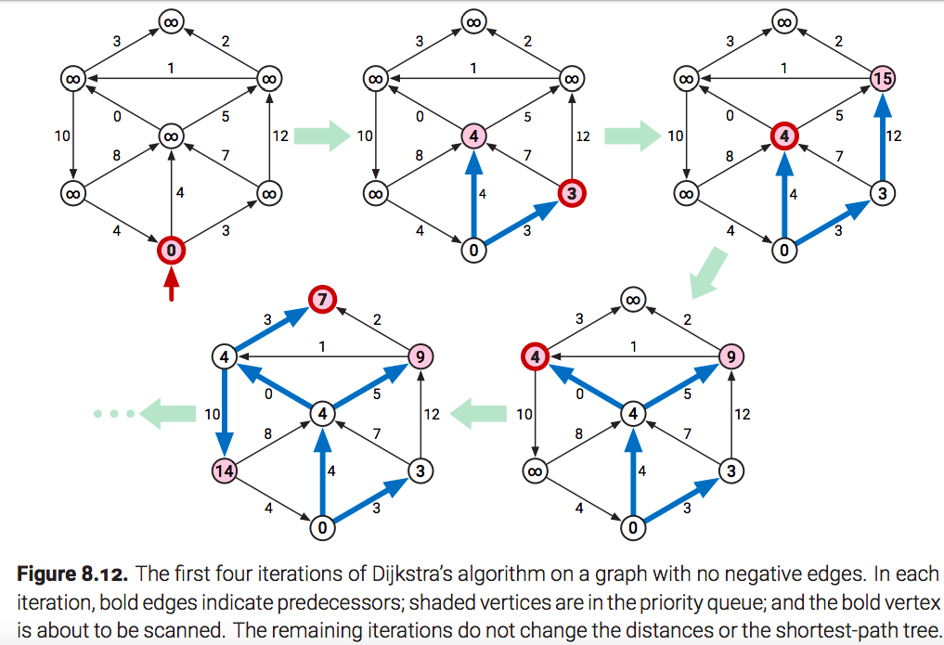
No negative edges

Slide 32
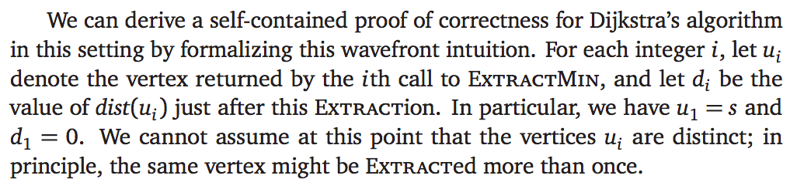
No negative edges

Slide 33
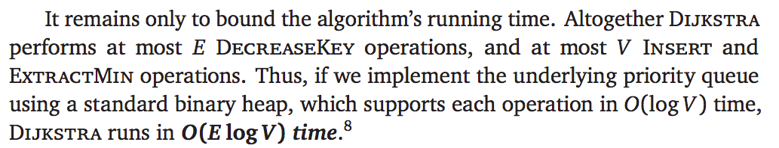
Analysis

Slide 34
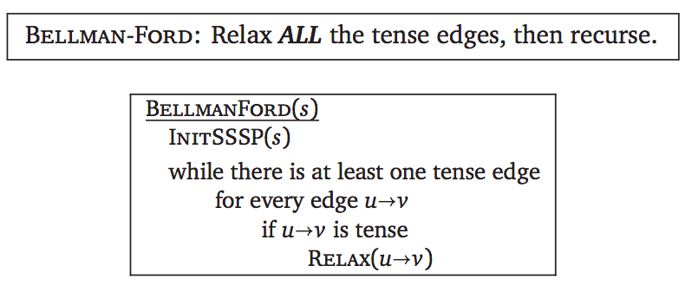
Bellman-Ford: Graphs with negative edges

Slide 35
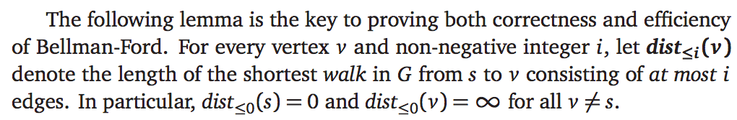
Bellman-Ford: Correctness Proof

Slide 36
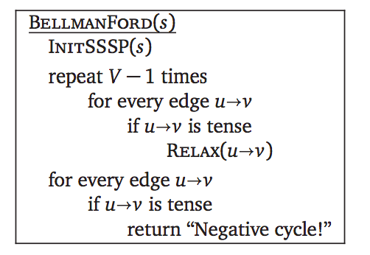
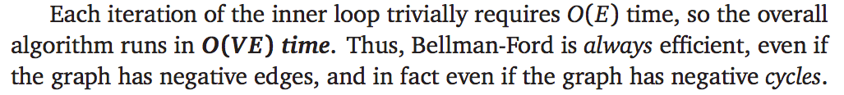
Bellman-Ford: Find negative cycles

Slide 37
Bellman-Ford: Find negative cycles

Slide 38
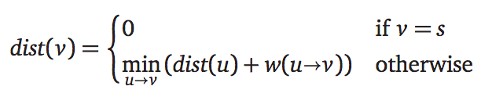
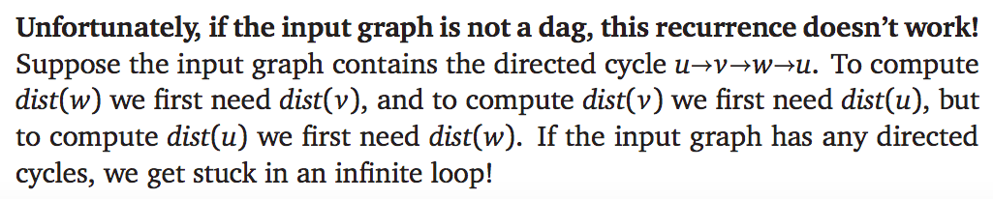
Bellman-Ford: Dynamic Programming
It’s tempting to use the same identity that we exploited for directed acyclic graphs:

Slide 39
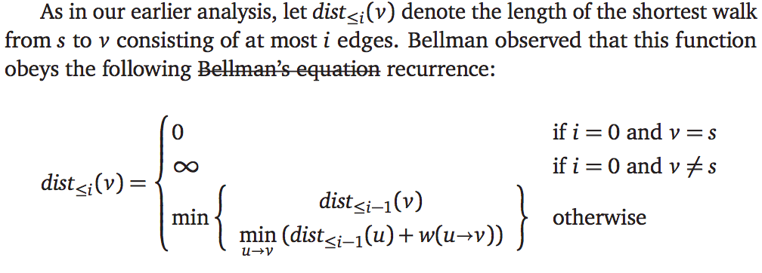
Bellman-Ford: Dynamic Programming
Correctness of the final shortest-path distances follows from the correctness of the recurrence, and the O(V E) running time is obvious.

Slide 40
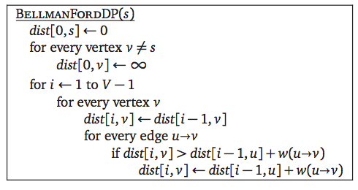
Bellman-Ford: Dynamic Programming

